Slide 1



Guidance for Safer Working Practice 2022
Based on the original work of the IRSC network 2006

Slide 2

Safer working practice 2022
A description of appropriate and non-appropriate behaviours for adults working with children and young people
Consulted with and agreed by all main education unions nationally in 2006
Updated in 2009, 2015 & 2019 with a Covid addendum published in May 2020
Adopted by many LAs and schools as the staff ‘Code of Conduct’

Slide 3
Why do allegations arise?
Poor culture within an organisation
Accidental harm
Naivety or poor practice on the part of the individual, who is unaware of the problem
Unintentional or misinformed action
Failure to follow procedures
Lack of training
Deliberate intention to abuse
False allegation
Misinterpreted by observers
Care & control incident

Slide 4
Do I have to close
my Facebook account?
Can I remove
a disruptive pupil
from my
classroom?
Surely its not safe to
teach pupils 1:1?
A pupil has got a
crush on me.
What should I do?
I’m worried
about the behaviour
of a colleague. What
can I do?
Can I apply sun
cream/change
children’s nappies?
Can I give
a distressed child
a hug?
A pupil has told me
something very
confidential, do I need
to tell anyone?
I’m really stressed
and worried that I’ll
‘lose it’ with a pupil.
What can I do?
Can I take a video
of the school
residential trip?
Can I buy Easter
eggs for my
class?
Notes:
Ask participants if they are satisfied that they /all the staff in their school could fully give answers to the ?’s
Explain that in considering these issues, the Safe Practice sub group learnt a great deal about staff views and feelings....next slide

Slide 5
Guidance isn’t necessary said some people
Staff are bound by professional codes anyway
It is not possible to legislate for every type of behaviour
An explicit code would be too long and boring to read
Role of management is to supervise professional behaviour
People use ‘common sense’ to govern actions

Slide 6
Guidance is necessary said the majority
Assists staff to work safely and professionally
Reduces the burden of assumption
Promotes transparency and minimises ‘grey’ areas
Makes clear the implications of not working to code
Makes clear to everyone what behaviour is expected and what is not acceptable
Clarifies responsibilities of both employer and employees

Slide 7
Contents of ‘the Code’
Underpinning principles
Status of Document
Duty of Care
Exercise of Professional Judgement
Power and Positions of Trust
Confidentiality
Propriety and Behaviour
Dress and Appearance
Gifts
Infatuations
Social Contact
Physical Education and other Activities that require Physical Contact
Showers and Changing
Pupils in Distress
Behaviour Management
Care, Control and Physical Intervention
Sexual Contact with Young People
One to One situations
Overnight Supervision and Examinations
Transporting Children
Education Visits and after School Clubs
First Aid and Administration of Medicine
Intimate / personal care
Curriculum
Photography, Video, Creative Art
Remote / virtual teaching
Whistleblowing
Curriculum
Sharing Concerns and Recording Incidents

Slide 8

Exercise: safe or unsafe?
Quiz: safe or unsafe?
Notes:
Or use the next slide instead

Slide 9
Exercise – safe or unsafe?
Transporting a child in your own car | Giving a child a small gift
Putting your arm around a distressed child | Offering to babysit for a child while the parent goes out
Rubbing sun cream onto the children | Being ‘friends’ with some of the parents on Facebook
Using a work laptop / tablet to access adult pornography | Staff are asked to undertake intimate care alone
Taking photos of children to create a school scrapbook or diary | Starting a relationship with someone that has been convicted for a serious offence
Shouting at the children | Giving medication to a child
Notes:
Aalternatively, can use the quiz sheet (downloaded separately)

Slide 10
Duty of care
Employers have duty of care towards staff, requiring provision of a safe working environment and guidance re safe working practice
Staff have a duty to take care of themselves and anyone who may be affected by their actions
Staff have a duty to keep children safe and protect them from harm - partly exercised through respectful, caring, professional relationships
Health and Safety at Work Act 1974

Slide 11
Underlying principles
‘Welfare of the child is paramount’ (Children Act,1989)
Staff are responsible for their own actions and behaviour and should avoid any conduct which would lead any reasonable person to question their motivation and intentions
Staff should work, and, be seen to work in an open and transparent way
Staff should discuss and/or take advice promptly from their line manager or another senior member of staff over any incident, which may give rise to concern

Slide 12
Records should be made of any such incident and of decisions made/further actions agreed
Staff should work to the same professional standards regardless of gender or sexuality.
All staff should know the name of their designated person for child protection, be familiar with local child protection arrangements and understand their responsibilities to safeguard and protect children and young people
Staff should be aware that breaches of the law and other professional guidelines could result in criminal or disciplinary action being taken against them.

Slide 13

Management responsibilities
To have clear mechanisms by which concerns can be raised
To make explicit these mechanisms via a written policy which is discussed with, and understood by, all staff
To promote a non-hierarchical culture
To be approachable
To be supportive and protective

Slide 14
Employee responsibilities
take responsibility for own actions and behaviour
act and be seen to act in the child’s best interest
avoid conduct which would lead any reasonable person to question their motivation and intentions
take advice from appropriate persons
discuss any misunderstanding with senior management
identify and report areas of risk/ vulnerability
remove self from situations where they may be a significant risk
report concerns regarding self
report concerns regarding colleagues (whistleblowing)

Slide 15
Staff behaviour / code of conduct
Applies to all Staff including temporary, agencies, contractors and volunteers
  “to create and embed a culture of openness, trust and transparency in which the school’s or college’s values and expected behaviour which are set out in the staff code of conduct are constantly lived, monitored and reinforced by all staff”.
  (KCSiE 2022)

Slide 16
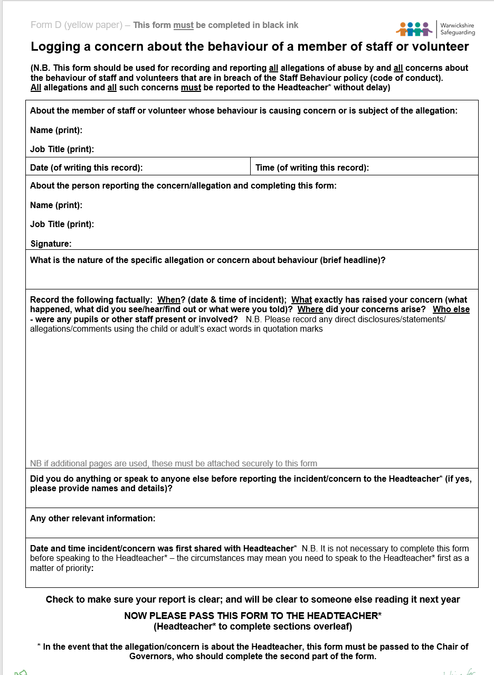

All staff should understand their professional role and responsibilities in work hours and outside of this time.
Record your concerns on a yellow form
Notes:
The safeguarding policy and procedures must include an explanation of the action to be taken when there are safeguarding concerns about a child and in the event of an allegation being made against a member of staff, and cover the use of mobile phones and cameras in the setting.
KCSiE 2022 page 99-103

Slide 17
Low level concerns
Low level concerns
The term ‘low-level’ concern does not mean that it is insignificant
Part Four, section two
Policies and procedures should acknowledge how the setting response to low level concerns that do not meet the harm threshold.
The whole school should ensure an open and transparent culture to record concerns and act to safeguard children.
KCSiE, 2022
Record in writing
Hold securely and respect confidentially
Review regularly and look for patterns

Slide 18

Allegations of abuse committed by a person working in a setting
Concerns about a member of staff share concerns with manager
Concerns about the Manager
in Committee/governor
or trust run provision
Speak directly to the Chair of Committee /Chair of governors or principal of trust who must contact the LADO.
Referrals are made on the Position of Trust Multi-agency referral form POT MARF and emailed to the LADO at their direct email address lado@warwickshire.gov.uk
LADO Phone: 01926 745376
Notes:
The setting’s whistleblowing policy should provide clear procedures for reporting concerns about a colleague or the manager– so that staff feel able to raise concerns and those concerns will be taken seriously.

Slide 19
keep conduct within professional boundaries
make appropriate professional judgements
Notes:
And when staff are in post, how can we be ensured that they understand the issues around professional boundaries and the need to make sound professional judgements in terms of their behaviour and actions? Explore this further. BEWARE these slides move!!!
The diagram represents one lane of the motorway. The green stripes are the hard shoulder and central reservation – both places that most people do not wish to be.
Let’s assume that that we all (hopefully) aim to travel the middle lane in terms of our behaviour.
In other words we learn by observation and experience as we go through life about the type of behaviour the middle lane represents. Sometimes we learn from the occasions when we veer slightly off course and the sounding horns / flashing lights of the vehicles around us bring us back on track.
We develop a sense of acceptable boundaries, which we then use in making professional judgements

Slide 20


Notes:
We often learn most from our mistakes. Some individuals make big mistakes when they first come into post, but properly managed, they will learn from these

Slide 21
Notes:
Other people start off ok, but gradually start moving over the commonly accepted boundaries and start wandering out of the middle lane. This is bad news as they may end up wandering off the edge of the motorway

Slide 22
Notes:
If someone like that is not managed, they might end up travelling the whole journey on the hard shoulder. If this behaviour is tolerated – and possibly more importantly – seen to be tolerated, it can have an effect on the rest of the staff. In this way, the ethos of a school is influenced

Slide 23
Notes:
So what stops someone veering over to the hard shoulder? How do they learn common standards, what is acceptable and what is not? What checks and balances are in place?

Slide 24
Supervision and Management
Training
Written advice
Guidance for Safe Practice
Peer Review
PROFESSIONAL LIFE
Learning from example
Disciplinary action
Press and media
Family
Role models
Media
Experience
Peers
PERSONAL LIFE
School
Internet
Notes:
The boxes at the bottom of the picture represent the checks and balances that act on our behaviour in ordinary life. We learn our own standards as we grow up and bring this knowledge into our professional lives.
The boxes at the top of the picture are examples of the experiences or sources of knowledge that inform our thinking and cause us to behave in certain ways in our professional lives. They represent the checks and balances that act on our behaviour in our working life.
In other words we learn by observation and experience about the type of behaviour the middle lane represents in the particular situation that we find ourselves. Sometimes we learn from the occasions when we veer slightly off course and the sounding horns / flashing lights of the vehicles around us bring us back on track. That is why it is important for staff to know what is expected of them and for organisations to have informal as well as formal management processes in place. If individuals start to veer off course and they are not pulled back (by themselves, or by the reactions of others), they may end up with a ‘bumpy ride’ on the hard shoulder or central reservation or in extreme cases, off the road altogether.
Do we have enough checks and balances in the professional setting? Do we have enough road signs, speed checks, reminders of appropriate action? We wouldn’t leave it to chance that people know which lane to drive on on the motorway, so should we in school? How can staff be given information about appropriate behaviour in supportive and positive way?
The diagram also helps to generate discussion about thresholds and the importance to have them clearly delineated whenever possible.

Slide 25
Discussion – creating an open culture
Empowering and encouraging members of staff and volunteers to report concerns or allegations about the behaviour of others is essential if we are going to tackle inappropriate or abusive behaviour. Please consider and discuss:
What might stop me reporting concerns?
What would help me overcome those problems?

Slide 26
Disclosing potential issues
KCSIE 2022 says that school leaders should
  “Create the right culture and environment so that staff feel comfortable to discuss matters within and, where appropriate, outside the workplace which may have implications for the safeguarding of children.” (344, p.83 DfE 2022)
These discussions can help school leaders to:
safeguard their employees’ welfare and contribute to their duty of care towards their staff
identify whether arrangements are needed to support these staff
manage children’s safety

Slide 27
Whistleblowing
Each individual has a responsibility for raising concerns about unacceptable practice or behaviour
To prevent the problem escalating
To protect / reduce risks to others
To prevent becoming implicated yourself

Slide 28
What stops people?
Starting a chain of events which spirals
Disrupting the work / project
Getting it wrong
Repercussions / damaging their career
Not being believed or heard
Culture of the organisation
Personal Relationships
Staff loyalties

Slide 29
How?
Voice your concerns, suspicions or uneasiness as soon as you feel you can
Try to pinpoint what practice is concerning you and why
Approach someone you trust and who you believe will respond
Make sure you get a satisfactory response ~ Don’t let matters rest

Slide 30
Checklist for individuals*
Are my actions fair, reasonable, warranted, proportionate, measured, safe and applied equitably?
From whom should I seek agreement? What should I record? Who must I tell?
What would be the expected professional behaviour in these circumstances?
What about my position of trust, am I a role model in this situation?
Do I understand which actions could lead to criminal and/or disciplinary action?
* Where guidance is unclear or non-existent

Slide 31
Allegations against staff
behaved in a way that has harmed a child or may have harmed a child;
possibly committed a criminal offence against or related to a child; or
behaved towards a child or children in a way that indicates they may pose a risk of harm to children.
behaved or may have behaved in a way that indicates they may not be suitable to work with children.
* Harm threshold met - refer to LADO
Low level concerns
concerns that are inconsistent with the staff code of conduct, including
inappropriate conduct outside of work; and / or
does not meet the allegations threshold or is otherwise not considered serious enough to consider a referral to the LADO.
* Harm threshold not met - follow in-house low level concerns procedure
Notes:
Part 4 of KCSiE - Allegations of abuse made against teachers, and other staff including supply teachers and volunteers has been separated into two sections. The first covers allegations or concerns that meet the threshold for harm. The second section is new and covers allegations or concerns that don’t meet the threshold. Governing bodies and proprietors should have policies and processes in place to deal with low-level concerns and allegations that don’t meet the harm threshold. Staff codes of conduct and safeguarding policies should explain what a low-level concern is and the importance of sharing any concerns.
A low-level concern is any concern that an adult has acted in a way that:
is inconsistent with the staff code of conduct, including inappropriate conduct outside of work
does not meet the allegations threshold or is not considered serious enough to refer to the local authority designated officer (LADO)
Examples of low-level concerns could include:
being over familiar with children. having favourites, taking photos of children on their mobile phone
engaging with a child one-to-one in a secluded area or behind a closed door, using inappropriate sexualised, intimidating or offensive language
To help prevent low-level concerns, staff codes of conduct, behaviour policies and safeguarding policies and procedures should be implemented effectively and appropriate action should be taken to deal with any concern.

Slide 32
Always …..
“Absolutely without fail - challenge poor practice or performance. If you ignore or collude with poor practice it makes it harder to sound the alarm when things go wrong”
Sounding the Alarm – Barnardos 1999

Slide 33




The Safer Recruitment Consortium
© 2022

