Slide 1
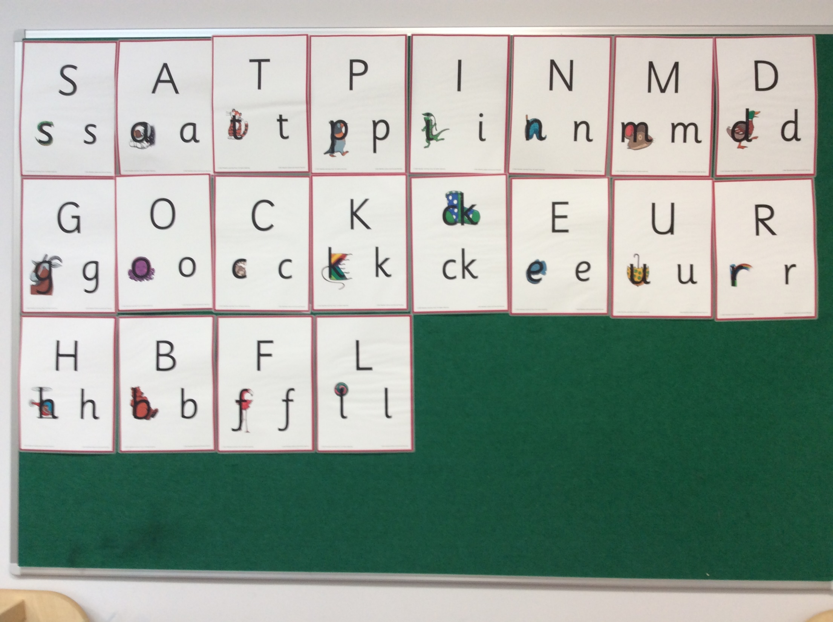
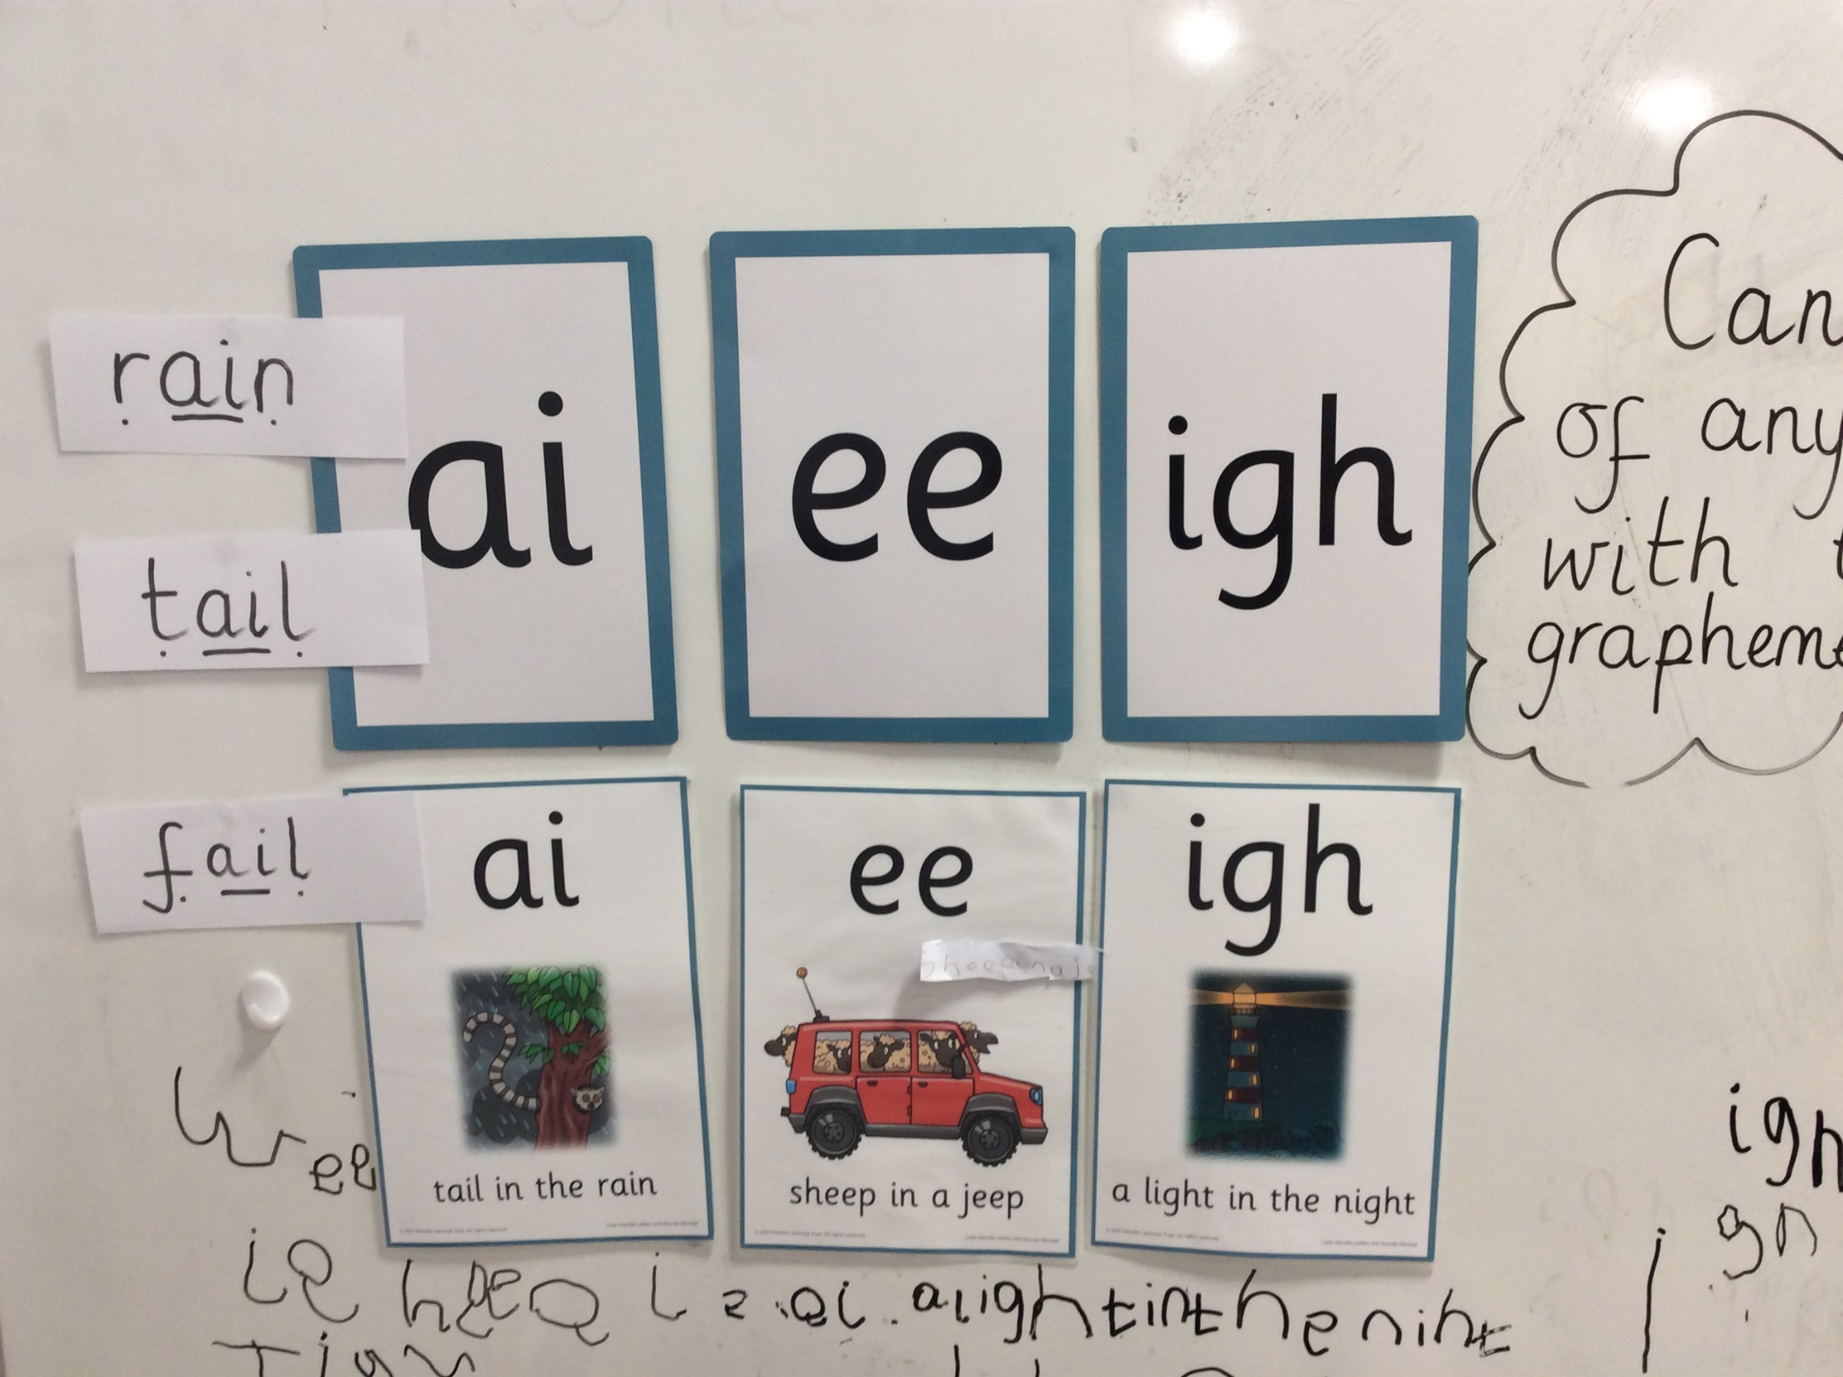
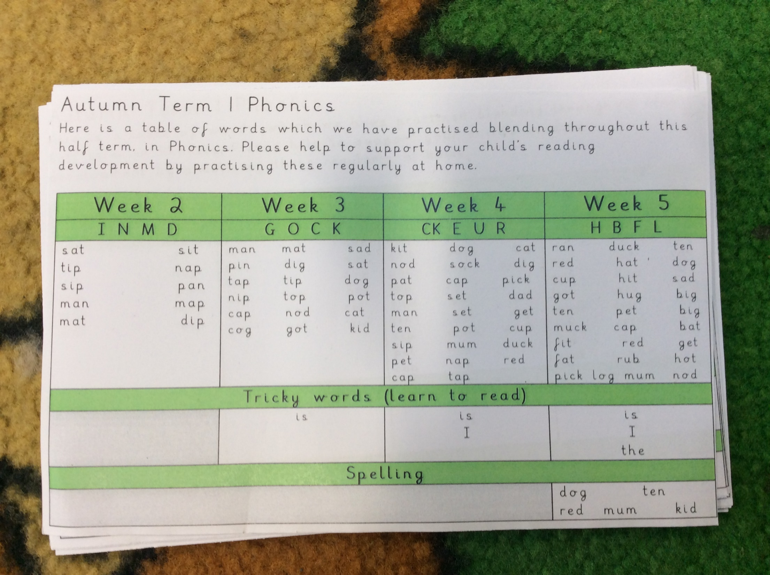
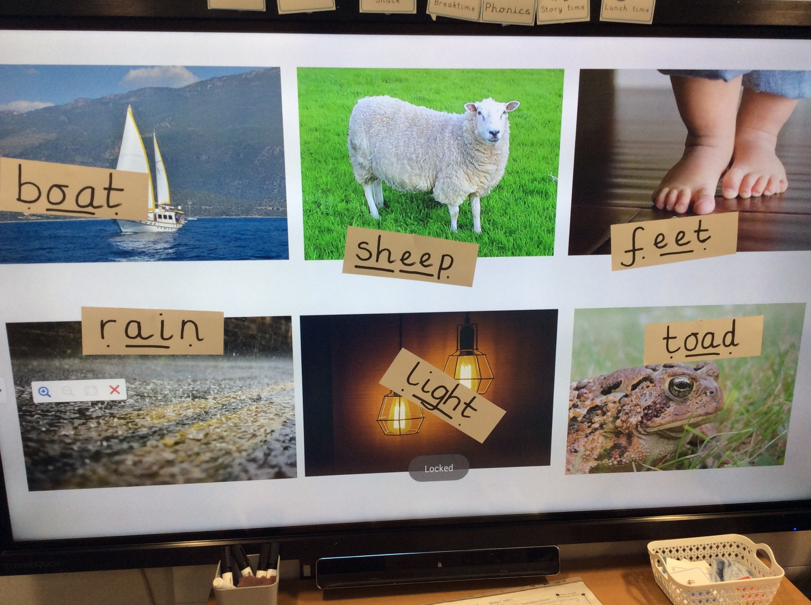
Phonics
Phonics is taught every day and we follow the scheme Little Wandle. During these lessons your children will begin to learn to read. In Reception the children will cover Phase 2, 3 and 4 of the scheme.
A Phonics meeting will be held early in the Autumn Term.

Slide 2
Phonics
Phonics is taught every day and we follow the scheme Little Wandle. During these lessons your children will begin to learn to read. In Reception the children will cover Phase 2, 3 and 4 of the scheme.
A Phonics meeting will be held early in the Autumn Term.

Slide 3
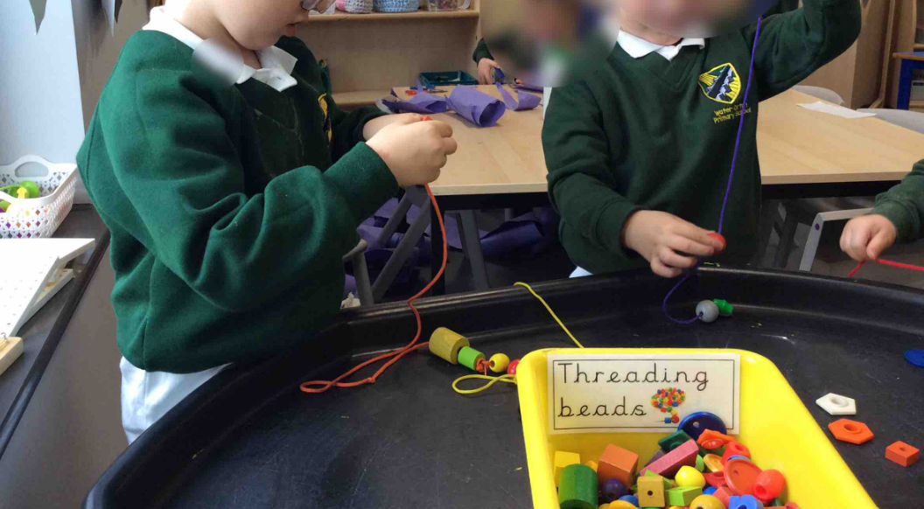
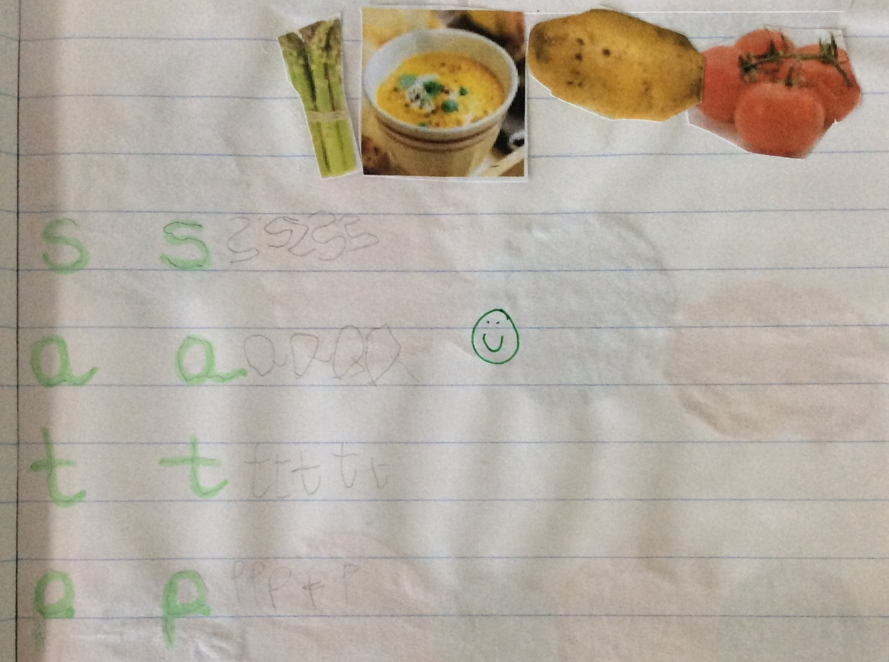
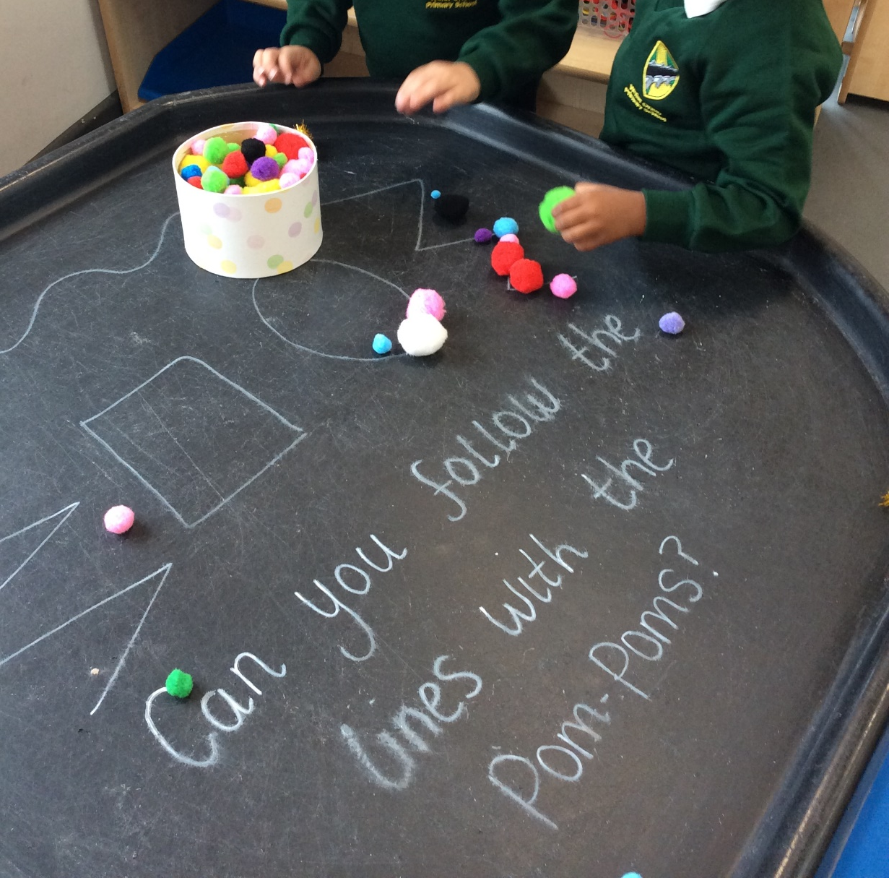
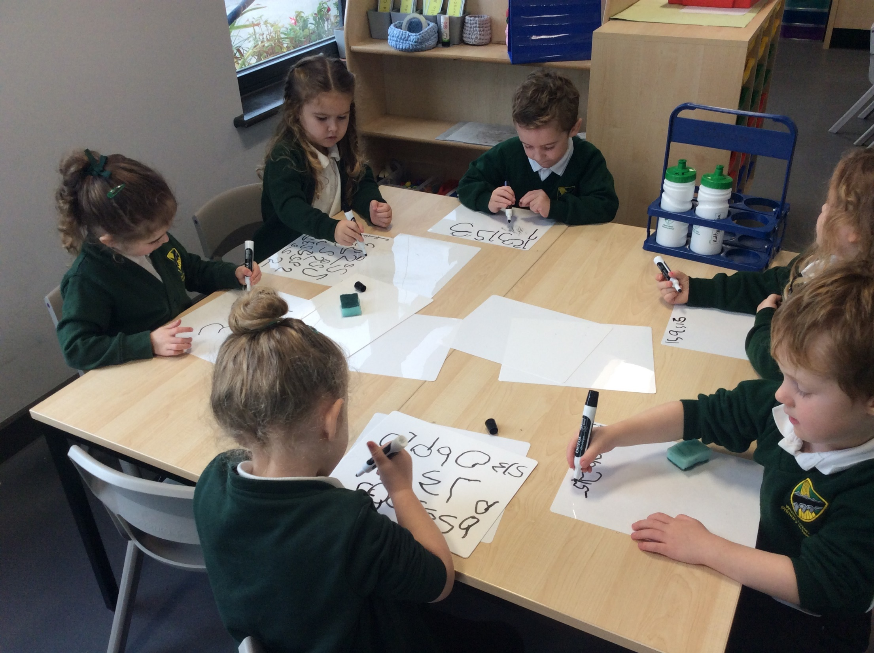
Literacy
Literacy is taught every day. The children will engage in lots of story times and develop skills in story telling as well as learning new vocabulary. The children will also have opportunities to develop their fine motor skills which aids letter formation and handwriting.

Slide 4
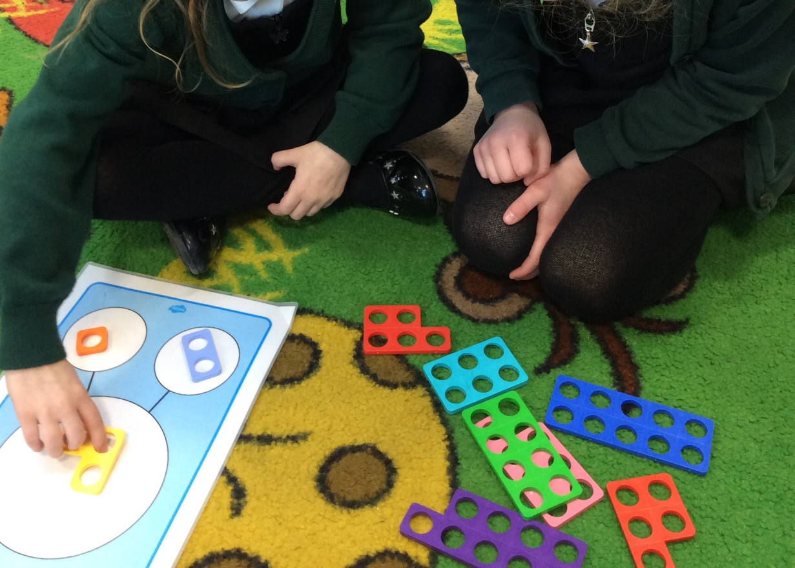
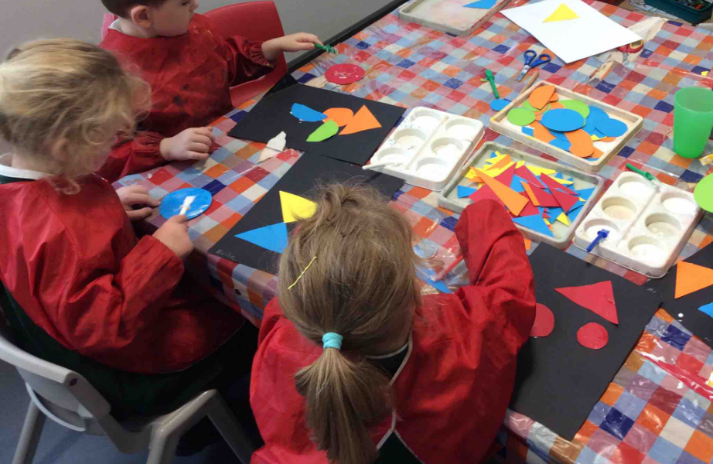
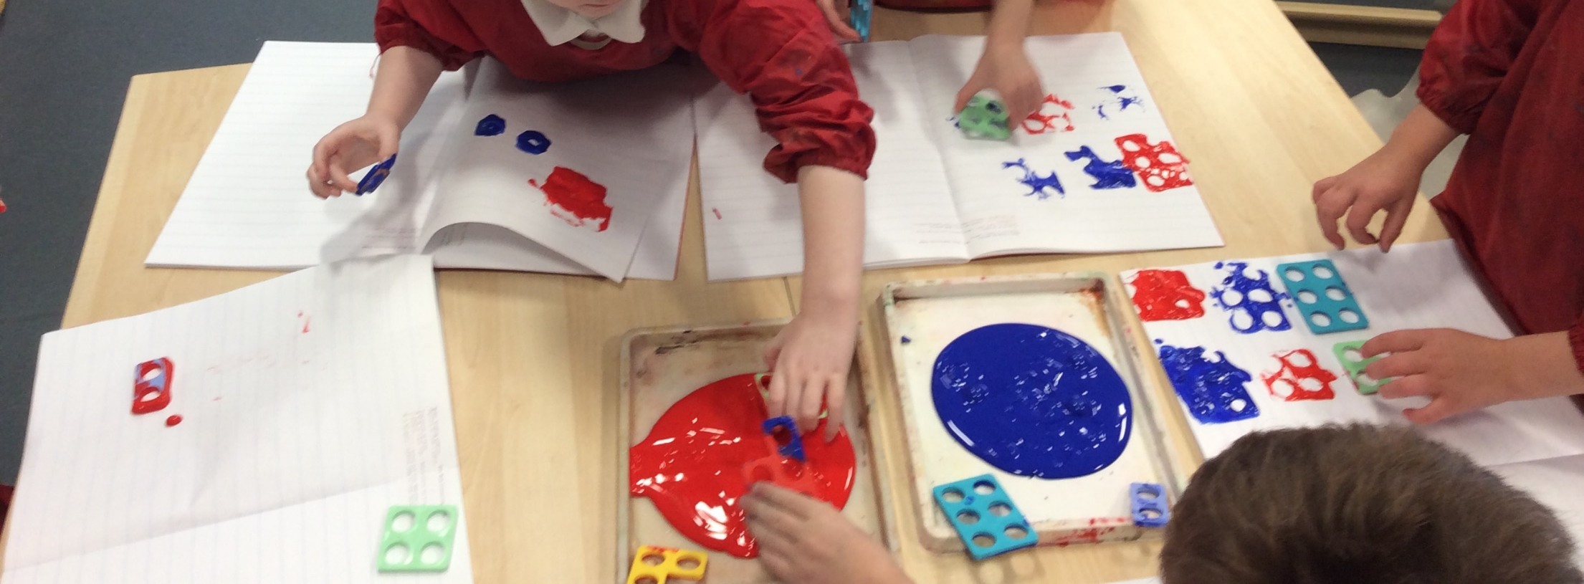
Mathematics
In Maths, the children will begin to develop a deep understanding of numbers to 10. The children will be given lots of opportunities to explore patterns and shapes.

Slide 5
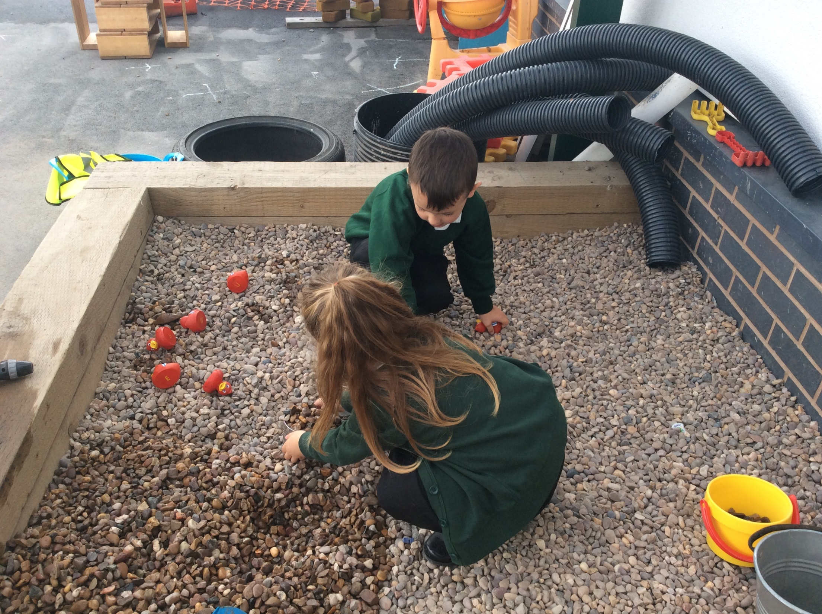
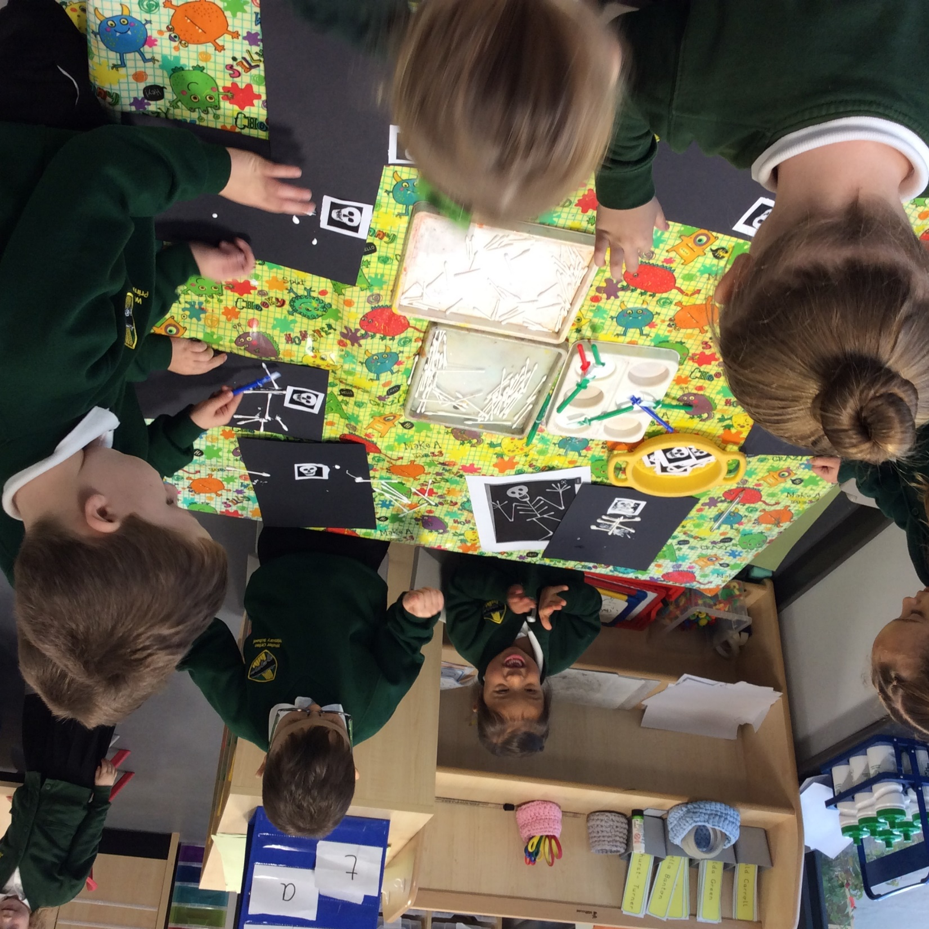
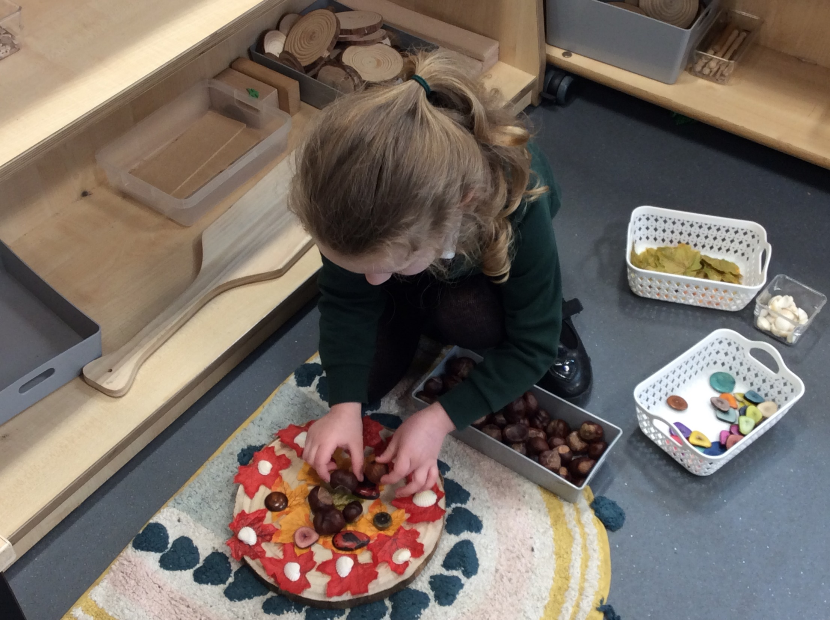
Child Initiated Play (CIP)
Throughout the school day, the children will be encouraged to explore the provision with a free flow approach. Within this time, the children will be learning through experimental play and through activities designed by the adults.

Slide 6
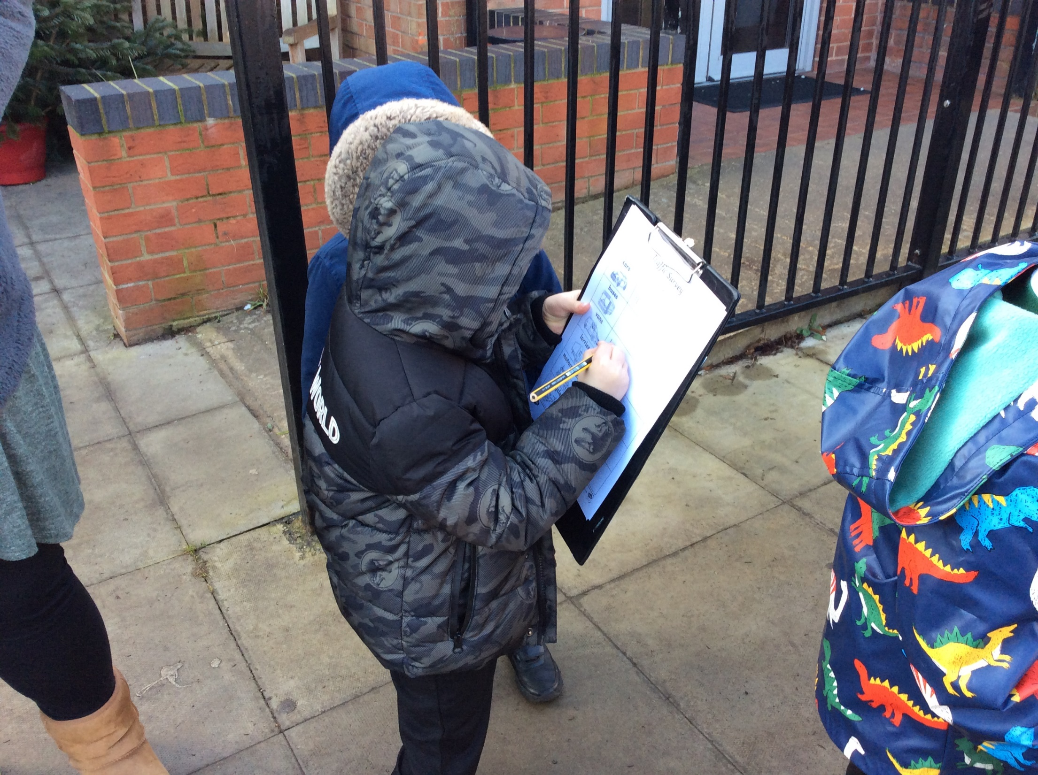
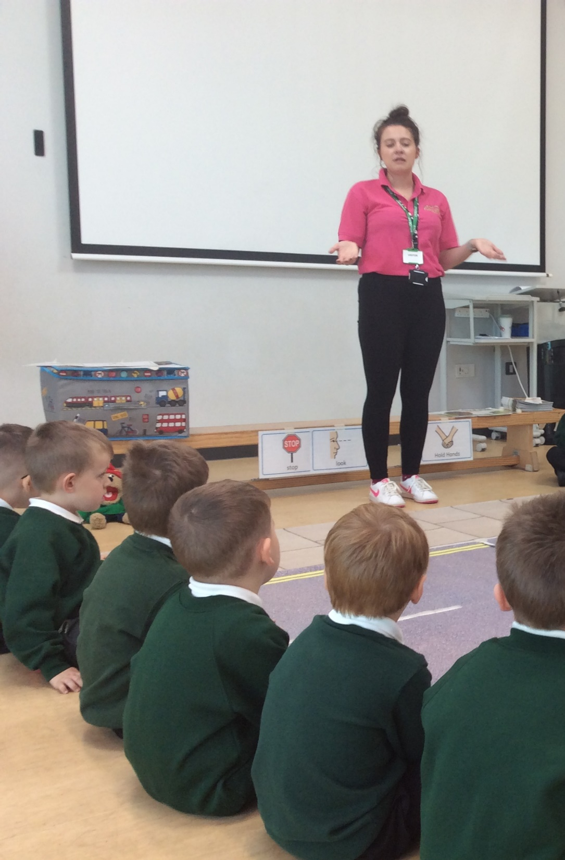
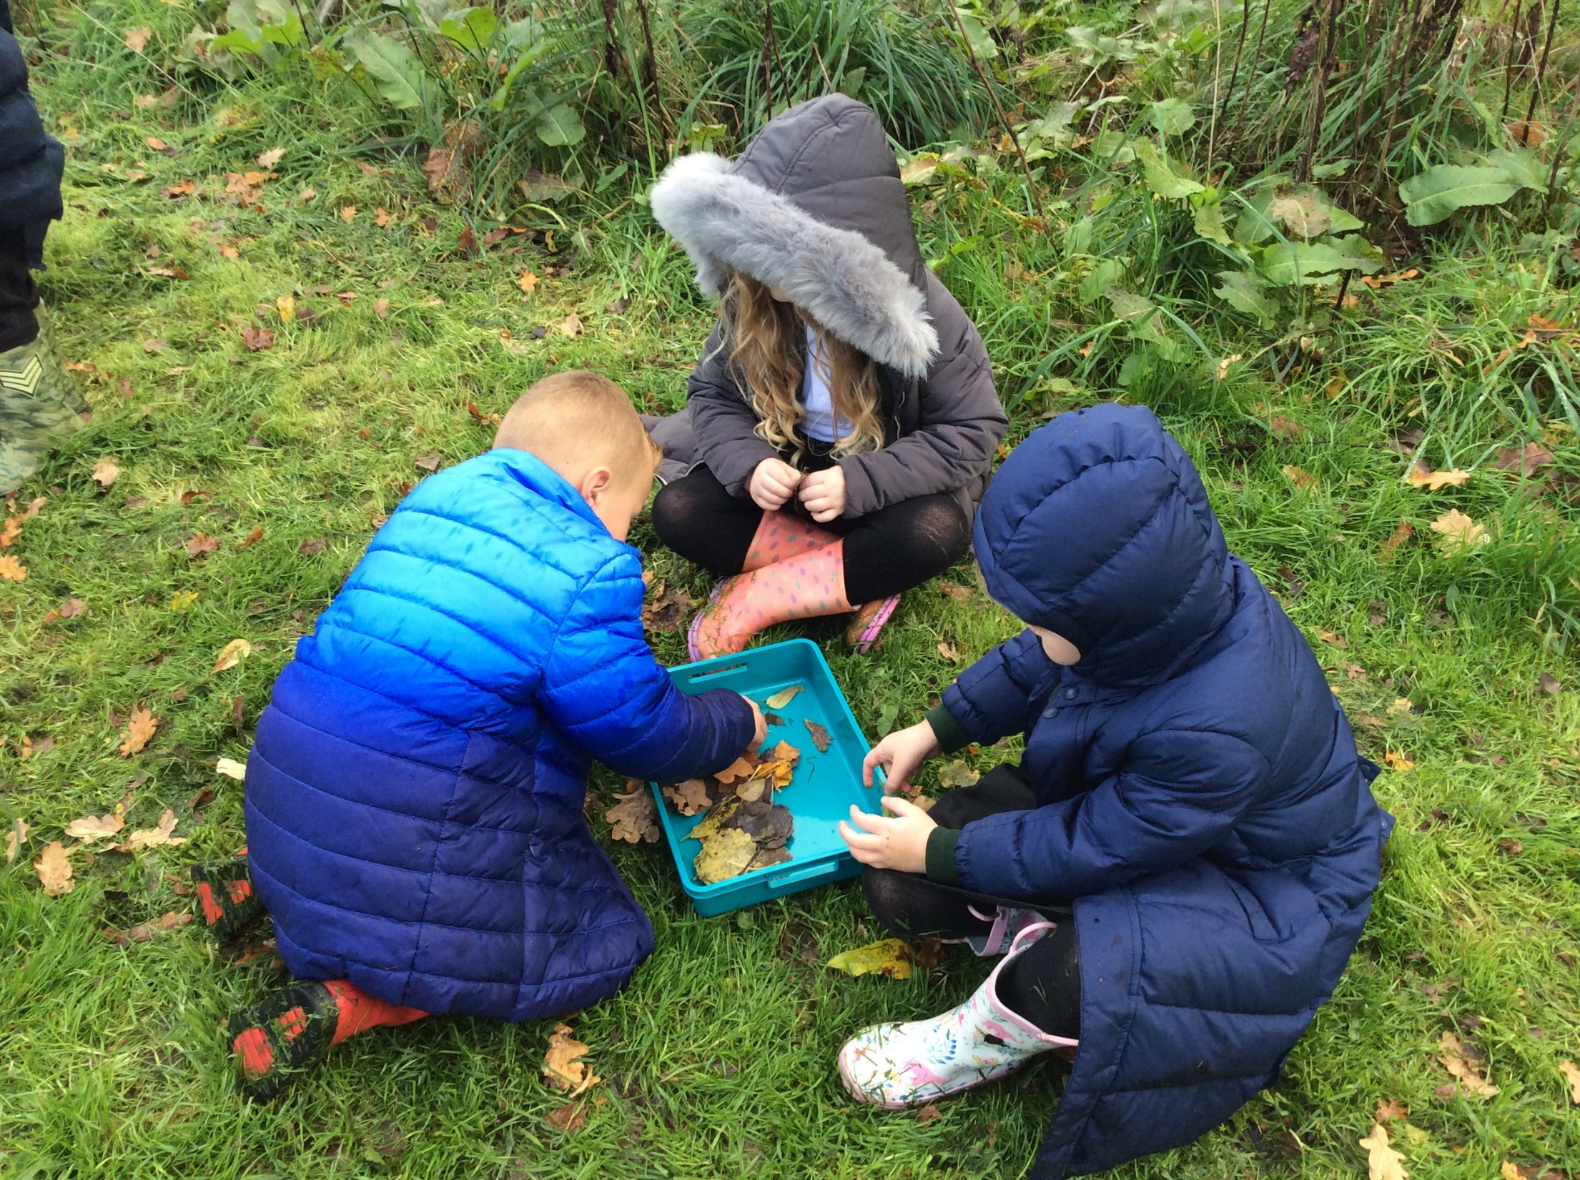
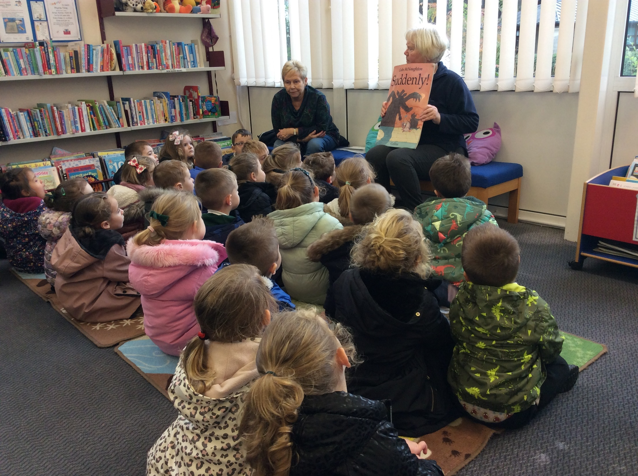
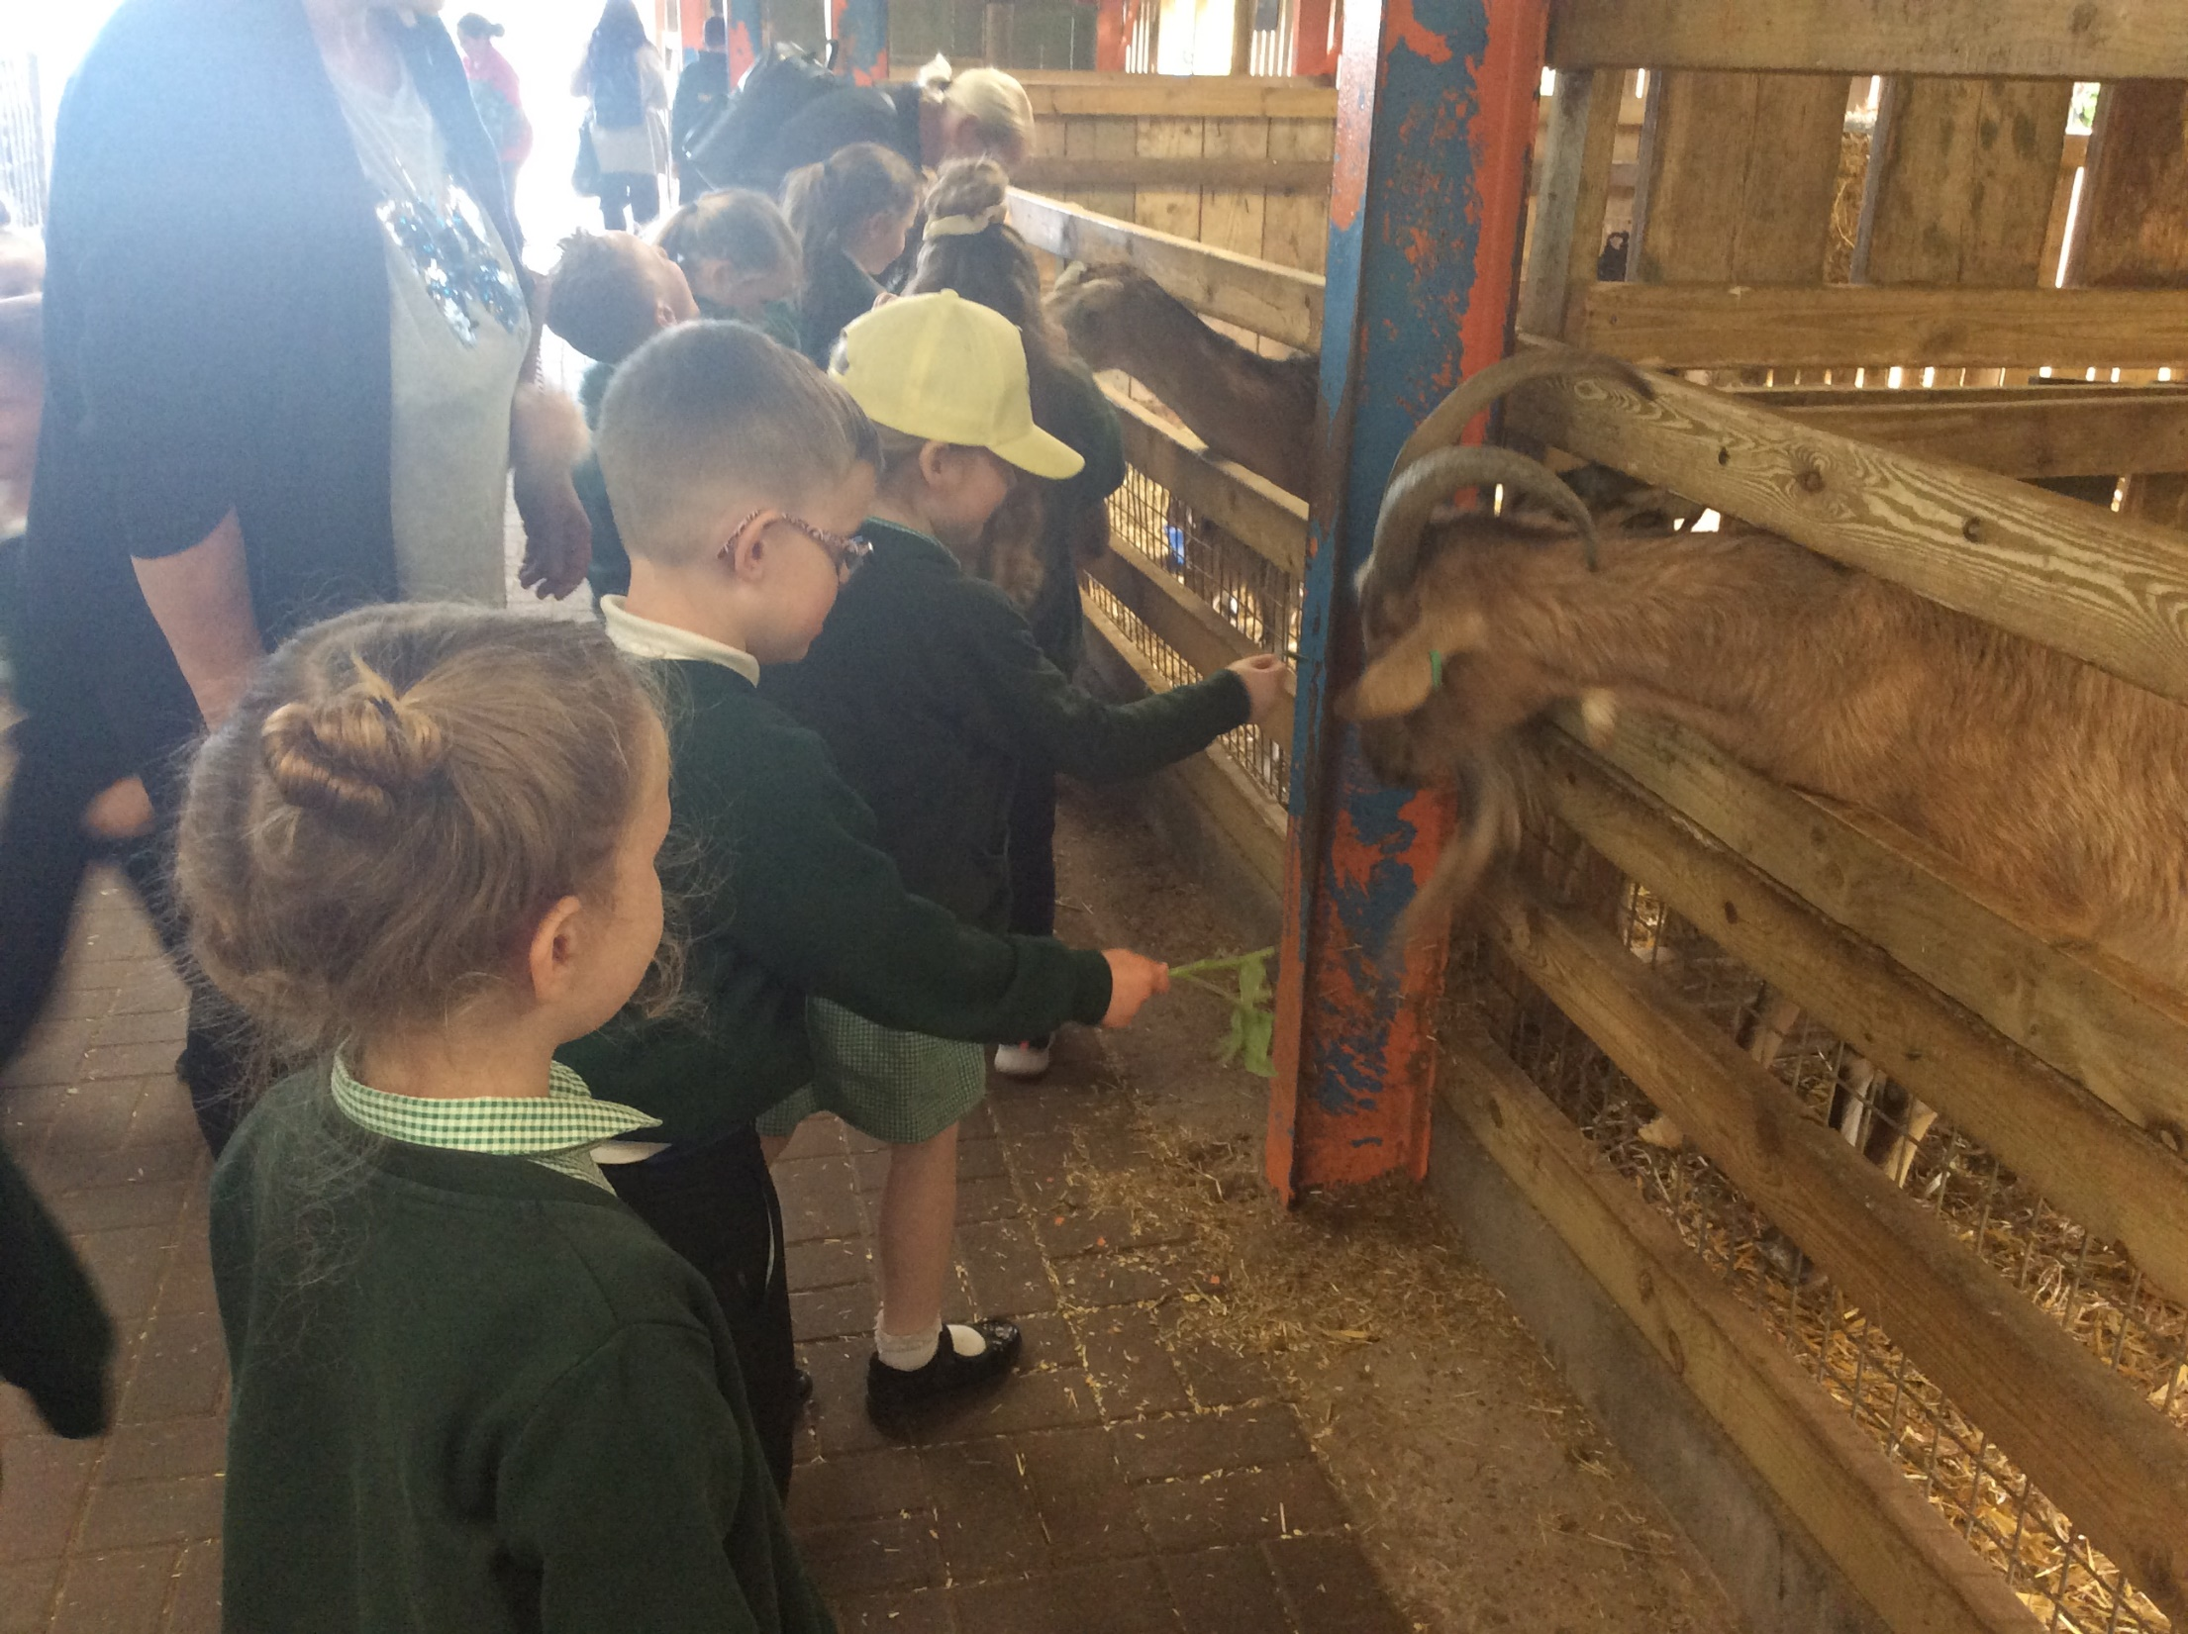
Wider Opportunities
Throughout the year, the children will have lots of visitors and go out into the local community.

