Slide 1
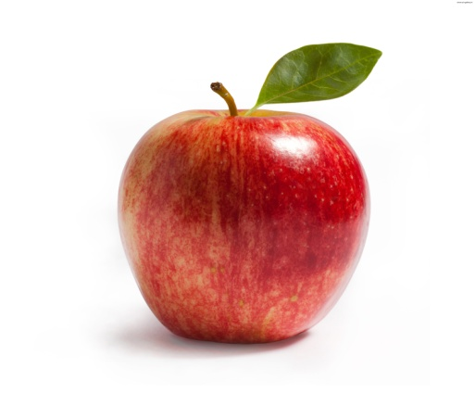




16p
28p
30p
50p
45p

Slide 2
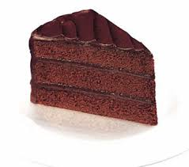
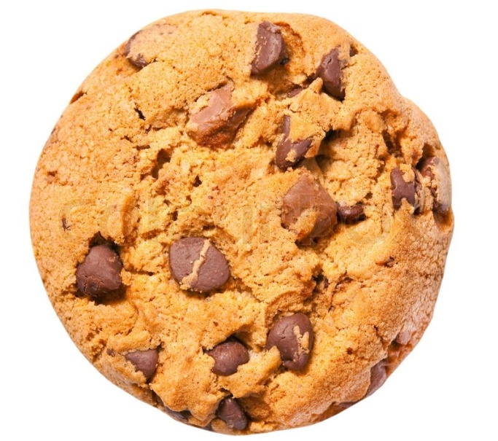



£1.70
85p
36p
95p
£1.00

Slide 3
A | B | C
10p+50p= 50p+ 30p= 30p+28p= 45p+ 50p= 36p+ 14p= 55p+ 25p= 56p+24p= 78p+10p= 50p+50p= £1.00+ 50p= | 30p+60p= 75p+ 10p= 60p+40p= 45p+ 55p= £1.00+ 70p= £1.10+50p= £1.12+ 38p= £1.20+60p= £1.00+ £1.00= £1.50+ £1.50= | 50p+70p= 66p+88p= £1.10+60p= £1.30+55p= £1.56+ 30p= £1.40+50p= £1.86+ 10p= £1.50+ £1.00= £2.00+ 46p= £2.15+ 45p=

