Slide 2
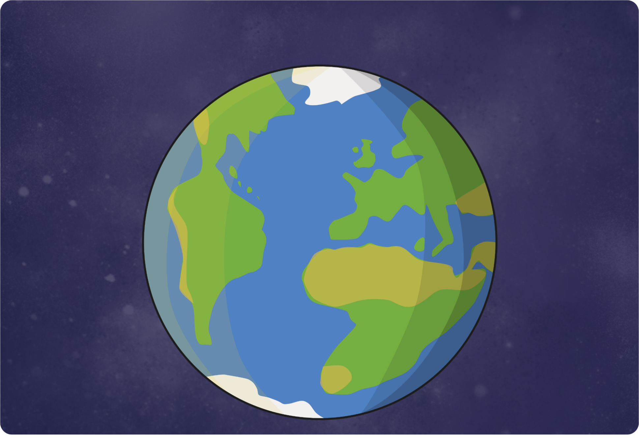
God saw that all the people on the Earth were acting badly,
so He decided to send a flood that would wipe out evil.

Slide 3
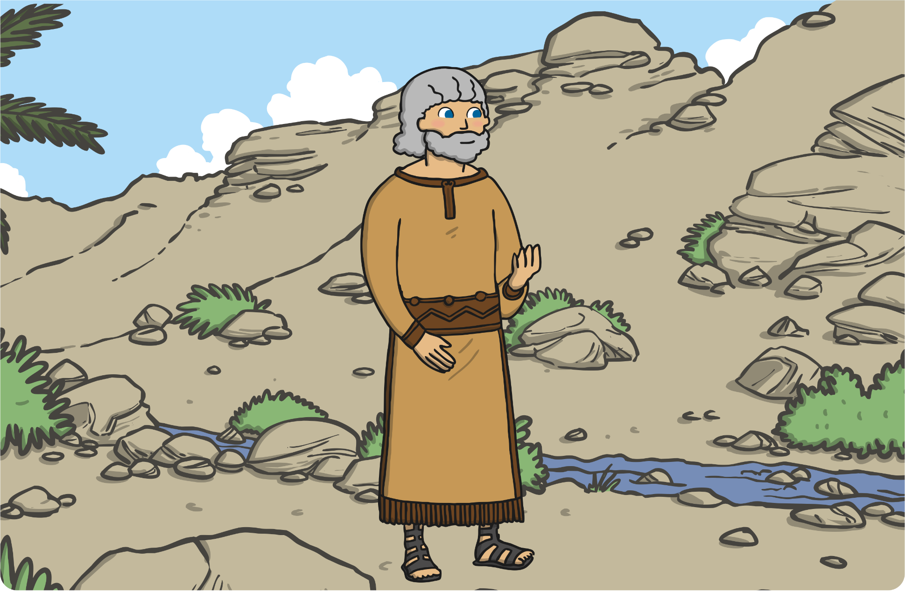
However, there was one good man on Earth.
His name was Noah, and God trusted him.

Slide 4
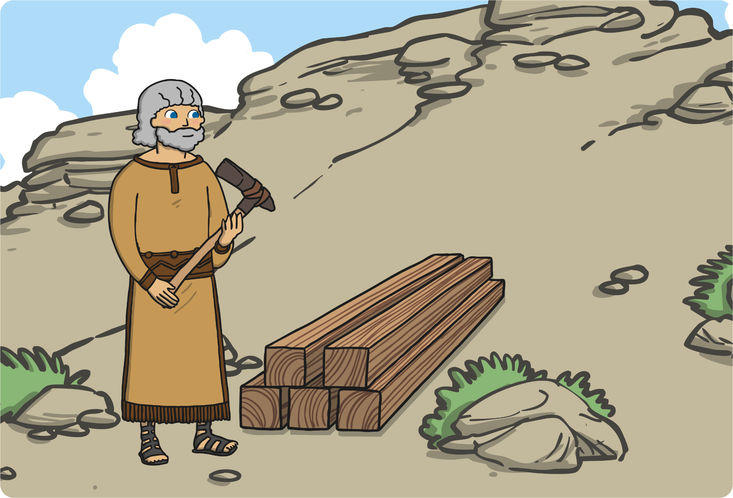
God decided that He would save Noah by telling him that the flood was coming. He would instruct Noah to build a really big boat called an ark.

Slide 5
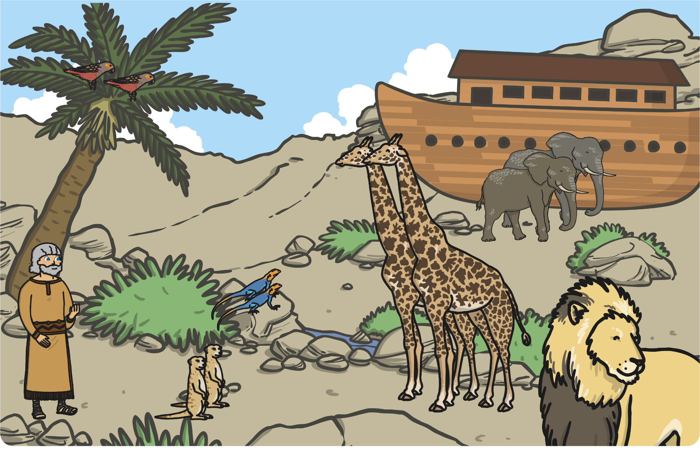
After Noah had built the ark, God told him to put two of every animal
on the Earth in it, both male and female.

Slide 6
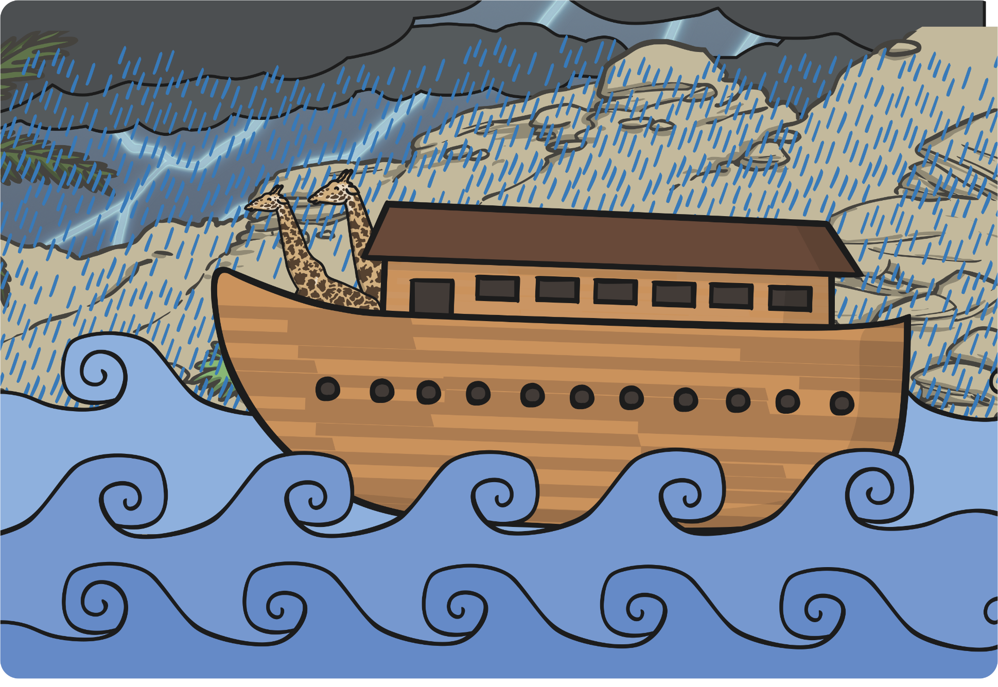
When Noah, his family, and the animals were all safely on the ark, the rain began to fall. It kept falling for forty days and nights.

Slide 7
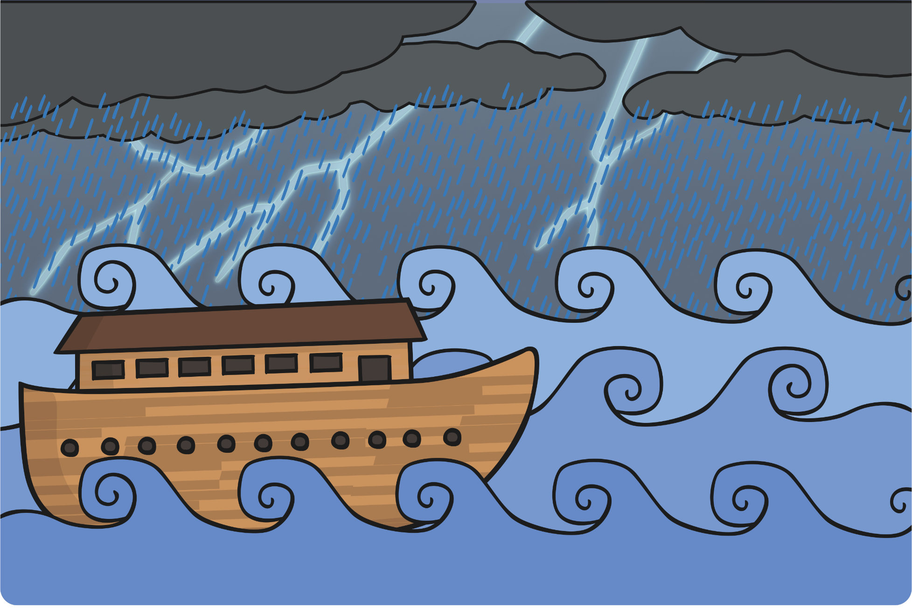
The waters flooded the Earth. Every living thing on the face of the Earth was wiped out except for Noah, his family, and the animals who were safe in the ark.

Slide 8
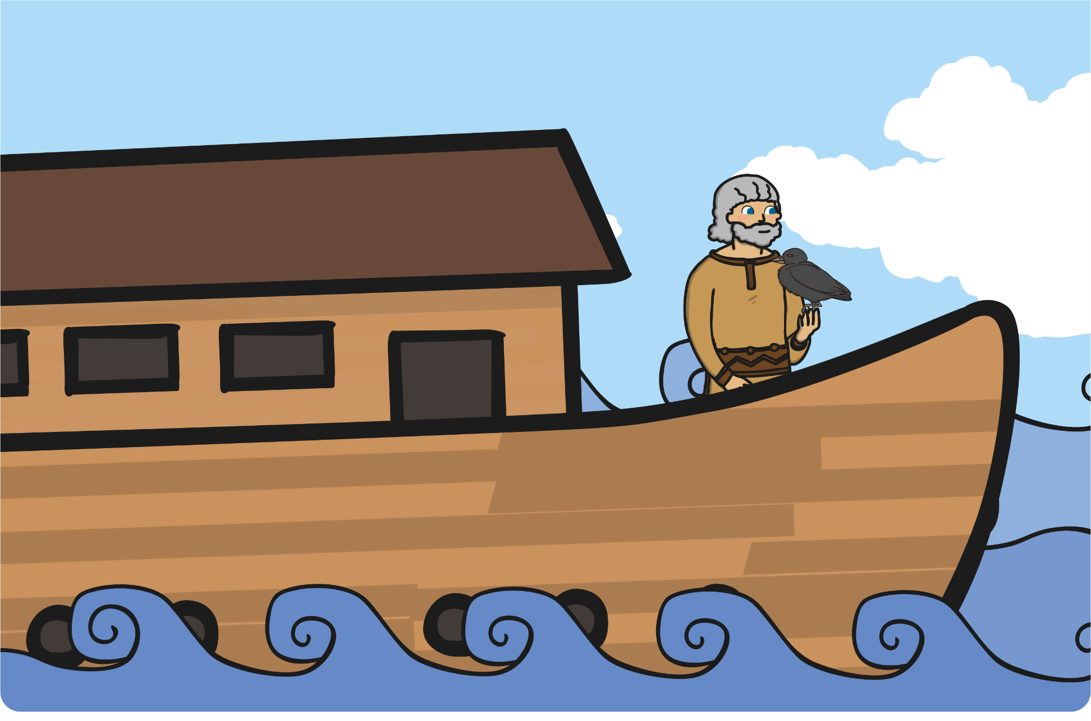
When the sun came out, the waters started to dry up, and the ark came to rest on a mountain. Noah sent out a raven to find dry land, but it came straight back.

Slide 9
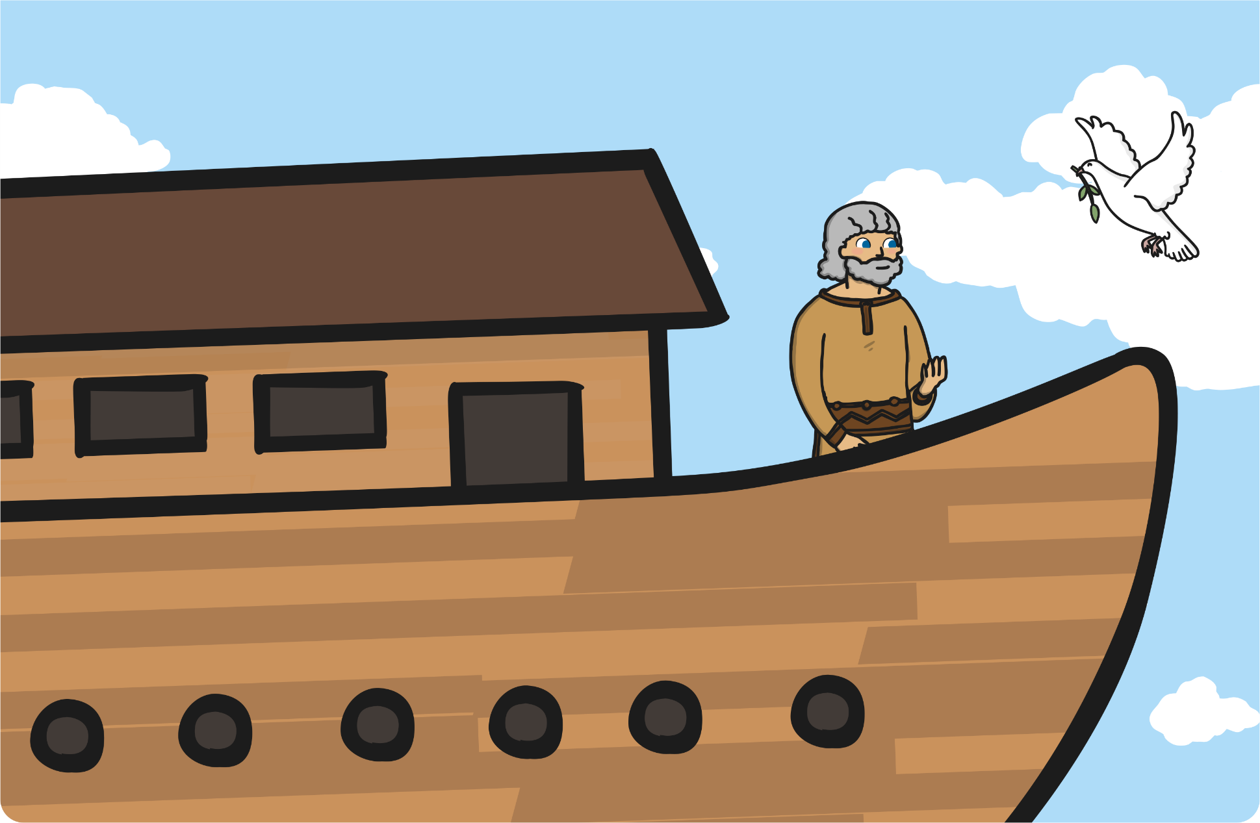
A few days later, he sent out a dove. The dove returned with a leaf in its beak. When the dove was sent out again, it did not return.

Slide 10
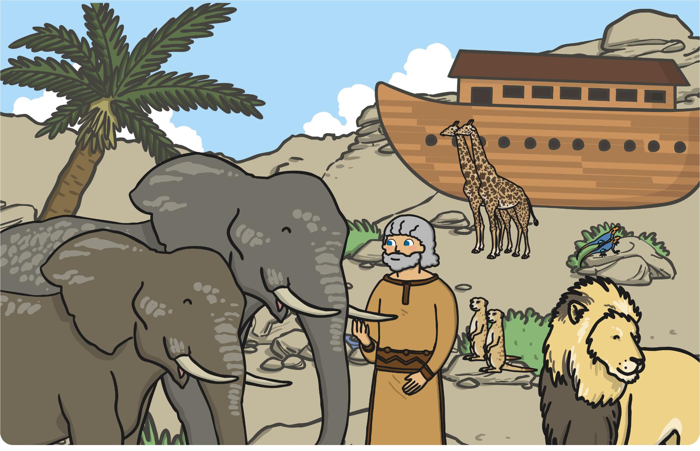
“The waters must have dried up completely!” exclaimed Noah.
So all of the animals and Noah’s family left the ark.

Slide 11
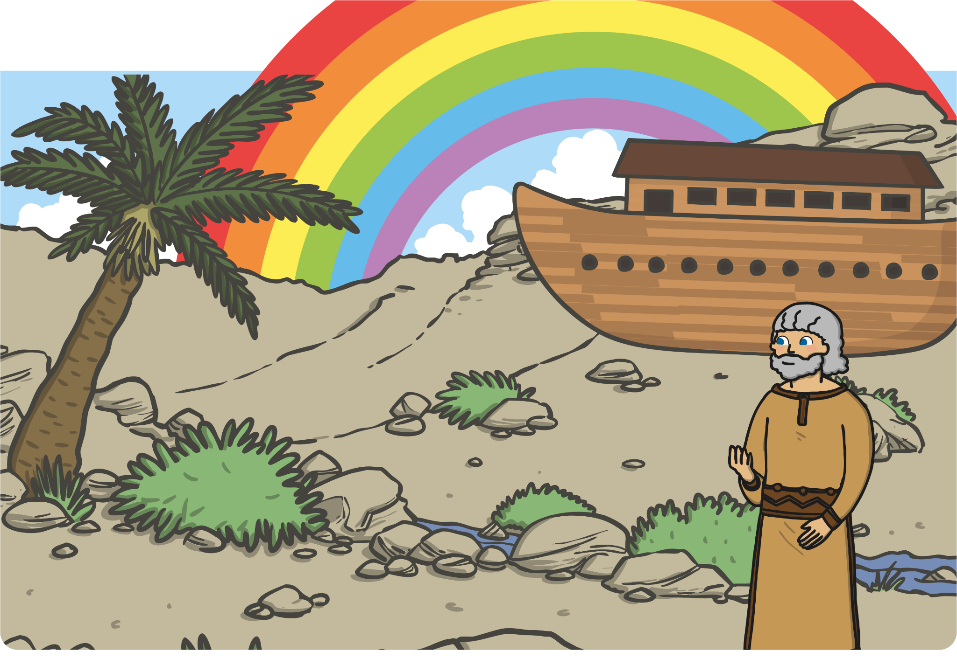
God promised He would never again send another flood that covered the Earth. He made a rainbow in the sky to remind everyone of His promise.

