Slide 1

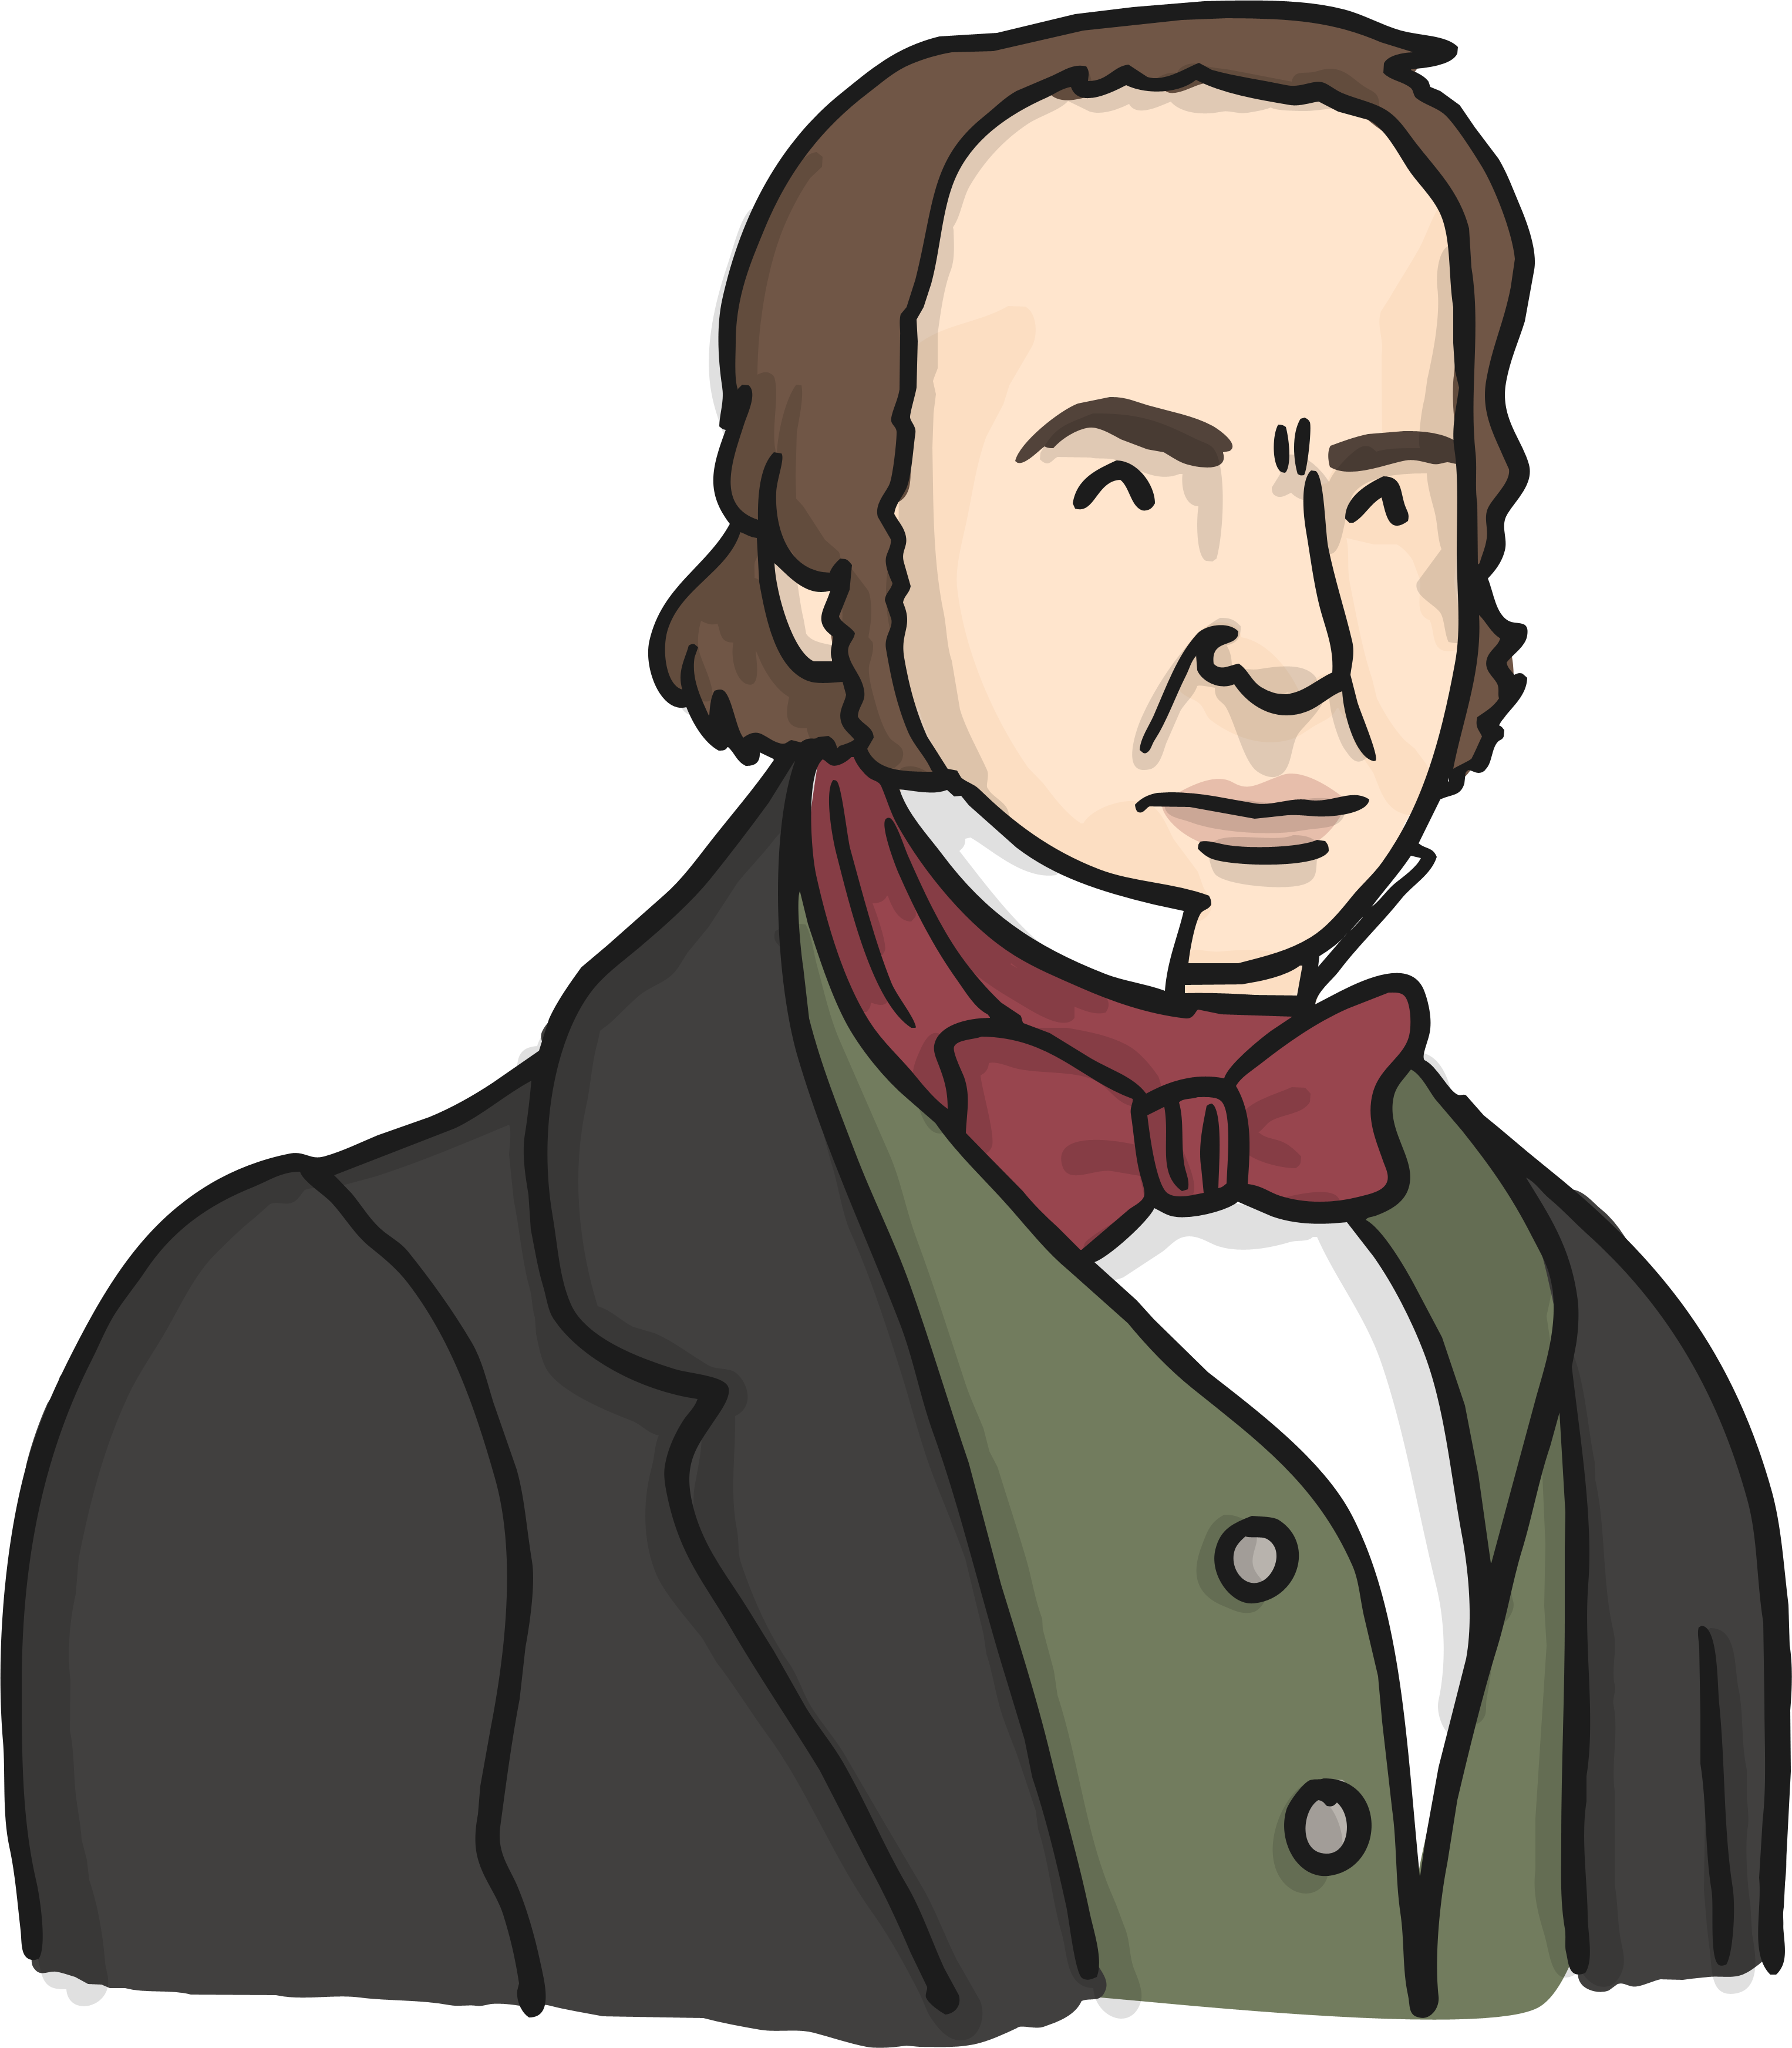

A task setting Powerpoint pack about Isambard Kingdom Brunel

Slide 2
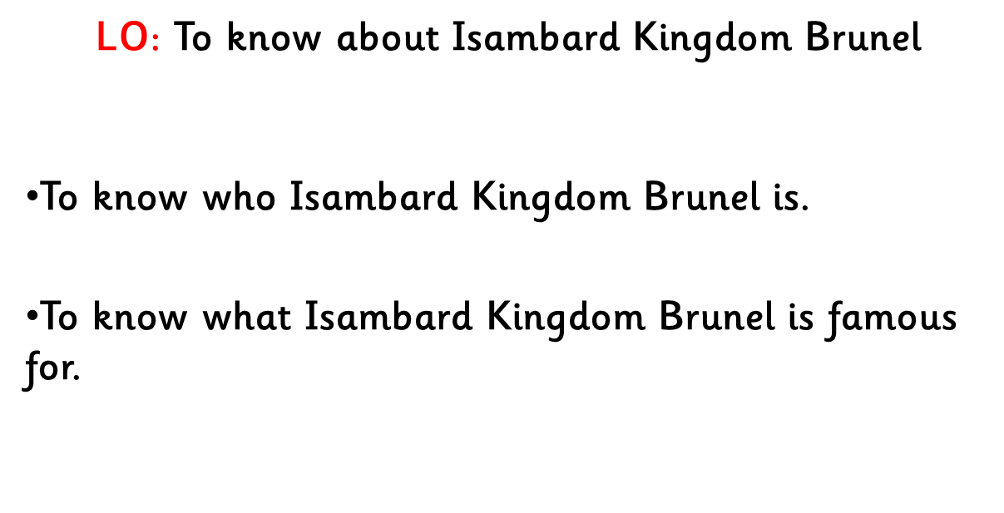

Slide 3
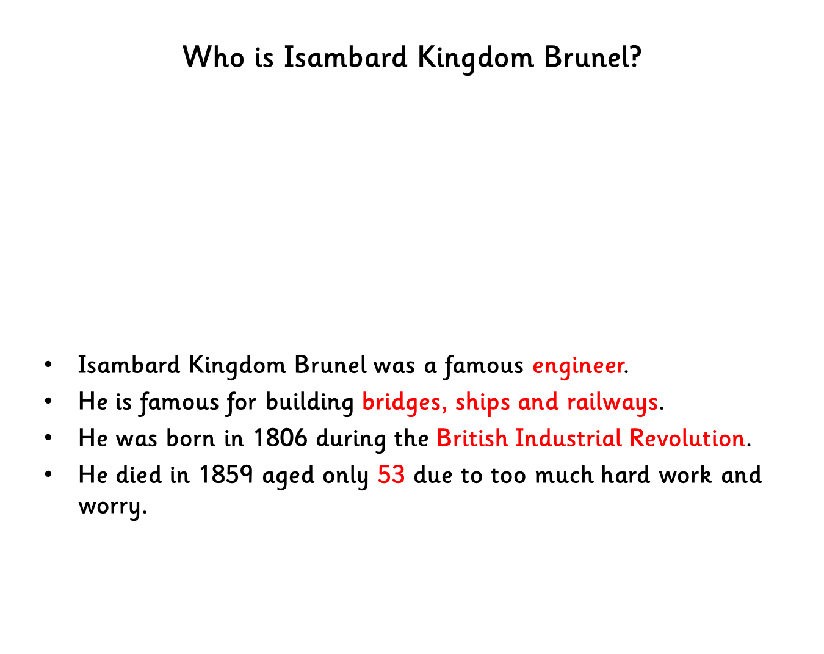
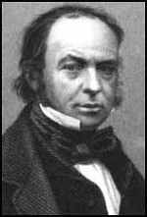

Slide 4
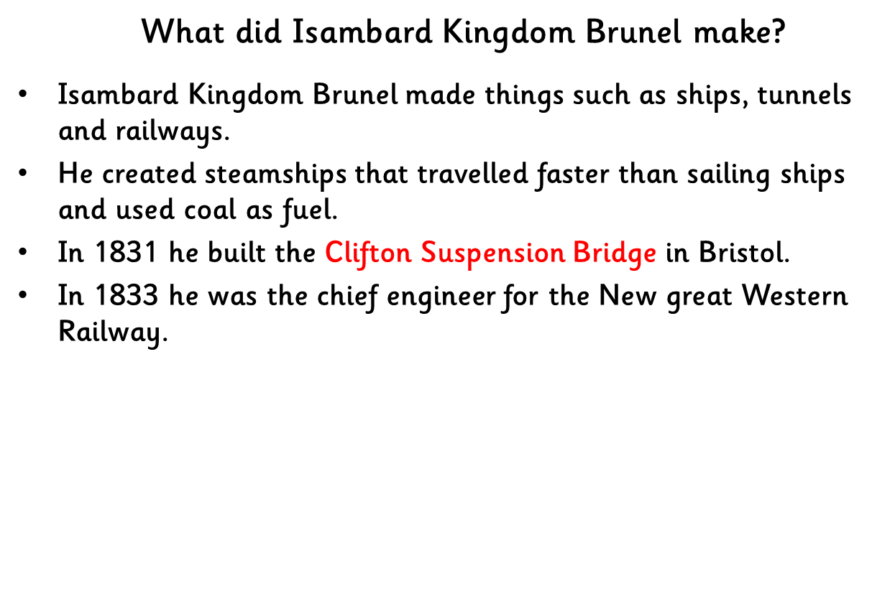
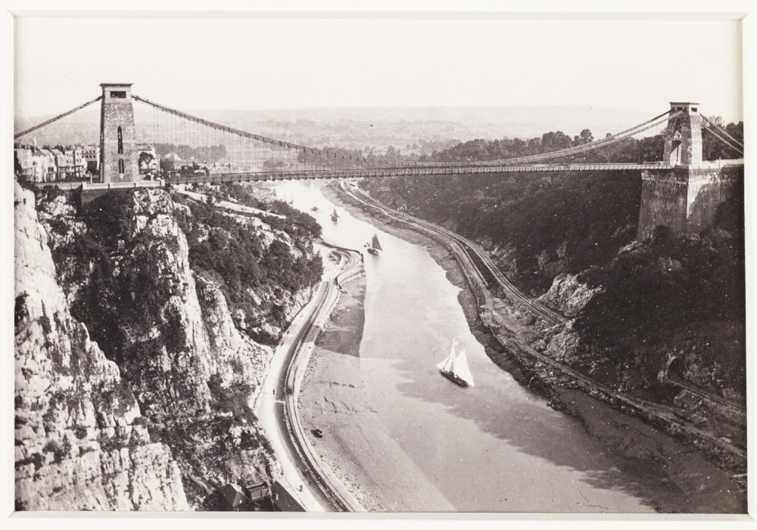
Photo courtesy of nationalmediamusuem (@flickr.com) - granted under creative commons licence - attribution

Slide 5
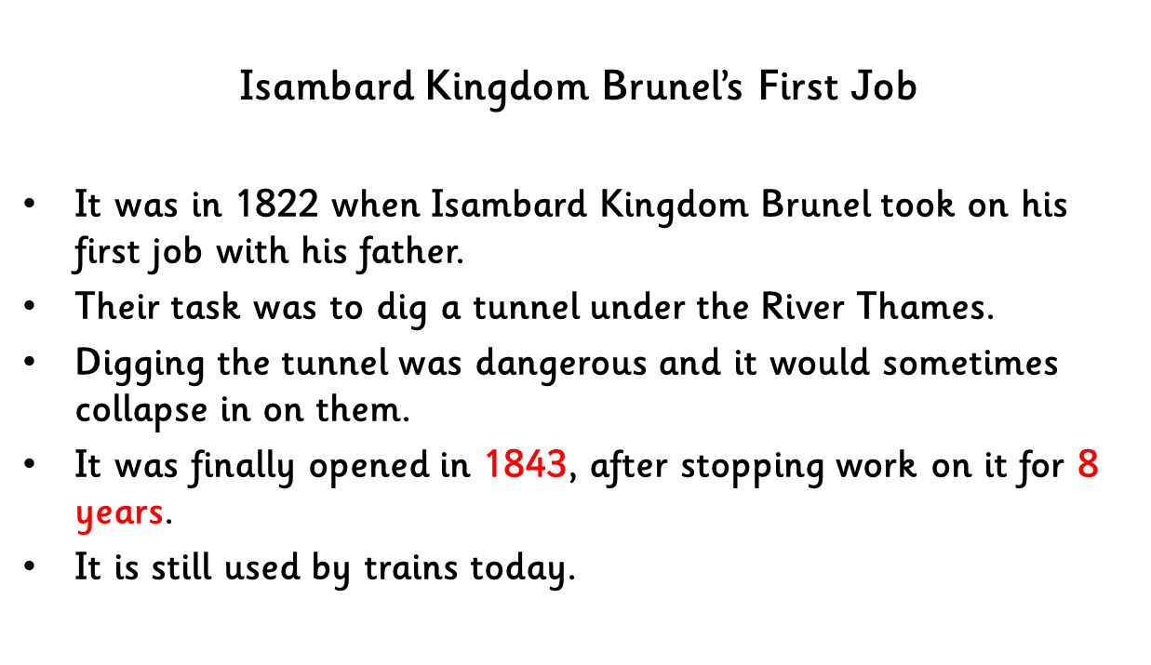
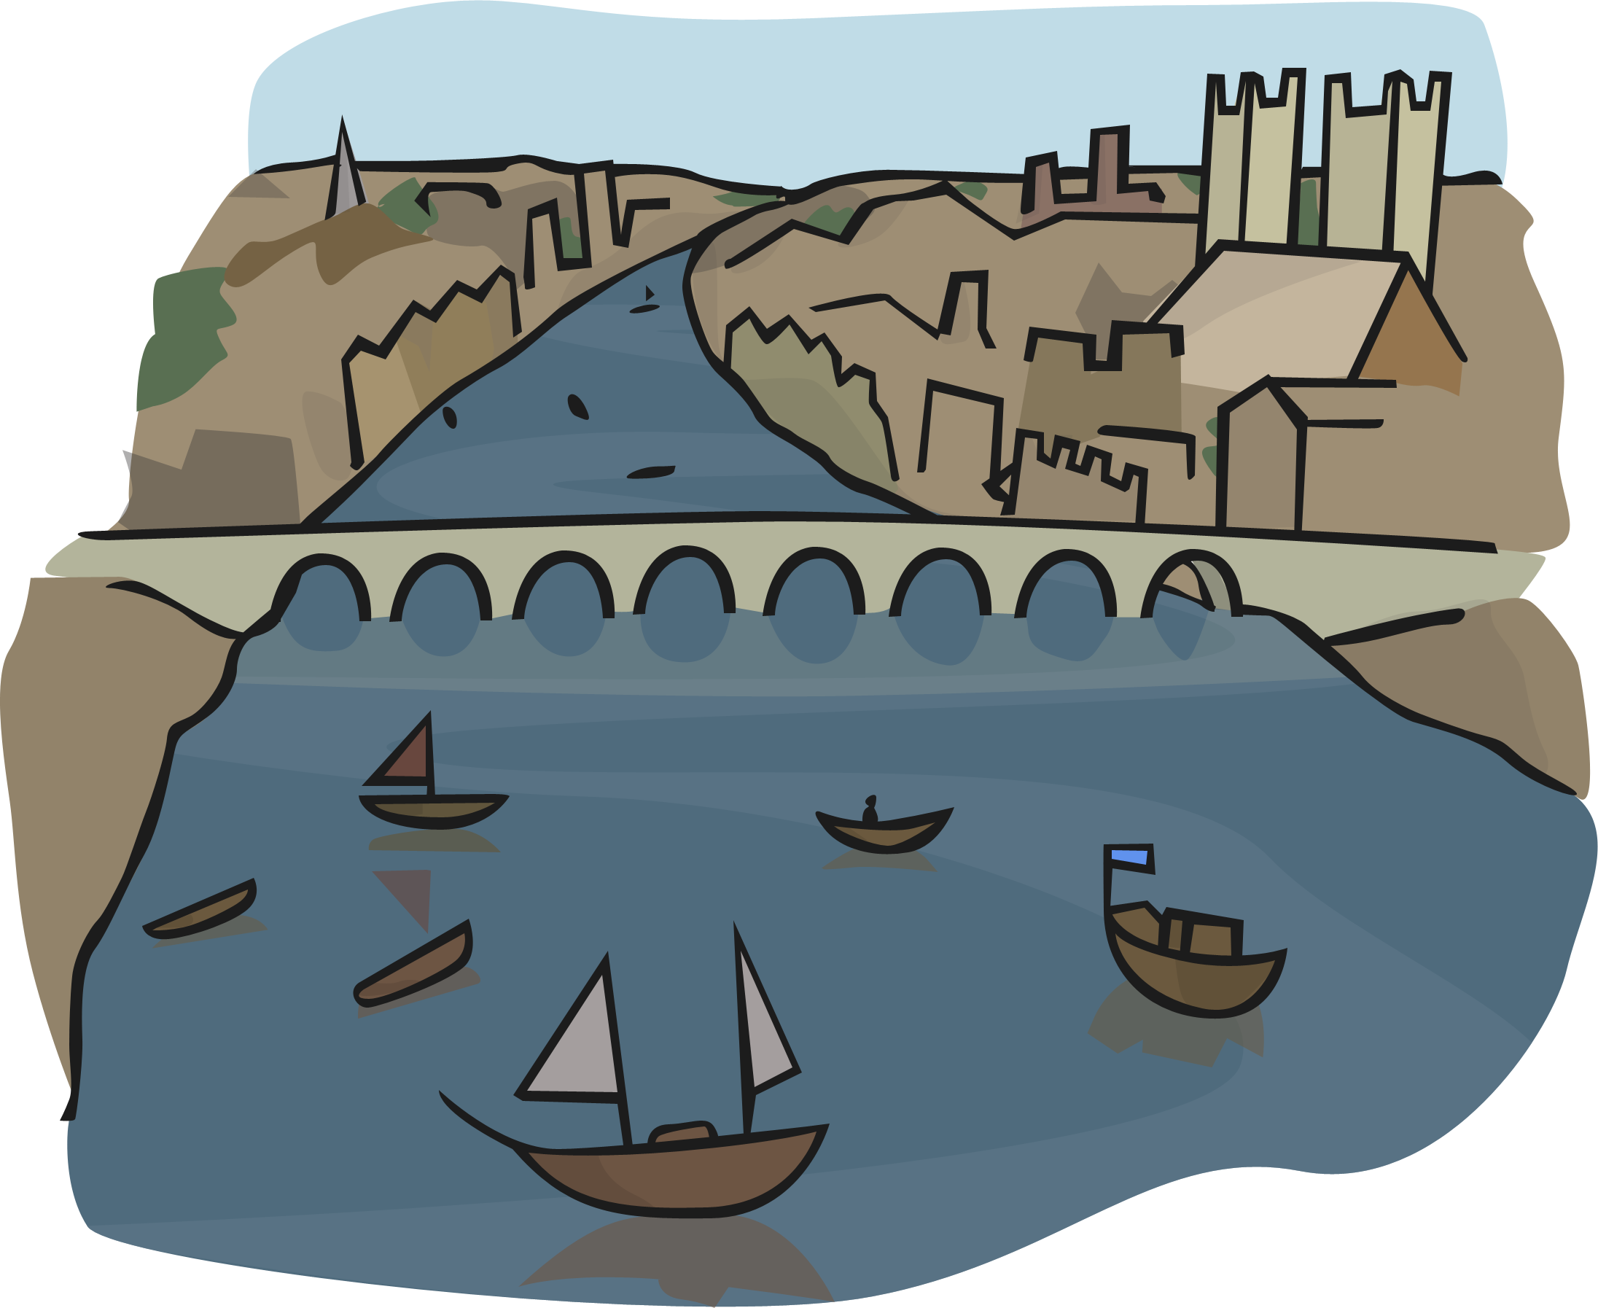

Slide 6
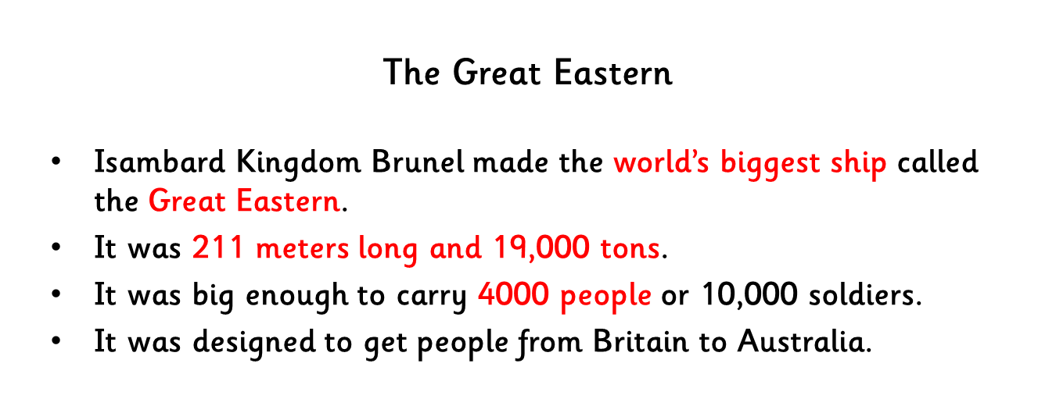
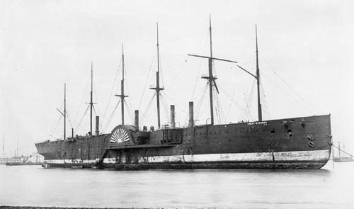
Photo courtesy of National Maritime Museum(@flickr.com) - granted under creative commons licence - attribution

Slide 7
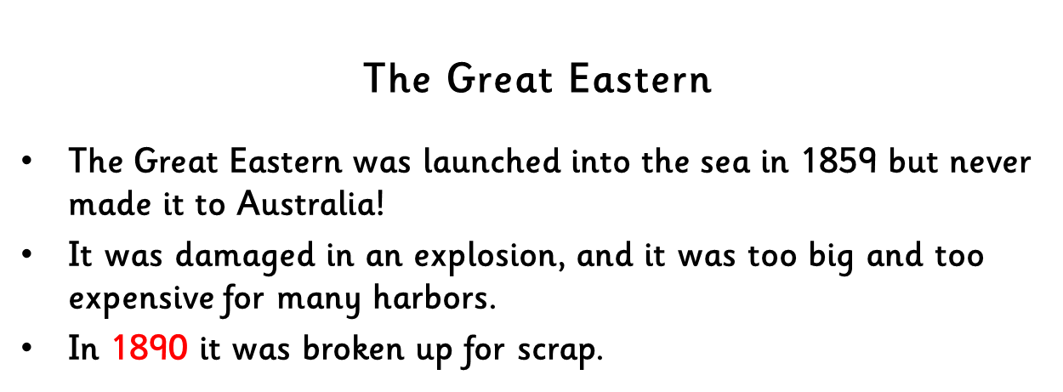
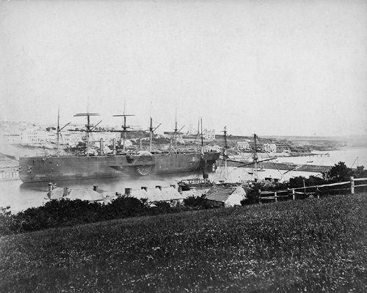
Photo courtesy of nationalmaritimemuseum(@flickr.com) - granted under creative commons licence - attribution

Slide 8
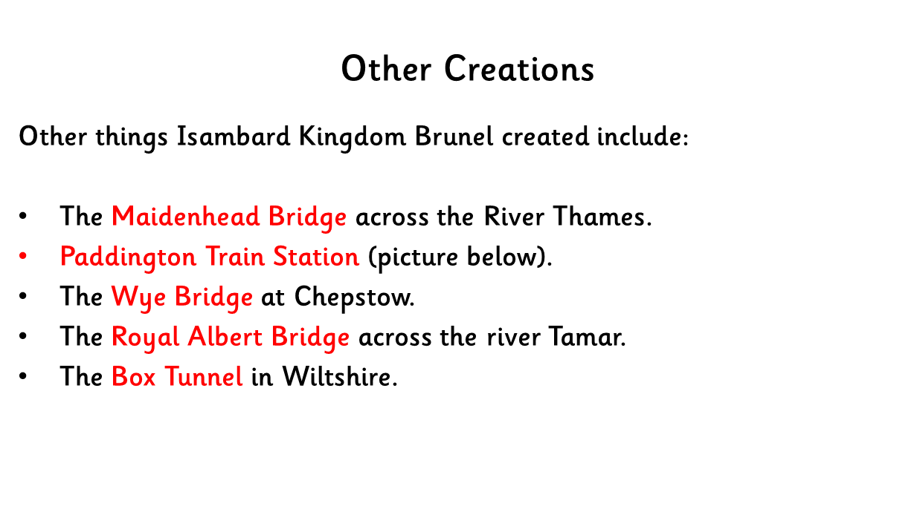
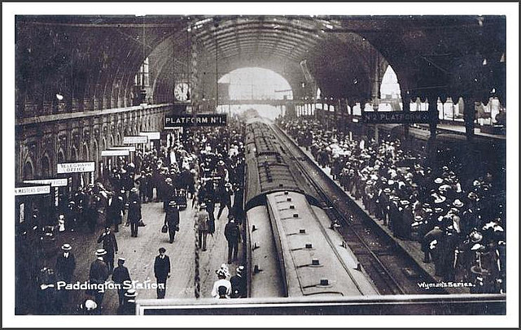
Photo courtesy of M&SLiterayAdventures(@flickr.com) - granted under creative commons licence - attribution

Slide 9
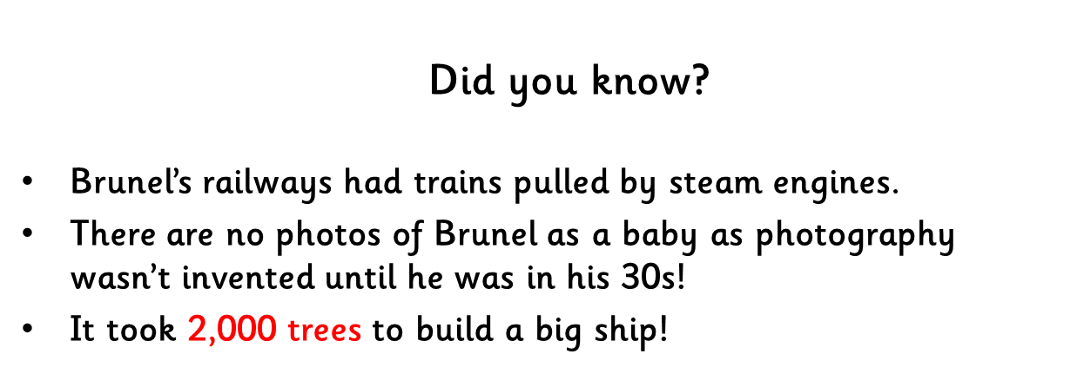
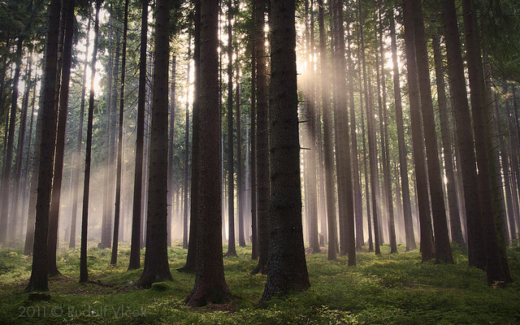
Photo courtesy of d o l f i (@flickr.com) - granted under creative commons licence - attribution

Slide 10


TEXT HERE
TEXT HERE
TEXT HERE
TEXT HERE
TEXT HERE
TEXT HERE

Slide 11
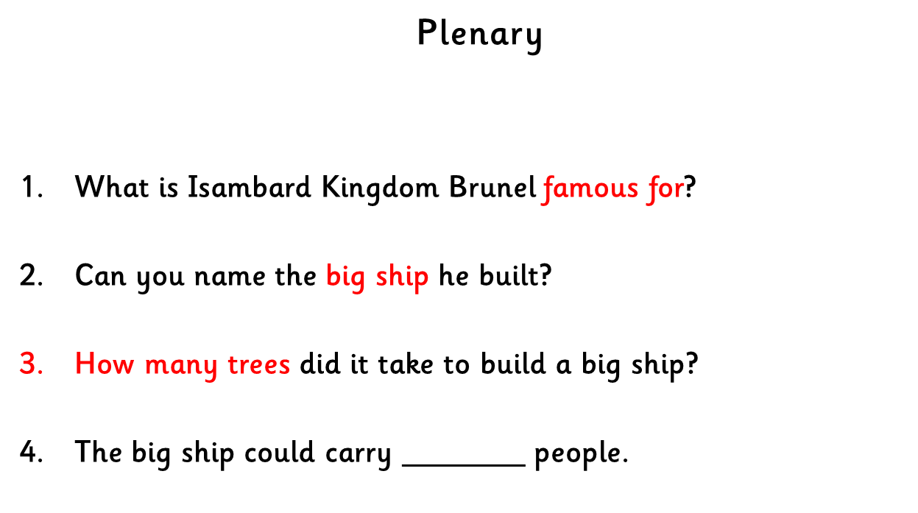


Slide 12

THE END

