Slide 1
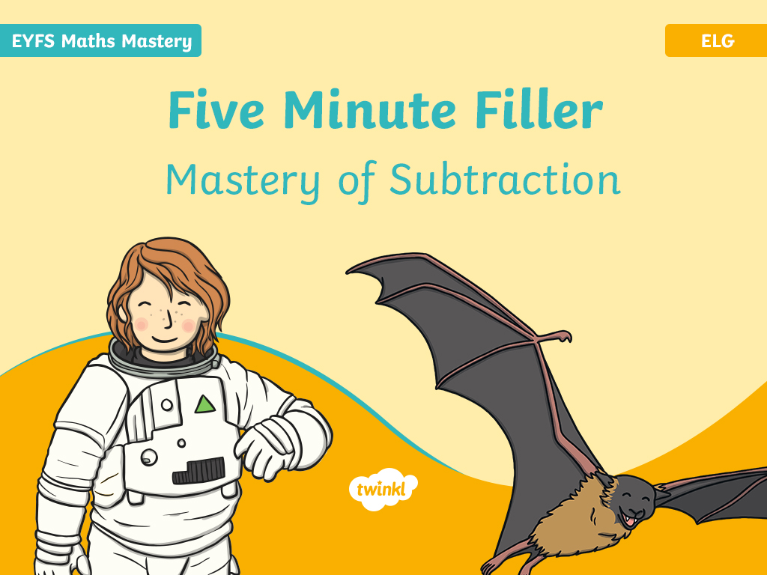

Slide 2
Contents
Boris the Bat’s Party – Counting Back
Larry Ladybird’s Fashion – Complement of a Set
Alien Adventure – Subtraction by Comparison
Hungry Henry the Caterpillar – Counting Back
Unicorn Horns – Complement of a Set
Minibeast Hunt – Subtraction by Comparison
Fergus the Frog – Counting Back
Under the Sea – Complement of a Set
Car Park – Subtraction by Comparison

Slide 3

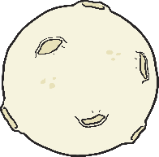

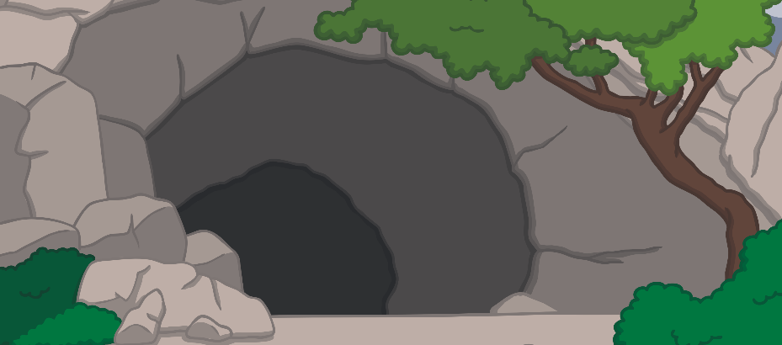
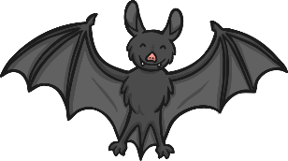
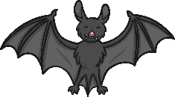
Boris the Bat’s Party – Counting Back
Boris the bat has invited 8 bat friends to a party in his cave. Some bats need to go home. Click on the moon to make some bats leave. How many bats are left in the cave? Count back from 8 to find the answer.
Can you also count back using your fingers?
How many bats are left in the cave?
How many do you need to count back?
reset
click again
Click the moon.
Click the star for the answer.
8
5
0
1
2
3
4
5
6
7
8
9
10
Click on the Boris the bat to reveal questions that encourage the development of children’s mathematical reasoning skills.

Slide 4





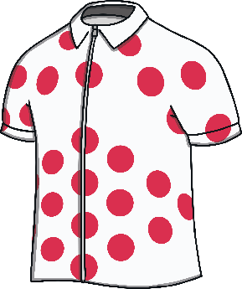


Larry Ladybird’s Fashion – Complement of a Set
How many clothes do have spots?
How many clothes are left for Larry to wear?
Larry Ladybird can’t decide what to wear. He knows he wants to wear something that has spots on. Can you say which clothes have not got spots?
How many clothes do not have spots?
reset
click again
Click here to take away the clothes that do not have spots.
Click on the Larry Ladybird to reveal questions that encourage the development of children’s mathematical reasoning skills.

Slide 5
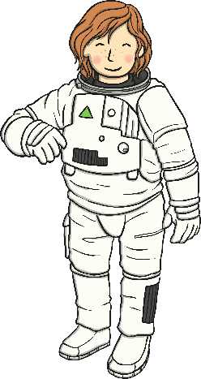


Alien Adventure – Subtraction by Comparison
How many purple aliens are there?
How many fewer blue aliens are there?
What is the difference between the green and purple aliens?
Astronaut Annie has travelled around space looking for aliens. She found some blue aliens and some purple aliens. Can you say how many of each colour she found?
How many blue aliens are there?
How many more purple aliens are there?
reset
click again
Click on the Astronaut Annie to reveal questions that encourage the development of children’s mathematical reasoning skills.

Slide 6



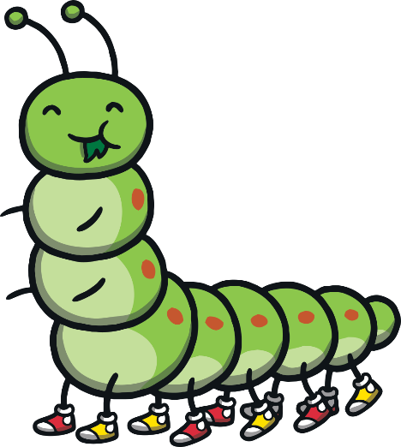

Hungry Henry the Caterpillar – Counting Back
Can you show me how to take 4 away from 10 using your fingers?
How can you use the number line to help you to count back? Can you show me?
Henry the caterpillar is very hungry! He has found a beautiful flower with 10 petals and is eating some of the petals, one by one. How many are left?
I think the answer is 5. Am I correct? What have I done?
reset
click again
Click to help the caterpillar eat some petals.
0
1
2
3
4
5
6
7
8
9
10
Click on the butterfly to reveal questions that encourage the development of children’s mathematical reasoning skills.

Slide 7

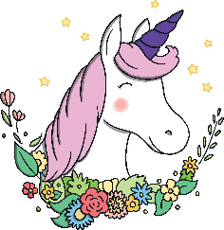

Unicorn Horns – Complement of a Set
The magical unicorns have different coloured horns. How many of each colour are there?
If the unicorns with the yellow horns disappeared, how many would be left? How do you know?
If the unicorns with the purple horns disappeared, how many would be left? How did you work this out?
How many unicorns are there altogether?
reset
hide yellow unicorns
hide purple unicorns
click again
Reset Unicorns
Click on the rainbow to reveal questions that encourage the development of children’s mathematical reasoning skills.

Slide 8
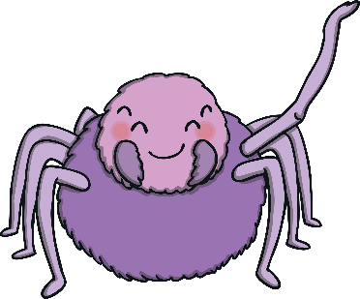





Minibeast Hunt – Subtraction by Comparison
How many fewer worms are there than ladybirds?
Which group has the least number of minibeasts in it?
The children in foundation stage have been on a minibeast hunt. How many of each type of minibeast did they find?
What is the difference between the number of ladybirds and worms?
reset
click again
Click on the spider to reveal questions that encourage the development of children’s mathematical reasoning skills.

Slide 9



Fergus the Frog – Counting Back
Which number lily pad will Fergus land on when he jumps back?
If Fergus jumped back another lily pad, which number would he land on?
Fergus the frog loves to jump! He is going to jump back 3 lily pads.
How many do we need to count back?
Jump, Fergus!
reset
click again
0
1
2
3
4
5
6
7
8
9
10
Click on the duck to reveal questions that encourage the development of children’s mathematical reasoning skills.

Slide 10
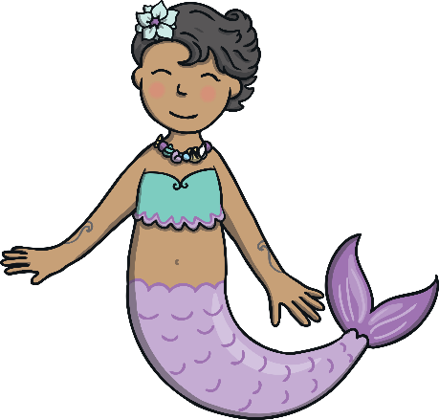
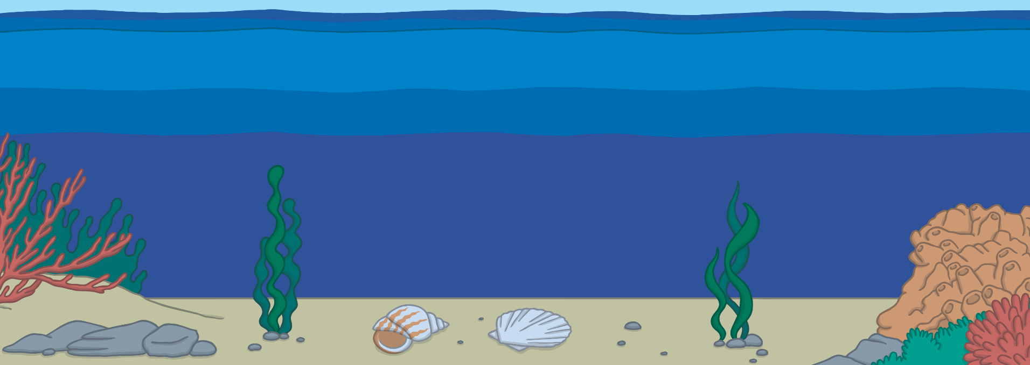


Under the Sea – Complement of a Set
How many fish are there?
If the red fish swim away, how many yellow fish would be left?
Can you use your fingers to check your answer?
There are lots of colourful fish in the sea.
reset
click again
Click on the mermaid to reveal questions that encourage the development of children’s mathematical reasoning skills.

Slide 11



Car Park – Subtraction by Comparison
What a busy car park! Click the button to make some more cars drive into the car park.
Are there fewer red cars or green cars?
What is the difference between the number of red cars and the number of green cars?
How many fewer green cars are there?
Click for more cars.
reset
click again
Click on the lollipop person to reveal questions that encourage the development of children’s mathematical reasoning skills.

