Slide 1
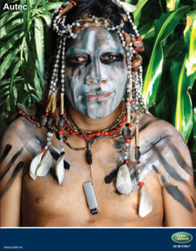
Amazon Tribes
LO: To be able describe how different tribes use the Amazon rainforest.
LO: To be able to compare your own life to that of an Amazon tribe.

Slide 2
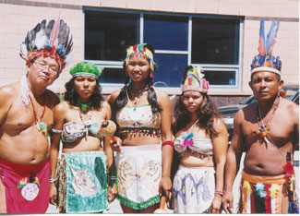
What does indigenous mean?
The first people to colonise Brazil were the tribal Indians (Amerindians). They lived in harmony with the plants and animals, much like their surviving ancestors today.

Slide 3
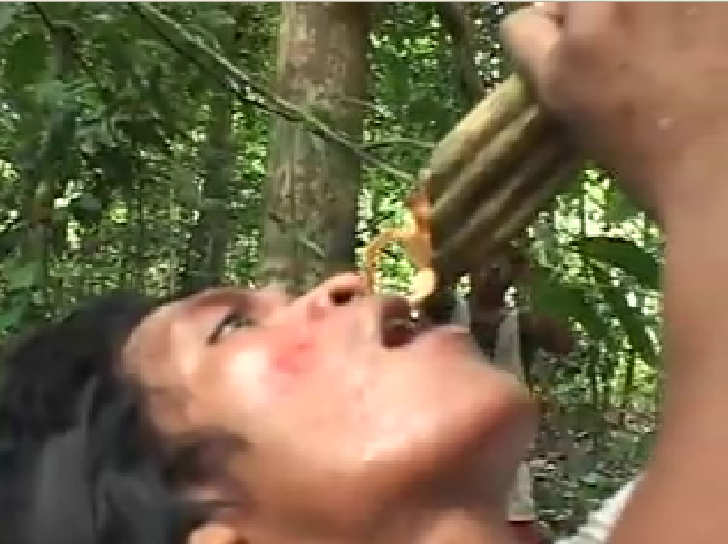
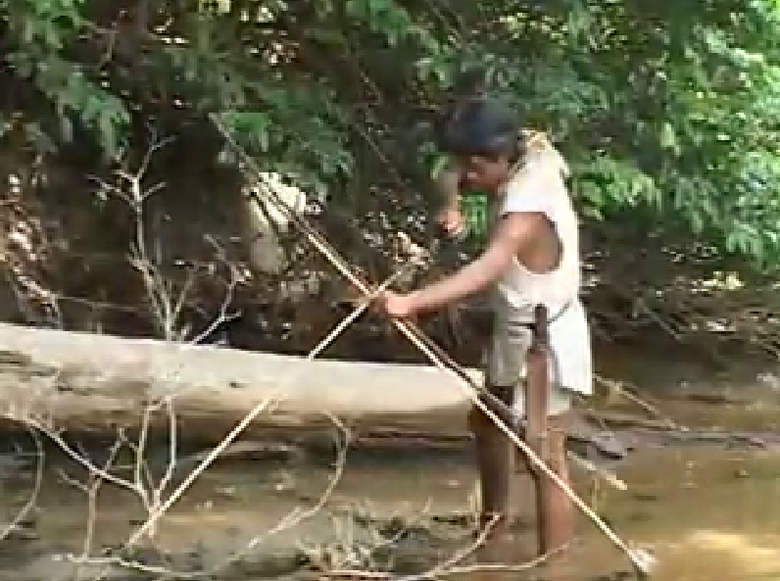
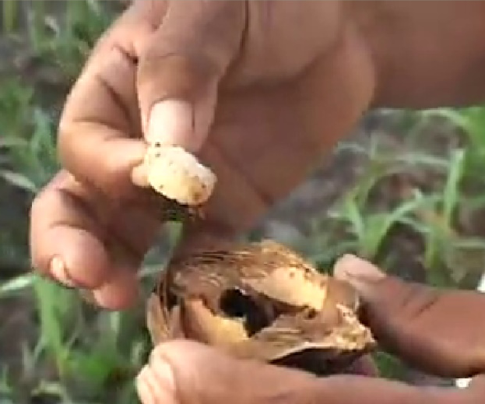
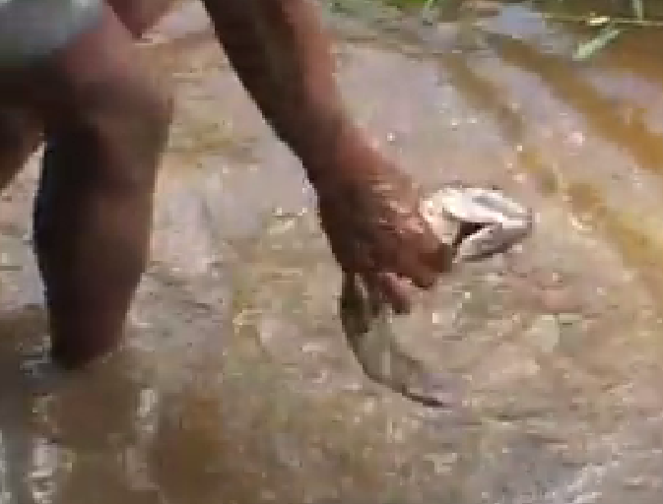
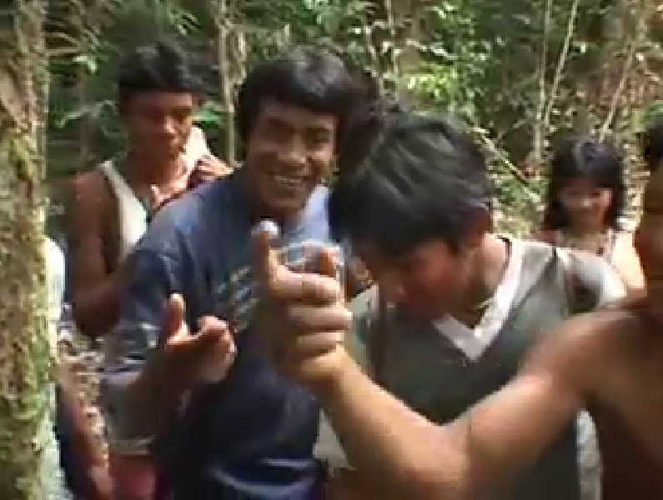
How do tribes use the Amazon?
Drinking water from a vine
Hunting for food
Eating Babassu as a snack
Catching a fish for lunch
Collecting medicine from a tree

Slide 4
Facts to find
Read the information on each tribe.
Think about how the tribe use the Rainforest?
Think about anything that the tribe does that is similar/different to your family?
Notes:
Use the grid worksheet and place tribe fact cards around the room

Slide 5
A letter from Akra
One of the tribes has written
a letter to you
You can now read through
your letter from Akra.
You are going to use this information to compare Akra’s life to your own.
Success Criteria
- compare your life with Akra’s.
– are the any similarities between your life and Akra’s?
– complete extension task questions (optional).
Notes:
Use the comparisons work sheet

Slide 6
Self assess
Success Criteria
L4 - compare your life with Akra’s.
L5 – create your own comparisons.
L6 – complete extension task questions.
Check your work.
What was good about your work?
How can you improve your work?

Slide 7
Review
3 Ways tribes use the Amazon Rainforest.
2 Differences between your life and Akra’s.
1 Suggest why is the Amazon rainforest important to tribes.

