Slide 1
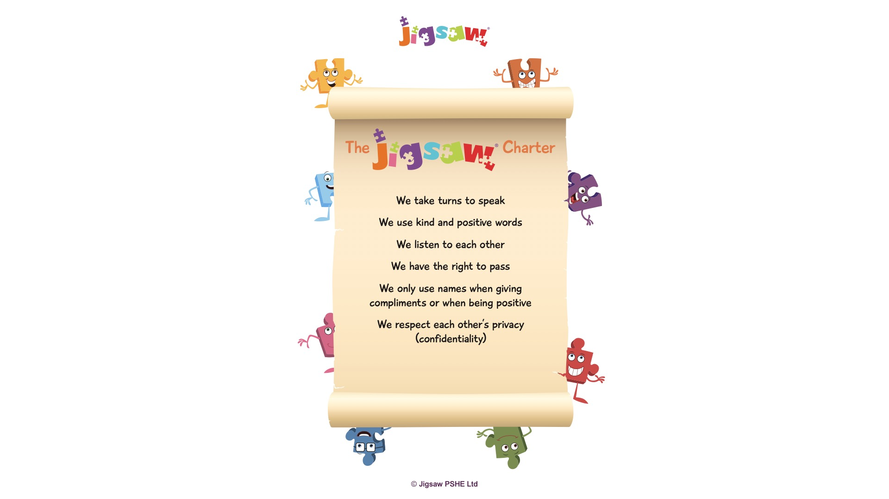

Slide 2
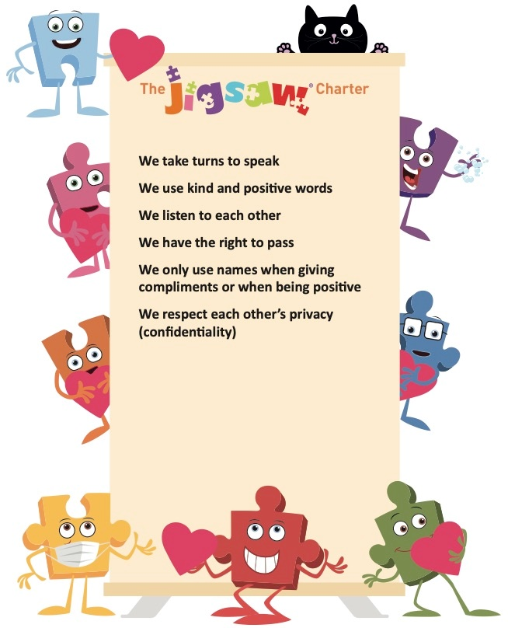
Covid safety rule 01
Covid safety rule 02
Covid safety rule 03

Slide 3


Slide 4


Slide 6
What is in
your welcome pack?

Slide 7


Slide 8


