Slide 1
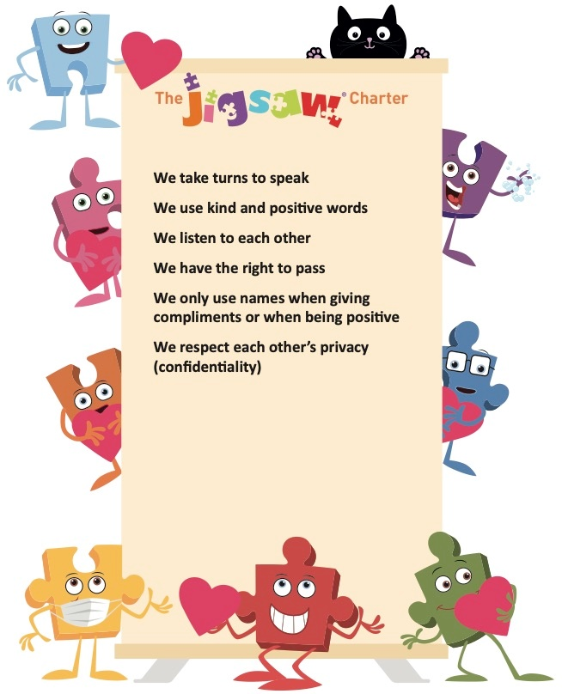
Covid safety rule 01
Covid safety rule 02
Covid safety rule 03

Slide 2







