Slide 1
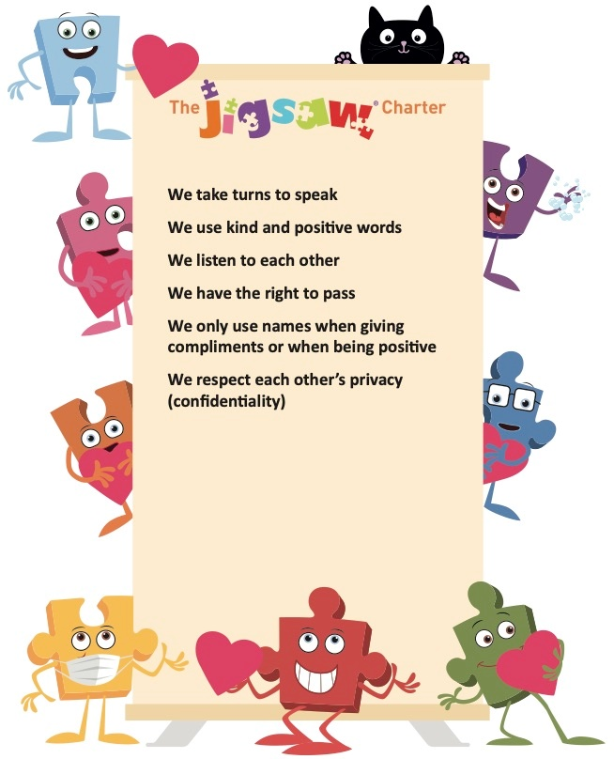
Covid safety rule 01
Covid safety rule 02
Covid safety rule 03

Slide 2
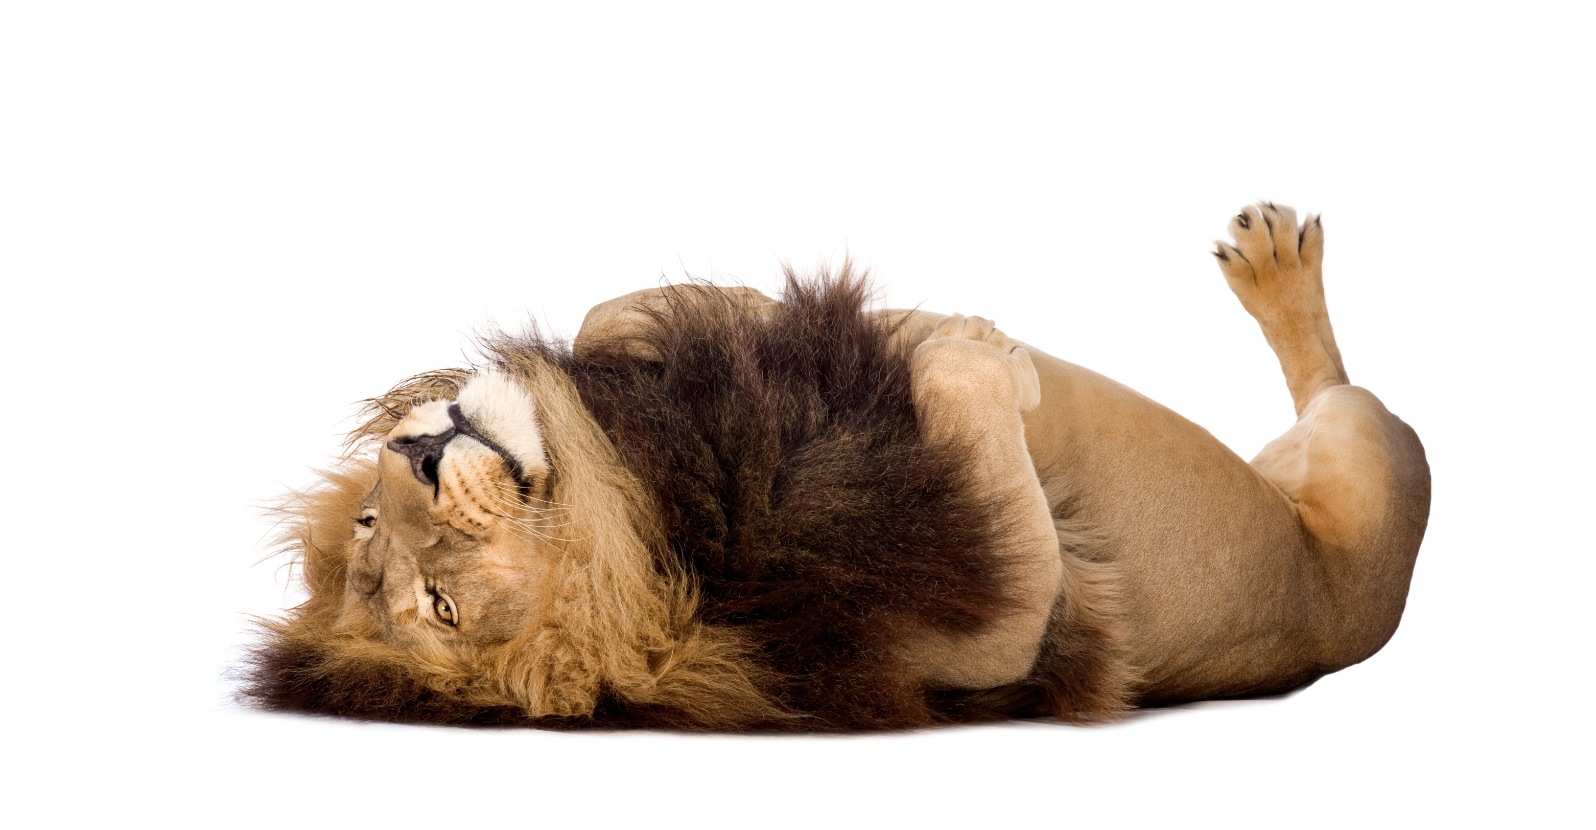
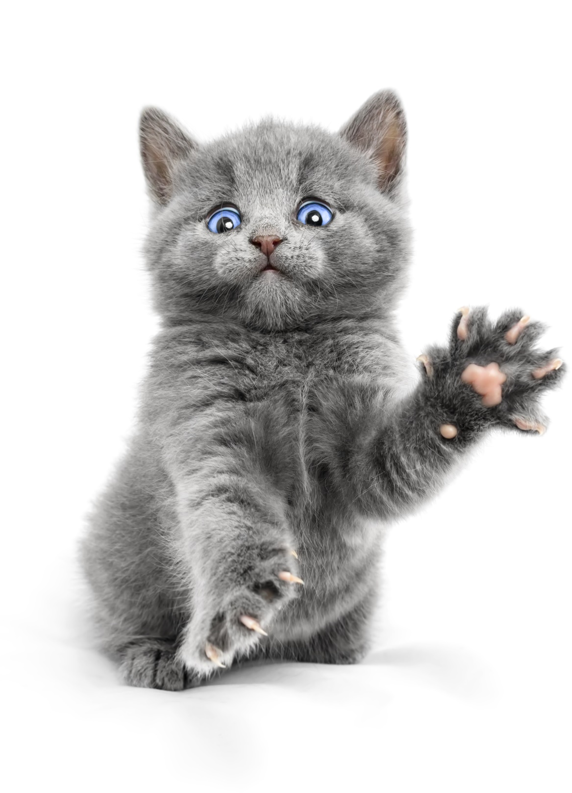
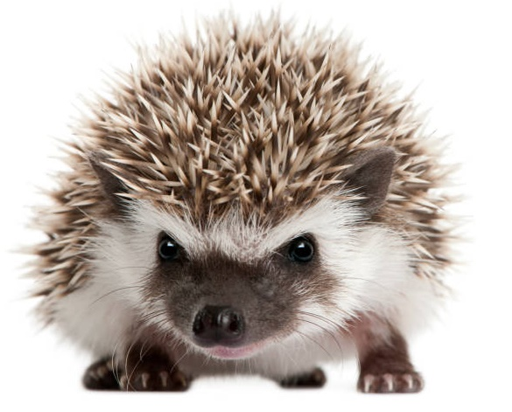

Slide 3
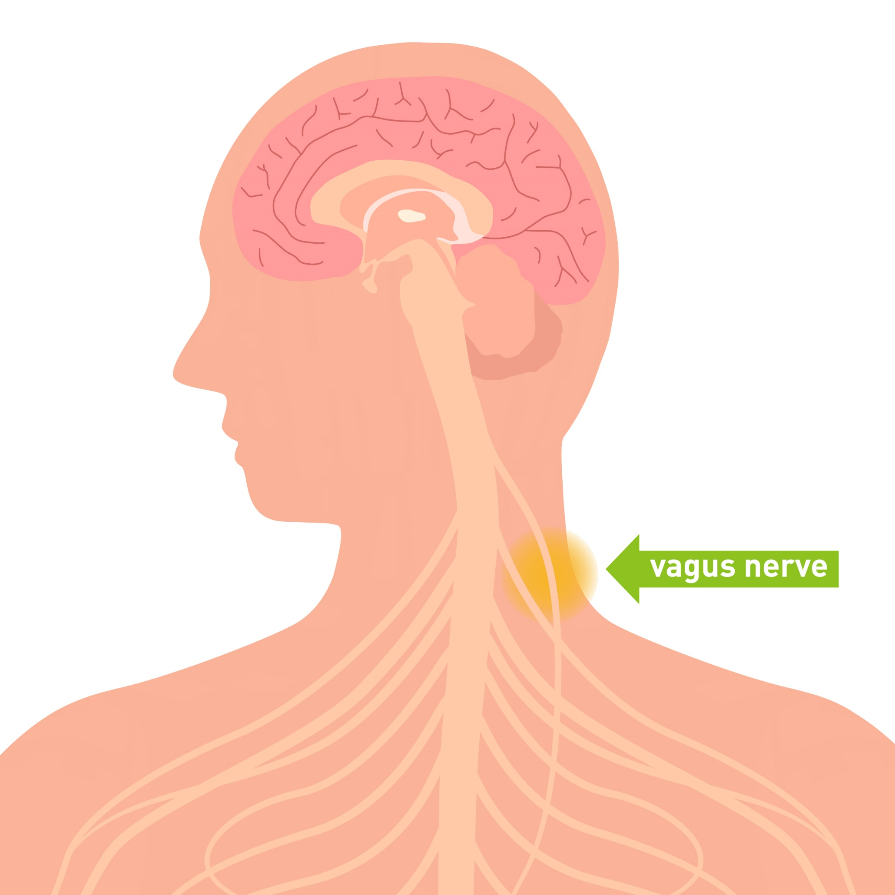

Slide 5

Using our senses to feel safe

Slide 6


