Slide 1


Slide 2
Some people are ‘vegetarians’.
What does this word mean?
Why might somebody be a vegetarian?
-

Slide 3
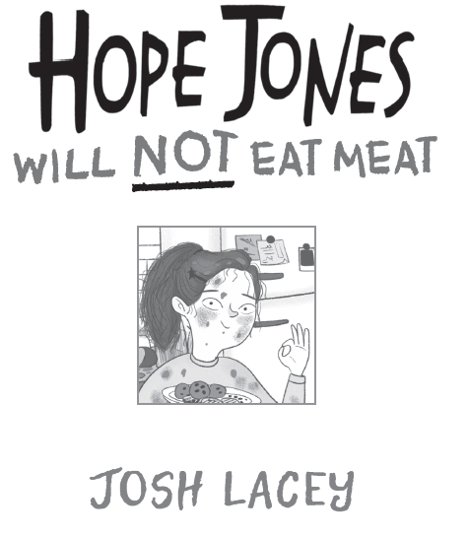

Slide 4
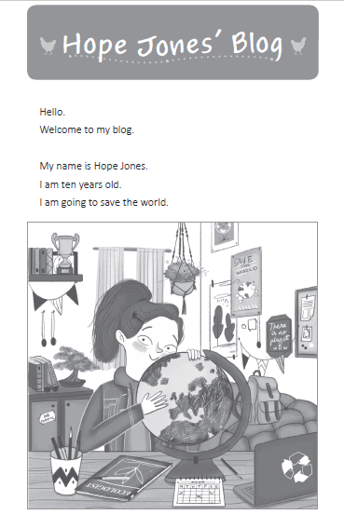

Slide 5
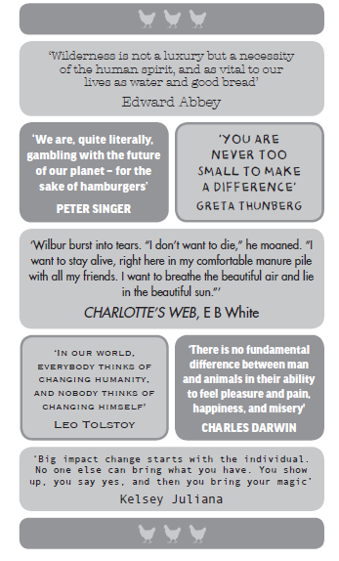

Slide 6
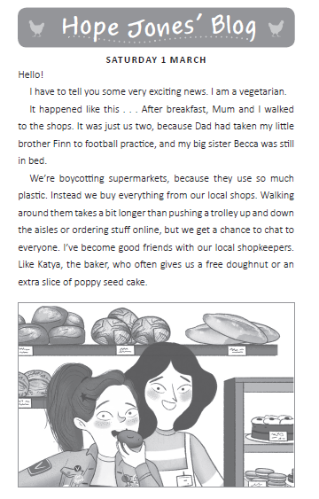

Slide 7
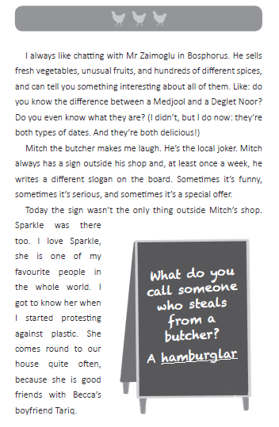

Slide 8
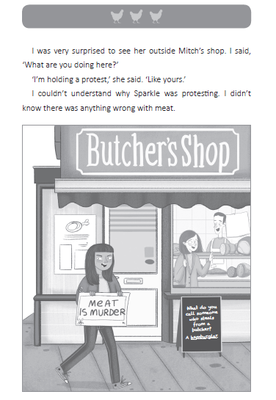

Slide 9
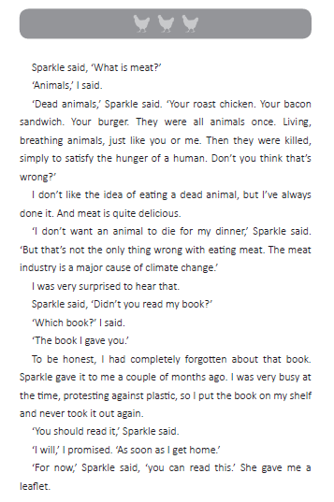

Slide 10
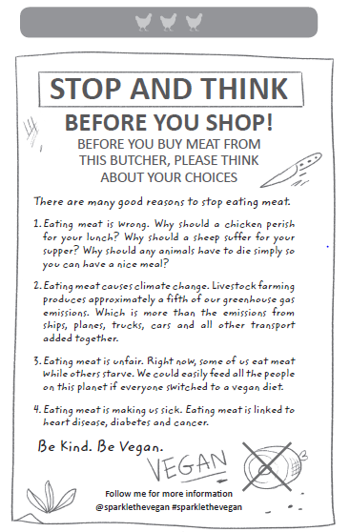

Slide 11
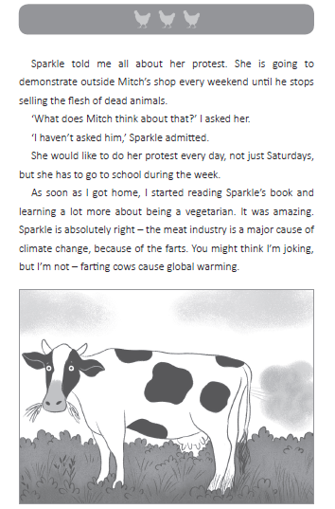

Slide 12
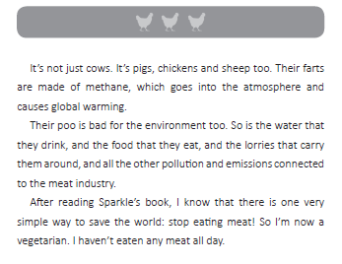

Slide 13
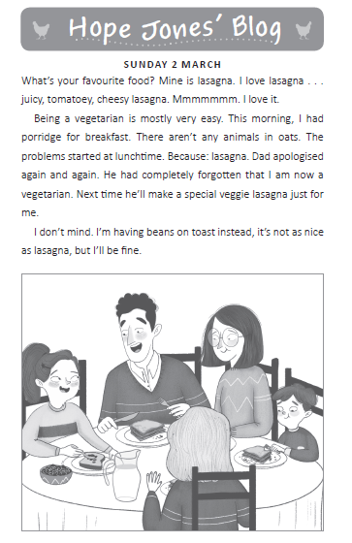

Slide 14
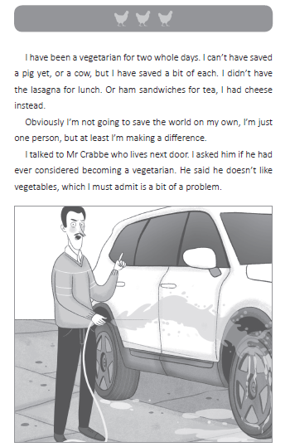

Slide 15
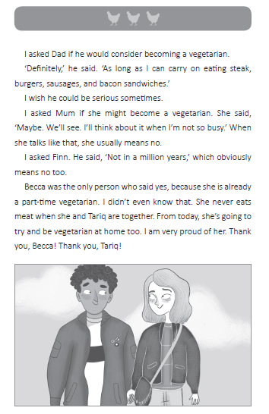

Slide 16
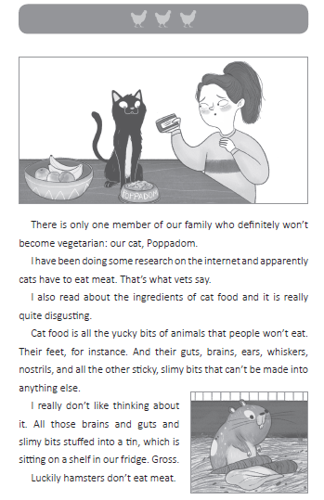

Slide 17
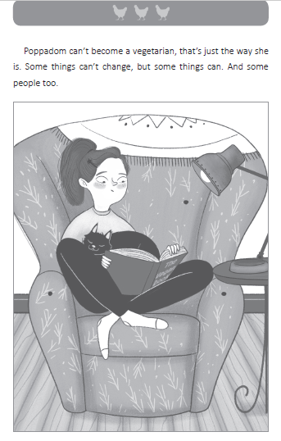

Slide 18
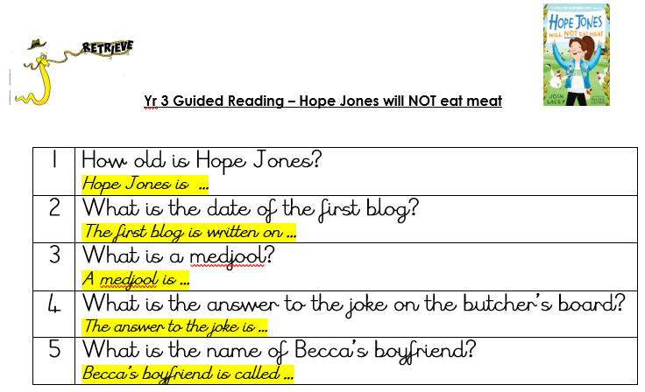

Slide 19
Answers
1 | How old is Hope Jones? Hope Jones is 10 years old.
2 | What is the date of the first blog? The first blog is written on Saturday 1st March.
3 | What is a medjool? A medjool is a date (fruit).
4 | What is the answer to the joke on the butcher’s board? The answer to the joke is a hamburglar.
5 | What is the name of Becca’s boyfriend? Becca’s boyfriend is called Tariq.

Slide 20
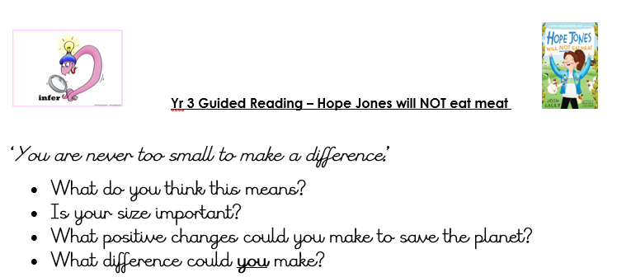

Slide 21
Possible answers-
‘You are never too small to make a difference.’
What do you think this means?
No matter how small the contribution, added together it makes a big difference.
Is your size important?
Small- size of actions are important.
What positive changes could you make to save the planet?
Recycle, reuse, walk more , use less plastic, become vegetarian, turn off lights etc.
What difference could you make?
Walk to school/shops, recycle toys/books, speak clearly on things you feel passionate about (e.g. animal rights, global warming etc.), find out information and learn about subjects.

Slide 22
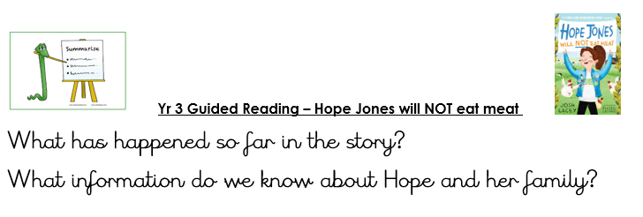

Slide 23
Possible answers-
What has happened so far in the story?
Hope has started a blog on her journey about being a vegetarian. She hates plastic waste and shops locally. Her friend protests outside the local butchers.
What information do we know about Hope and her family?
That she has a mum, dad, little brother and big sister.
They have boycotted supermarkets because they use too much plastic.
They are friends with all their local shopkeepers.
Her mum, dad and brother would never consider becoming vegetarian but her big sister is one ‘part-time’.

Slide 24
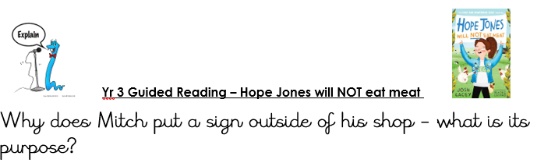

Slide 25
Possible answer-
Why does Mitch put a sign outside of his shop- what is its purpose?
For humour as his is considered to be ‘local joker’ to make people smile and maybe draw in new customers.

Slide 26
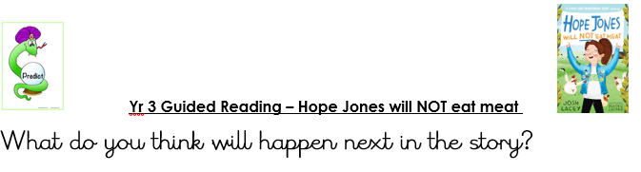

Slide 27
Possible answer-
What do you think will happen next in the story?
I think although Hope agrees with Sparkle’s ‘meat is murder’ sign, she may not feel comfortable with her protesting outside her friend Mitch’s shop.

Slide 28
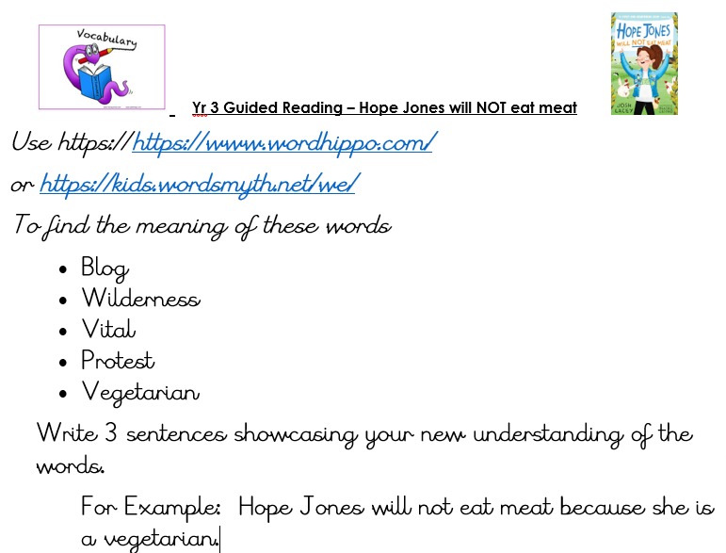
After lesson task:

Slide 29
Answers
Blog- a website containing a writer’s experience.
Wilderness- a wild and uninhabited region.
Vital- necessary to life/existence.
Protest- an expression of disapproval/ objection.
Vegetarian- a person who does not eat meat and subsists on veg, fruit, nuts and grain etc.

