Slide 1


Slide 2
5.3.21
LO: Understand Fractions as Numbers

Slide 3
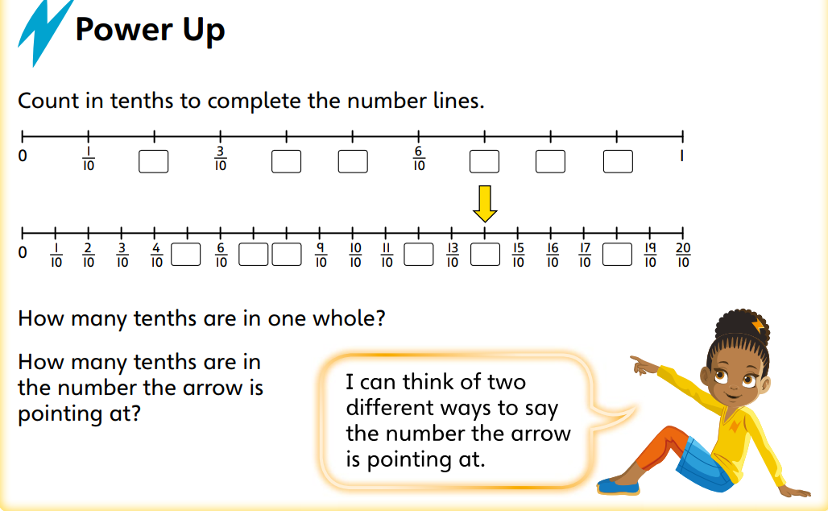

Slide 4
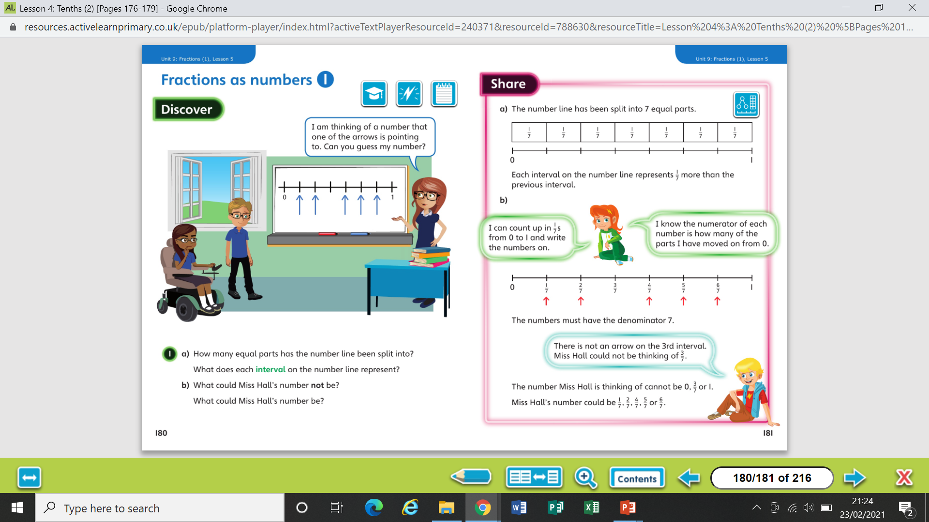

Slide 6
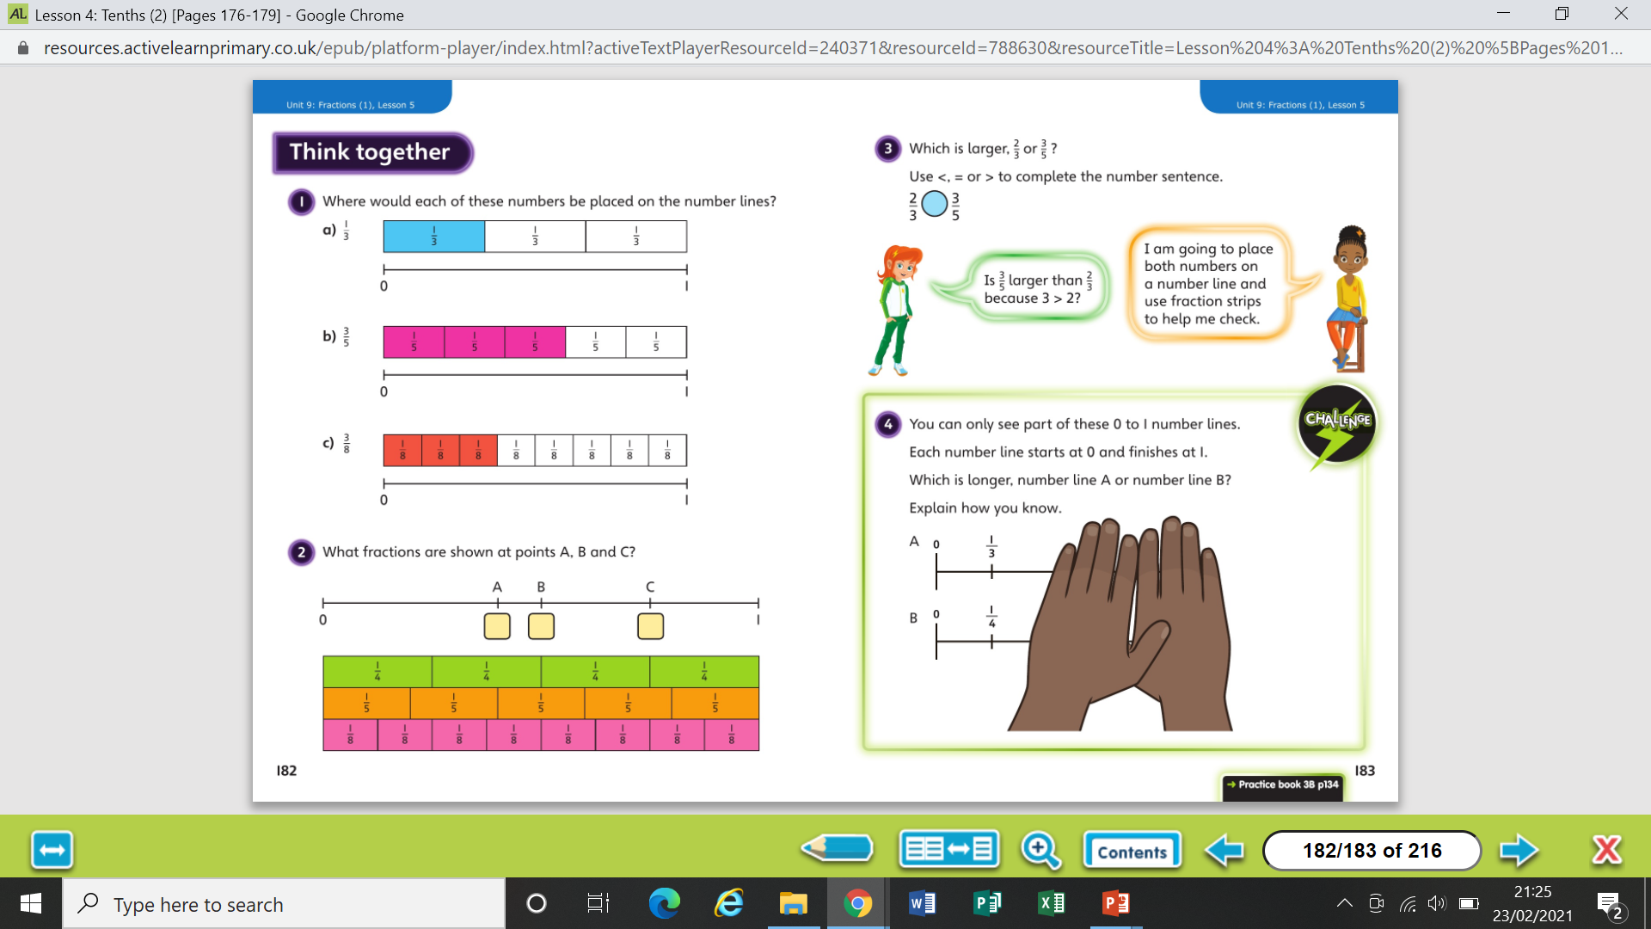

Slide 8
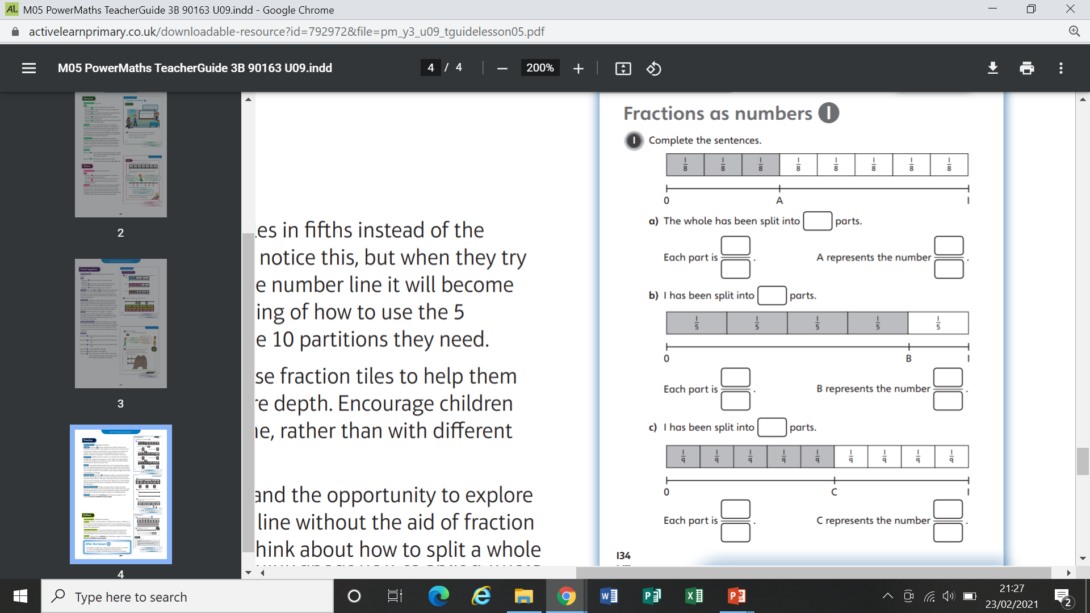
Worksheet

Slide 9
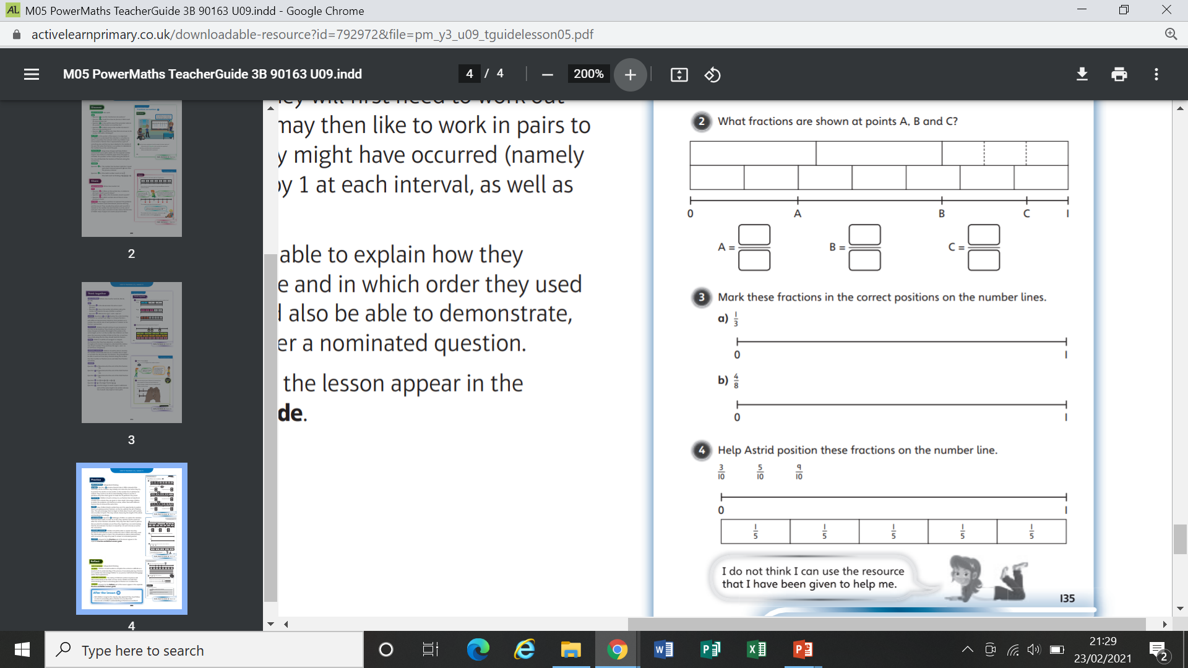
Worksheet

Slide 10
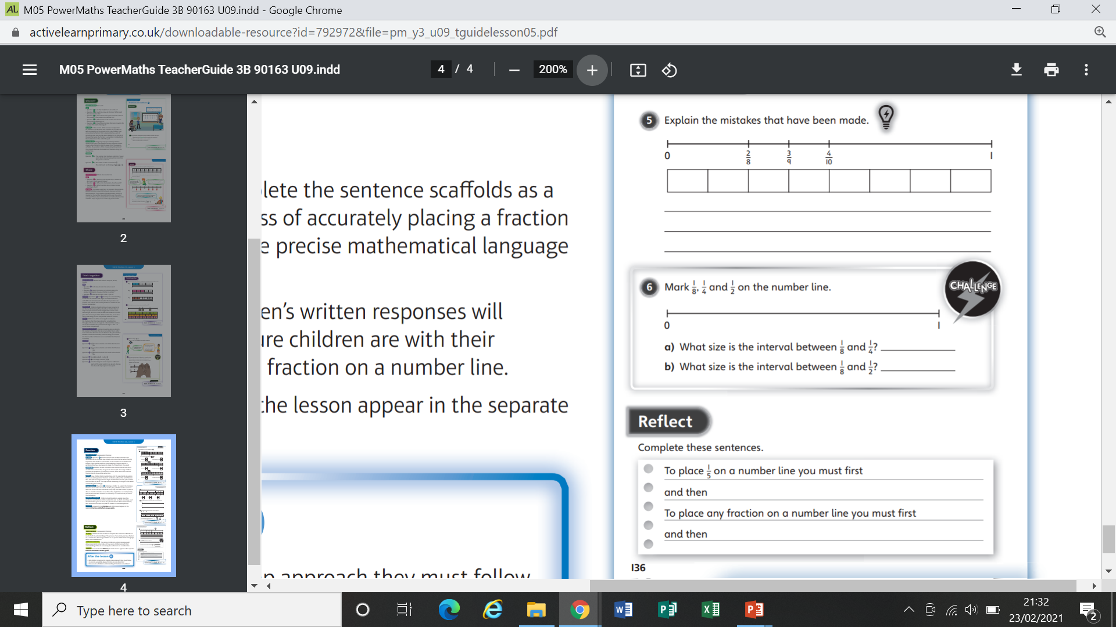
Worksheet

Slide 11
Worksheet

