Slide 1


Slide 2
4.3.21
LO: Finding Tenths

Slide 3
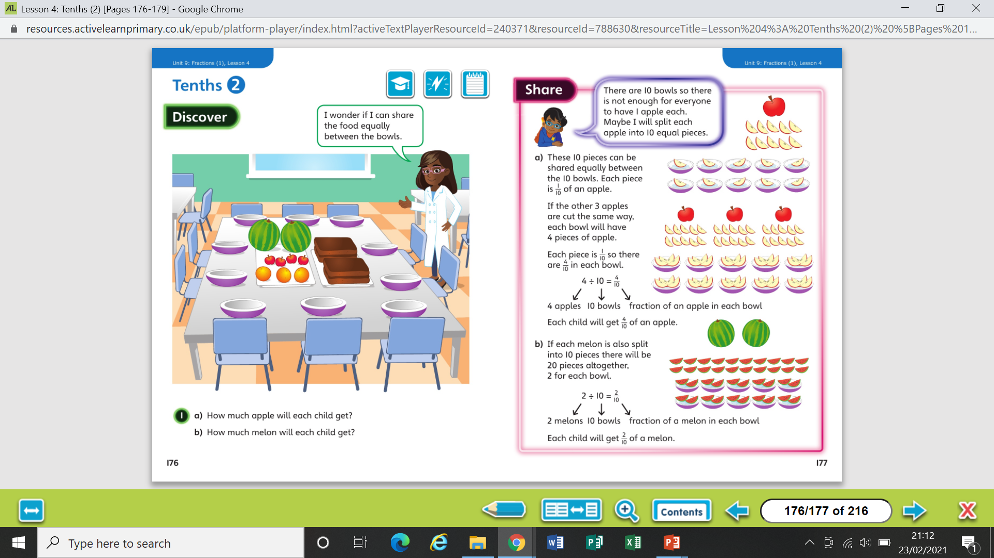

Slide 5
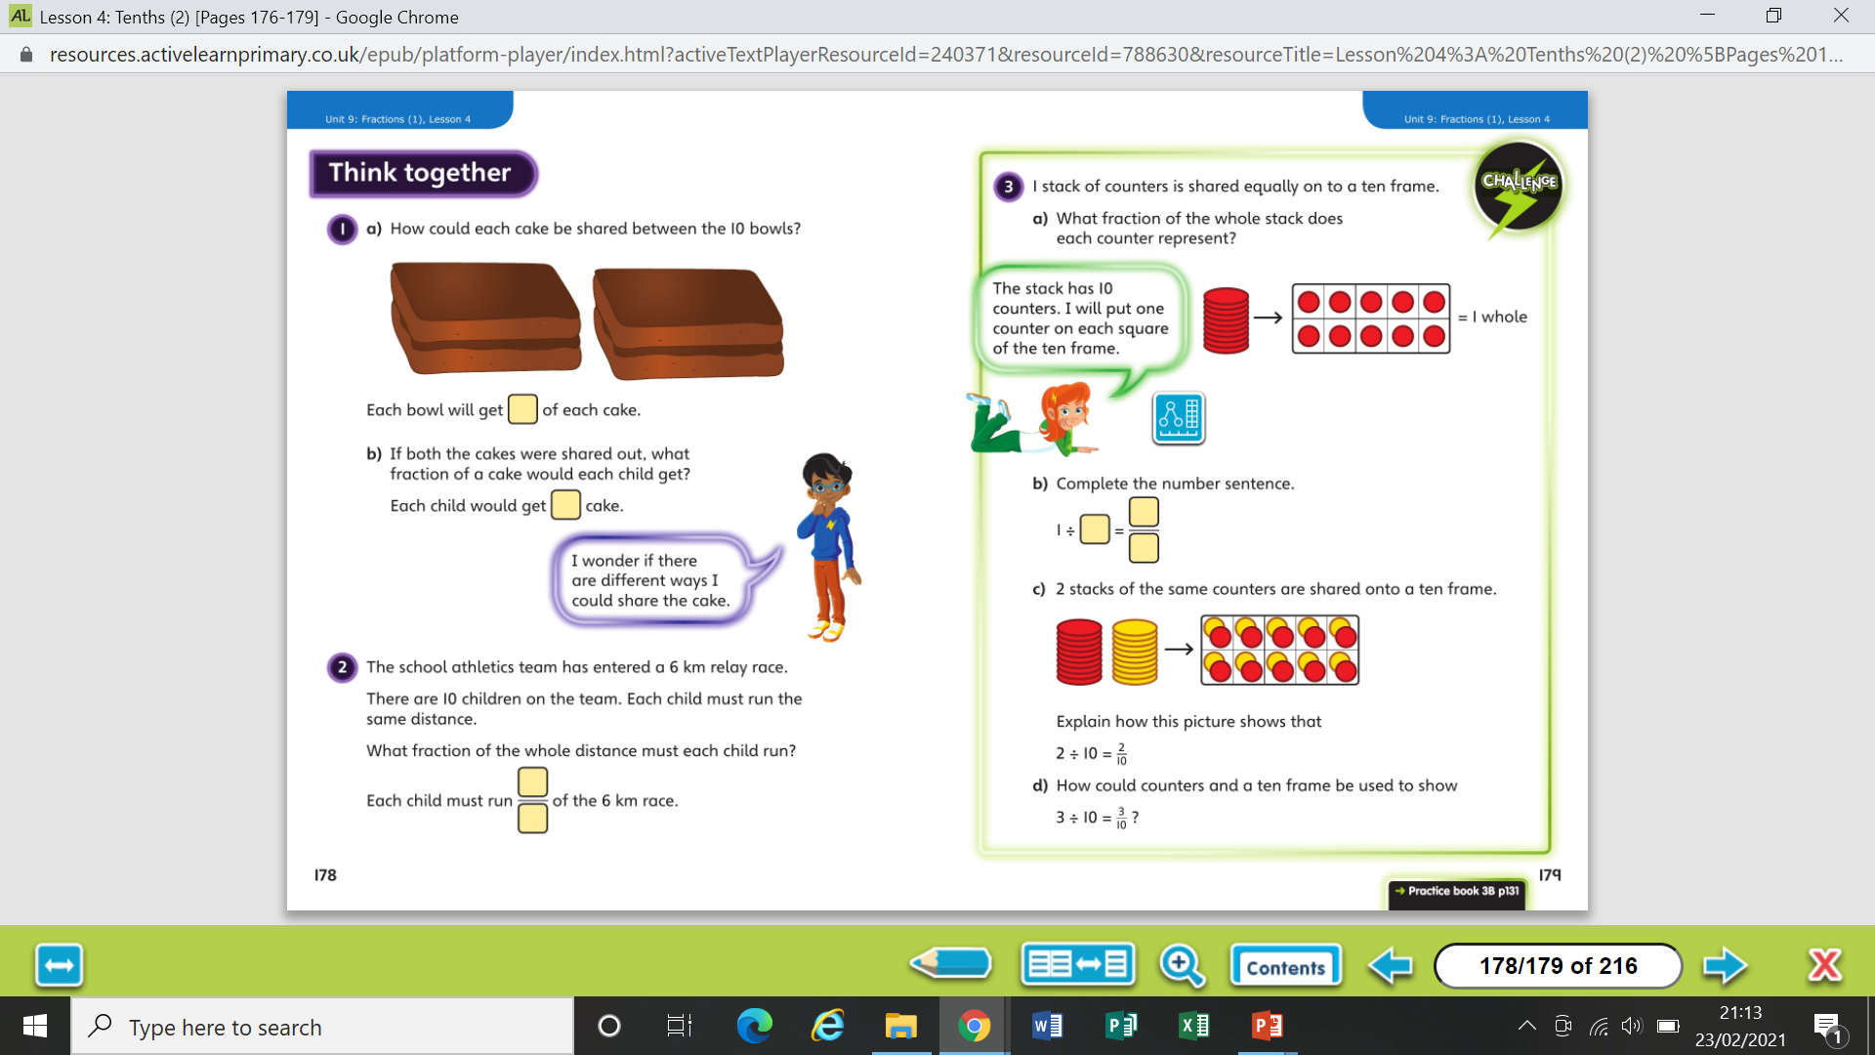

Slide 7
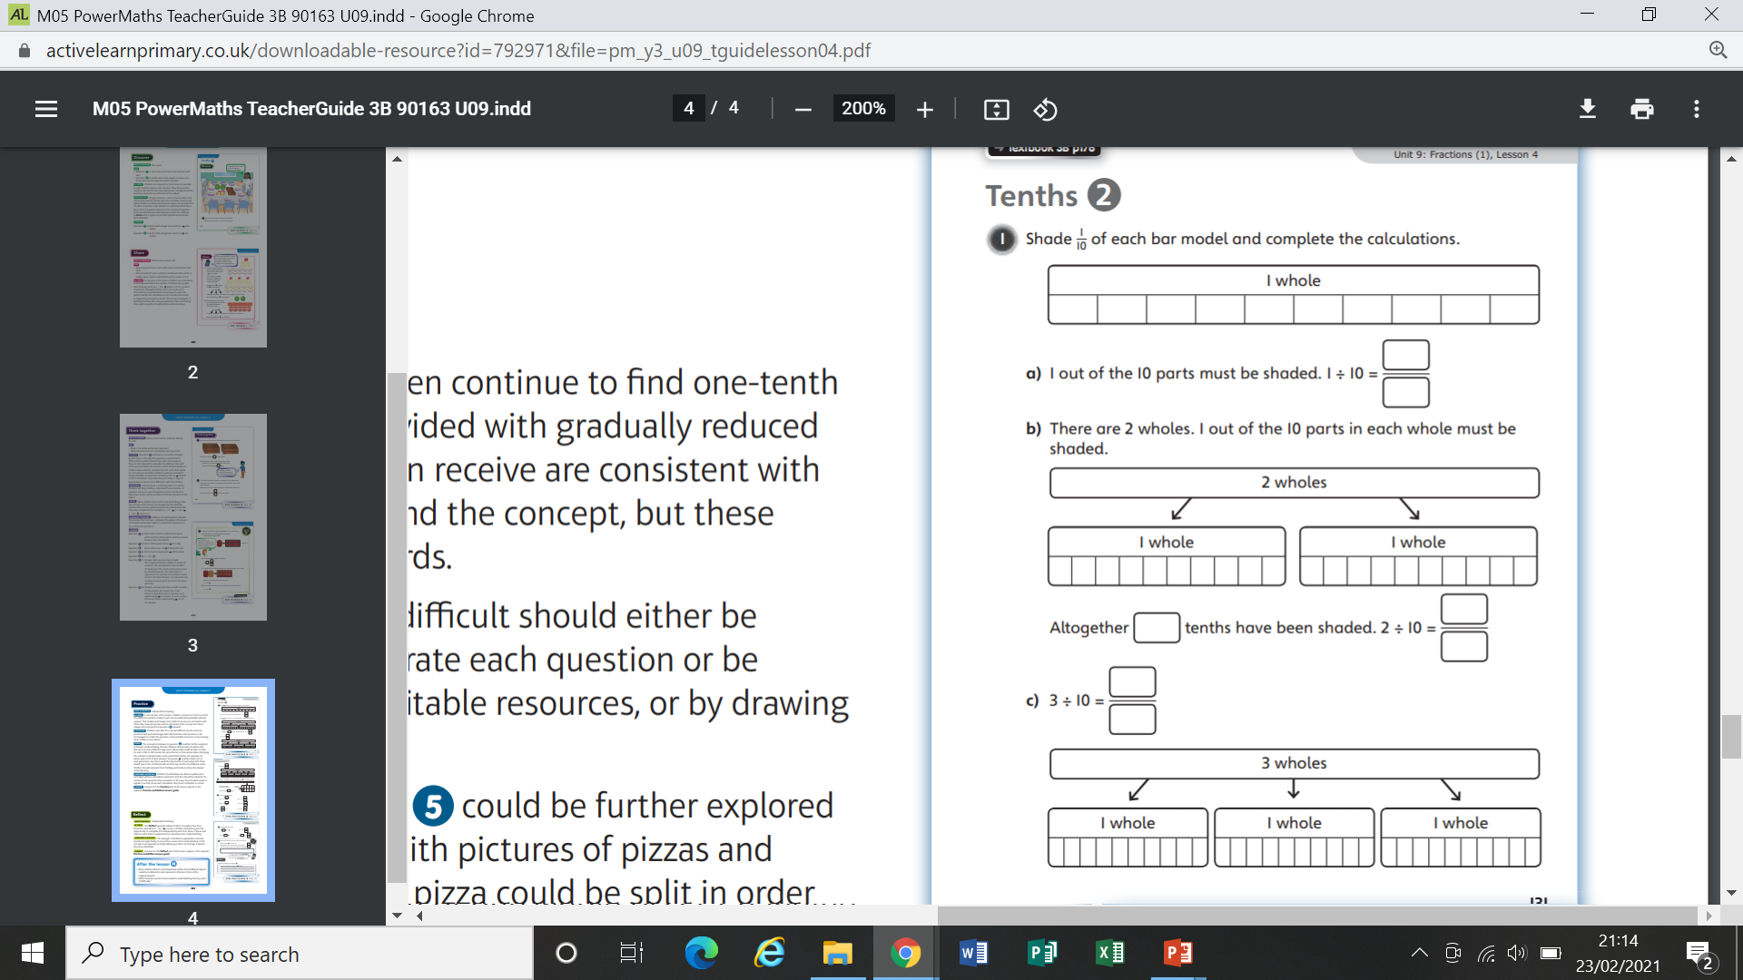
Worksheet

Slide 8
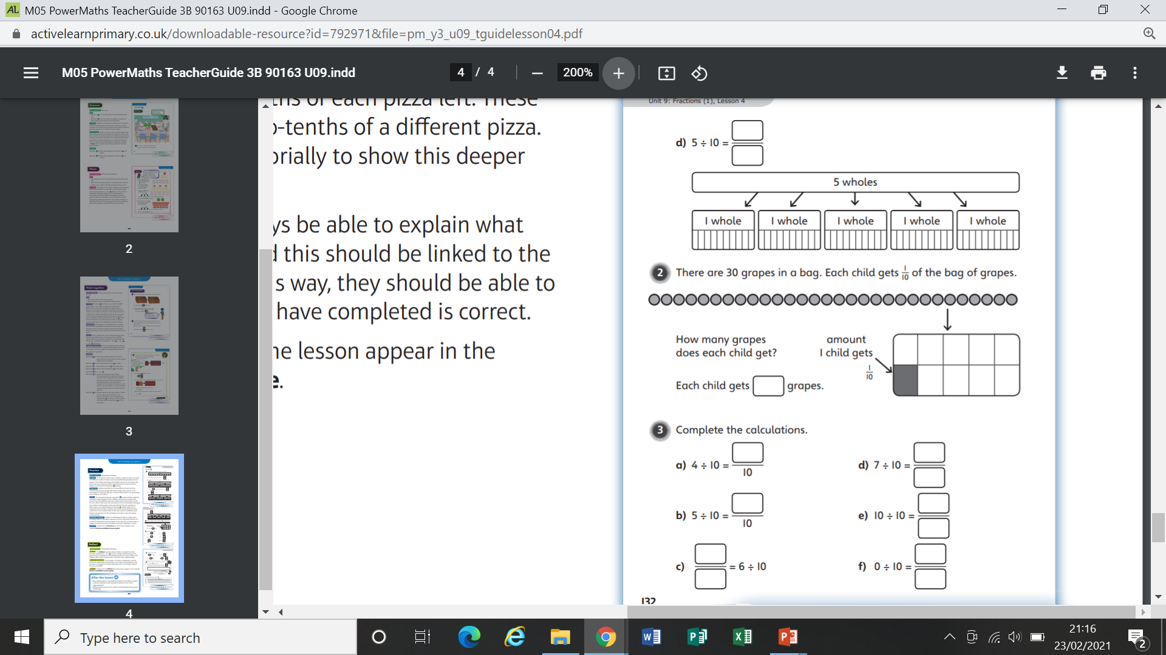
Worksheet

Slide 9
Worksheet

Slide 10
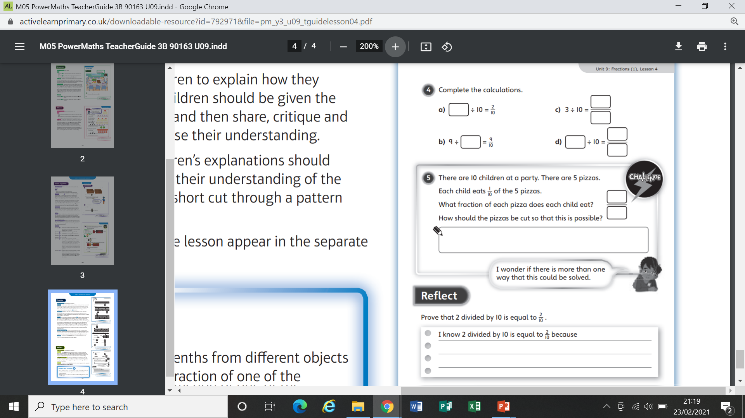
Worksheet

Slide 11
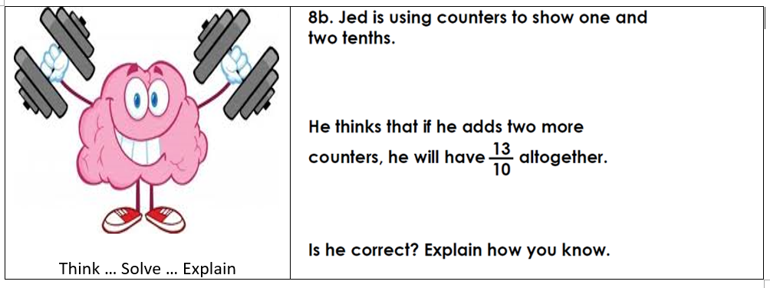

Slide 12
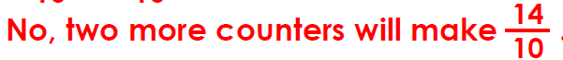
Answer

