Slide 1


Slide 2
3.3.21
LO: Understanding Tenths

Slide 3
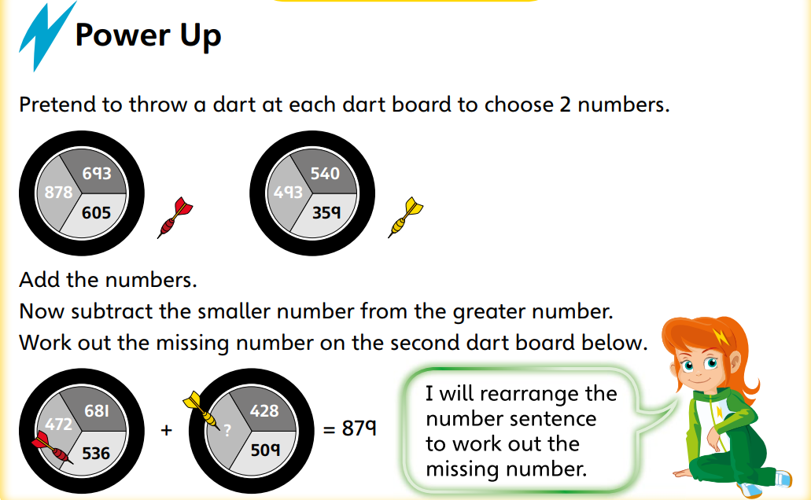

Slide 4
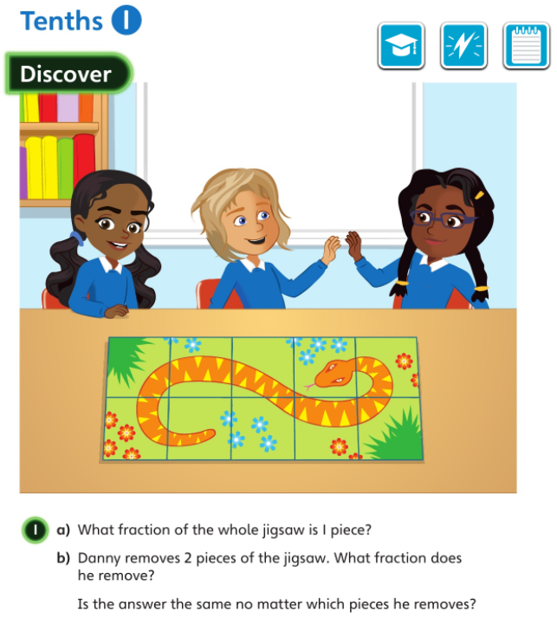

Slide 5


Slide 6
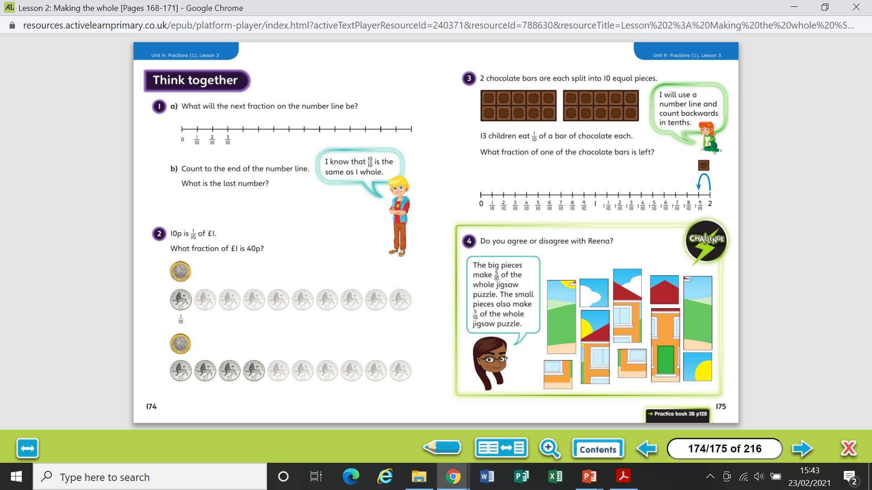

Slide 8
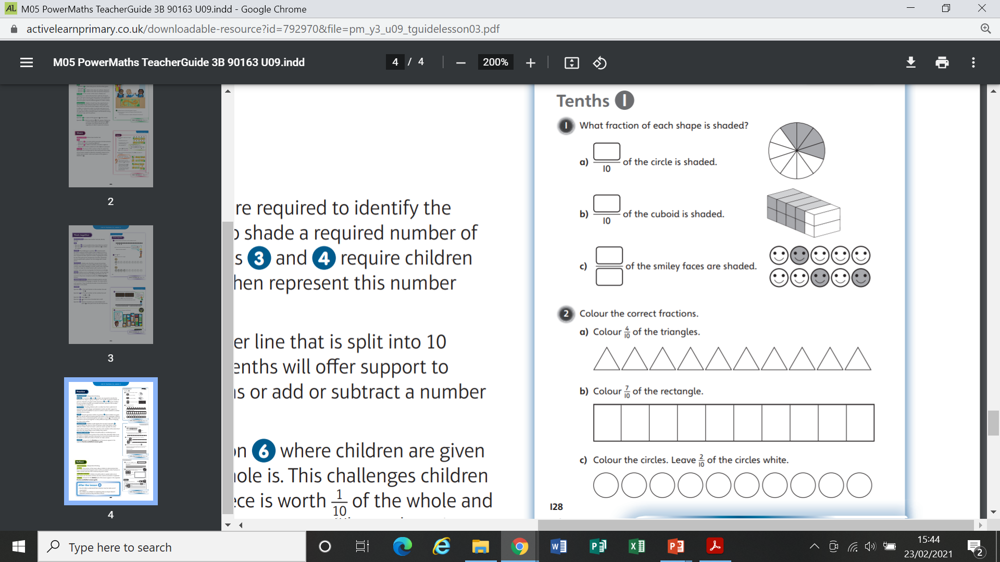
Worksheet

Slide 9
Worksheet

Slide 10
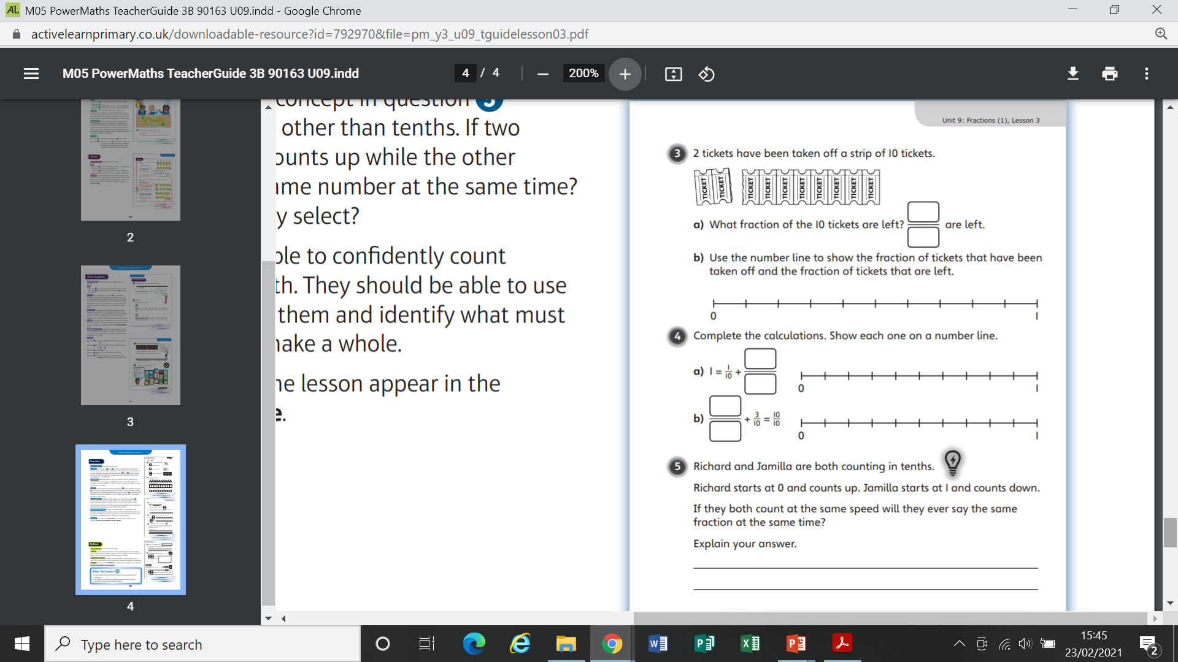
Worksheet

Slide 11
Worksheet

Slide 12
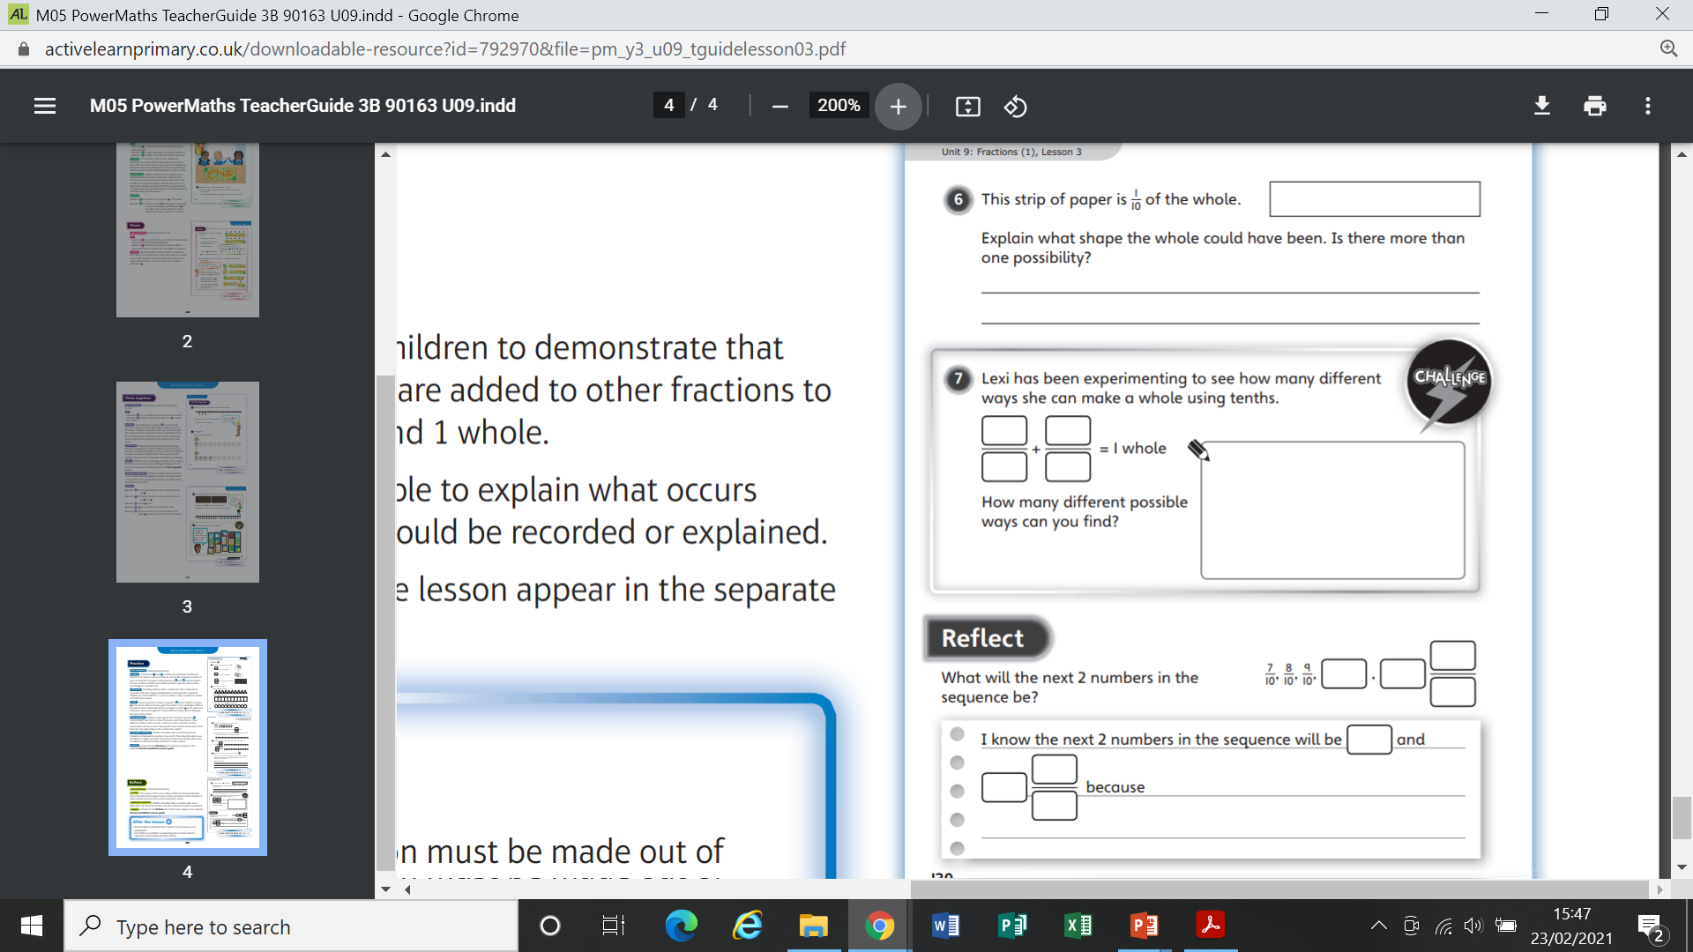
Worksheet

Slide 13
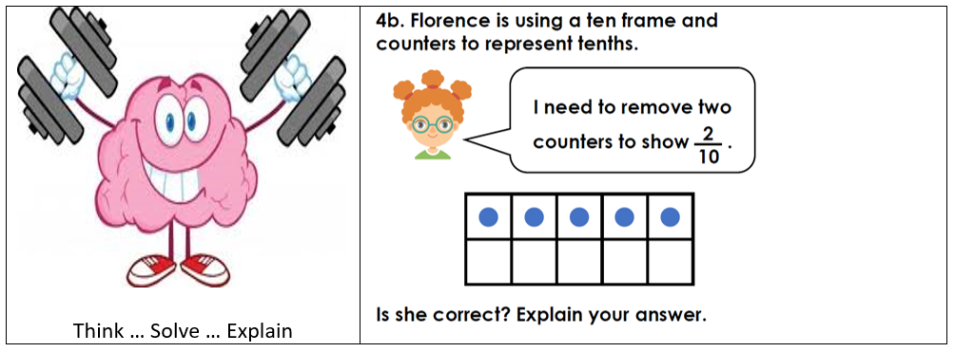

Slide 14
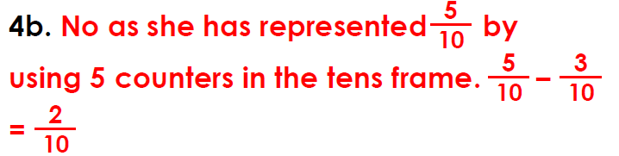
Answer

