Slide 1


Slide 2
12.3.21
LO: Understand unit and non-unit fractions.

Slide 3
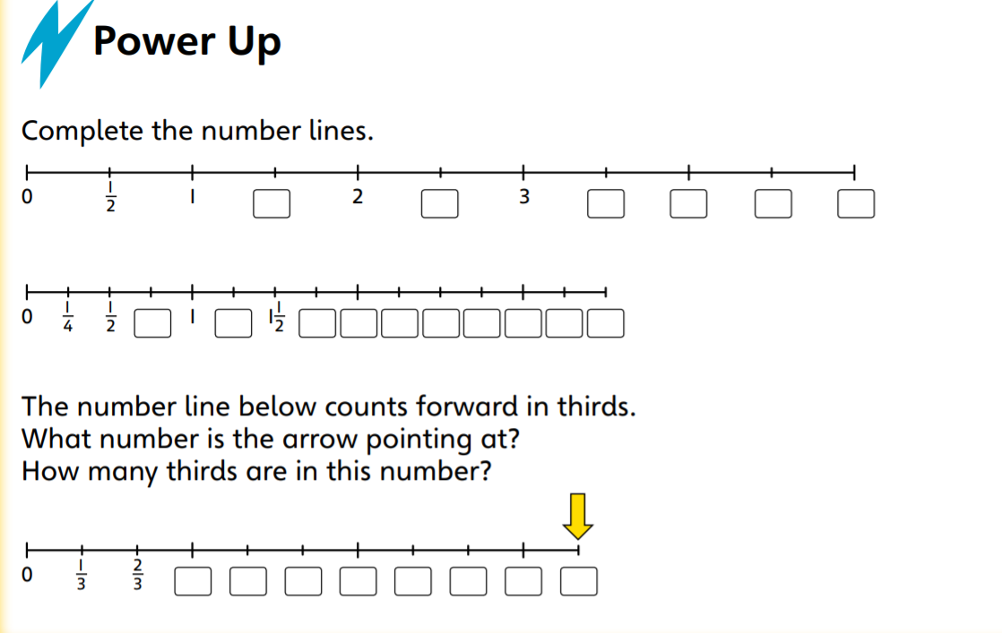

Slide 4
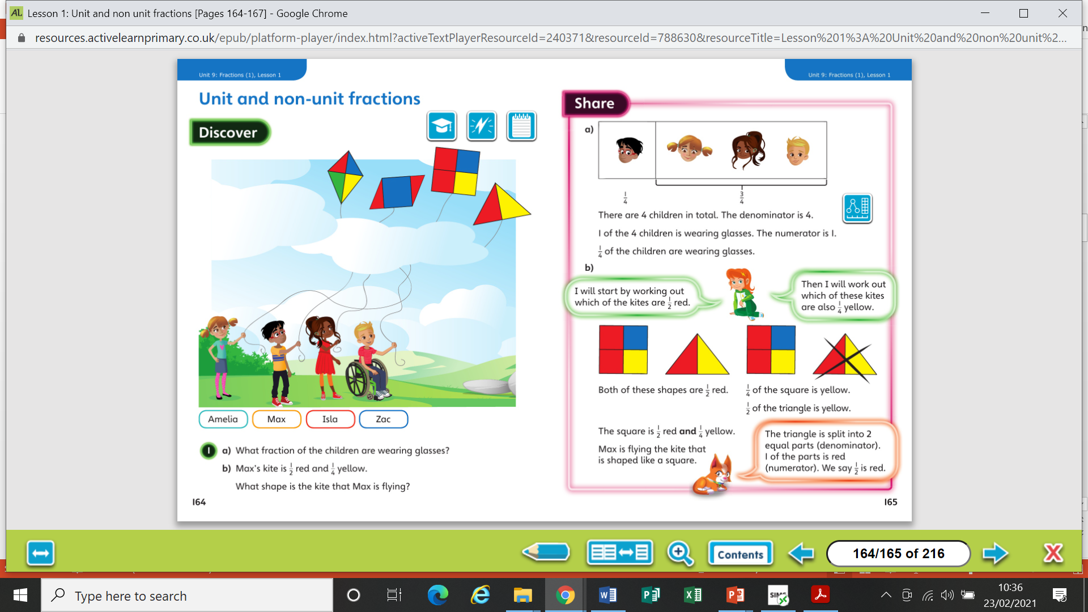

Slide 6
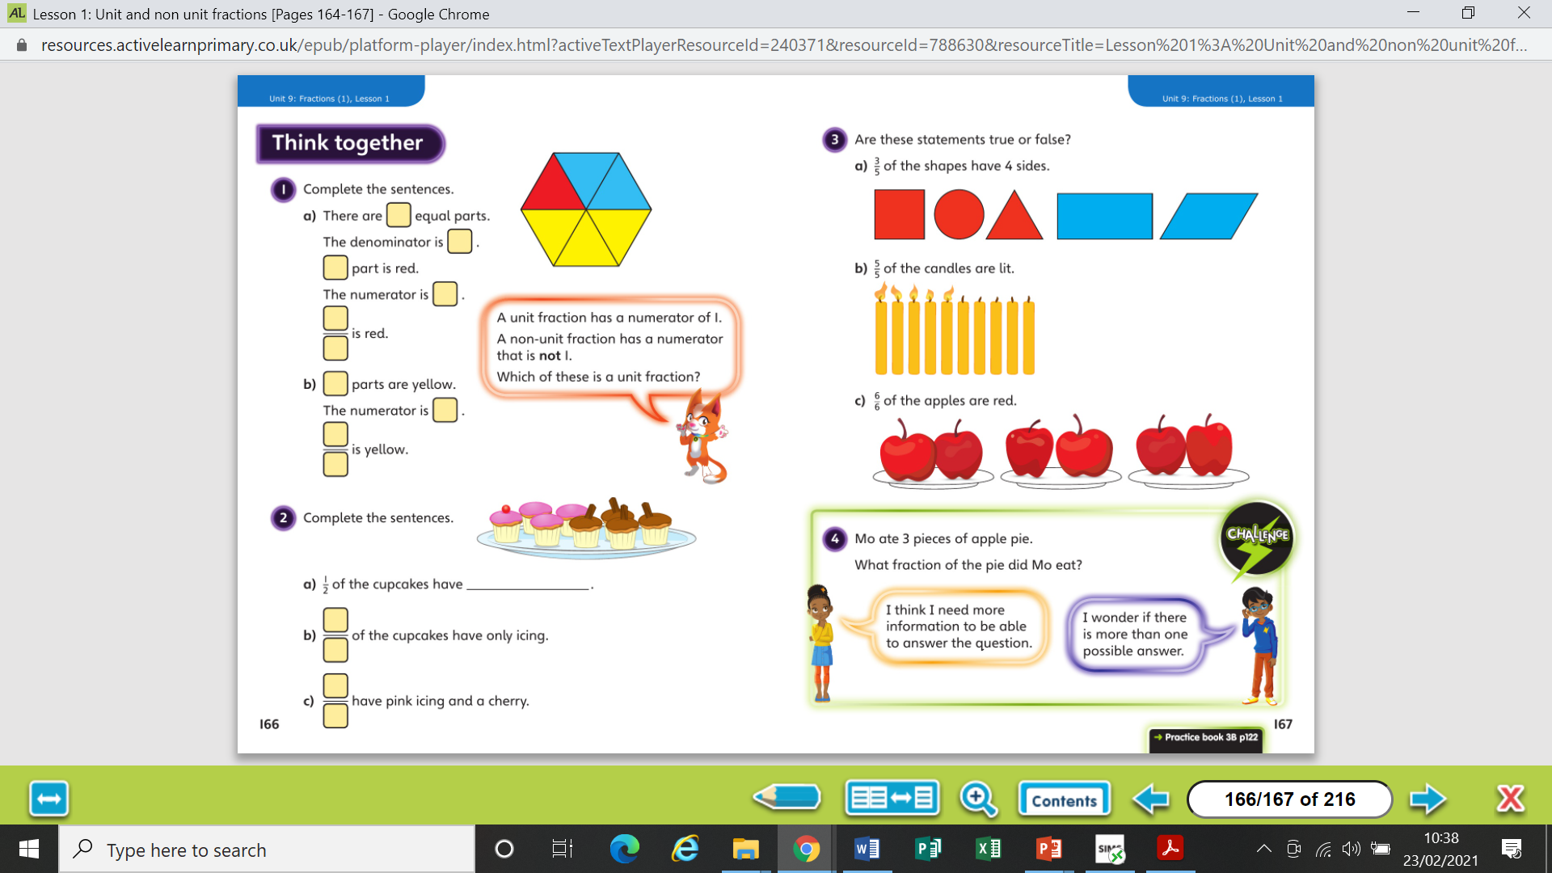

Slide 8
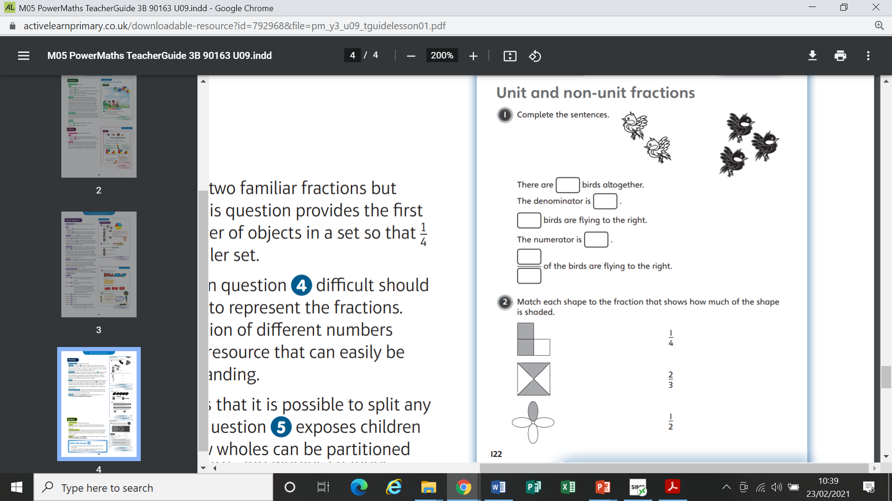
Worksheet

Slide 9
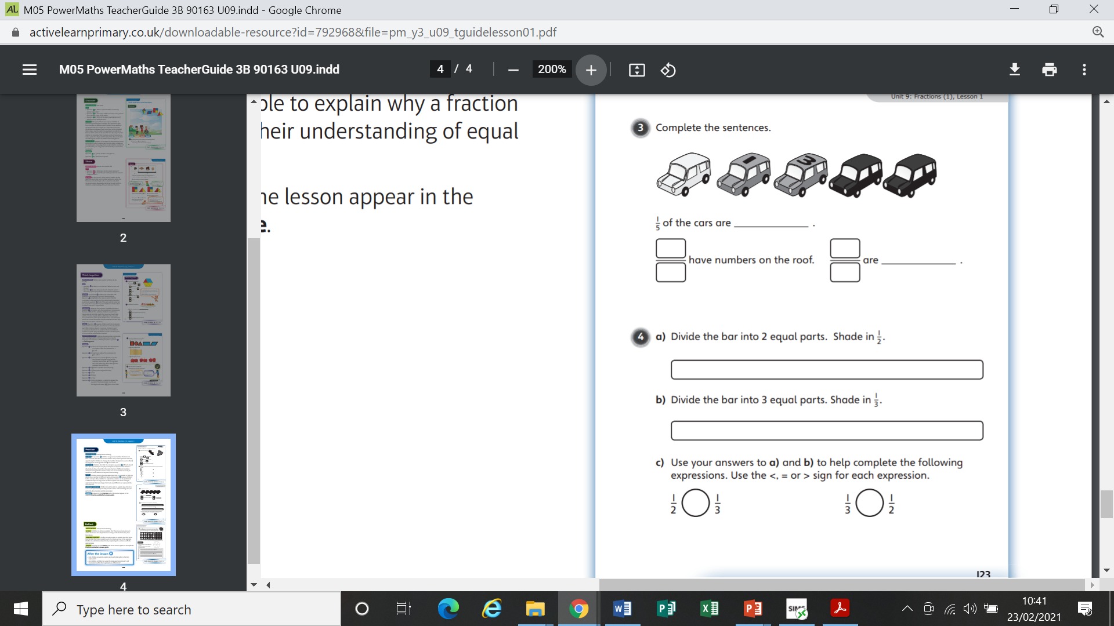
Worksheet

Slide 10
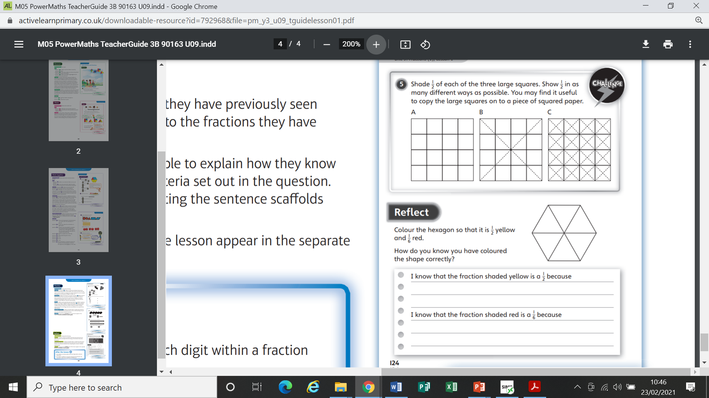
Worksheet

Slide 11
Worksheet

Slide 12
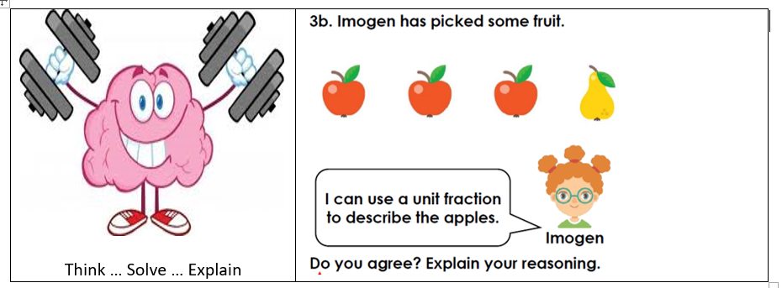

Slide 13
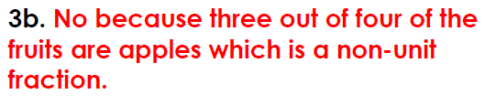
Answer

