Slide 1
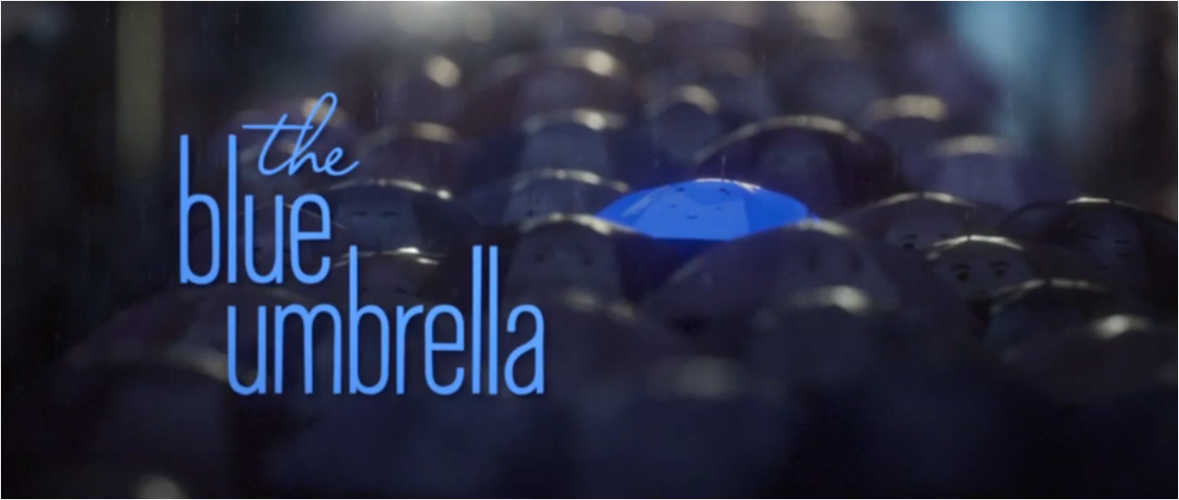

Slide 2
Let’s enjoy the Blue Umbrella together…
https://prettybird.co/us/talent/collaborators/saschka-unseld/work/the-blue-umbrella/

Slide 3
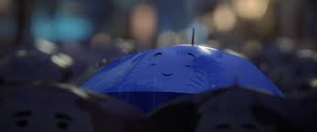
Day 1

Slide 4
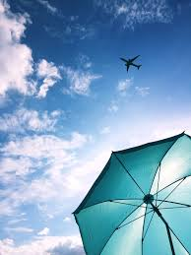
The search begins
Action sentence
Personification
Alliteration

Slide 5
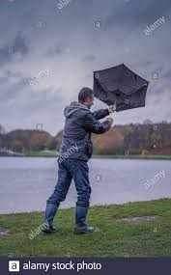
Action sentence
Blue made a snap decision. He wriggled and shook himself free, twirling away into the sky in search of his
crimson love.

Slide 6
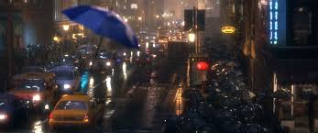
https://www.youtube.com/watch?v=VqBZMR83wCg
Personification
Pirouetting gracefully among silent, concrete giants, he looked down at the twinkling lights of the frenzied city below.

Slide 7
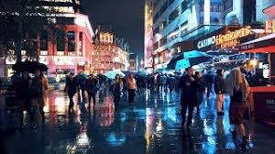
Alliteration https://www.youtube.com/watch?v=zVQQlD__HnI
Far below him, horns were hooted harshly, footsteps fell frantically and buses braked busily.

Slide 8
Day 2

Slide 9
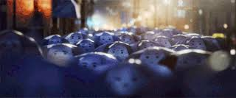
In the way of the traffic
Repetition for effect
Personification
Complex sentence

Slide 10
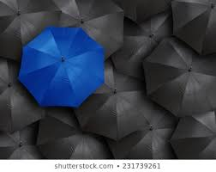
Repetition
Closer, closer, closer still. Whoosh! The lorry blasted Blue away

Slide 11
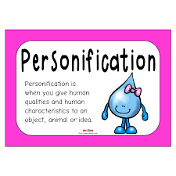

Slide 12
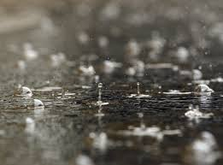
Personification
The angry, glaring eyes of a taxi startled him as he hurtled out of harm’s way at the last possible moment.

Slide 13
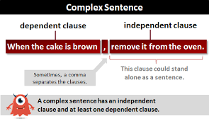

Slide 14
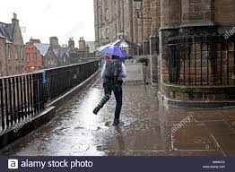
Complex sentence
Landing in a puddle, and with barely a chance to catch his breath, Blue was swept away by a mouthful of freezing water from the gutter.

Slide 15
Day 3

Slide 16
Crash! Is this the end for Blue?
Simile
Adjectives
Onomatopoeia

Slide 17
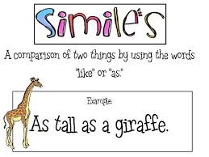

Slide 18
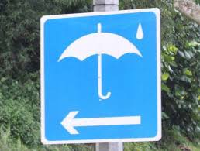
Simile
Quick as the flick of a footballer’s kick, the road sign pushed him clear.

Slide 19
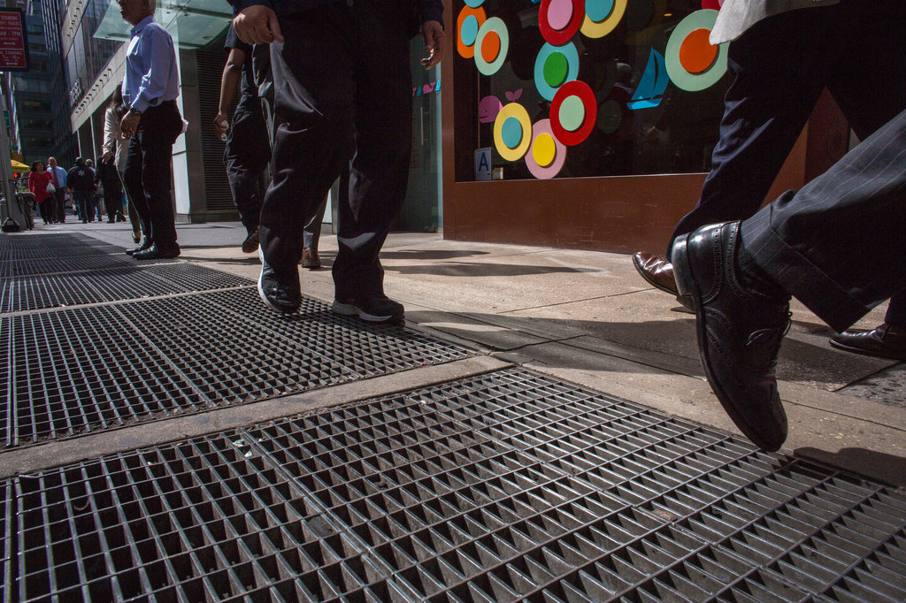
Adjectives
In a last-ditch attempt to save Blue, a well-meaning vent gave an almighty puff – propelling him skywards into oncoming traffic.

Slide 20
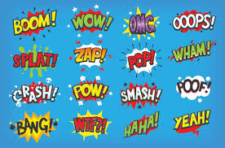

Slide 21
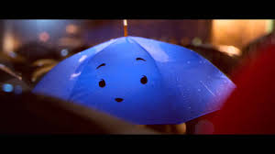
Onomatopoeia https://www.youtube.com/watch?v=fZV7rwZ8xaA
Whoosh! Screech! Splat! The world turned black.

Slide 22
Day 4

Slide 23
Feeling defeated
Sounds
Feelings
Dialogue

Slide 24
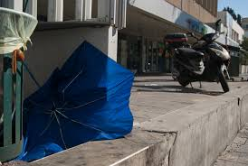
Sounds
From the gutter, his silence was broken by the cold droning of the traffic.

Slide 25
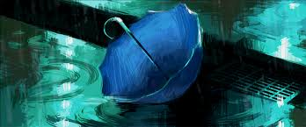
Feelings
Dazed and confused, the world came back into focus; he felt desolate.

Slide 26
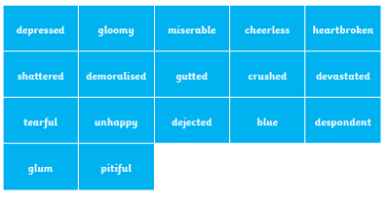

Slide 27
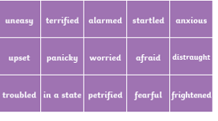

Slide 28
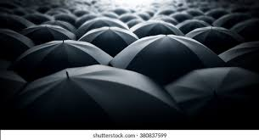
Dialogue https://www.youtube.com/watch?v=uoE9ET6CtaI
Looking around him, Blue searched for any flash of red in the crowd. “I’ve lost her, she’s gone,” he exhaled sadly

Slide 29
Day 5

Slide 30
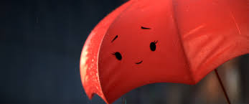
Red to the Rescue
Precise Verb
Synonym
Adverb

Slide 31
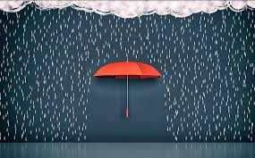
Precise Verb
His heart leapt as he saw his rescuer.

Slide 32
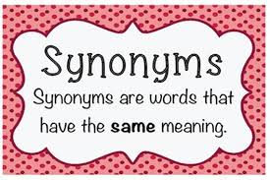

Slide 33
Synonym https://www.youtube.com/watch?v=-9YvRfg-ebg
Under the protective gaze of Red’s caring canopy, Blue was enveloped in a soft, purple glow.

Slide 34
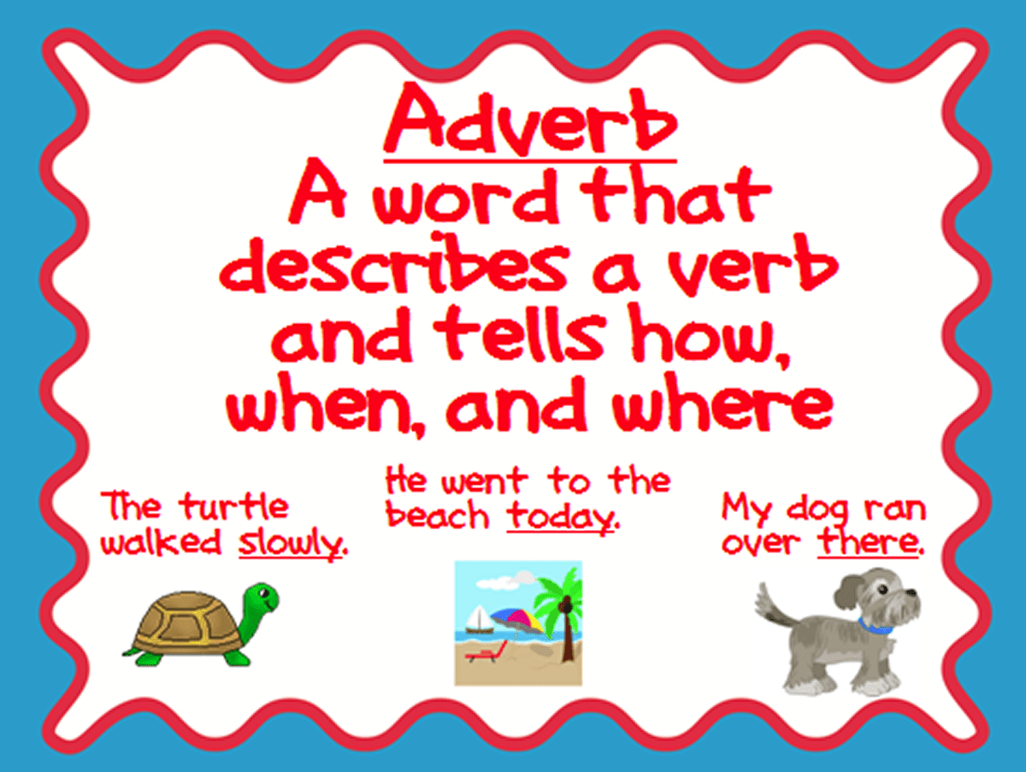

Slide 35
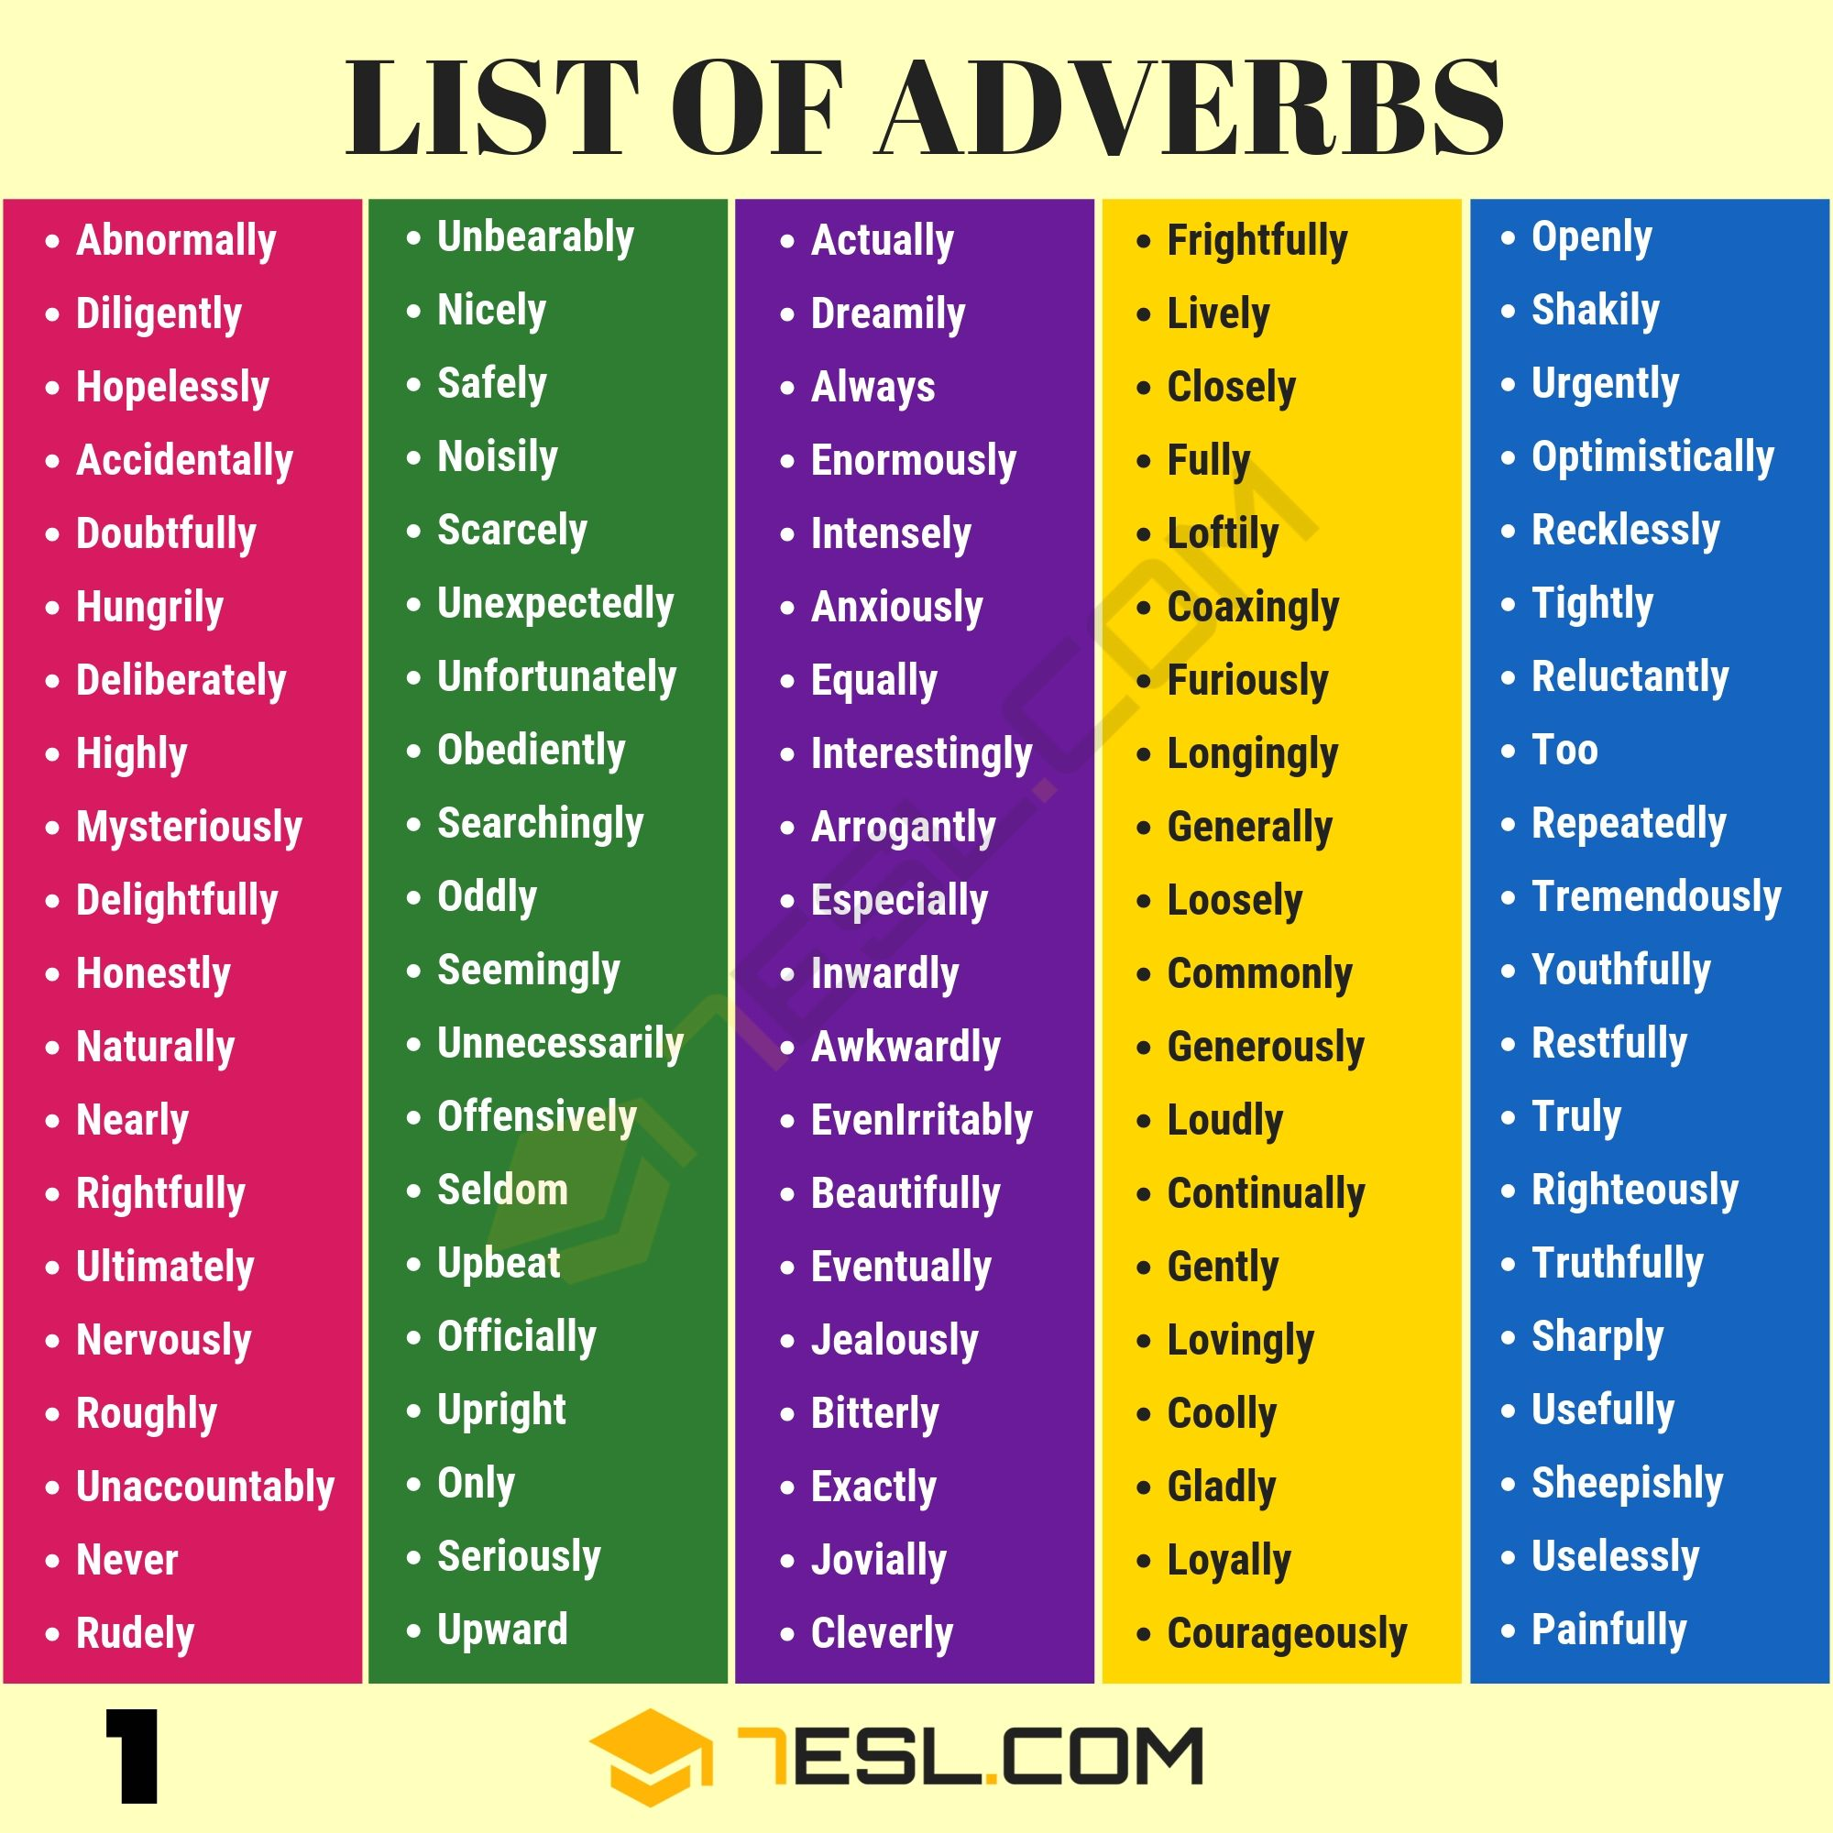

Slide 36
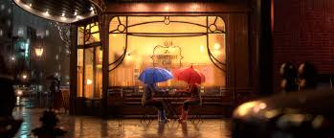
Adverb
Finally, sitting in the haven of a warm and cosy café. Blue’s cheek gently brushed against Red’s.

