Slide 1
Lesson 5

Slide 2
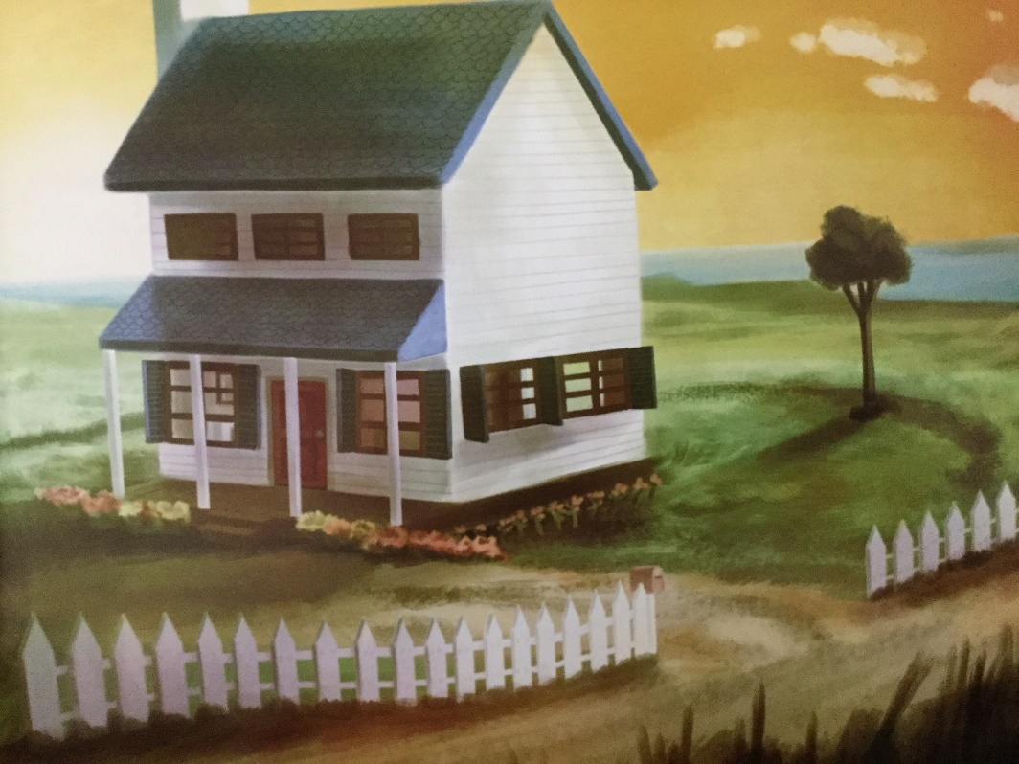
Create an adverbial phrase to show time has passed.
Two years later, after months of hard work, the house was as good as new.

Slide 3
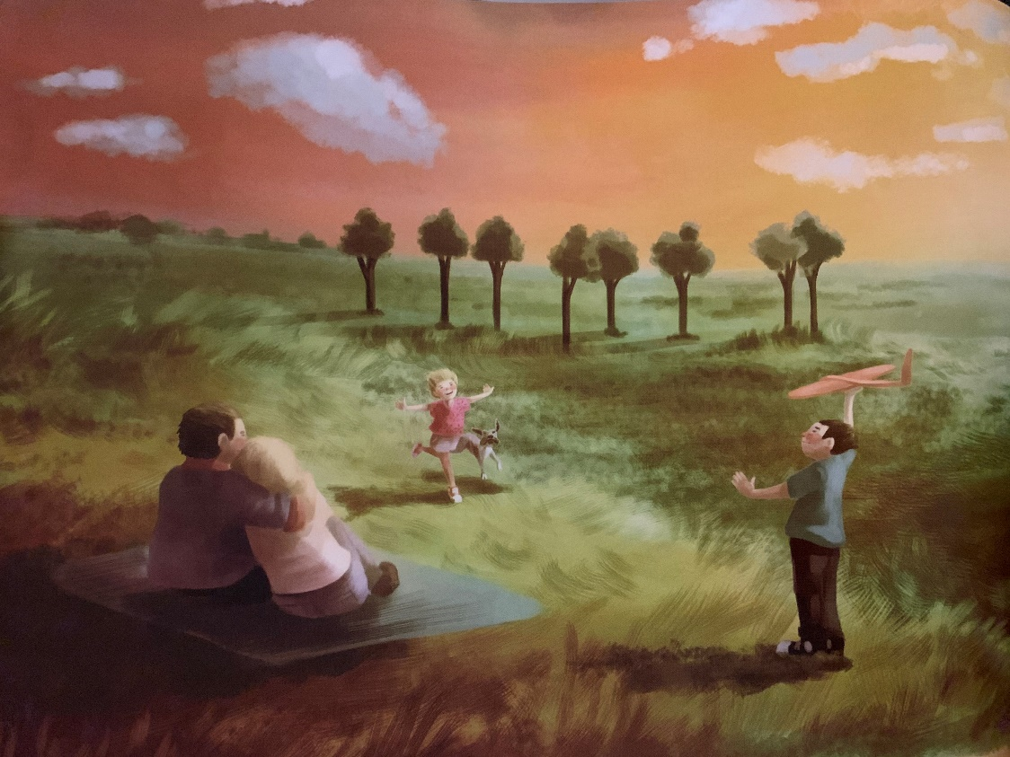
Create a noun phrase.
Under the sun-kissed skies, Dad hugged mum tight.

Slide 4

Create a topping and tailing effect.
Giggling in the field, a family played – a boy with a red aeroplane, a laughing girl and a loyal dog. As the crow glided away, it saw a house with a blue roof, white timber and surrounded by flowers. Above the patchwork landscape, the crow knew they had done it.

