Slide 1
Lesson 4

Slide 2
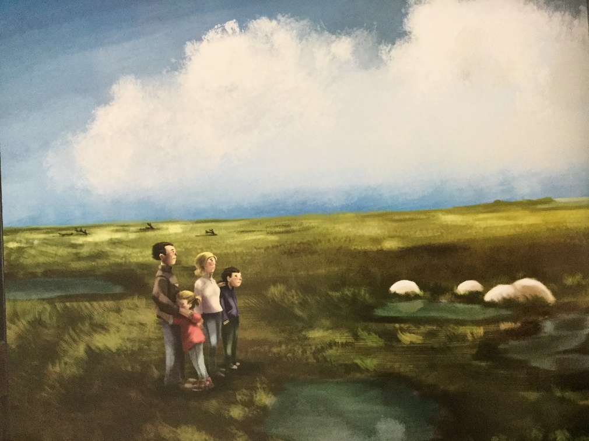
Create feeling sentence.
Sophie turned away as a tear of devastation rolled down her cheek.

Slide 3
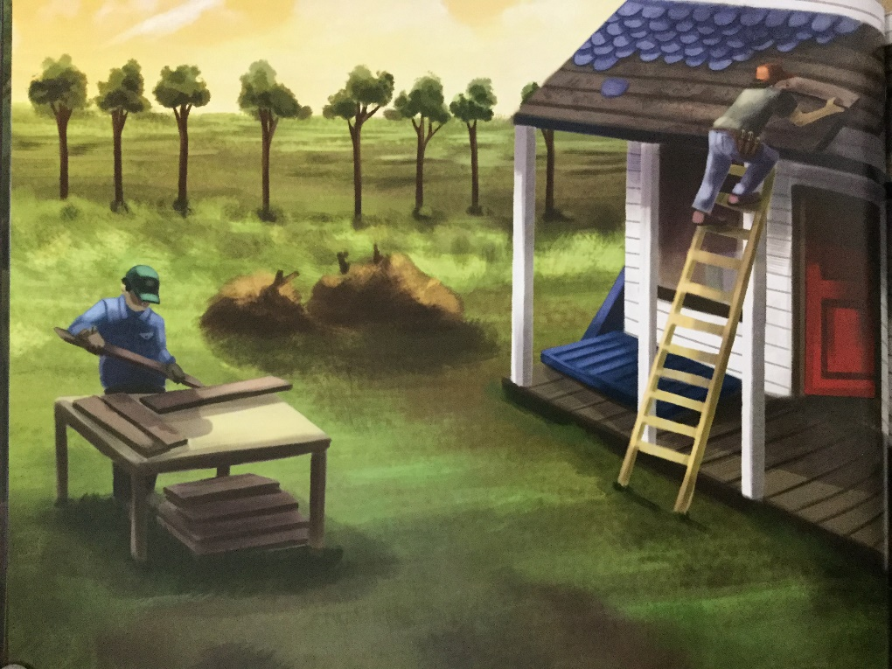
Create a complex sentence.
If they could fix the tiles on the rood, if they could paint the timber white, if they could plant new trees, then it would be a home again.

Slide 4
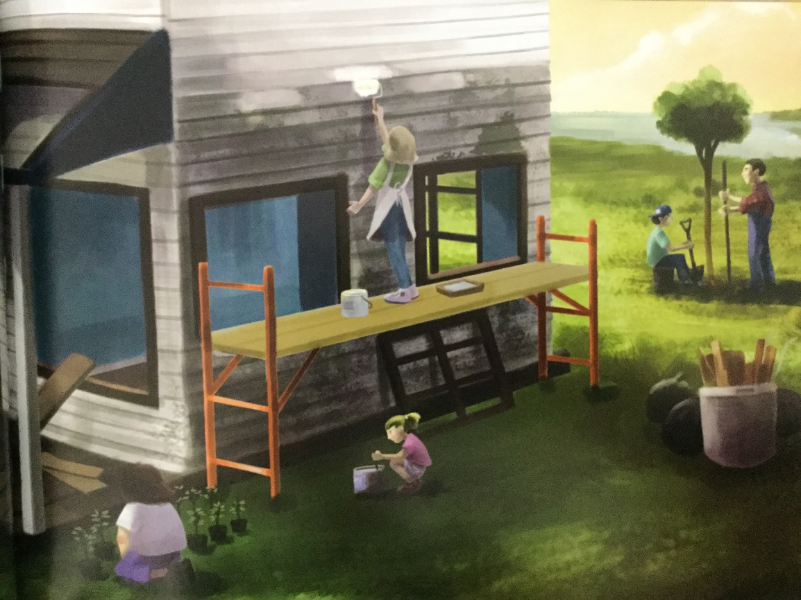
Create an inflected question.
Sophie asked, “We’re really going to do this, aren’t we?”

Slide 5

https://www.youtube.com/watch?v=kXsYqIQ6lRw
Create a sound sentence.
As Sophie stirred the paint, she listened to nails being hammered, wood being sawed and contented whistling, and that was her reply.

