Slide 1
Lesson 3

Slide 2
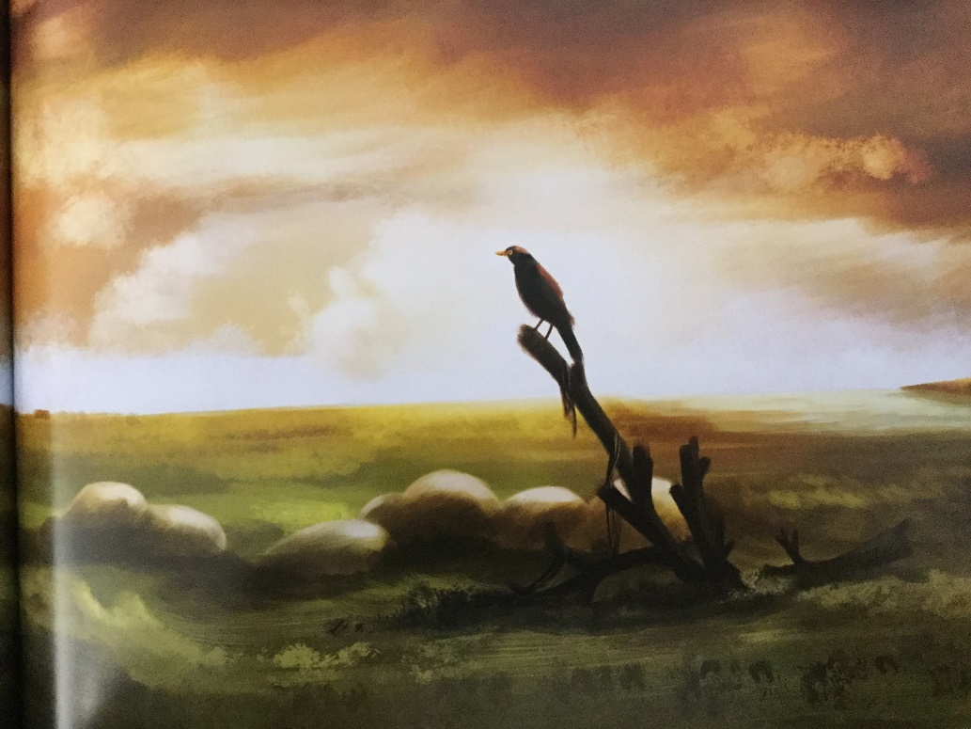
Create sentence with repetition.
The crow looked. The crow watched. The crow stared.

Slide 3
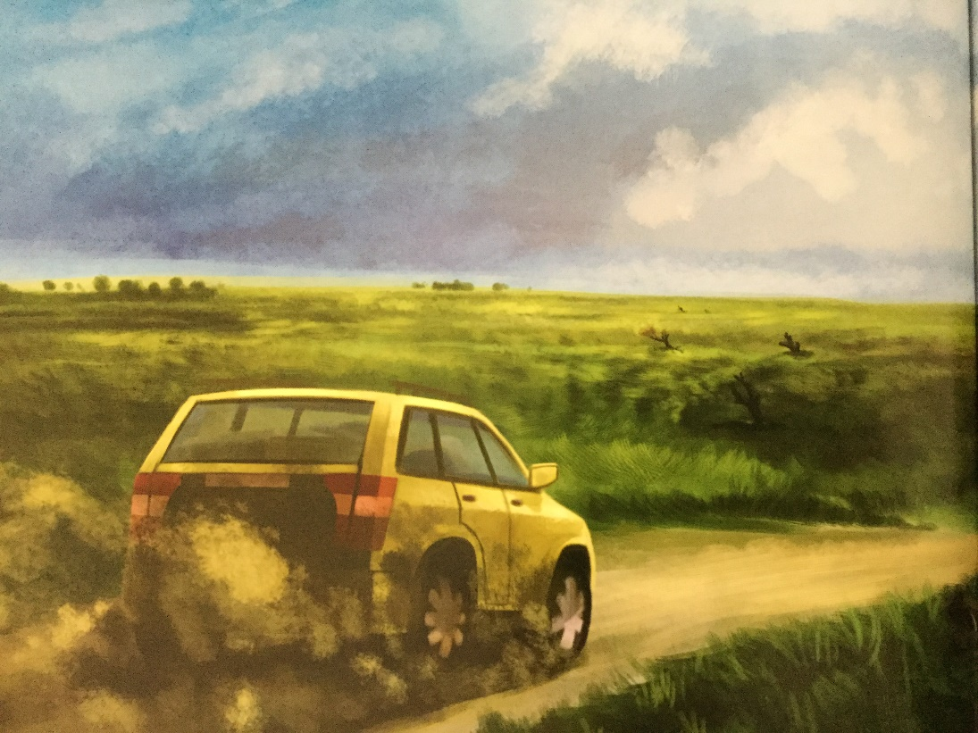
Create a complex sentence.
As the sun rose, the family returned to assess the damage and the crow flew away.

Slide 4
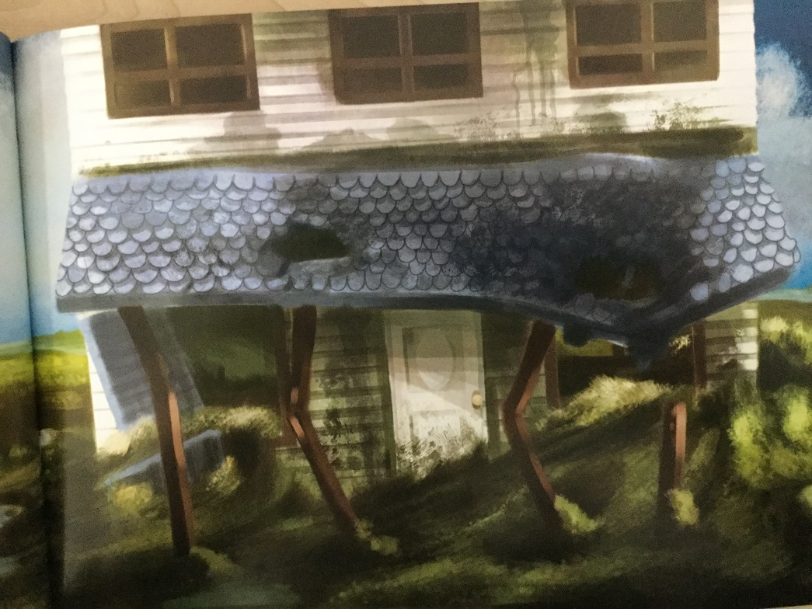
Create a complex sentence with alliteration.
Dismayed by the devastation, the family surveyed their broken, bruised and damaged house.

Slide 5
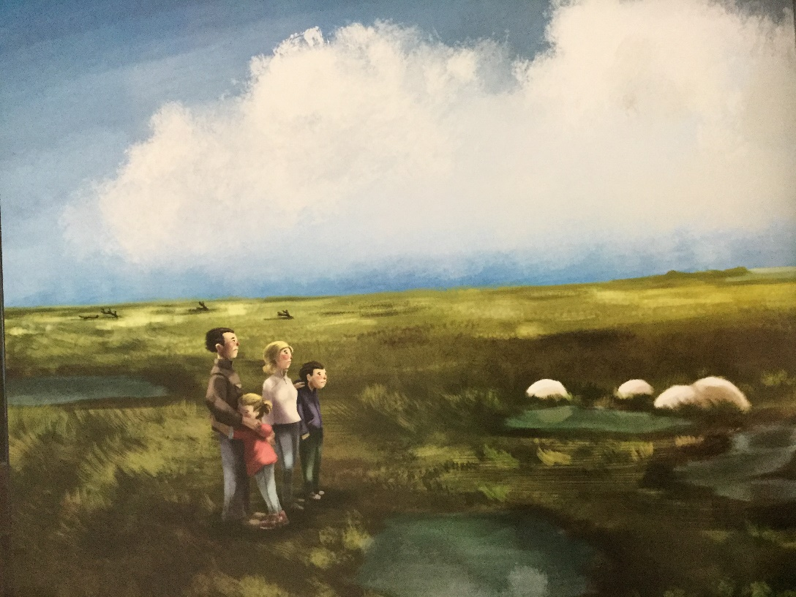
Create water imagery.
Puddles of despair surrounded them.

