Slide 1
Lesson 2

Slide 2
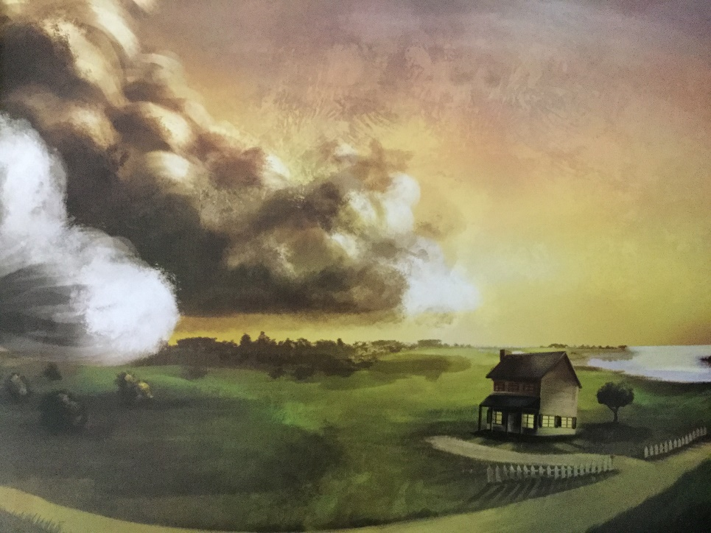
Create a personification sentence for the scene.
The storm wrenched the trees from their roots, punched holes in the rood and kicked the walls to smithereens.

Slide 3
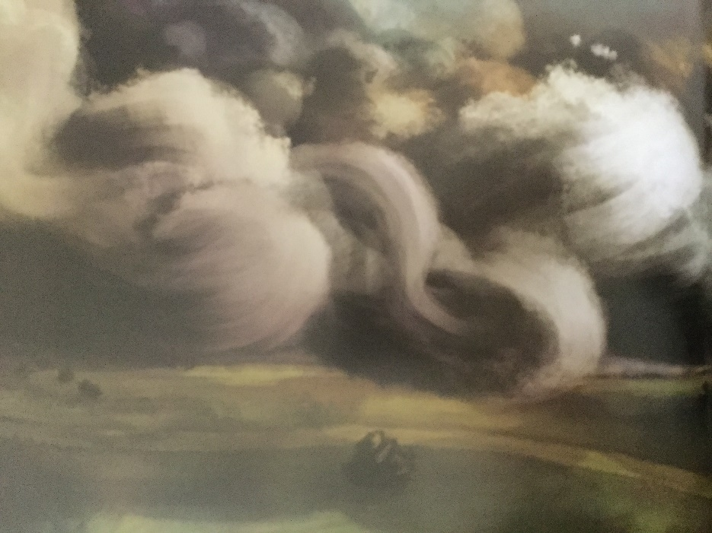
Create a synonym sentence. (They have used different synonyms for ‘grey’ in this sentence.
In the darkening sky, graphite turned to slate, slate turned to pewter, pewter turned to charcoal.

Slide 4
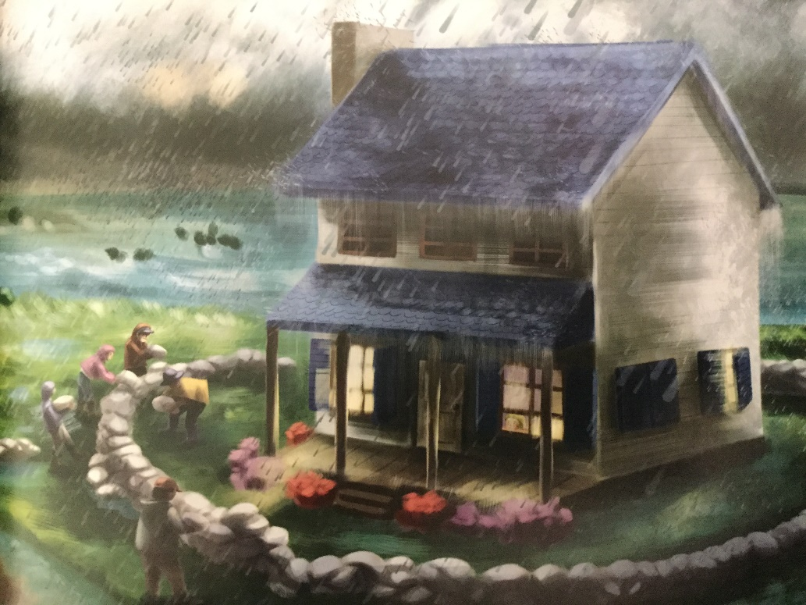
Create a one word exclamation sentence.
“Enough!” the house cried out to the unforgiving storm.

Slide 5
Create a one word exclamation sentence.
“Enough!” the house cried out to the unforgiving storm.

