Slide 1
LO: A Hindu life: what is important?

Slide 2
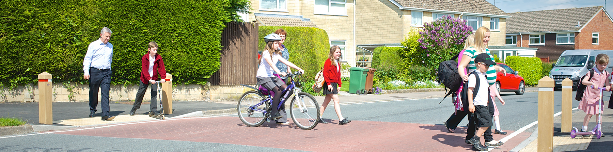
Discuss
In pairs tell each other your journey to school, from waking up to sitting down this morning.
Do you always eat the same breakfast?
Was anything lost this morning?
Did anything funny happen?
Do you always take the same route?

Slide 3
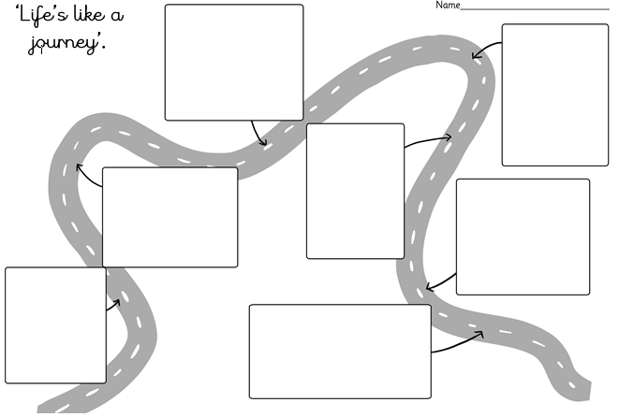
Some people talk of life as a journey.
Is there anything you have to do in order to achieve these future steps- practice, try hard, listen carefully etc.

Slide 4
Duties and responsibilities
The metaphor of life as a journey can be used about Hindu aims and duties.
Aims: Look at your life path- What are the aims on your journey map? Can you identify any other aims? (e.g. get married, be happy, drive a car, particular job?
Duties: What duties do you have at home and at school? (e.g. chores and tidying up).
Write duties that will always be important on the life path in another colour.

Slide 5
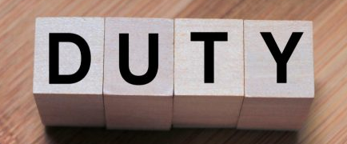
Dhrama
Means ‘duty’ in Hinduism.
Duties:
Not getting angry.
Being truthful in speech.
Working for justice.
Forgiving people.
Having children when you are married.
Trying not to quarrel (argue).
Living a simple life.
Looking after your family.
Fulfilling religious duties such as worship.
Study the scriptures.

Slide 6
Choose 1 of the duties and finish these sentences starters for each, in your book.
Chosen duty: _______________
It is important to fulfil this duty because…
This duty would help me because…
This duty would help my family because…
This duty would help my community because…

Slide 7
https://www.bbc.co.uk/programmes/p02n5v2q
Watch the video on the cycle of birth and rebirth.
Listen out for what ‘good karma’ and ‘bad karma’ means.

Slide 8
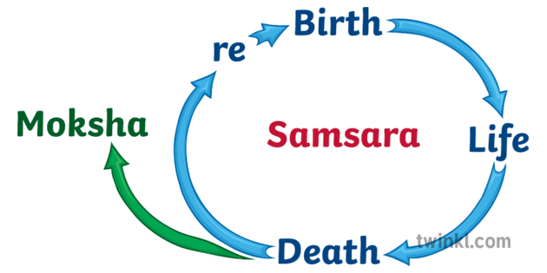
Moksha
Once you die, you are born again in another body and live another life. This is called reincarnation/ rebirth.
Eventually, Hindu’s hope to join God and not live any more lives, this is called ‘moksha’.

Slide 9

What are good and bad actions?
Think back to the Hindu duties you have learned about. This is what Hindus must do to be good and avoid to be bad.

Slide 10
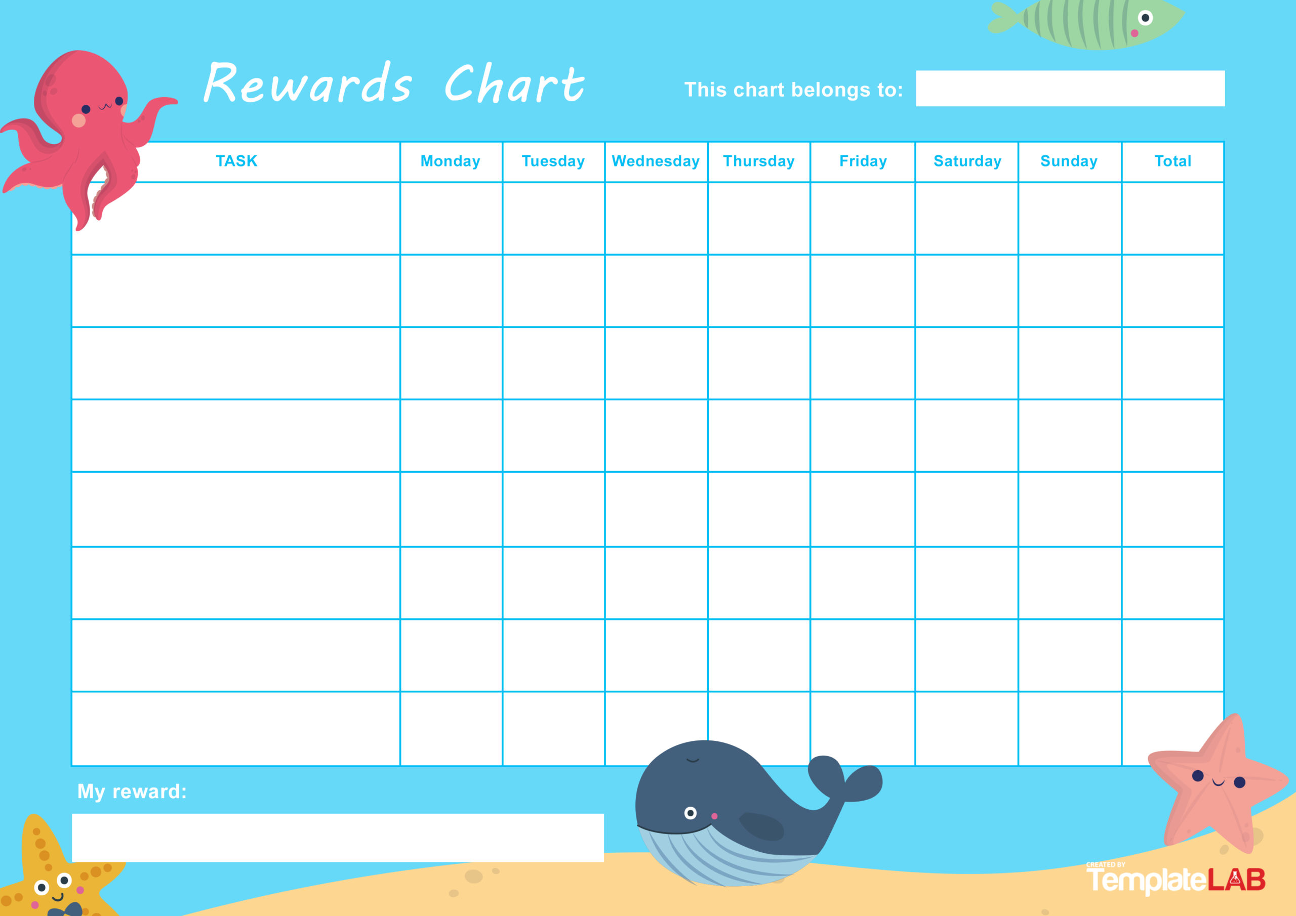
Good karma and bad karma
It’s like a reward chart. Every time a Hindu does a good actions they earn ‘good karma’ and every time they do something bad they earn ‘bad karma’.
Eventually. their karma dictates what life they will be born into next.

Slide 11
Draw a cycle of life like Vraj’s in the clip.
Then, write a sentence explaining the how Hindu’s believe the life cycle works.

Slide 12

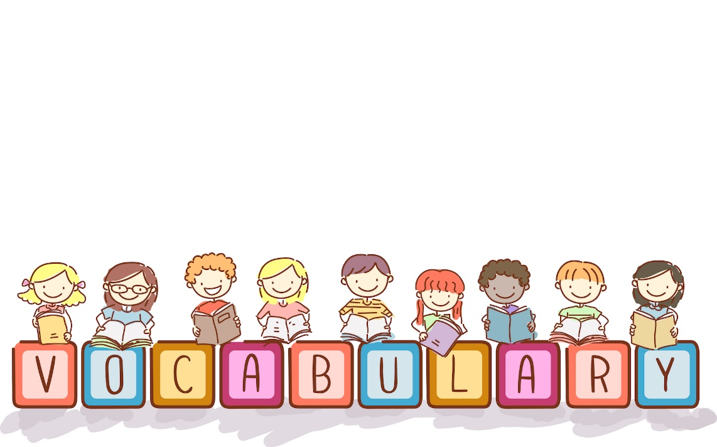
Match the definitions
Dhrama |  | Joining God and not living any more lives.
Moksha |  | Doing bad actions results in this.
‘good karma’ |  | Means ‘Duty’ in Hinduism.
‘bad karma’ |  | Doing good actions results in this.

