Slide 1
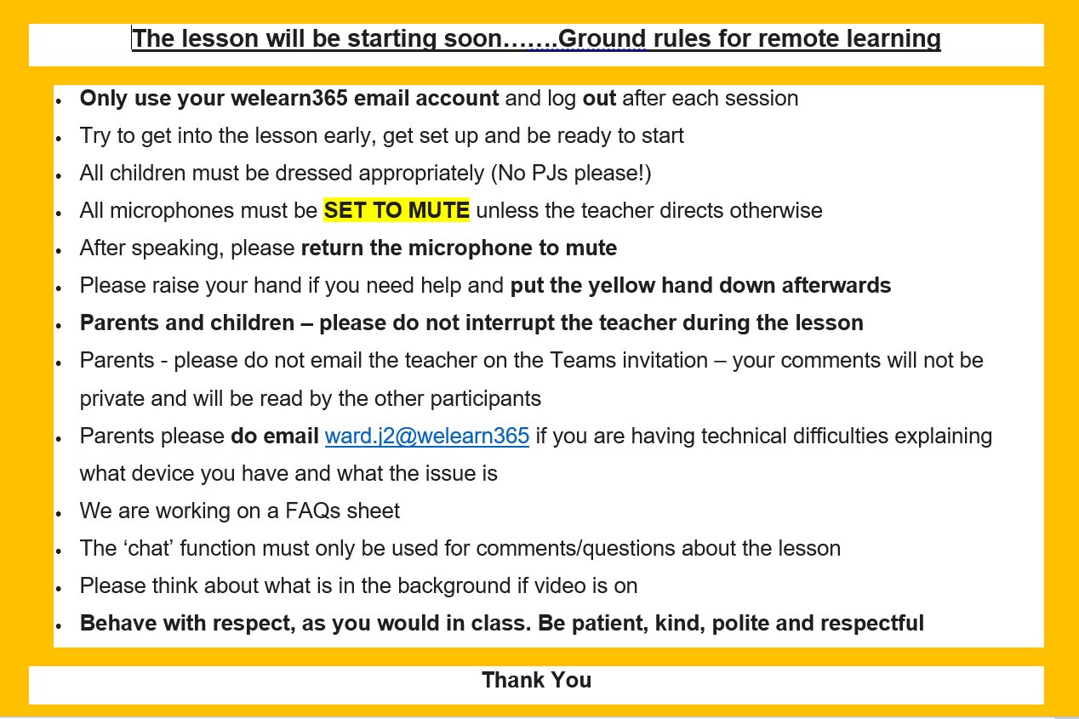

Slide 2
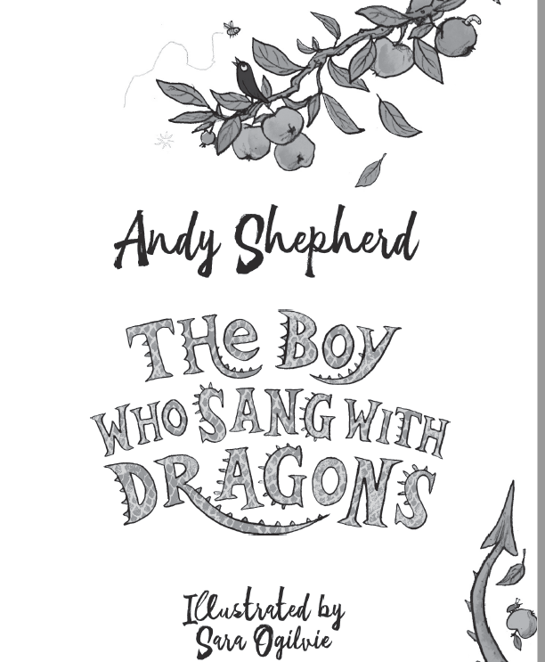

Slide 3
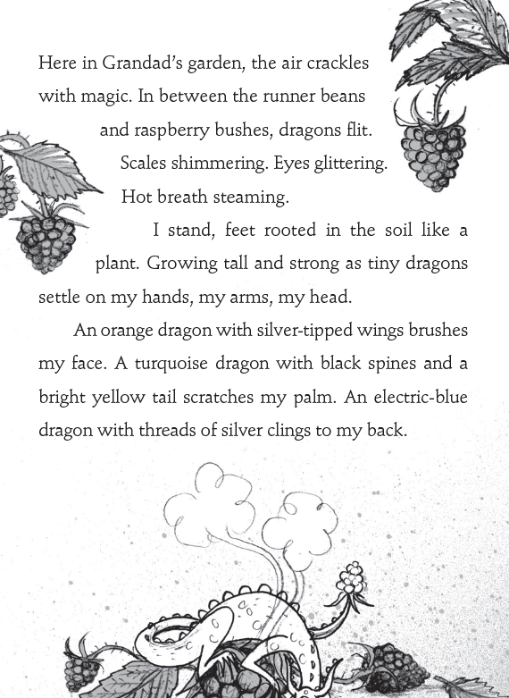

Slide 4
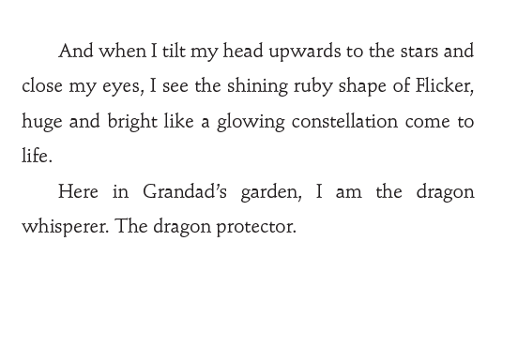

Slide 5
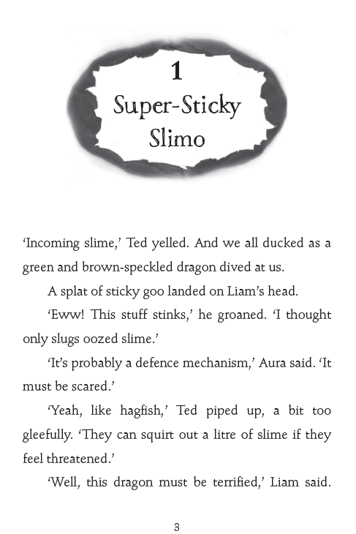

Slide 6
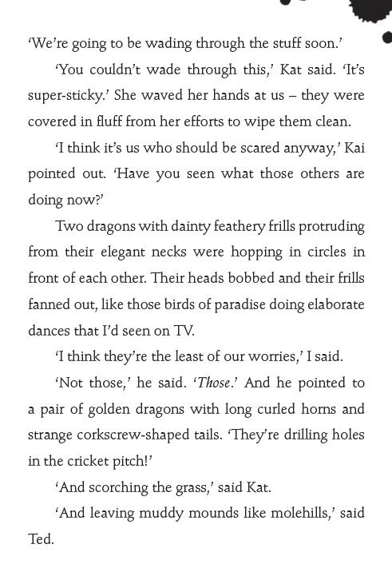

Slide 7
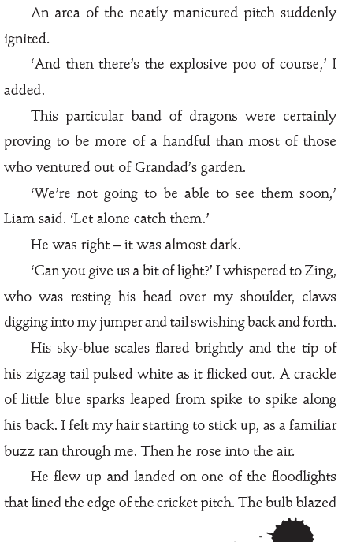

Slide 8
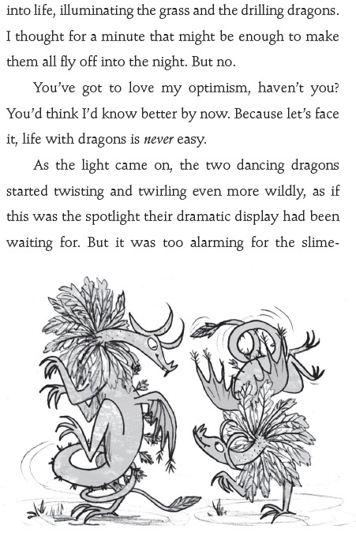

Slide 9
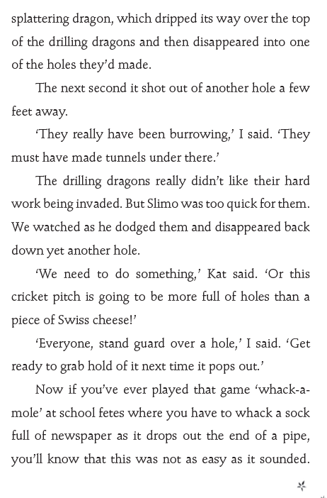

Slide 10
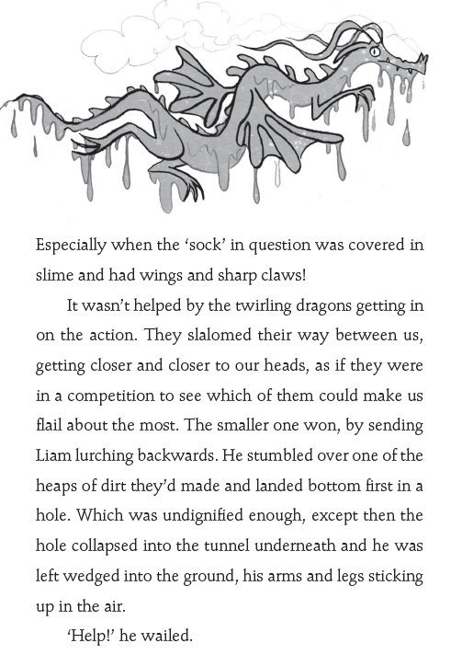

Slide 11
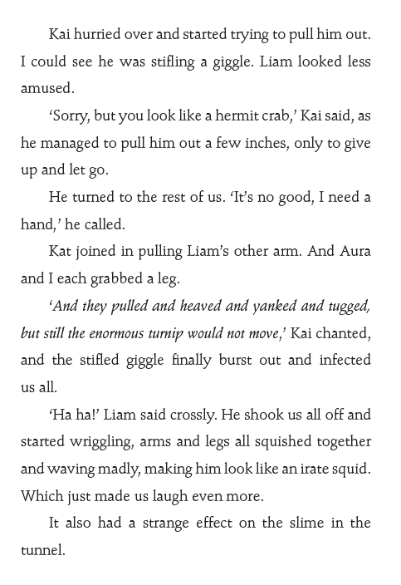

Slide 12
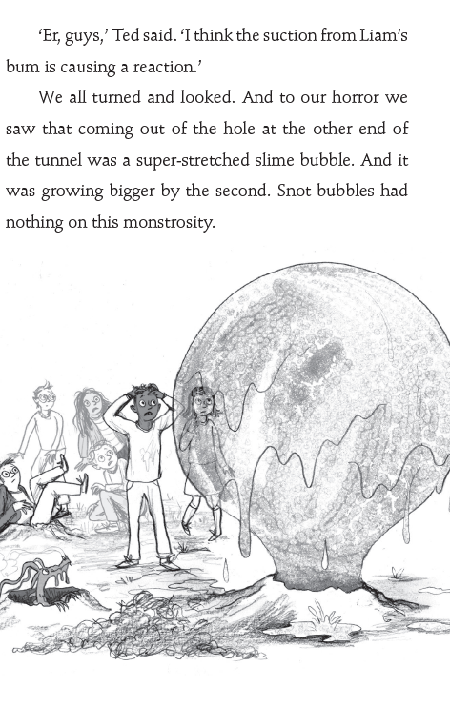

Slide 13
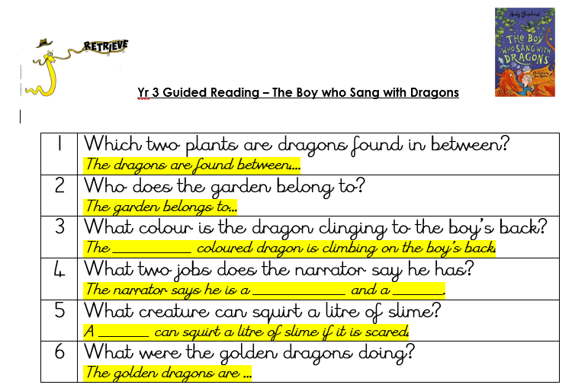

Slide 14
Answers
1 | Which two plants are dragons found in between? Runner beans and raspberry.
2 | Who does the garden belong to? Grandad
3 | What colour is the dragon clinging to the boy’s back? Electric blue with thread of silver.
4 | What two jobs does the narrator say he has? The dragon whisperer. The dragon protector.
5 | What creature can squirt a litre of slime? Hagfish
6 | What were the golden dragons doing? Drilling holes in the cricket pitch, scorching the grass and leaving muddy mounds like Molehills.

Slide 15
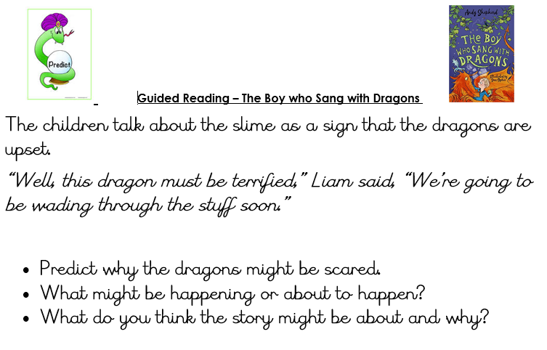

Slide 16
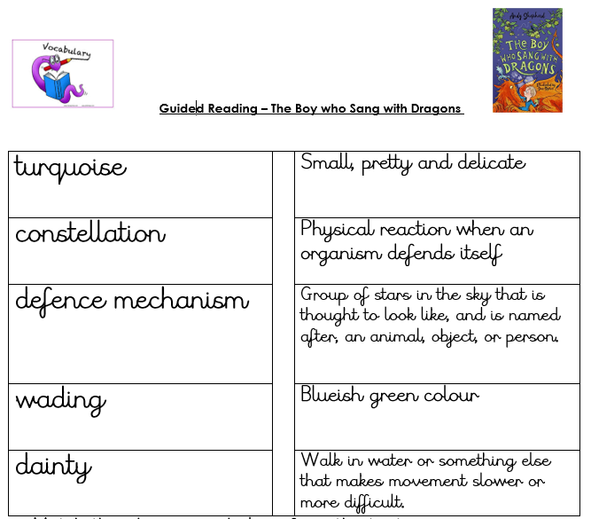

Slide 17
Answers

Slide 18
Please share your work with me. A photo via email would be good. It will be lovely to see how you are getting on.
If you haven’t printed the sheets, your answers on paper will be fine.

