Slide 1


Slide 2
25/1/2021
LO: Recognise Money.

Slide 3
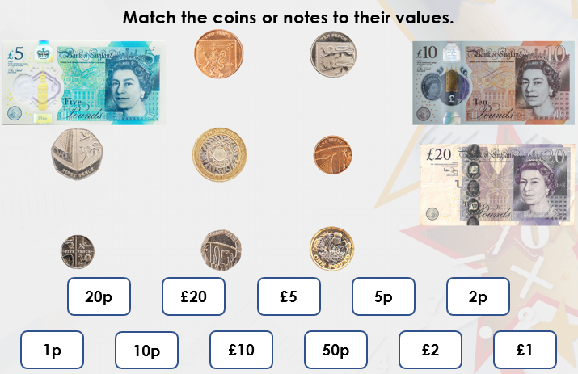
Starter

Slide 4
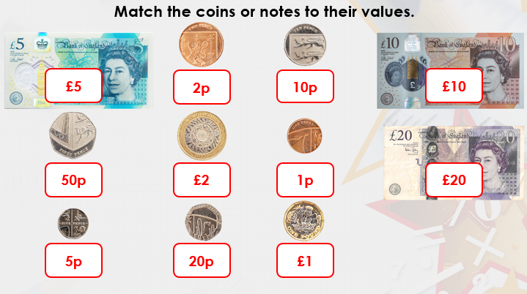
Answers

Slide 5

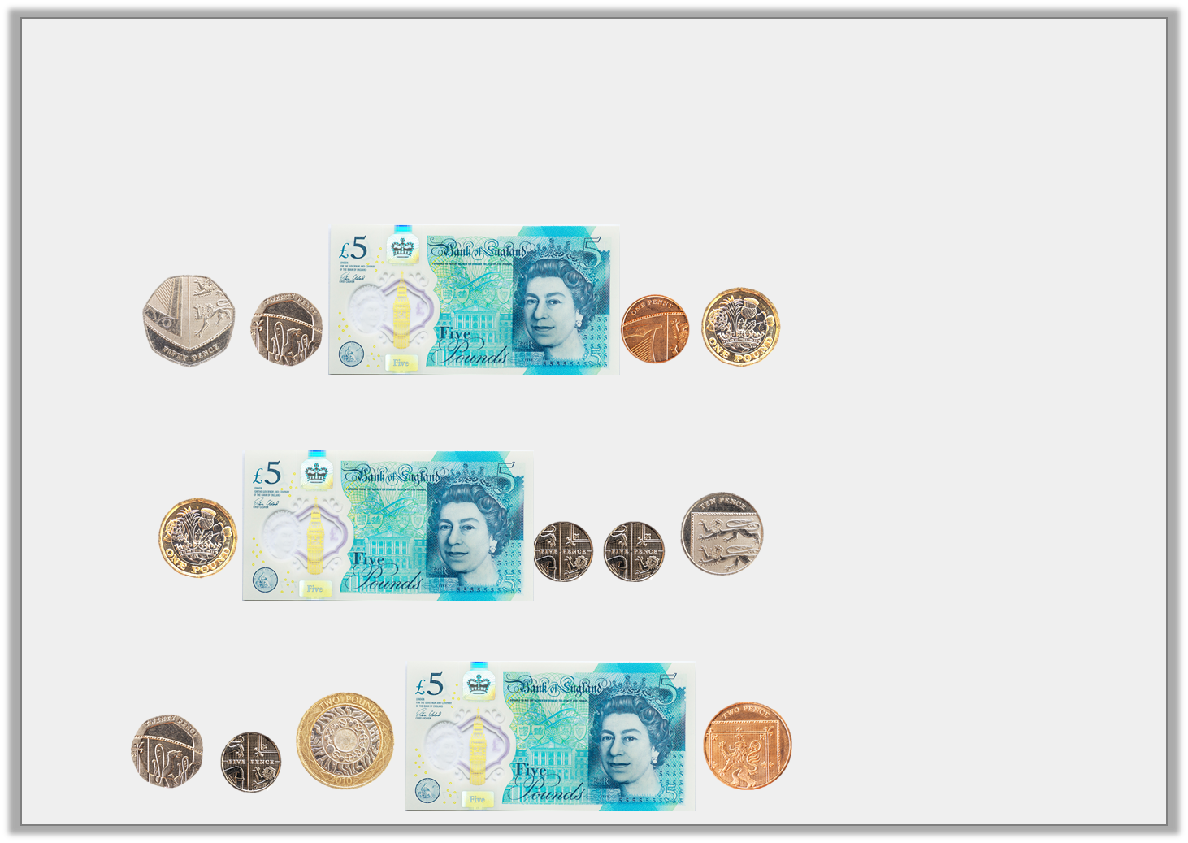

Varied Fluency 1
Match the notes and coins to the correct amounts.
A.
B.
C.
£6 and 20p
£6 and 71p
£7 and 27p
© Classroom Secrets Limited 2018

Slide 6
Varied Fluency 1
Match the notes and coins to the correct amounts.
A.
B.
C.
£6 and 20p
£6 and 71p
£7 and 27p
© Classroom Secrets Limited 2018

Slide 7
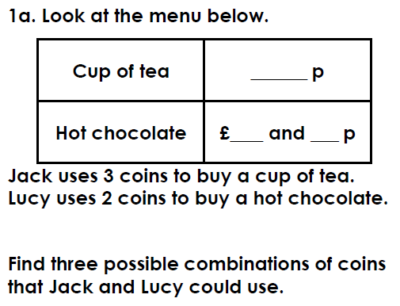
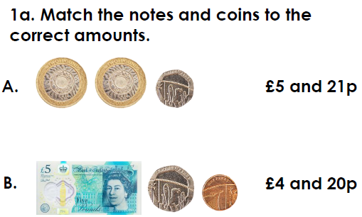
Have a go at these similar questions.
If you have the worksheet printed they are the same.

Slide 8
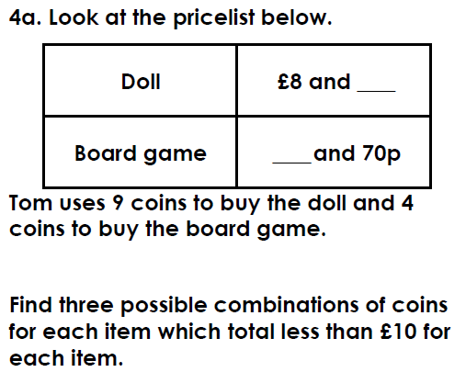
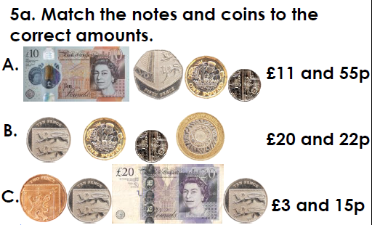
Have a go at these similar questions.
If you have the worksheet printed they are the same.

Slide 9
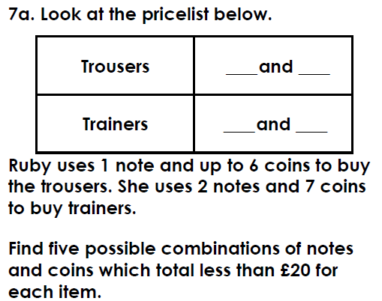
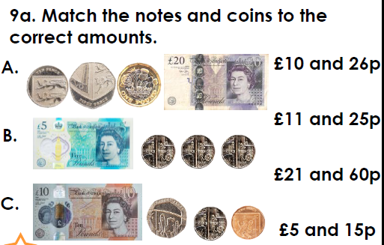
Have a go at these similar questions.
If you have the worksheet printed they are the same.
Challenge questions at back of worksheet document

Slide 10
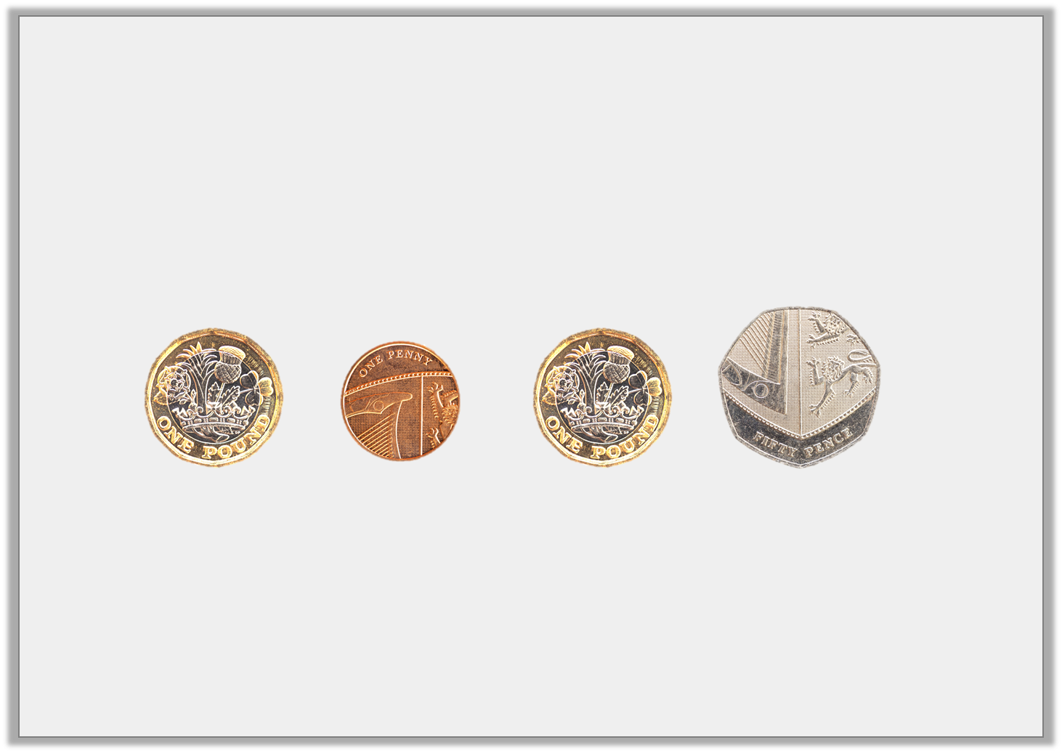
Varied Fluency 2
Identify the total of the coins below.
© Classroom Secrets Limited 2018

Slide 11
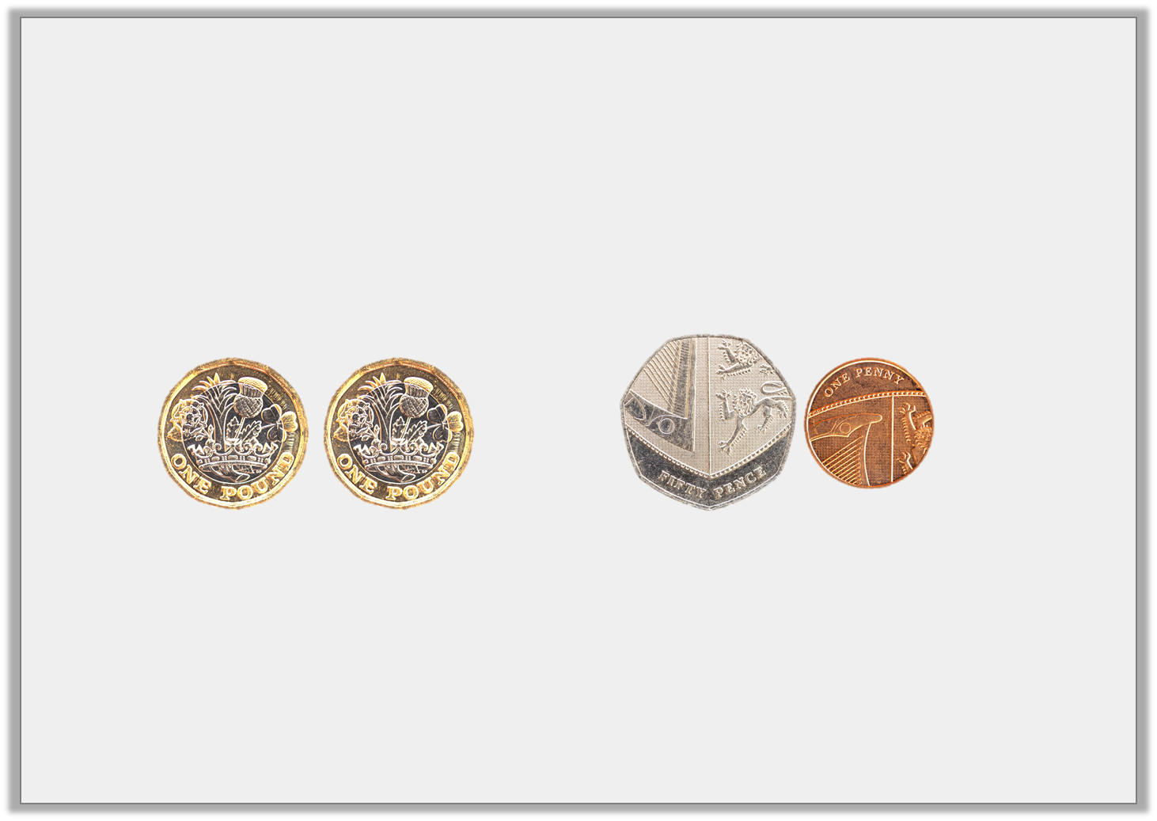
Varied Fluency 2
Identify the total of the coins below.
£2 and 51p
© Classroom Secrets Limited 2018

Slide 12
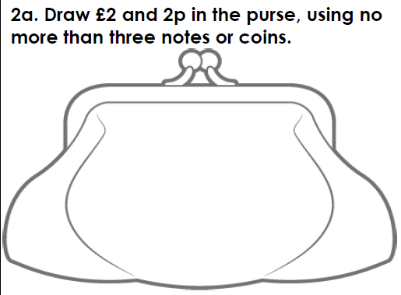
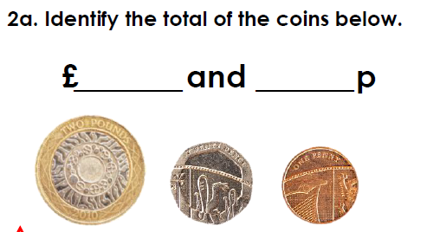
Have a go at these similar questions.
If you have the worksheet printed they are the same.

Slide 13
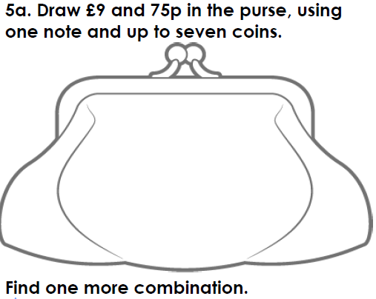
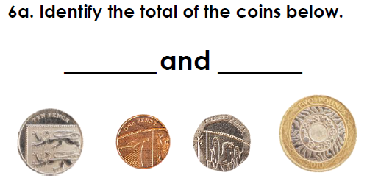
Have a go at these similar questions.
If you have the worksheet printed they are the same.

Slide 14
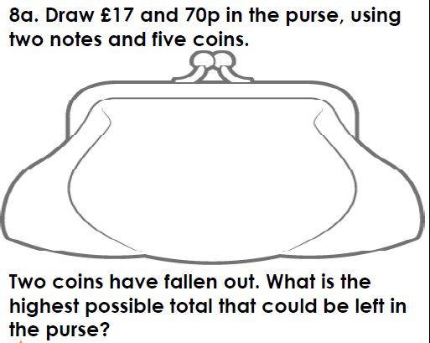
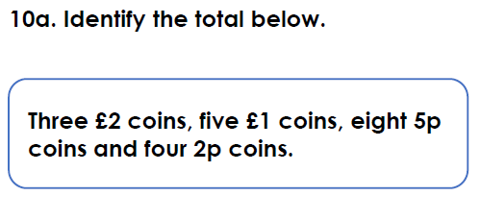
Have a go at these similar questions.
If you have the worksheet printed they are the same.
Challenge questions at back of worksheet document

Slide 15
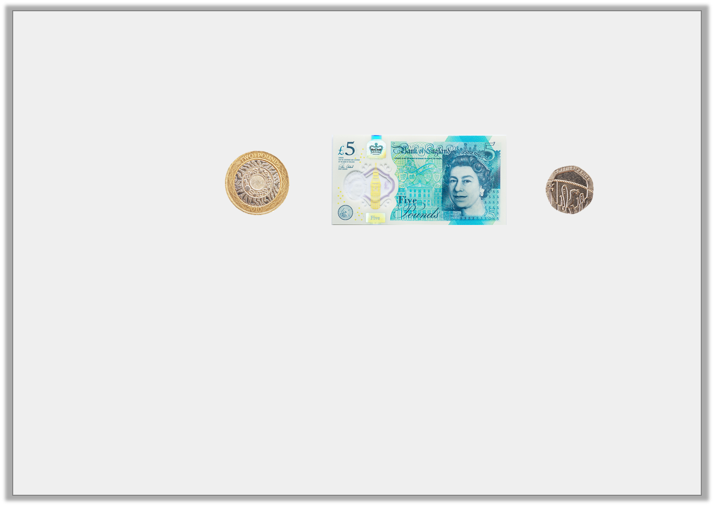
Varied Fluency 3
Which has the greatest value?
A.
B. | £7 and 40p
C. | £8 and 20p
© Classroom Secrets Limited 2018

Slide 16
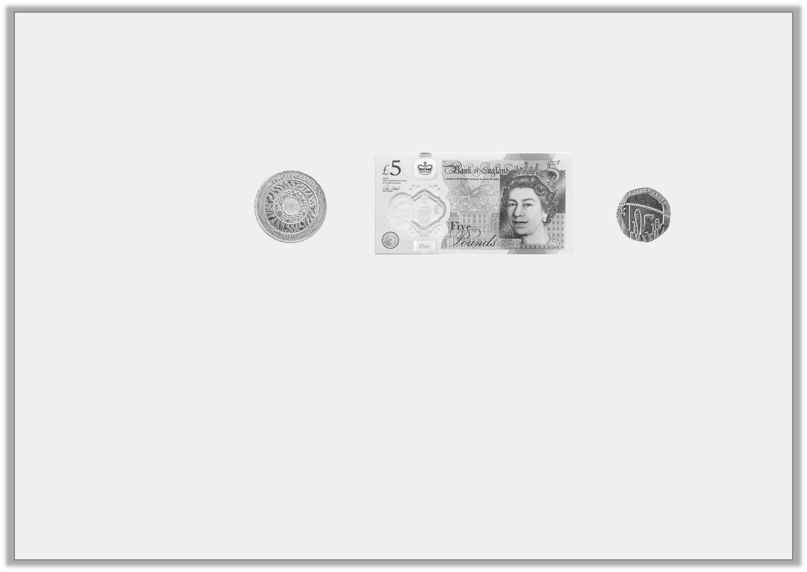
Varied Fluency 3
Which has the greatest value?
A.
B. | £7 and 40p
C. | £8 and 20p
© Classroom Secrets Limited 2018

Slide 17
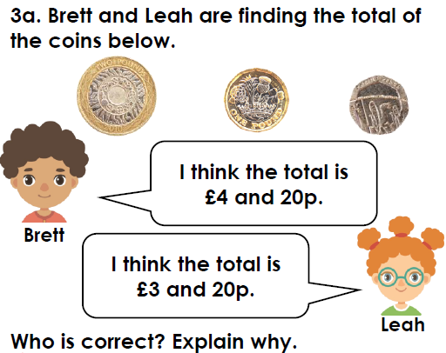
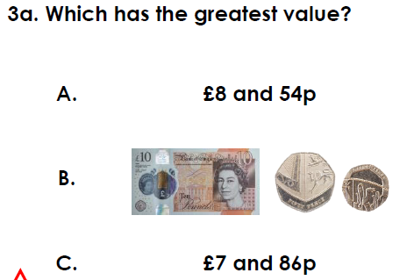
Have a go at these similar questions.
If you have the worksheet printed they are the same.

Slide 18
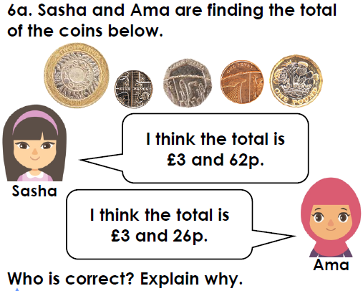
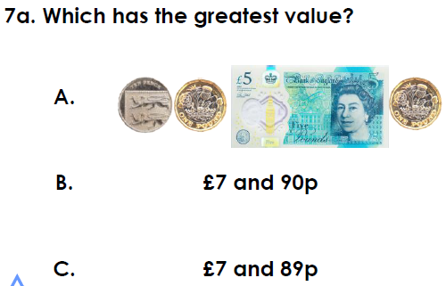
Have a go at these similar questions.
If you have the worksheet printed they are the same.

Slide 19
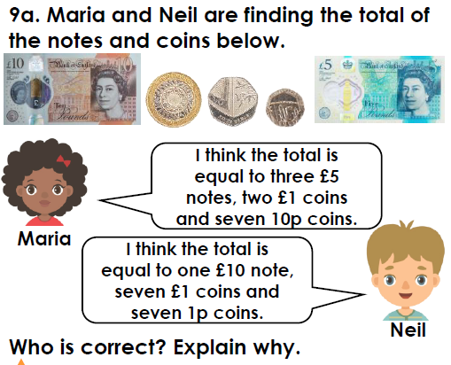
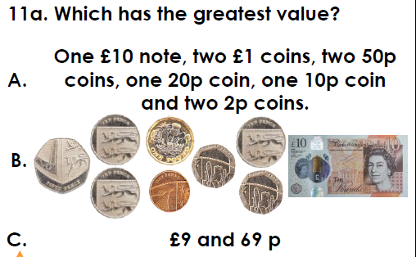
Have a go at these similar questions.
If you have the worksheet printed they are the same.
Challenge questions at back of worksheet document

Slide 20


