Slide 2
Aim
Add and subtract amounts of money to give change, using both £ and p in practical contexts.

Slide 3

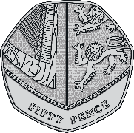
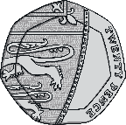
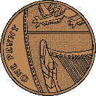
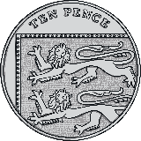
Convert Pounds and Pence
Diving
What is the total value of the coins?
Find groups of £1 (or 100p) to help you.
2
There are
whole pounds.
85
There are
pence left over.
2
and
85
p.
So there is £

Slide 4
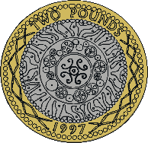
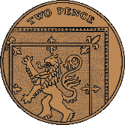
Convert Pounds and Pence
Diving
What is the total value of the coins?
Find groups of £1 (or 100p) to help you.
4
Can you find other ways to make £1 using these silver-coloured coins?
whole pounds.
50p + 20p + 20p + 10p = £1
50p + 20p + 10p + 10p + 10p = £1
50p + 10p + 10p + 10p + 10p = 10p = £1
There are
32
There are
pence left over.
4
and
32
p.
So there is £

Slide 5
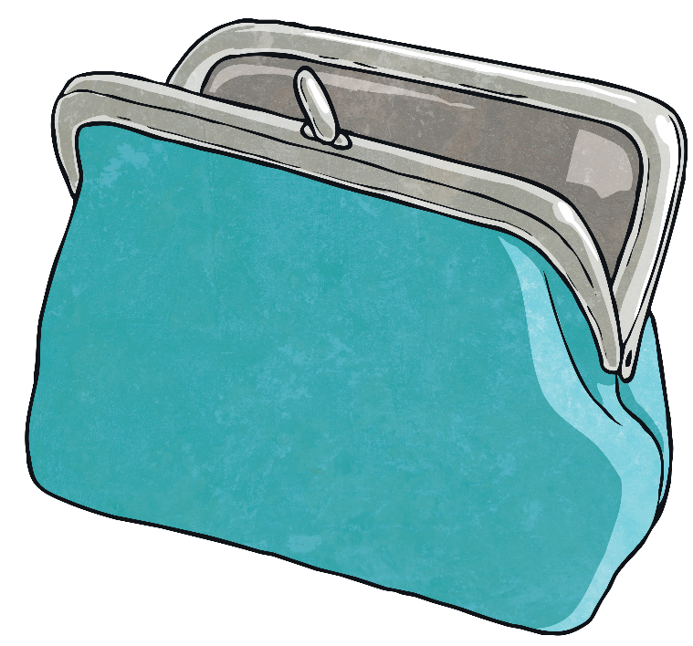
Convert Pounds and Pence
Diving
Write each amount in pounds and pence.
a
750 pence
£7 pounds and 50 pence
b
400 pence
£4
c
607 pence
£6 and 7 pence
d
998 pence
£9 and 98 pence

Slide 6






Convert Pounds and Pence
Deeper
Match the amount to the owner.
Amount A
Amount B
Amount C
£2 and 75 pence
£3 and 18 pence
£3
I have less than three pounds.
I have an exact number of pounds.
I have more than three pounds.
Amount C
Amount B
Amount A
Finn
Freddie
Ada

Slide 7


Convert Pounds and Pence
Deeper
Freddie and Polly have these coins.
There must more than 300 pence.
I don’t agree with you.
Who is correct?
Freddie is correct. The coins total £3 and 20 pence. £3 is the same as 300 pence and 20 pence more makes 320 pence in total, which is more than 300 pence.

Slide 8

Convert Pounds and Pence
Deepest
Polly has some silver-coloured coins – each coin is less than £1. Altogether, she has £2 and 15 pence.
Show 4 different combinations of coins that Polly may have.
There are many possible answers, for example:

Slide 9

Convert Pounds and Pence
Deepest
Ada has these coins in her purse.
She selects 4 coins to pay for a lolly.
Find all of the different amounts that Ada could have paid.
Which combinations of coins make exactly £1 and which are more than £1?
Exactly £1 | More Than £1
50p + 20p + 20p + 10p = £1 | 50p + 50p + 20p + 20p = £1 and 40 pence 50p + 50p + 20p + 10p = £1 and 30 pence

Slide 10


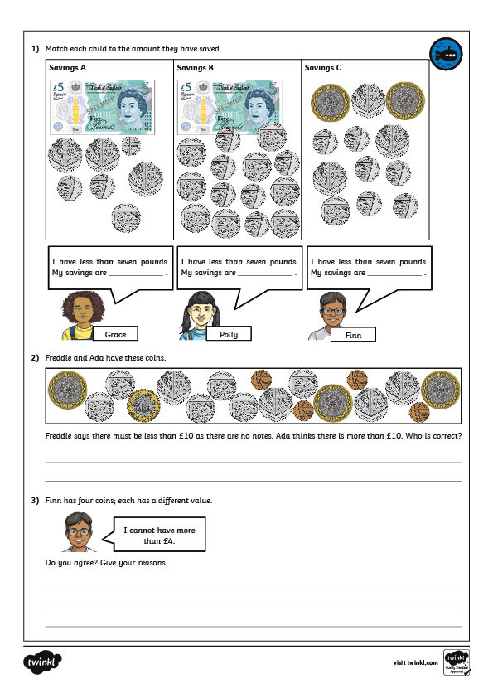
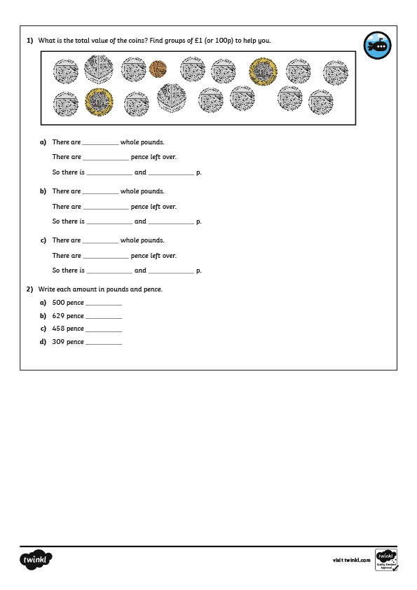
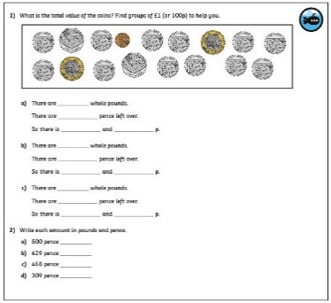
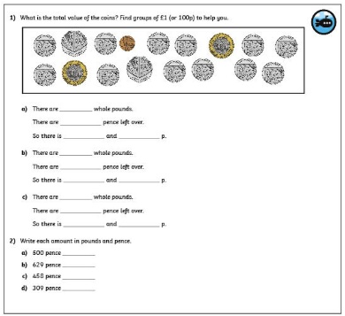
Convert Pounds and Pence
Dive in by completing your own activity!

