Slide 1


Slide 2
28/1/2021
LO: Subtract amounts of money.

Slide 3

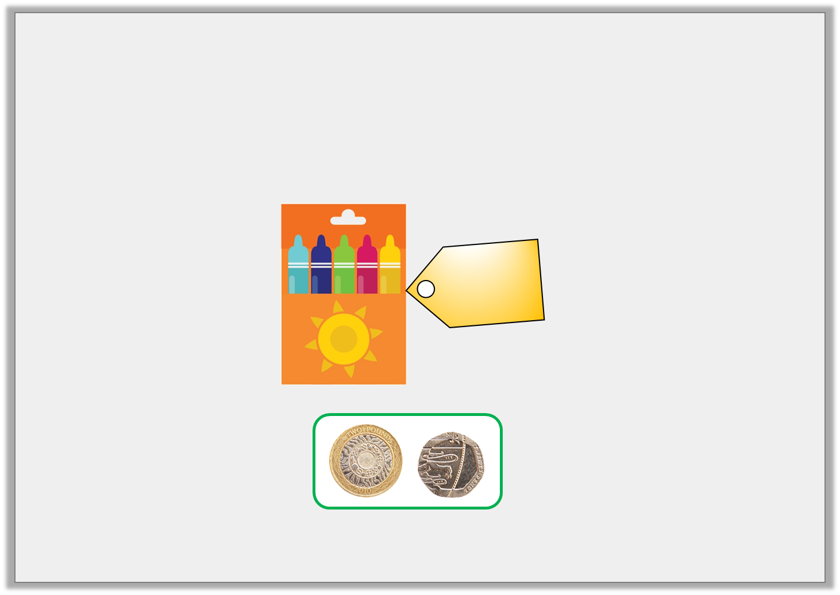

Starter
Introduction
Jack is saving to buy a packet of felt tips.
How much more money does he need to save?
£3
and
35p
© Classroom Secrets Limited 2019

Slide 4
Introduction
Jack is saving to buy a packet of felt tips.
How much more money does he need to save?
Jack needs to save another £1 and 15p.
£3
and
35p
© Classroom Secrets Limited 2019

Slide 5
Varied Fluency 1
Complete the missing numbers on the number line.
£1 and _____ p
£____ and 20p
75p
£2 and
______ p
£6 and
70p
© Classroom Secrets Limited 2019

Slide 6
Varied Fluency 1
Complete the missing numbers on the number line.
£1 and 75p
£4 and 20p
75p
£2 and
50p
£6 and
70p
© Classroom Secrets Limited 2019

Slide 7
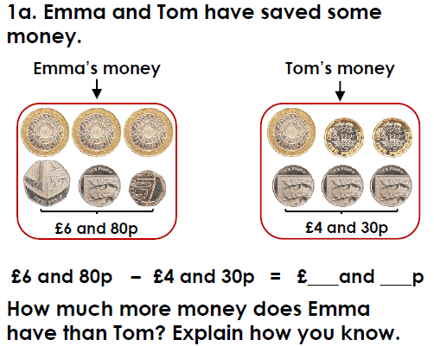
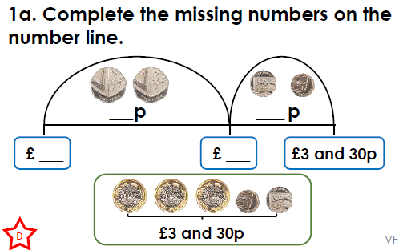
Have a go at these similar questions.
If you have the worksheet printed they are the same.

Slide 8
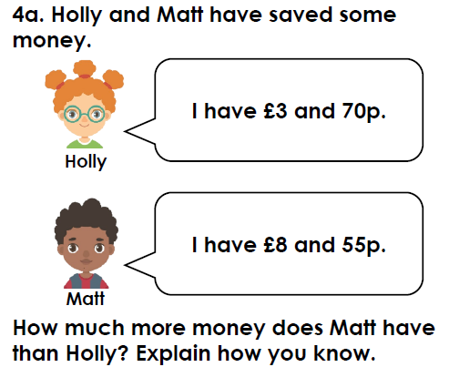
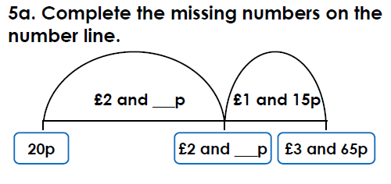
Have a go at these similar questions.
If you have the worksheet printed they are the same.

Slide 9
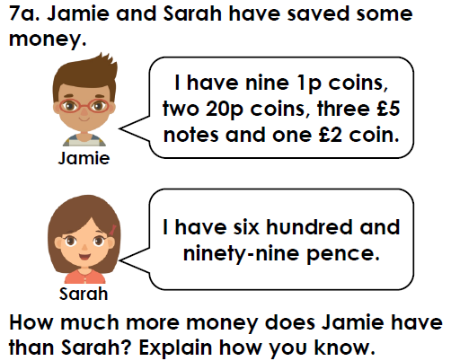
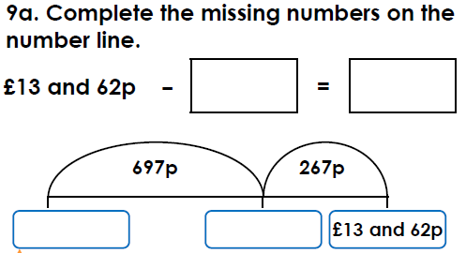
Have a go at these similar questions.
If you have the worksheet printed they are the same.
Challenge questions at back of worksheet document

Slide 10
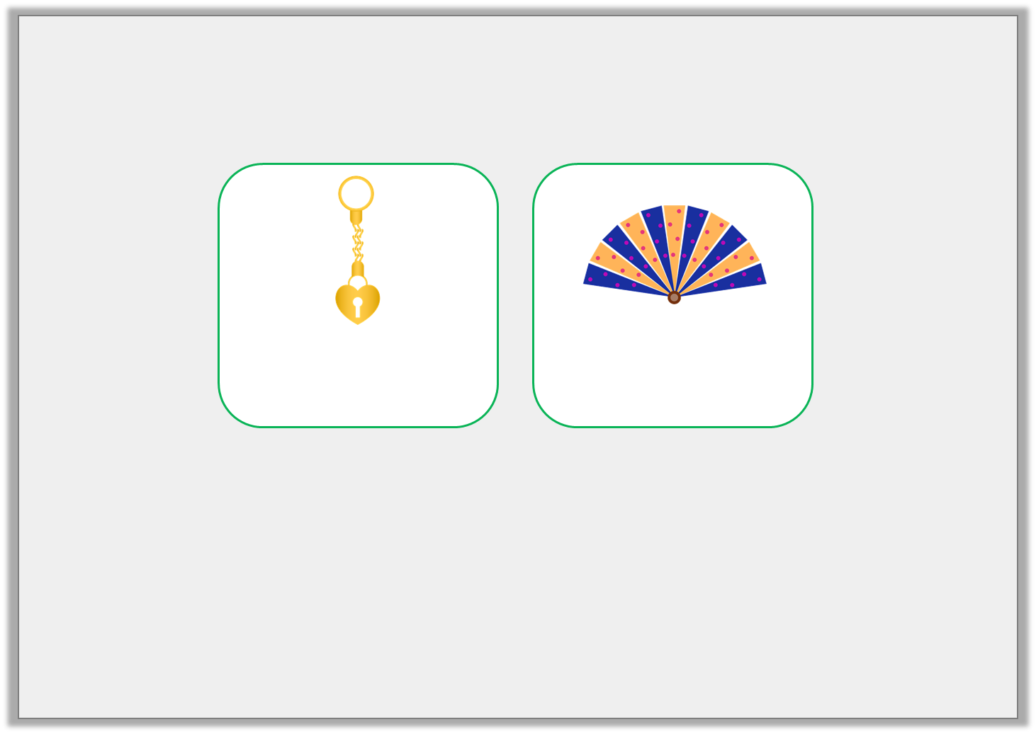
Varied Fluency 2
Shirelle likes two items in the museum’s gift shop.
How much less does the gold keyring cost?
£_____ and ______p
£3 and 60p
£7 and 45p
© Classroom Secrets Limited 2019

Slide 11
Varied Fluency 2
Shirelle likes two items in the museum’s gift shop.
How much less does the gold keyring cost?
£3 and 85p
£3 and 60p
£7 and 45p
© Classroom Secrets Limited 2019

Slide 12
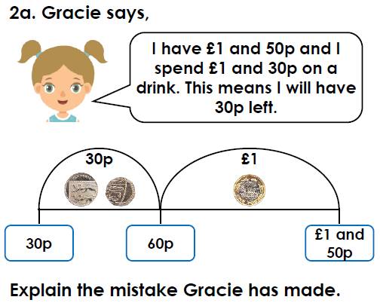
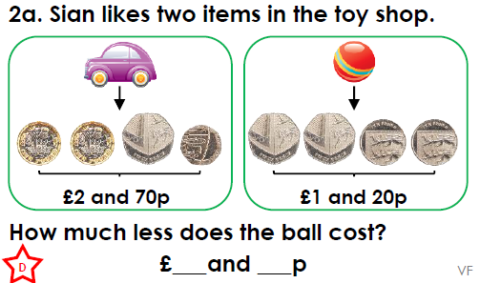
Have a go at these similar questions.
If you have the worksheet printed they are the same.

Slide 13
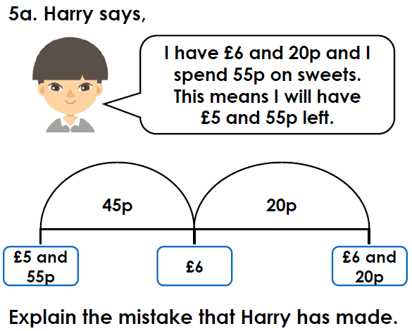
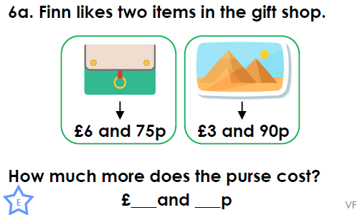
Have a go at these similar questions.
If you have the worksheet printed they are the same.

Slide 14
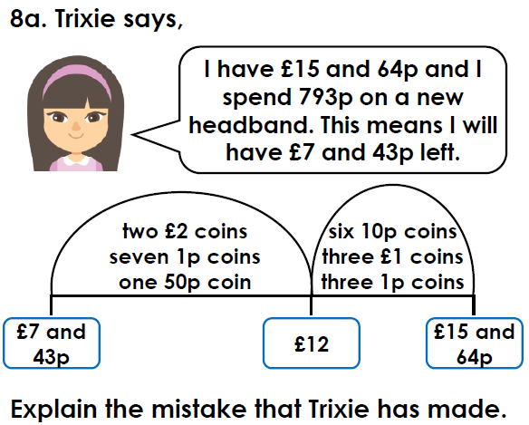
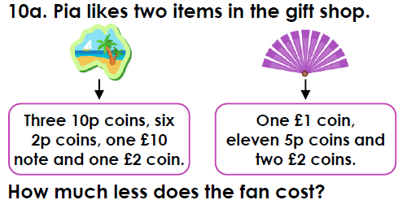
Have a go at these similar questions.
If you have the worksheet printed they are the same.
Challenge questions at back of worksheet document

Slide 15
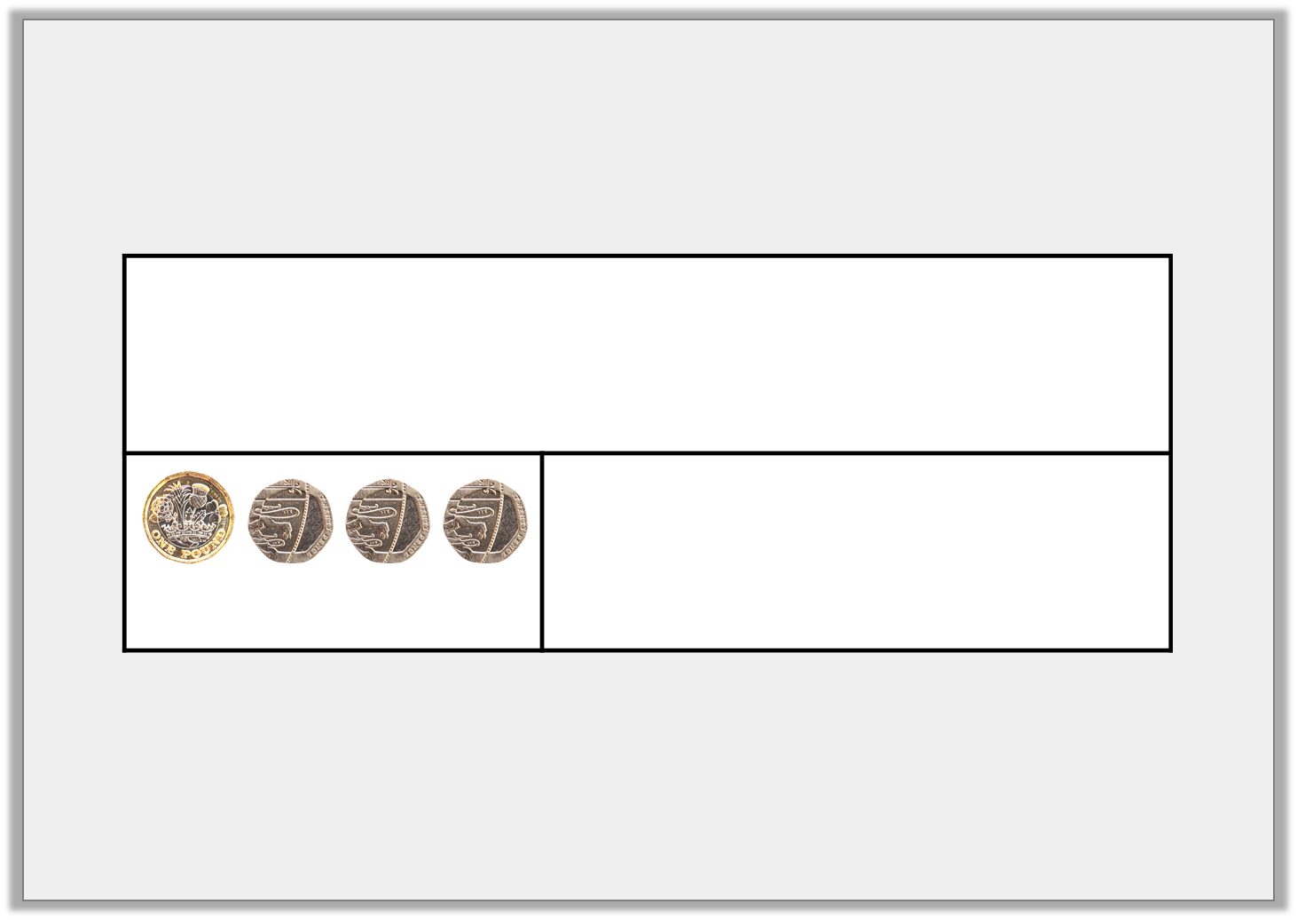
Varied Fluency 3
Saoirse had £7 and 85p in her piggy bank. She spent £1 and 60p. Complete the bar model to show how much she has left.
= £1 and 60p
© Classroom Secrets Limited 2019

Slide 16
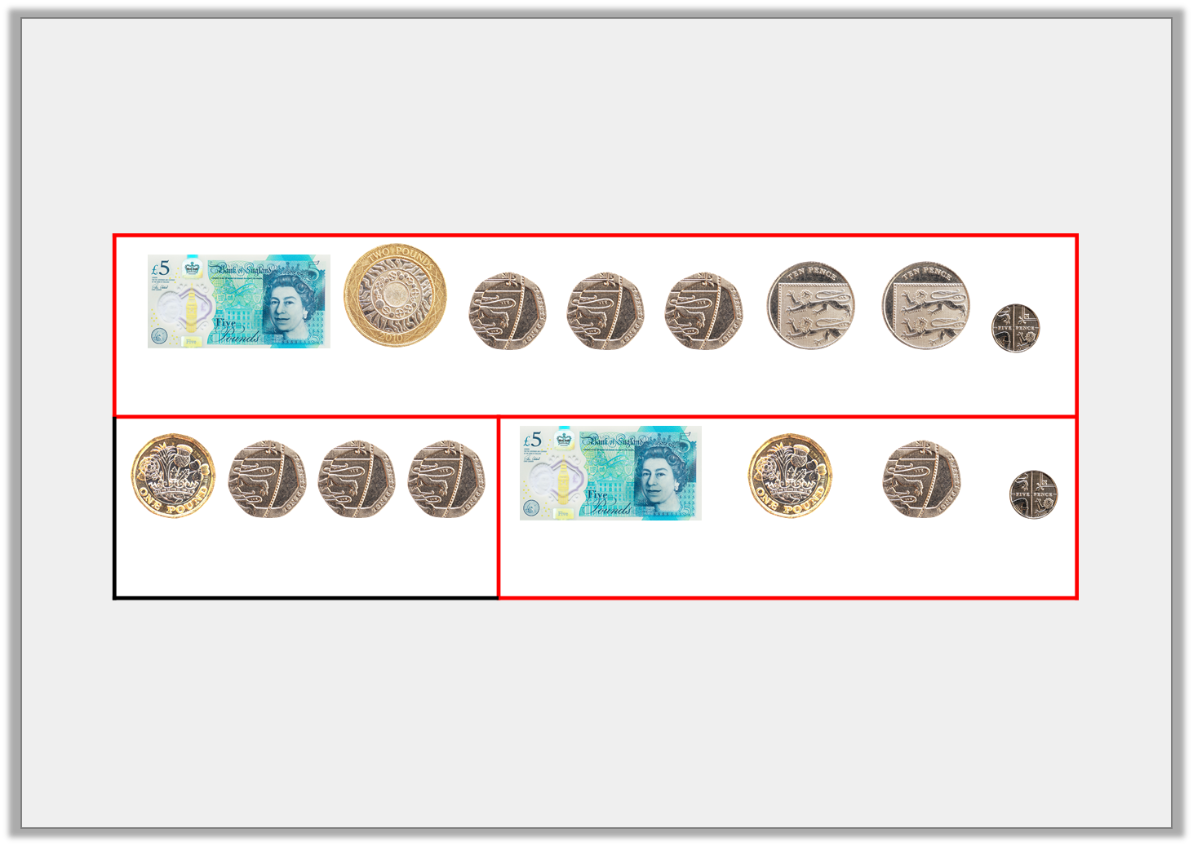
Varied Fluency 3
Saoirse had £7 and 85p in her piggy bank. She spent £1 and 60p. Complete the bar model to show how much she has left.
Saoirse has £6 and 25p left.
= £7 and 85p
= £1 and 60p
= £6 and 25p
© Classroom Secrets Limited 2019

Slide 17
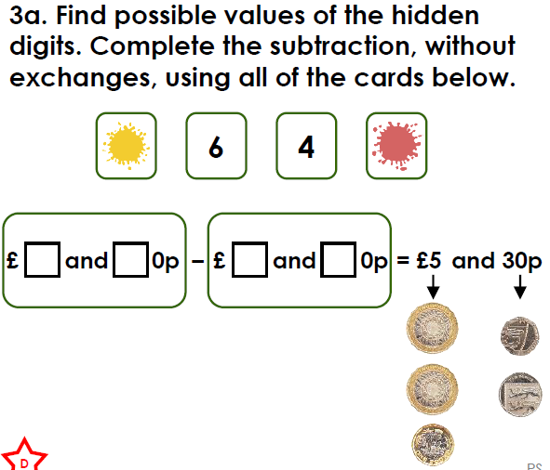
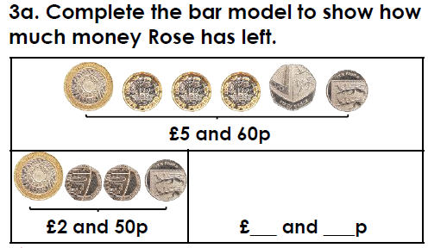
Have a go at these similar questions.
If you have the worksheet printed they are the same.

Slide 18
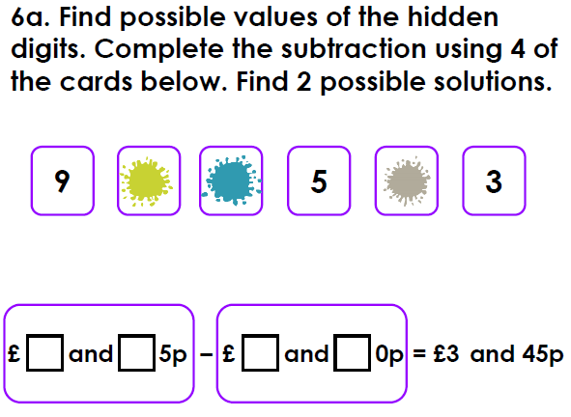
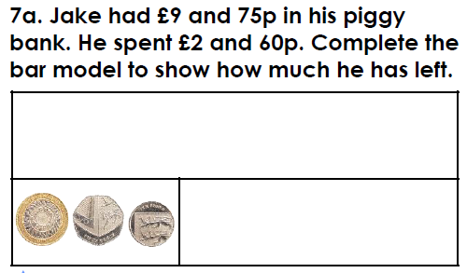
Have a go at these similar questions.
If you have the worksheet printed they are the same.

Slide 19
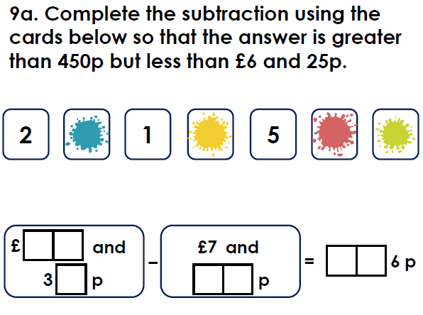
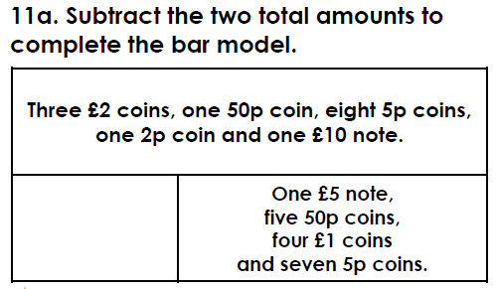
Have a go at these similar questions.
If you have the worksheet printed they are the same.
Challenge questions at back of worksheet document

Slide 20



