Slide 1


Slide 2
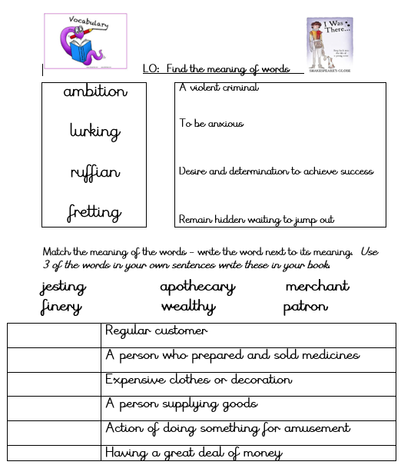

Slide 3
Answers

Slide 4


Slide 5
Answers
patron
apothecary
finery
merchant
jesting
wealthy

Slide 6
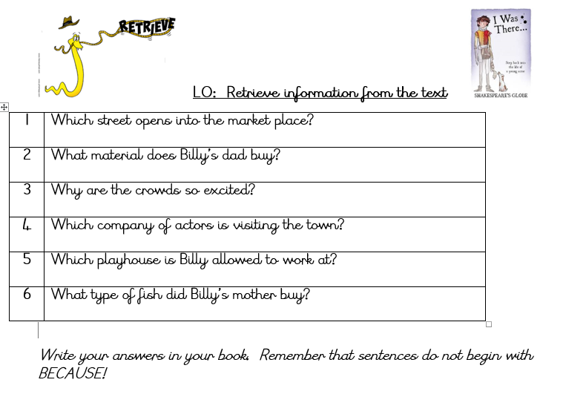
Linked to Chapter 2

Slide 7
Answers
1 | Which street opens into the market place? Cake Lane
2 | What material does Billy’s dad buy? Silk
3 | Why are the crowds so excited? An acting company is in town.
4 | Which company of actors is visiting the town? The King’s Men
5 | Which playhouse is Billy allowed to work at? Globe playhouse in London
6 | What type of fish did Billy’s mother buy? Trout

Slide 8


