Slide 1


Slide 2
11/01/20
LO: Compare multiplication and division statements.

Slide 3
Starter
Match the array to the correct multiplication and work out the answers.
7 x 2
8 x 4
5 x 3

Slide 4

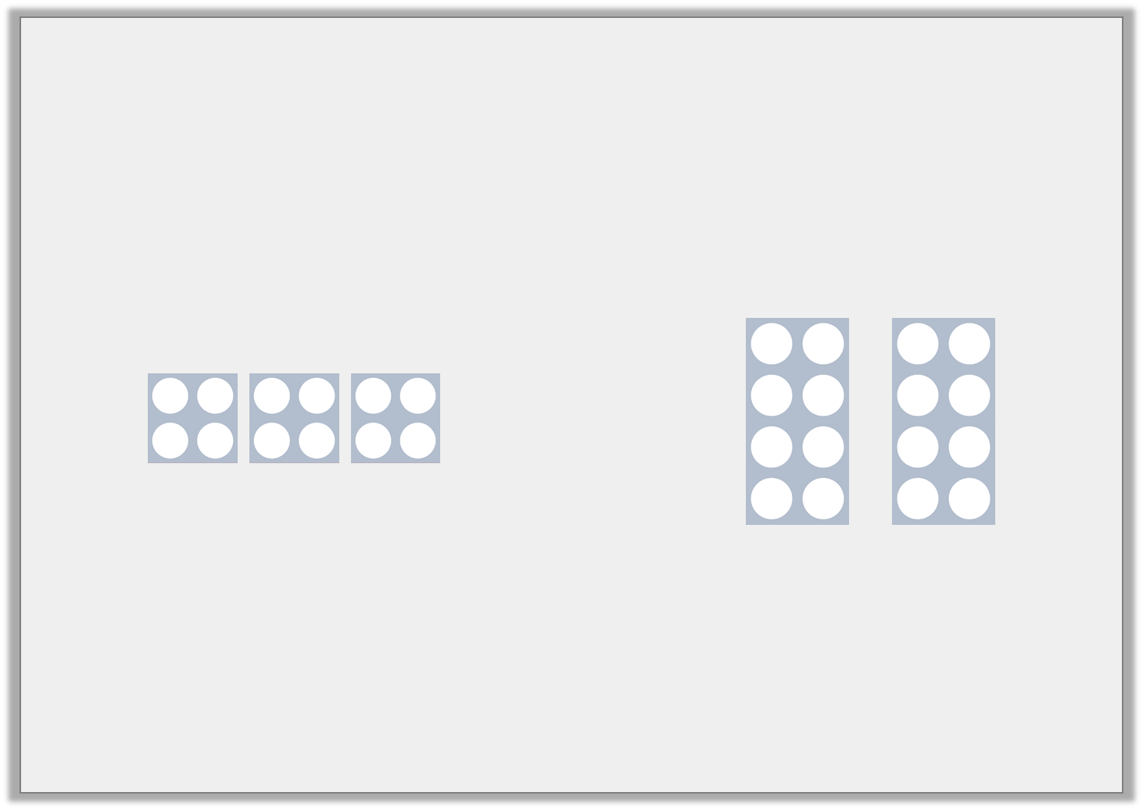

Varied Fluency 1
Circle the symbol to make the statement correct.
<
>
=
© Classroom Secrets Limited 2018

Slide 5
Varied Fluency 1
Circle the symbol to make the statement correct.
<
>
=
© Classroom Secrets Limited 2018

Slide 6
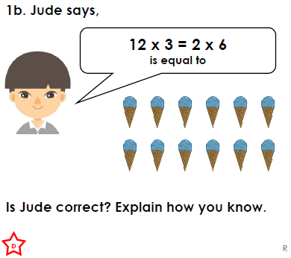
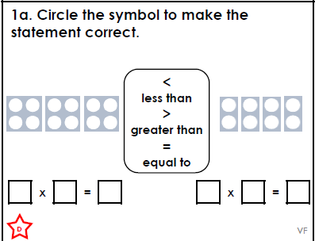
Have a go at these similar questions.
If you have the worksheet printed they are the same.

Slide 7
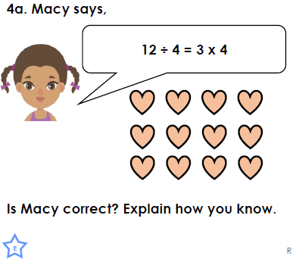
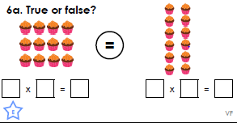
Have a go at these similar questions.
If you have the worksheet printed they are the same.

Slide 8
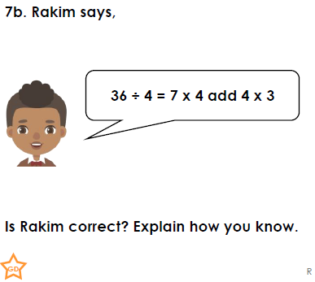
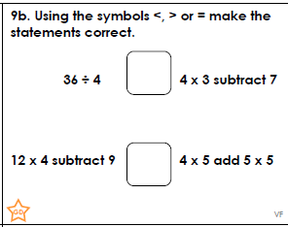
Have a go at these similar questions.
If you have the worksheet printed they are the same.
Challenge questions at back of worksheet document

Slide 9
Varied Fluency 3
Complete the bar models.
Use <, > or = to make the statement correct.
6 x ? = 18
4 | 4 | 4 | 4
© Classroom Secrets Limited 2018

Slide 10
Varied Fluency 3
Complete the bar models.
Use <, > or = to make the statement correct.
6 x 3 = 18
3 | 3 | 3 | 3 | 3 | 3
16
4 | 4 | 4 | 4
>
© Classroom Secrets Limited 2018

Slide 11
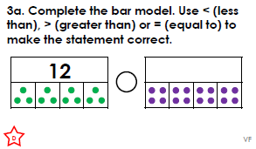
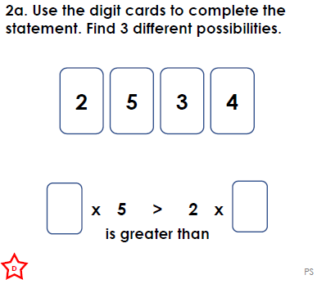
Have a go at these similar questions.
If you have the work sheet printed they are the same

Slide 12
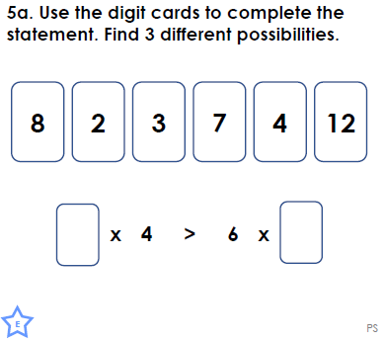
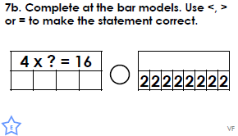
Have a go at these similar questions.
If you have the worksheet printed they are the same.

Slide 13
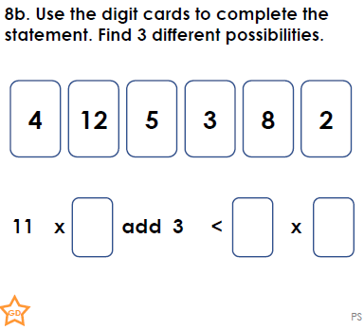
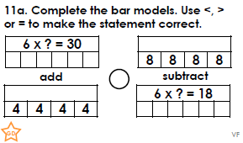
Have a go at these similar questions.
If you have the worksheet printed they are the same.
Challenge questions at back of worksheet document

Slide 14
Varied Fluency 4
Use <, > or = to complete the number comparison statements.
A. | 3 x 8 |  | 4 + 4 + 4 + 4 + 4
B. | 32 ÷ 8 |  | 24 ÷ 4
C. | 36 ÷ 3 |  | 6 x 3
© Classroom Secrets Limited 2018

Slide 15
Varied Fluency 4
Use <, > or = to complete the number comparison statements.
A. | 3 x 8 | > | 4 + 4 + 4 + 4 + 4
B. | 32 ÷ 8 | < | 24 ÷ 4
C. | 36 ÷ 3 | < | 6 x 3
© Classroom Secrets Limited 2018

Slide 16
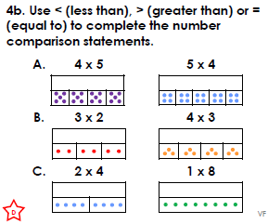
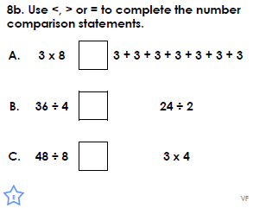
Have a go at these similar questions.
If you have the worksheet printed they are the same.

Slide 17
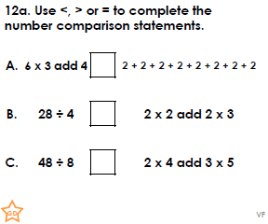
Have a go at these similar questions.
If you have the worksheet printed they are the same.
Challenge questions at back of worksheet document

Slide 18



