Slide 2
Aim
Write and calculate mathematical statements for multiplication and division using the multiplication tables that they know, including for two-digit numbers times one-digit numbers, using mental and progressing to formal written methods.

Slide 3

Related Calculations
Diving
Complete the calculation for each set of place value counters.
1
1
1
1
1
1
1
1
1
1
1
1
1
5 × 3 = 15
1
1
1
1
1
3 × 5 = 15
4 × 2 = 8
1
1
1
1
1
2 × 4 = 8
10
10
10
10
10
10
10
10
10
10
10
10
10
3 × 50 = 150
50 × 3 = 150
10
10
10
10
10
or
40 × 2 = 80
2 × 40 = 80
10
10
10
10
10
5 × 30 = 150
30 × 5 = 150
or
20 × 4 = 80
4 × 20 = 80

Slide 4


Related Calculations
Diving
Each bag contains 10 footballs.
There are 3 columns of 4 bags.
There are 3 columns of 40 balls.
3 × 4 = 12
4 × 3 = 12
3 × 40 = 120
40 × 3 = 120
There are 12 bags altogether.
There are 120 balls altogether.

Slide 5
Related Calculations
Diving
11 × 2 = 22
If we know that 11 × 2 = 22, we know that 11 × 20 = 220. Complete the fact family for this calculation.
11 × 20 = 220
220 ÷ 20 = 11
20 × 11 = 220
220 ÷ 11 = 20
2 × 110 = 220
220 ÷ 110 = 2
110 × 2 = 220
220 ÷ 2 = 110

Slide 6


Related Calculations
Deeper
Spike has made this array:
10
10
10
10
10
10
10
I can use this array to help me work out 40 × 7.
10
10
10
10
10
10
10
10
10
10
10
10
10
10
10
10
10
10
10
10
10
Do you agree with Spike? Explain your reasons.
Spike is correct. The array shows 7 columns of counters. Each column has 4 counters that are each worth 10, so each column is worth 40.

Slide 7


Related Calculations
Deepest
Tyler has 240ml of paint. He wants to use all of the paint to fill some paint pots. However, he only wants to use one size of pot.
Which pots could he use?
How many pots of this size would he be able to fill ?
11ml
20ml
50ml
60ml
90ml
Tyler could not use this pot. 240 is not a multiple of 11.
Tyler could use this pot. 240 is a multiple of 20.
12 × 20 = 240 so he could fill 12 pots.
Tyler could not use this pot. 240 is not a multiple of 50.
Tyler could use this pot. 240 is a multiple
of 60.
4 × 60 = 240 so he could fill 4 pots.
Tyler could not use this pot. 240 is not a multiple of 90.

Slide 8


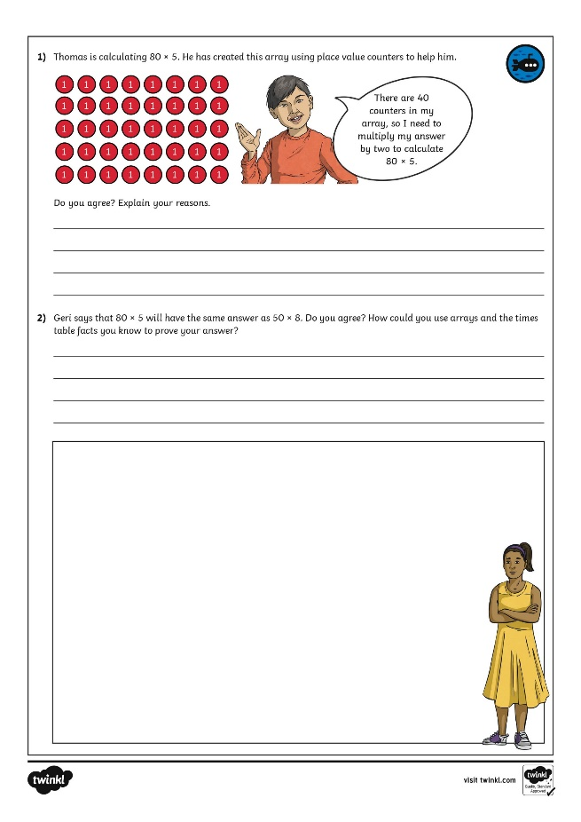
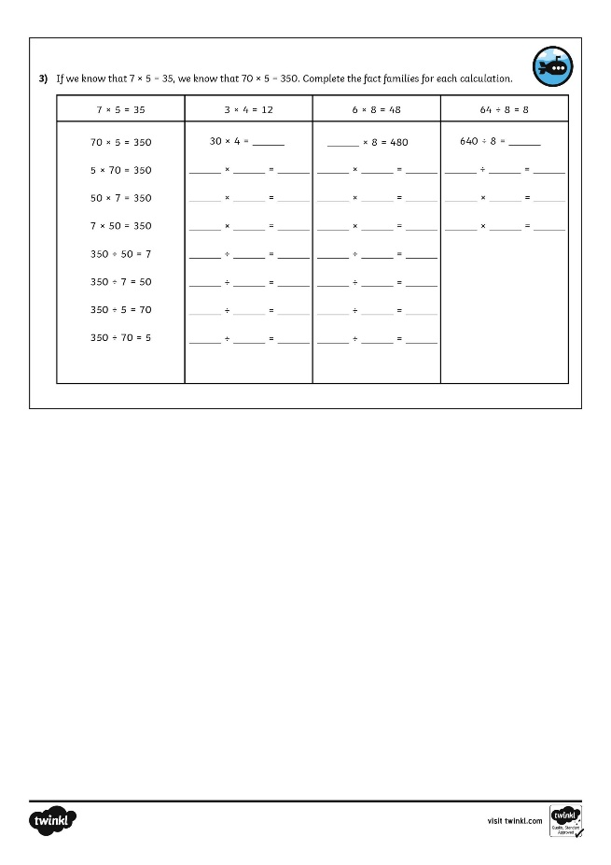
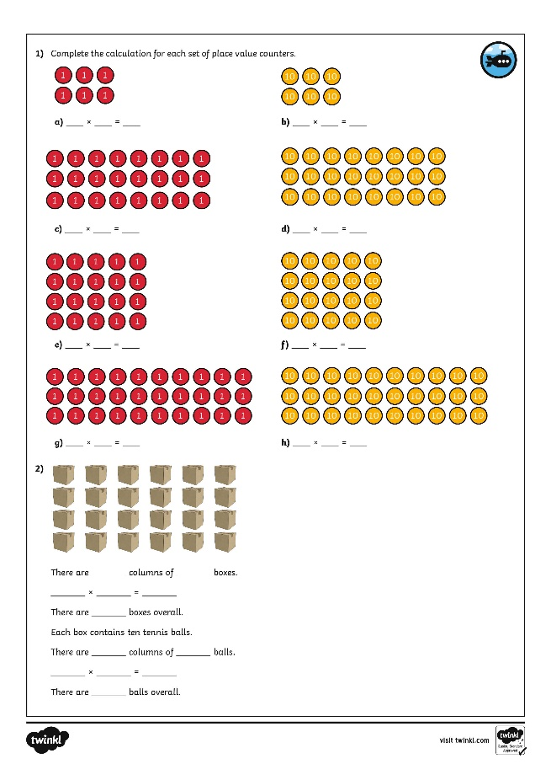
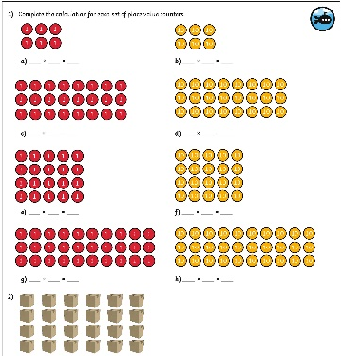
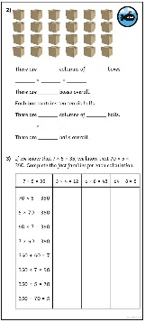
Related Calculations
Dive in by completing your own activity!

