Slide 2
Aim
Write and calculate mathematical statements for multiplication and division using the multiplication tables that they know, including for two-digit numbers times one-digit numbers, using mental and progressing to formal written methods.

Slide 3



Multiply 2 Digits by 1 Digit (1)
Diving
Complete each calculation to match the representation shown in the picture.
Tens | Ones
Tens | Ones
10
10
1
1
10
10
1
1
10
10
1
1
10
10
1
1
22
×
4
=
88
13
×
3
=
39

Slide 4
Multiply 2 Digits by 1 Digit (1)
Diving
How would you use place value counters to represent the calculation and find the answer?
Tens | Ones
10
10
1
21 × 3 =
63
10
10
1
10
10
1

Slide 5



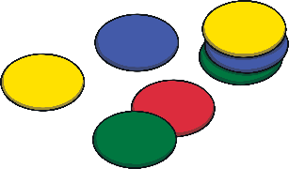
Multiply 2 Digits by 1 Digit (1)
Diving
Use place value counters or base ten to find the answer to this calculation. Then, show the answer as column multiplication.
Tens | Ones
 | 3 | 2
× |  | 2
10
10
10
1
1
10
10
10
1
1
Tens | Ones
6
4

Slide 6

Multiply 2 Digits by 1 Digit (1)
Deeper
Diana has used place value counters to represent a calculation.
Which calculation has she represented? What would the answer be?
23 × 3
32 × 2
32 × 3
Tens | Ones
10
10
10
1
1
10
10
10
1
1
10
10
10
1
1
32 × 3
Diana has made 3 lots of 32, which represents 32 × 3.
32 × 3 = 96

Slide 7

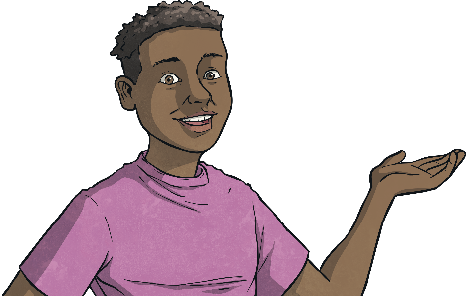
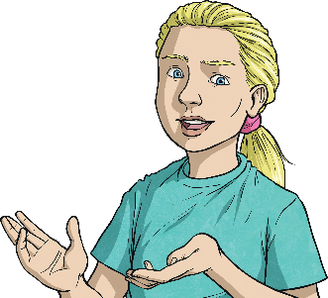
Multiply 2 Digits by 1 Digit (1)
Deepest
Use these numbers to solve the problems below.
You may need to use some numbers more than once. For each question, you should always use one number from each group in your calculation.
2
3
12
14
23
Write a multiplication calculation with an answer that is one less than 70.
Write a multiplication calculation that does not need an exchange and has an answer that has 4 tens.
Write all the multiplication calculations that do not need an exchange and have answers that are even numbers.
23 × 3 = 69
23 × 2 = 46
12 × 2 = 24
12 × 3 = 36
14 × 2 = 28
23 × 2 = 46

Slide 8


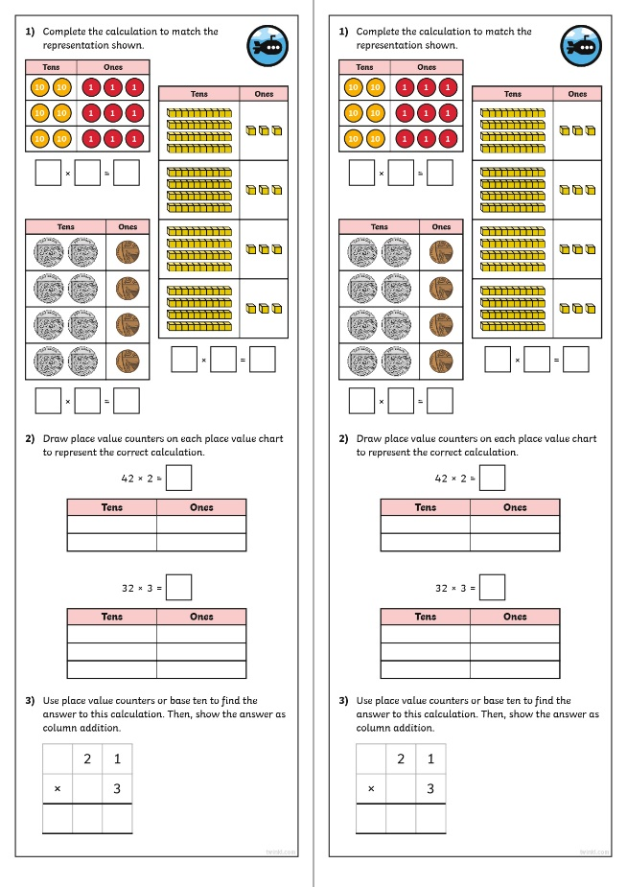
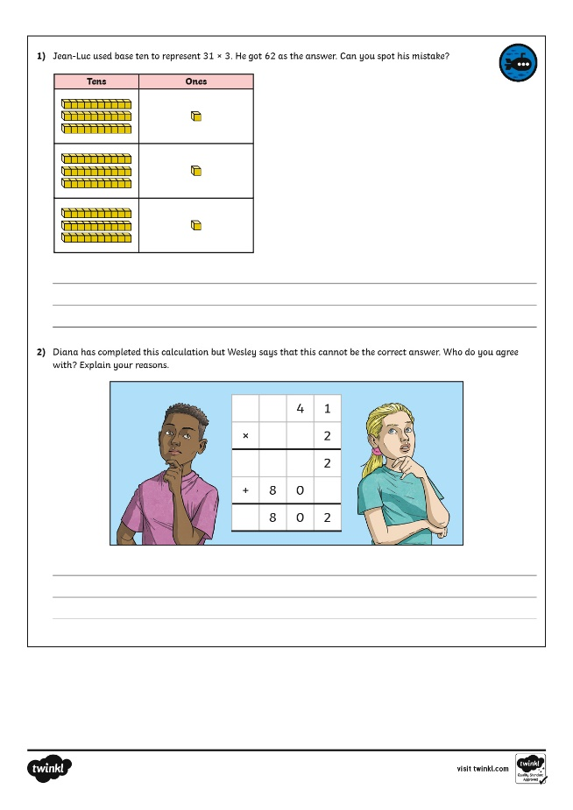
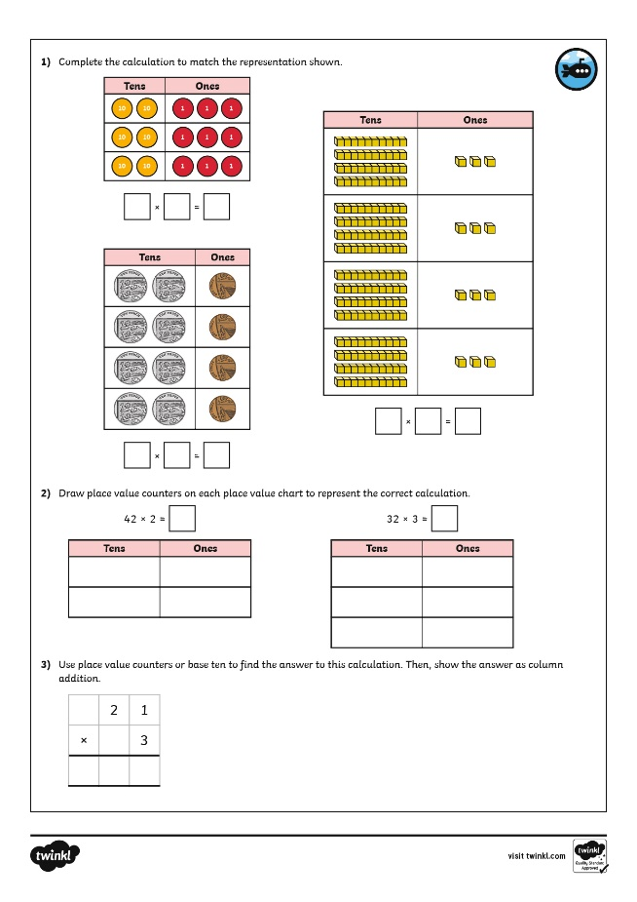
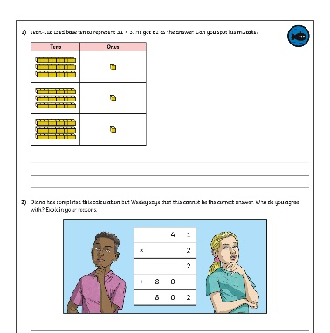
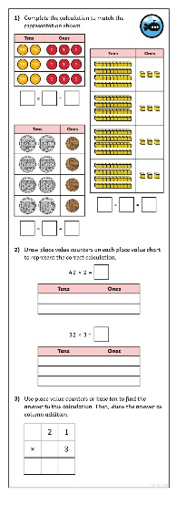
Multiply 2 Digits by 1 Digit (1)
Dive in by completing your own activity!

