Slide 1


Slide 2
14/01/21
LO: To multiply 2 digit numbers by 1 digit numbers.

Slide 3
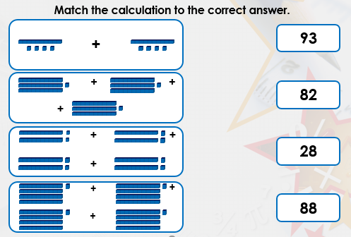
Starter

Slide 4
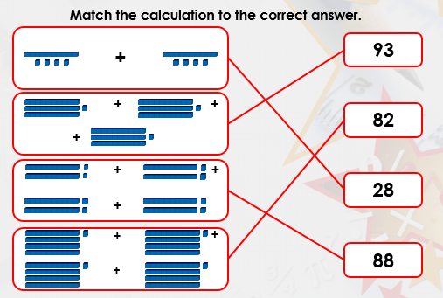

Slide 5
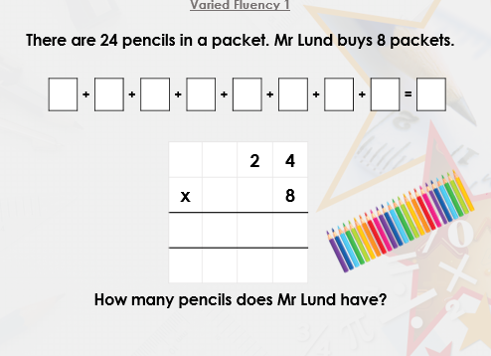

Slide 6
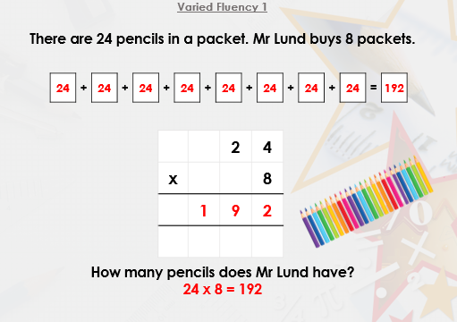

Slide 7
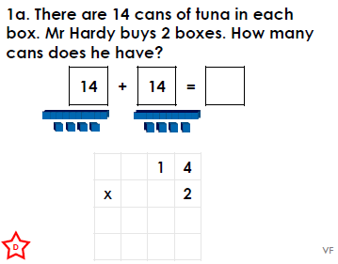
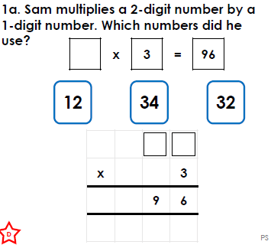
Have a go at these similar questions.
If you have the worksheet printed they are the same.

Slide 8
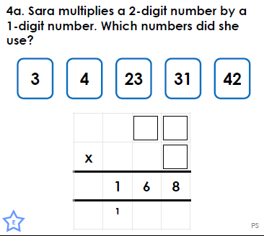
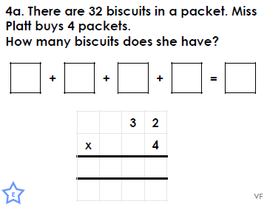
Have a go at these similar questions.
If you have the worksheet printed they are the same.

Slide 9
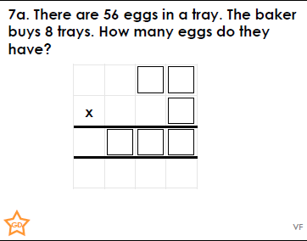
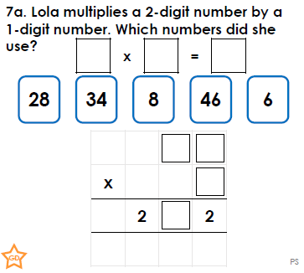
Have a go at these similar questions.
If you have the worksheet printed they are the same.
Challenge questions at back of worksheet document

Slide 10
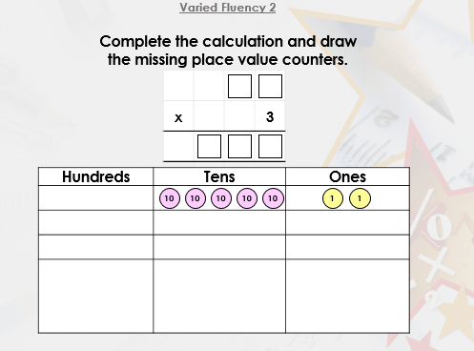

Slide 11
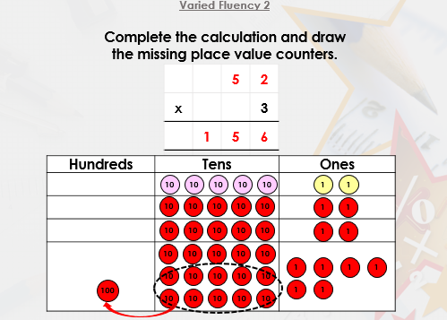

Slide 12
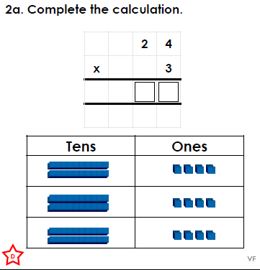
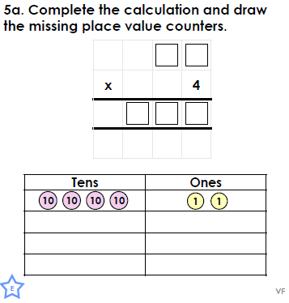
Have a go at these similar questions.
If you have the worksheet printed they are the same.

Slide 13
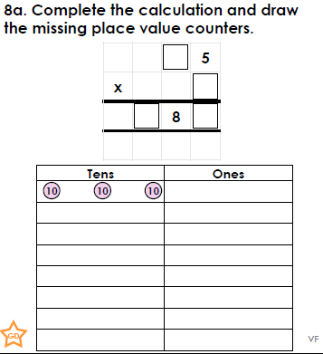
Have a go at these similar questions.
If you have the worksheet printed they are the same.
Challenge questions at back of worksheet document

Slide 14
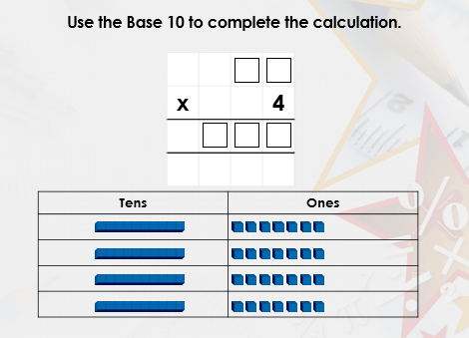

Slide 15
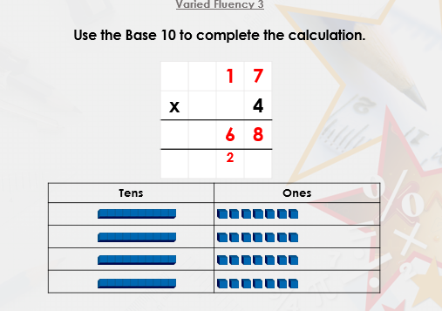

Slide 16
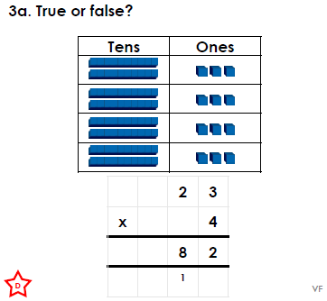
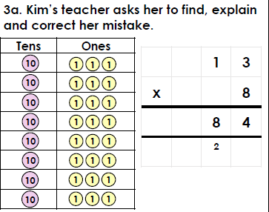
Have a go at these similar questions.
If you have the worksheet printed they are the same.

Slide 17
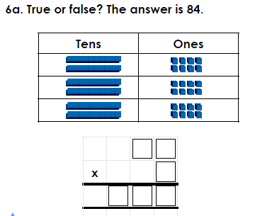
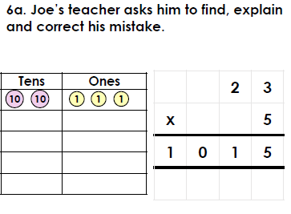
Have a go at these similar questions.
If you have the worksheet printed they are the same.

Slide 18
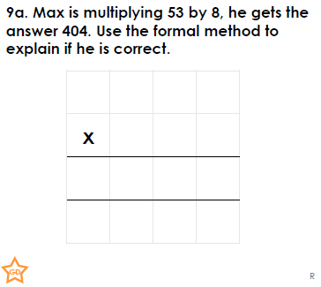
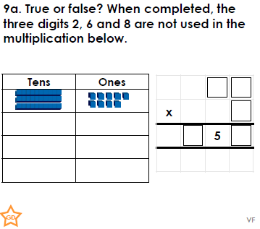
Have a go at these similar questions.
If you have the worksheet printed they are the same.
Challenge questions at back of worksheet document

Slide 19



