Slide 1


Slide 2
Tuesday 12th January
LO: To create a story map.

Slide 3
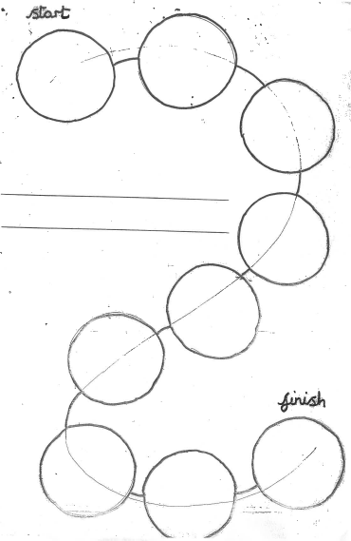
What were the key events of the story?
1.
2.
3.
4.
5.
6.
7.
8.
9.

Slide 4
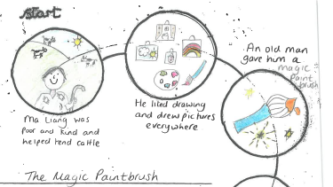
Sentences for key events:
Can we improve the sentences? How?

