Slide 1


Slide 2


Slide 3
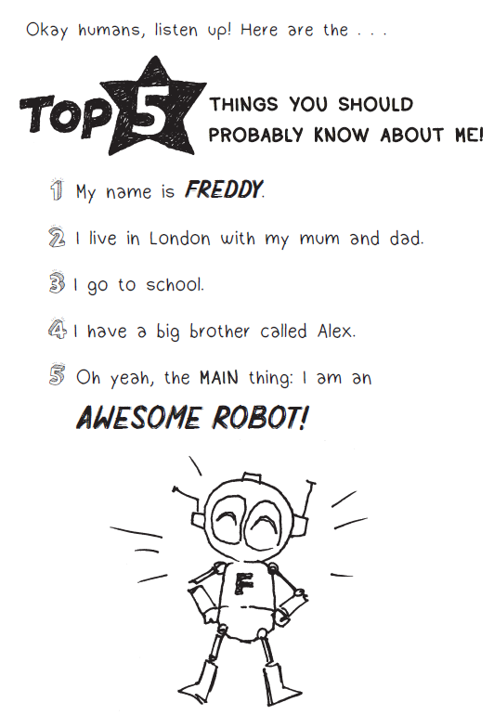

Slide 4
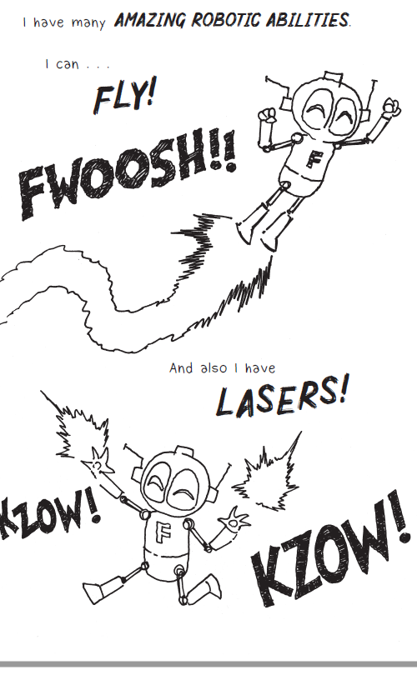

Slide 5
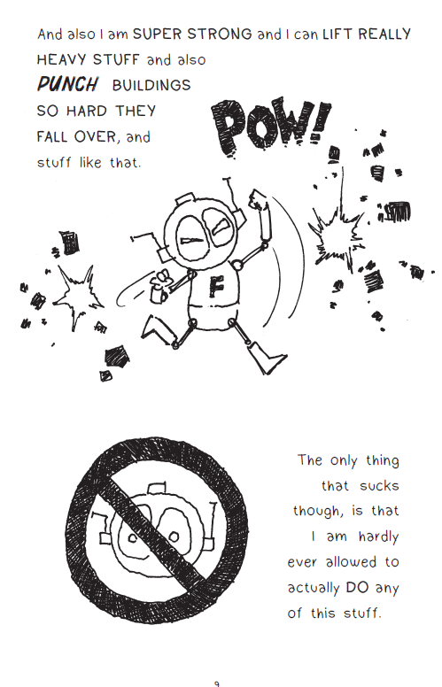

Slide 6
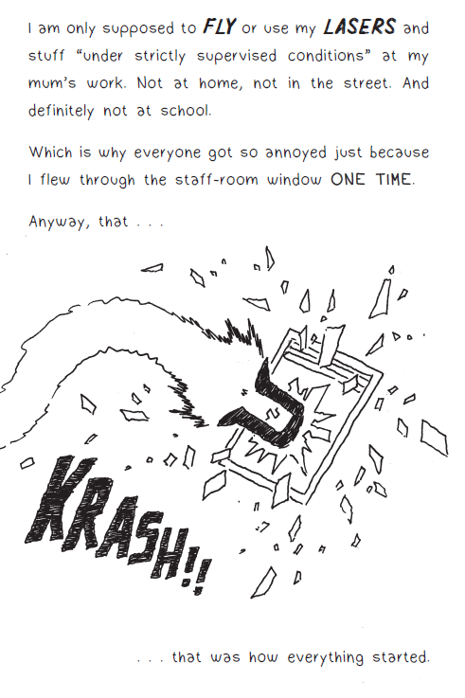

Slide 7
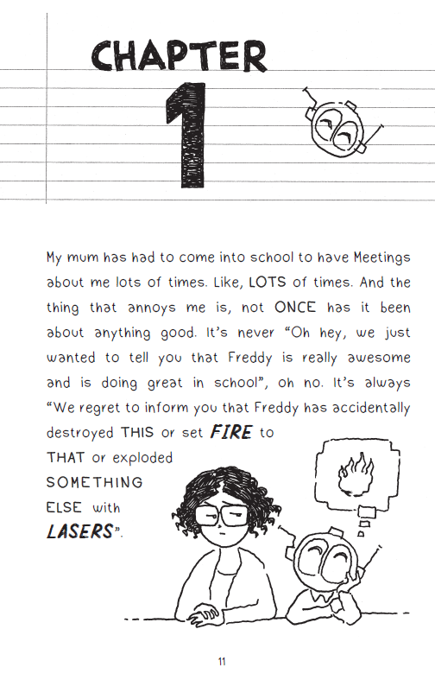

Slide 8
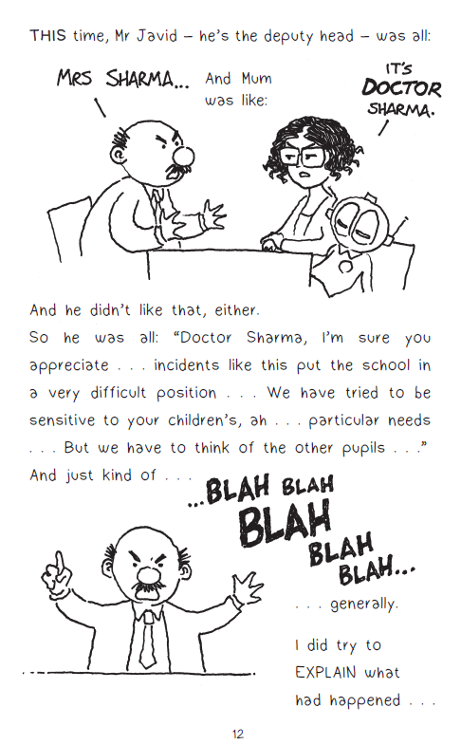

Slide 9
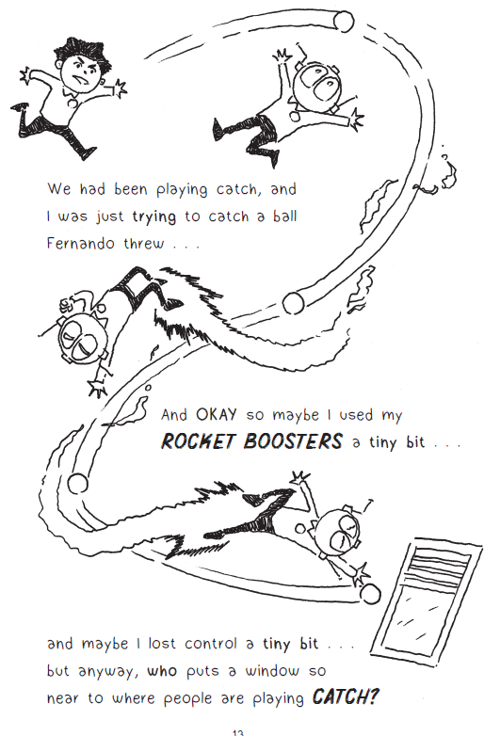

Slide 10
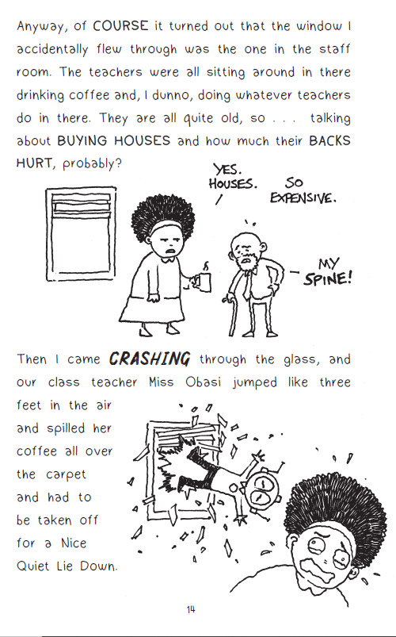

Slide 11
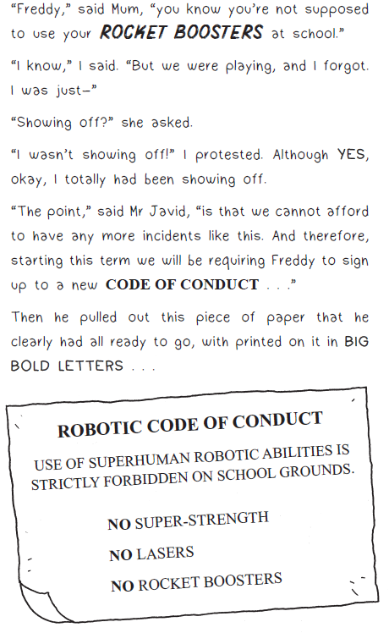

Slide 12
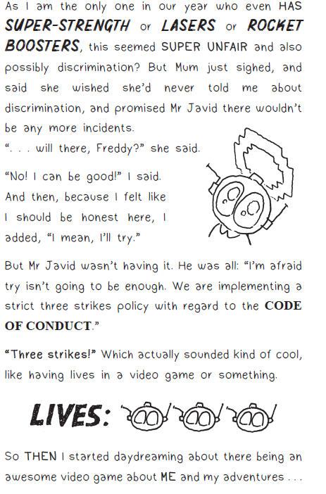

Slide 13
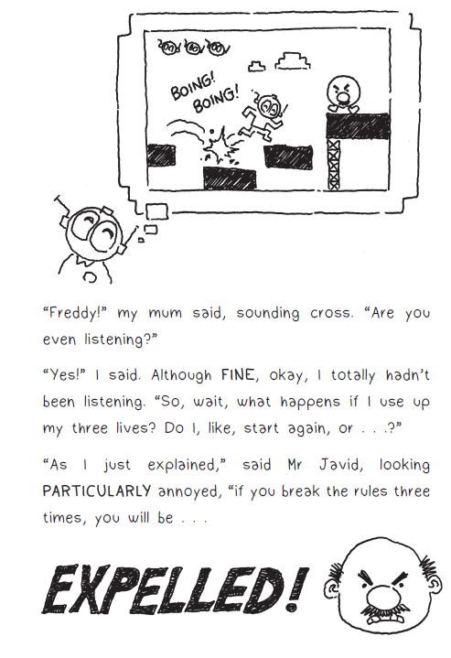

Slide 14
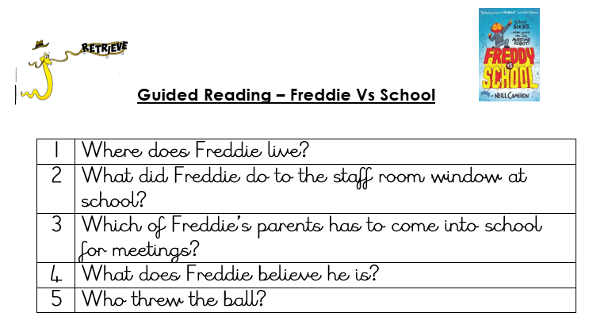

Slide 15
Answers
1 | Where does Freddie live? In London with Mum and Dad.
2 | What did Freddie do to the staff room window at school? He flew through the staff room window.
3 | Which of Freddie’s parents has to come into school for meetings? Freddie’s mum.
4 | What does Freddie believe he is? An awesome robot.
5 | Who threw the ball? Fernando.

Slide 16


