Slide 1


Slide 2
19/1/21
LO: To divide a 2-digit number by 1-digit.

Slide 3
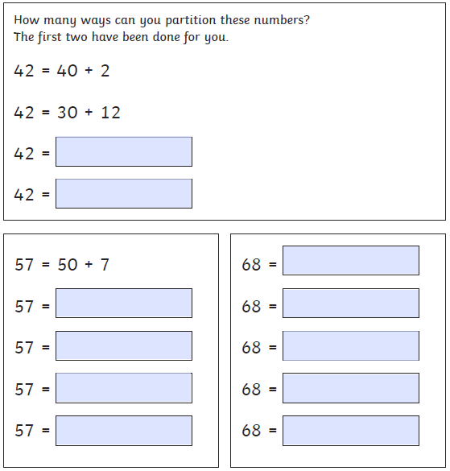
Starter
Partitioning

Slide 4
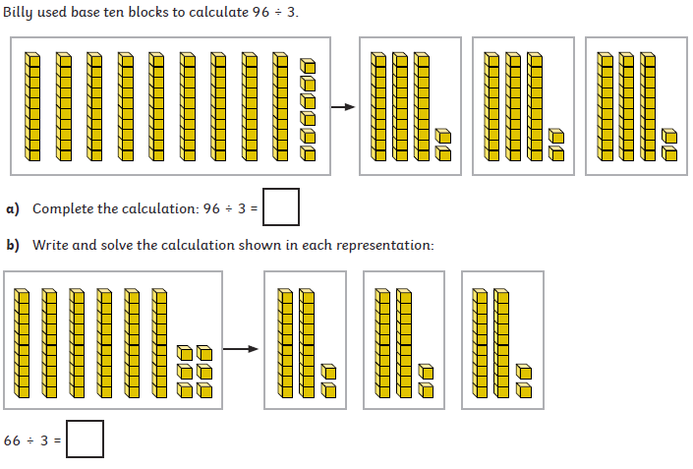

Slide 5
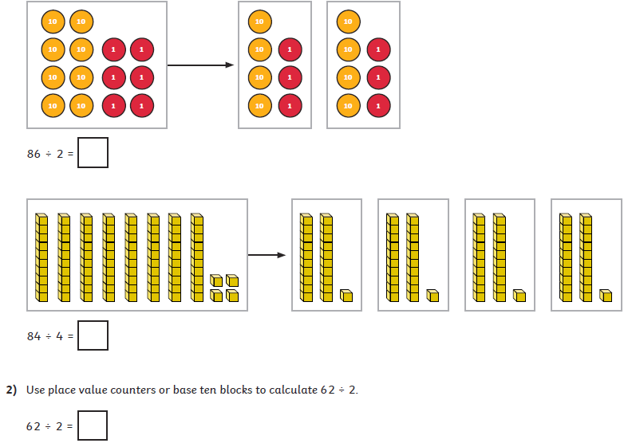
Try this question before we go through it.

Slide 6
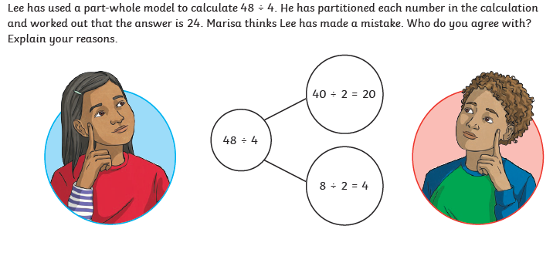

Slide 7
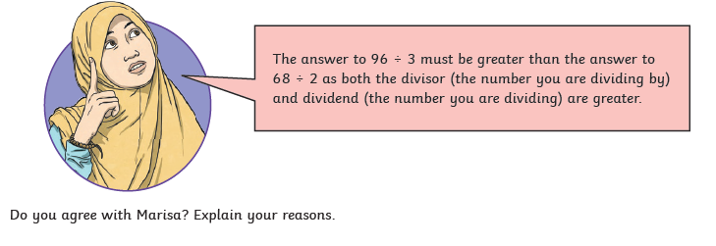

Slide 8



