Slide 1
LO: A Hindu life: what is important?

Slide 2
https://www.bbc.co.uk/programmes/p0114x86
Watch the video on Mumbai.
Discuss
Why was the city names Mumbai?
What did you like the look of?
What was interesting?
What was unusual or unexpected?
Some people call Mumbai Bombay which means ‘good bay’ in Portuguese.

Slide 3
https://www.bbc.co.uk/programmes/p0115j0s
Watch the video on ‘Life in Mumbai’.
Discuss
What did the British do in the 17th Century?

Slide 4
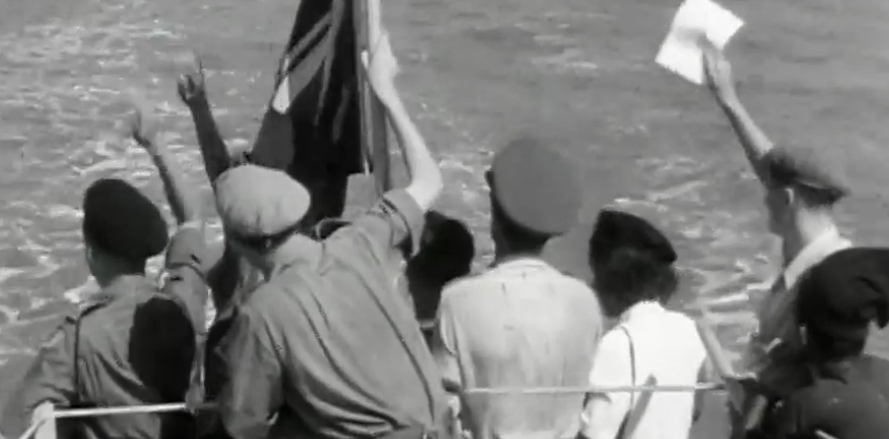
The clip says the British ‘gained control of Mumbai’ and ‘leased it’ to a company.
What does this mean?
It means that the British navy invaded Mumbai and took it over, making it part of Britain. Then they leased/loaned it to a company; The East India Trading Company.
British rule ended in 1947.

Slide 5
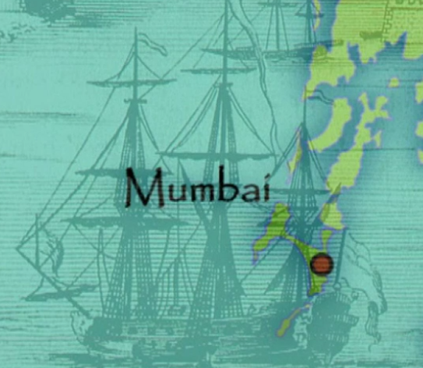
Task
Around the picture write emotion words on how this might have felt for them.
We would not like it if India invaded Birmingham and took all its goods to sell.

Slide 6
https://www.bbc.co.uk/programmes/p0114rp3
Watch the video on ‘Life in Mumbai’ Part 2.
Discuss
Why do some people in Mumbai have to live in ‘Shanty towns’ (poverty, lack of housing?
What are the problems with living in such a place?
What do you think about the Sarghar’s living conditions?

Slide 7

Mahatma Gandhi
Mahatma Gandhi devoted his whole life to fighting against injustice.
What does ‘injustice’ mean?
Known as the Father of India and a beacon of light in the last decades of British colonial rule, promoting non-violence, justice and harmony between people of all faiths.
Task- Create a fact file. Use the Ghandi PPT to help you get more information.

Slide 8
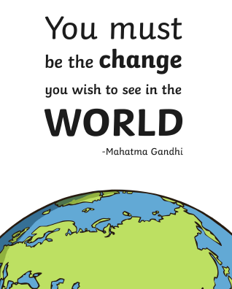

Slide 9
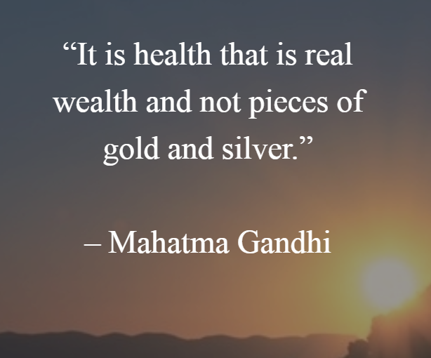
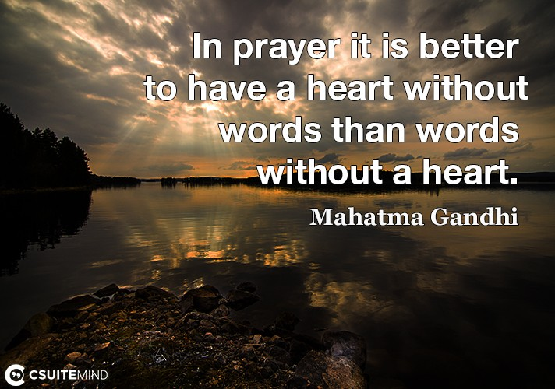

Slide 10

Why is Gandhi a Hindu hero?
What Hindu duties did Gandhi follow and how did he follow these?

