Slide 1


Slide 2


Slide 3
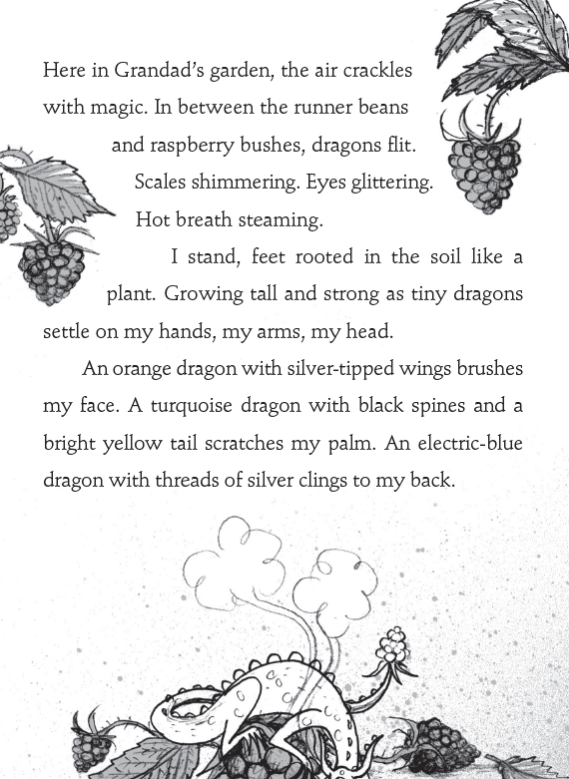

Slide 4
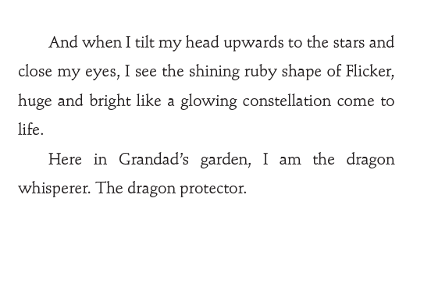

Slide 5
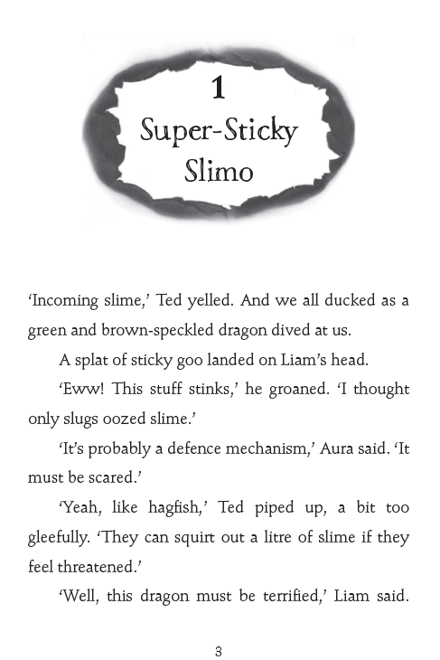

Slide 6
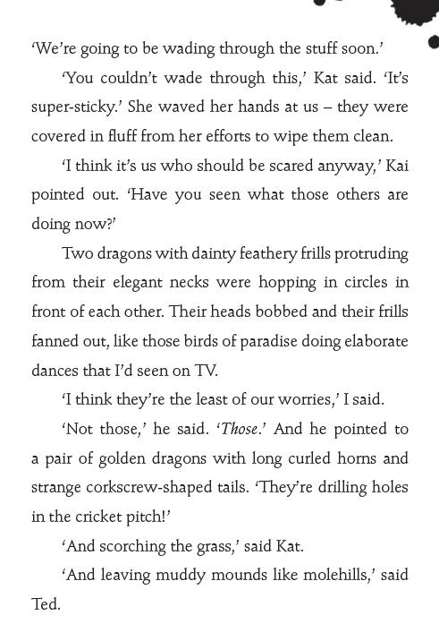

Slide 7
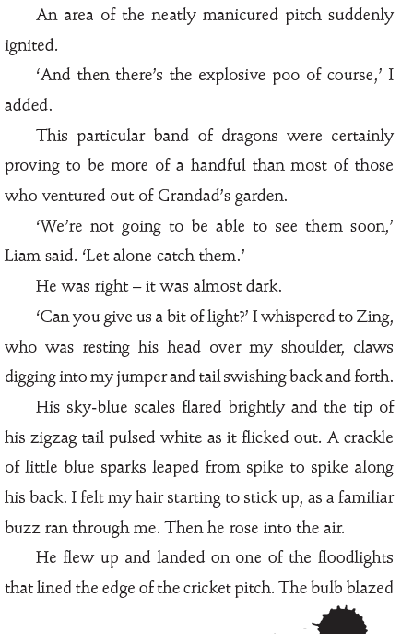

Slide 8
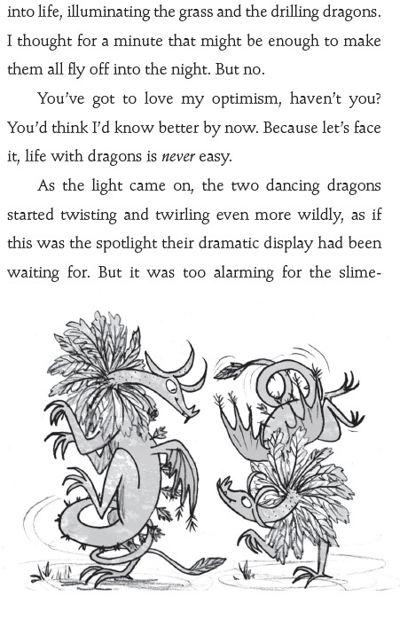

Slide 9
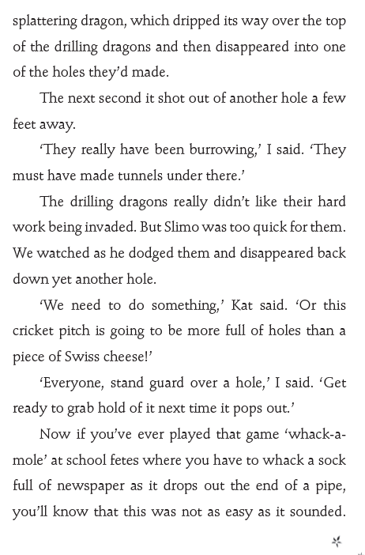

Slide 10
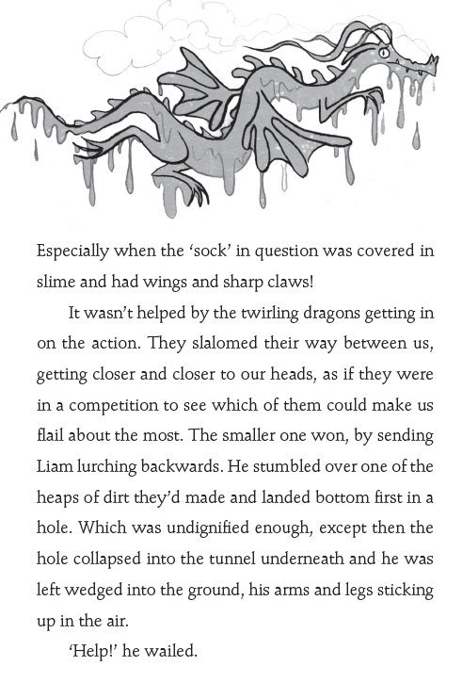

Slide 11
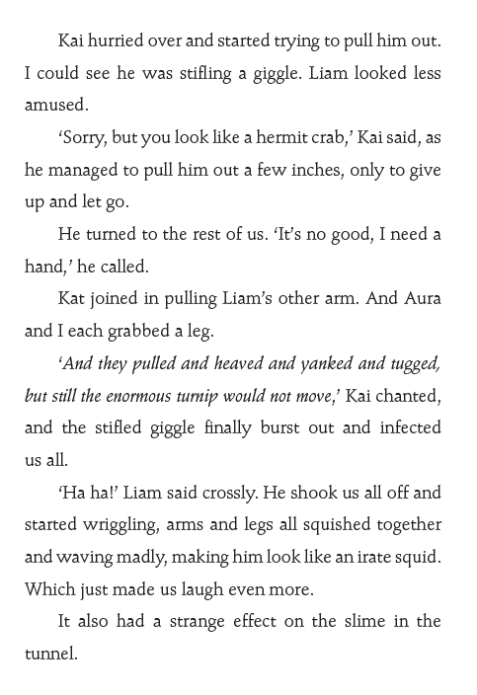

Slide 12
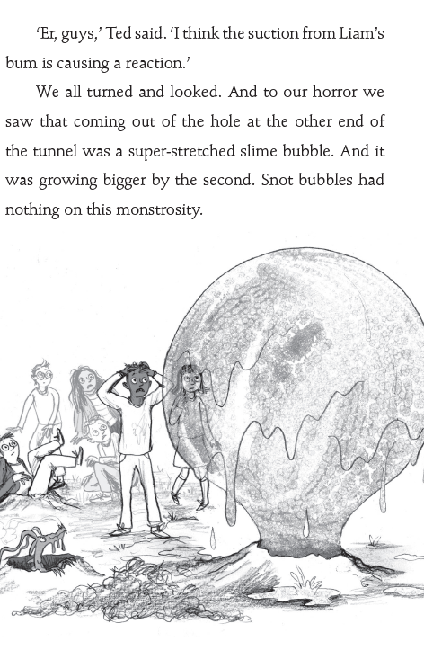

Slide 13
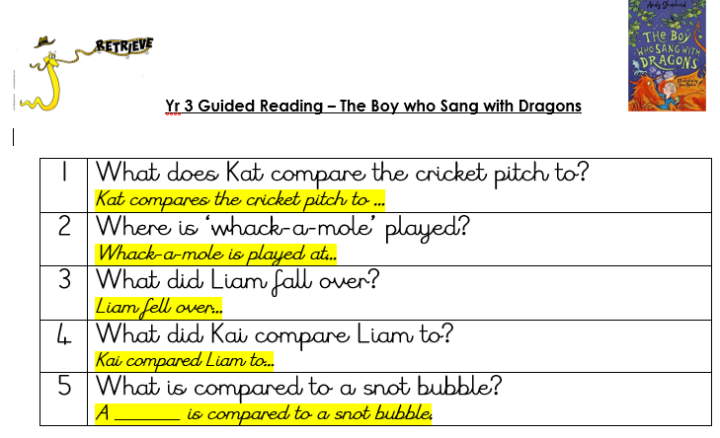

Slide 14
Answers
1 | What does Kat compare the cricket pitch to? A piece of Swiss cheese.
2 | Where is ‘whack-a-mole’ played? School fetes.
3 | What did Liam fall over? A heap of dirt.
4 | What did Kai compare Liam to? A hermit crab.
5 | What is compared to a snot bubble? A super-stretched slime bubble.

Slide 15
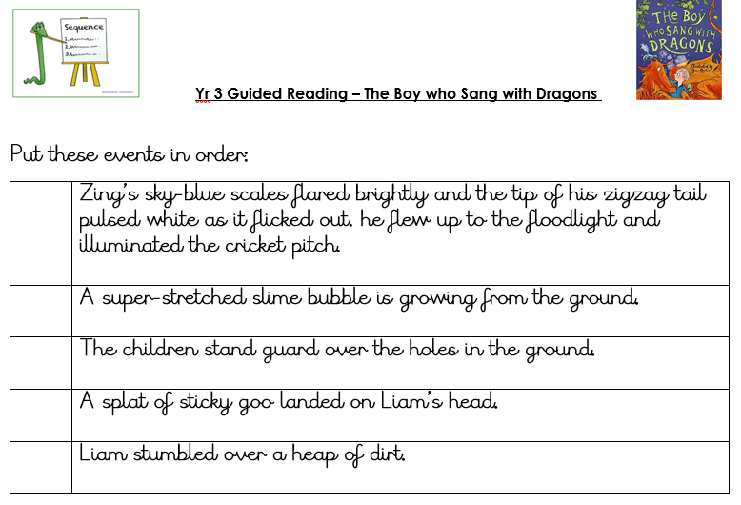

Slide 16
Answers
2
5
4
1
3

Slide 17
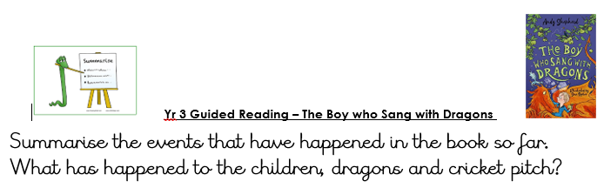

Slide 18
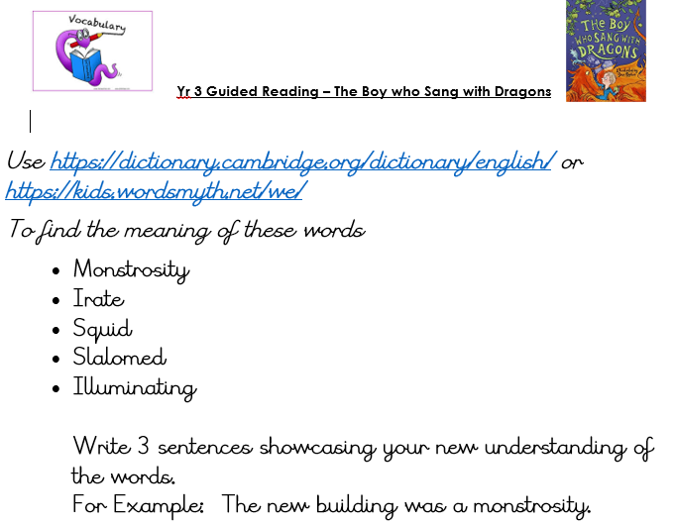
After lesson task

Slide 19
Answers-
To find the meaning of these words
Monstrosity- a thing, especially a building, which is very large and unsightly.
Irate- feeling or characterized by great anger.
Squid- an elongated, fast-swimming animal with eight arms and two long tentacles, typically able to change colour.
Slalomed- move or race in a winding path, avoiding obstacles.
Illuminating- helping to clarify or explain something.

