Slide 1


Slide 2
LO: Identify features in a poem.

Slide 3
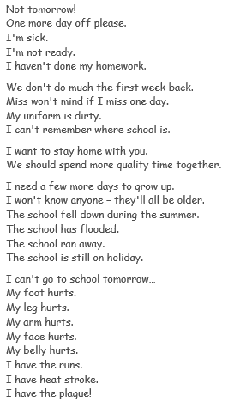

Slide 5
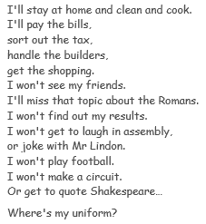

Slide 6
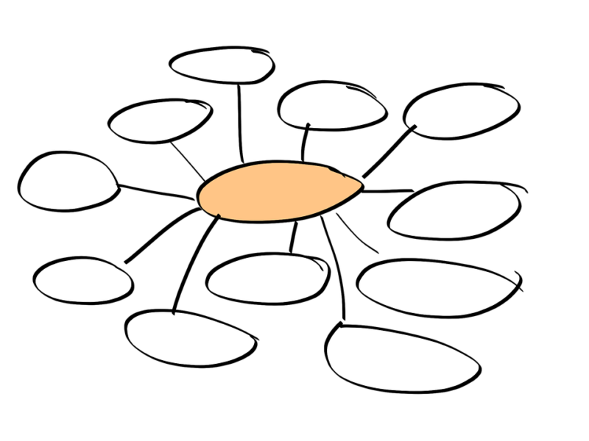
Let’s here some of your ideas from yesterday.

Slide 7
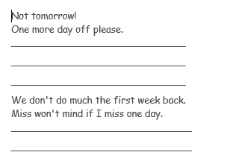
With our plan of excuses, we can now create our own version.
Use the writing frame to help you.
As a challenge- you could reword the beginning sentences too.

Slide 8
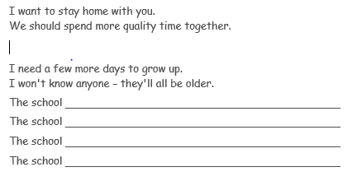
As a challenge- you could reword the beginning sentences too.

Slide 9
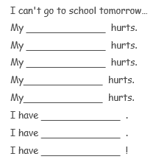
As a challenge- you could reword the beginning sentences too.

Slide 10
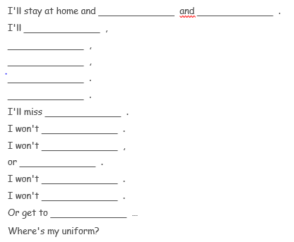
As a challenge- you could reword the beginning sentences too.

Slide 11
Let’s here what you have came up with.
Make sure you are now reading back through your work and looking to make improvements.

