Slide 1


Slide 2
LO: Identify features in a poem.

Slide 3
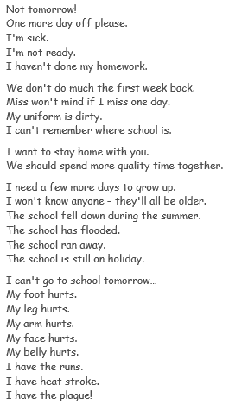

Slide 5
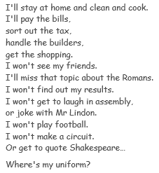

Slide 6
Punctuation
Identify the different punctuation that has been used throughout the poem.
- Make a list of the punctuation you can see.

Slide 7
Repetition- repeating words, phrases or stanzas.
Let’s explore this!
Highlight any repetition you can see in the poem.

Slide 8
Stanzas- grouped lines.
How have the stanzas been used to create effect?
- Have a look through the poem. What kind of excuses are being made in each stanza?

Slide 9

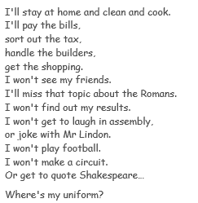
Does the child make excuses all the way through this last stanza?
Why do you think the writer has not separated this last stanza?

