Slide 1
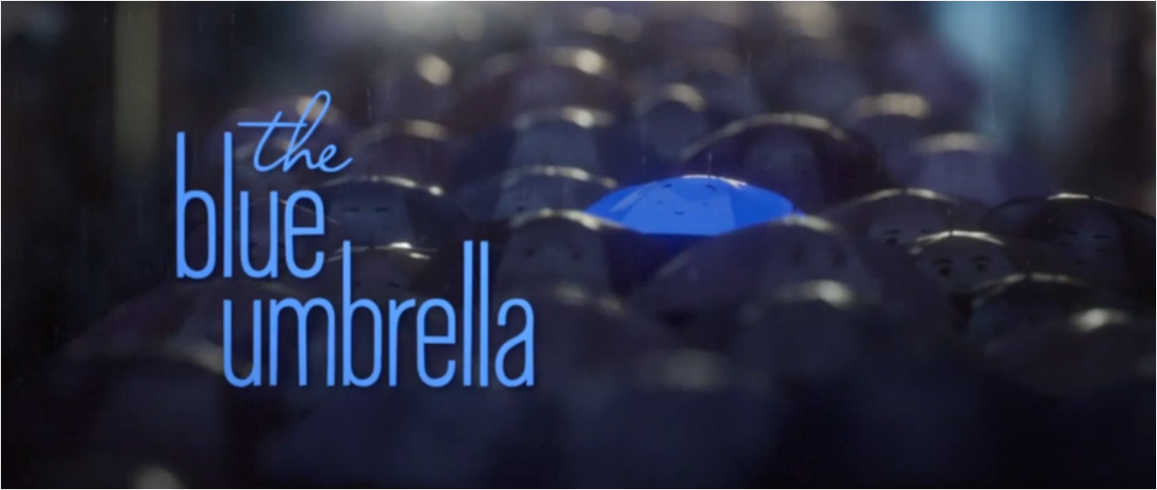

Slide 2
Let’s enjoy the Blue Umbrella together…
https://prettybird.co/us/talent/collaborators/saschka-unseld/work/the-blue-umbrella/

Slide 3
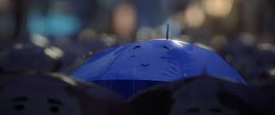
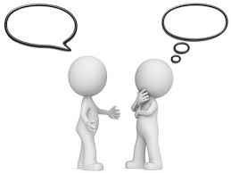
What did you think about the film?
Discuss in class your favourite bits and what you liked and didn’t like.

Slide 4
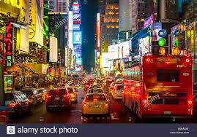
Let’s create!
https://www.youtube.com/watch?v=IN3891Aqam4

Slide 5
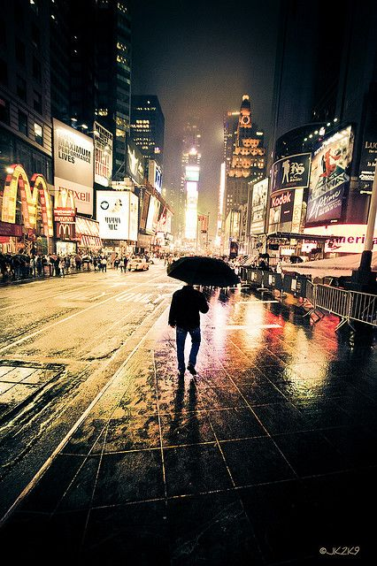
Which sounds could you hear?
Which colours can you see?
Use the word mats to help you or use https://www.wordhippo.com/
or https://www.thesaurus.com/
Think about colours, sounds, climate, weather, feelings.

Slide 6
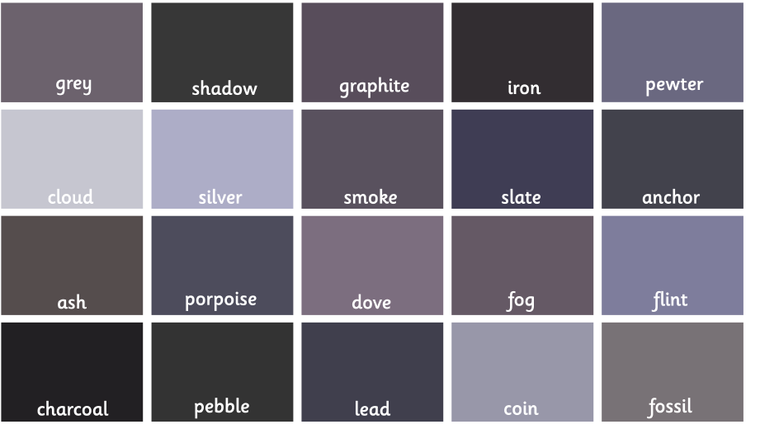

Slide 7
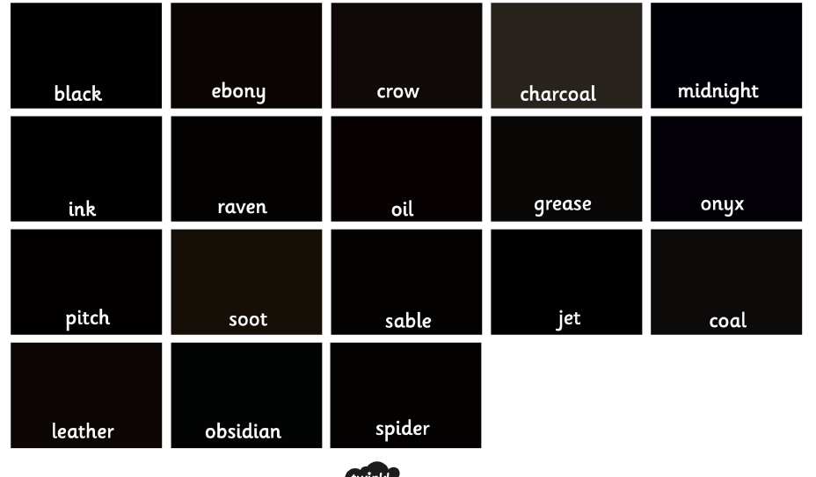

Slide 8
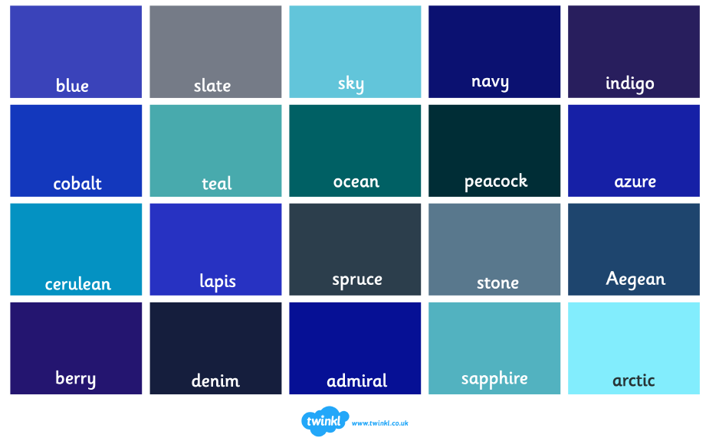

Slide 9
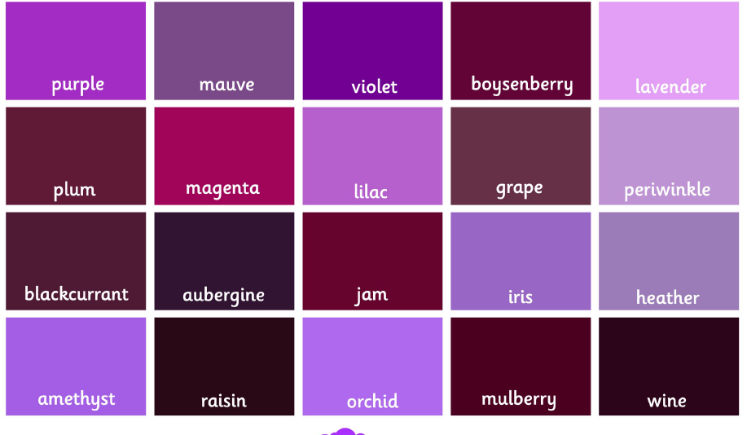

Slide 10
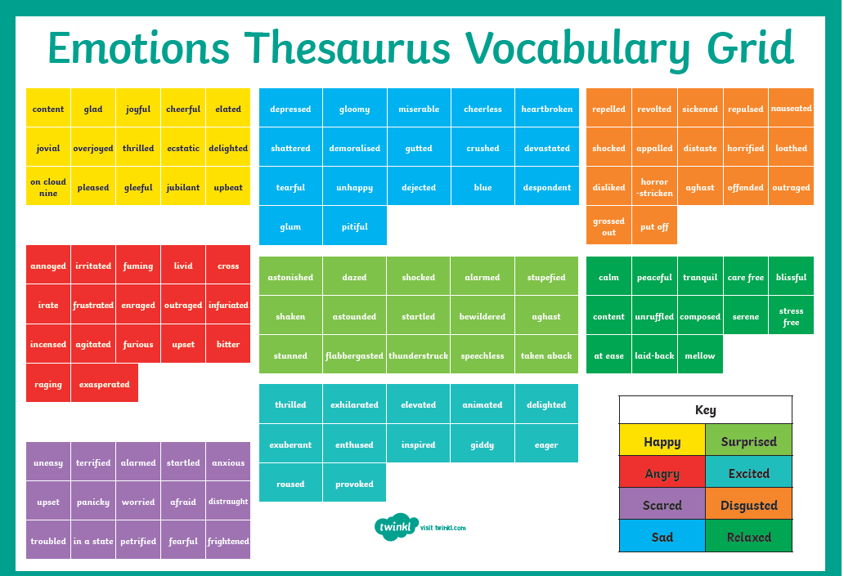

Slide 11
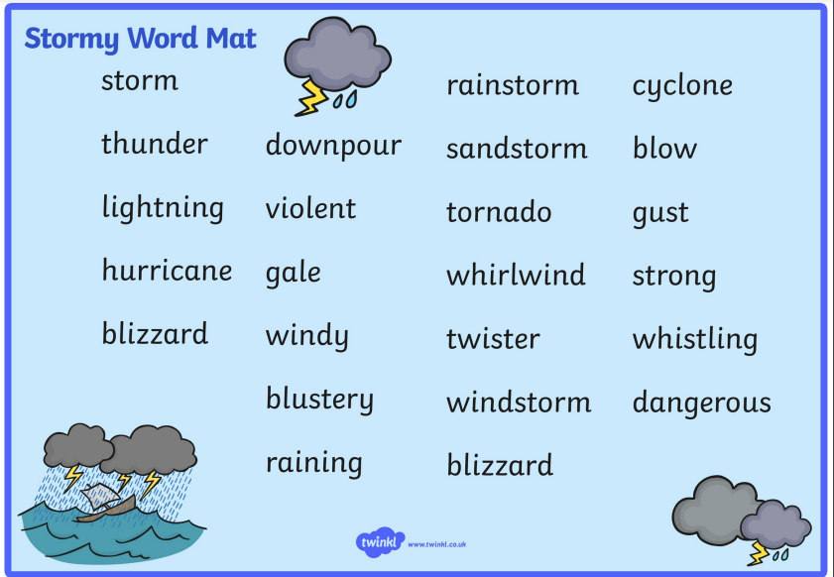

Slide 12
Record your ideas choose 3. Think about why you chose those.
Simile: the rain tumbled and twirled out of the sky like tiny diamonds, drenching the crowds with the sounds and smells of the city.
Personification: torrents of water sprinted down the pavement and vaulted into the storm drains.
Sound sentence: The city streets were violently shouting and honking as thousands of tired feet marched along the pavements.
Adverbial phrase: In a sea of onyx, a blue dome punctuated the inky umbrella waves.
Colour sentence: Fossil grey skies flashed with lightening.

Slide 13


Slide 14
Day 2

Slide 15
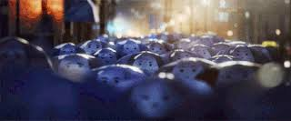
A sea of umbrellas
Fronted adverbial
Simile
Power of three (negative adjectives)

Slide 16
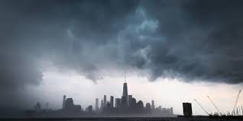
Fronted adverbial https://www.youtube.com/watch?v=b3hr3bhpeho
One evening, as workers left their jobs, a storm started.

Slide 17
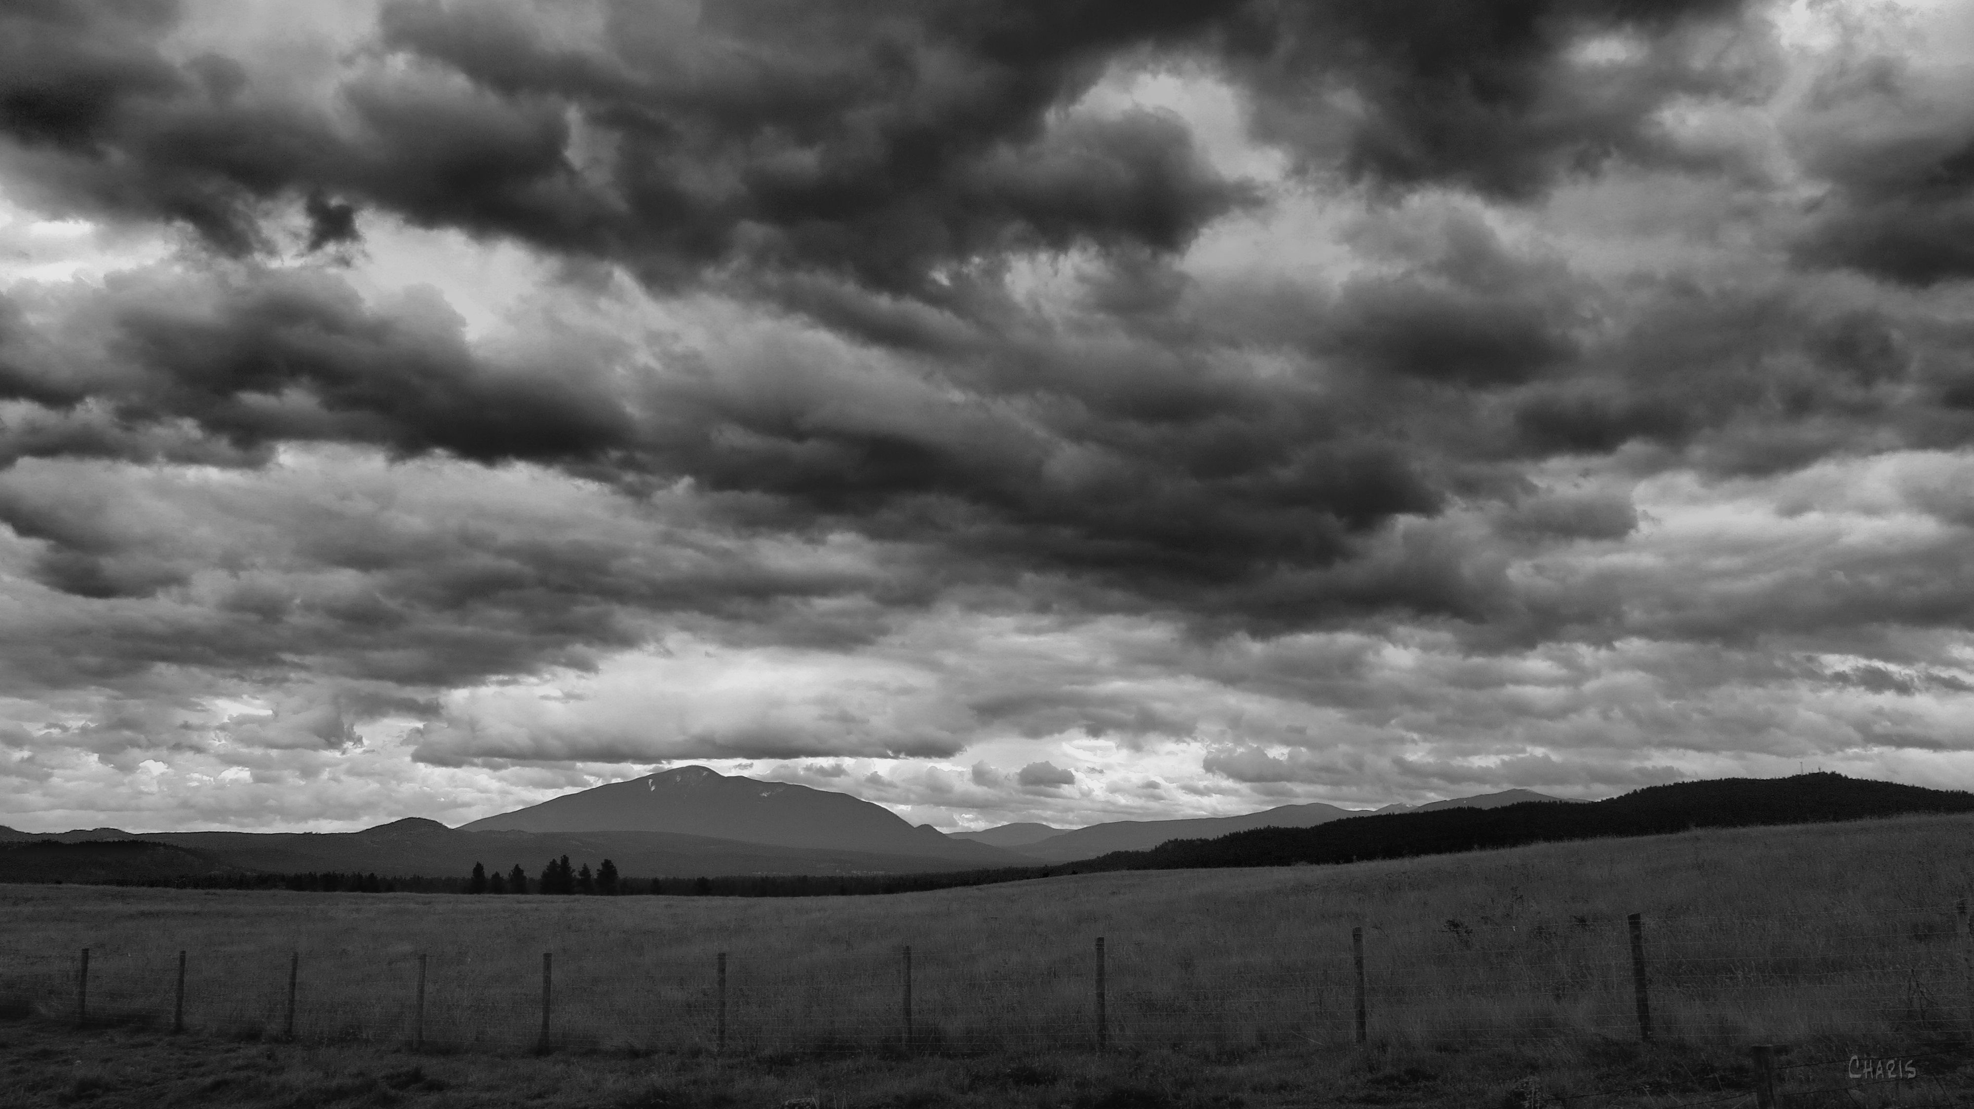
Simile https://www.youtube.com/watch?v=gkmkaglmkzk
It was as grey as a foreboding shadow.

Slide 18
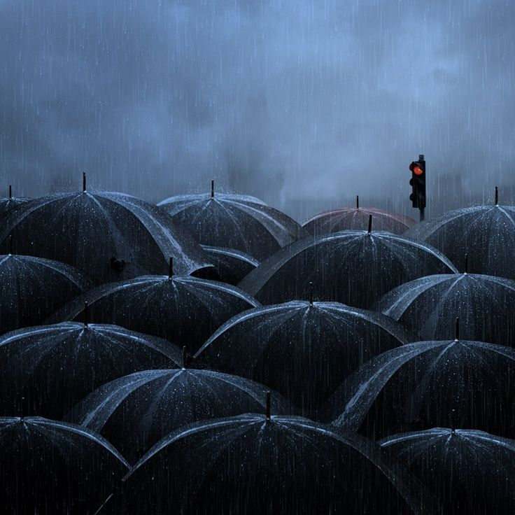
Power of Three
Moving as a mass of misery, the umbrellas marched – glum, cheerless, gloomy.

Slide 19
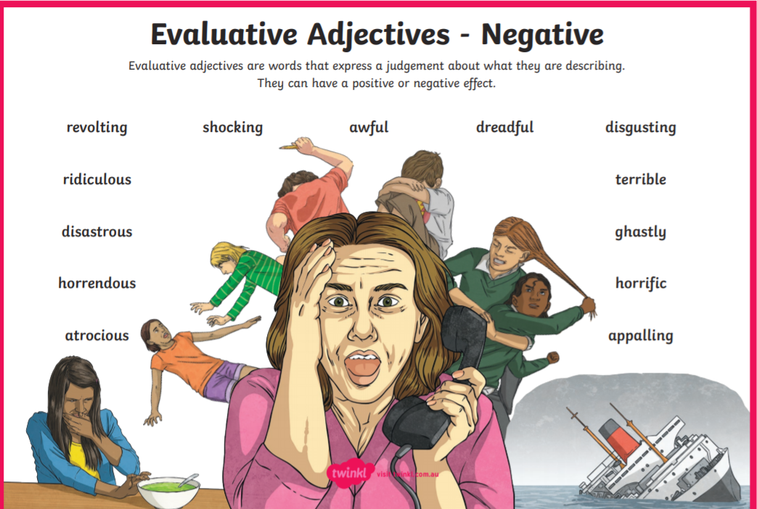

Slide 20
Day 3

Slide 21
A dancing blue umbrella
Precise verb
Complex sentence
Simile

Slide 22

Precise Verb
Out of the sea of grey, a bright blue umbrella emerged.

Slide 23
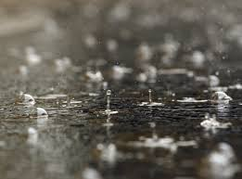
Complex Sentence https://www.youtube.com/watch?v=hrpiX4bh5Nw
Elated, with a sense of fulfilment, he danced amongst the musical raindrops.

Slide 24
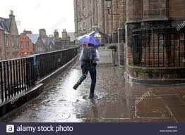
Simile
Blue watched fascinated and curious as he saw commuters leaping over puddles like graceful ballet dancers.

Slide 25
Day 4

Slide 26
Standing Side by Side
Role on the wall
Adverbial
Question
Imperative verb

Slide 27
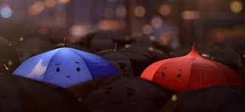
Role on the wall
Explore the dialogue between the blue umbrella and the red umbrella as they meet for the first time. What would they be thinking? What would they say to each other? Squeeze your role-play for the FANTASTICS.

Slide 28
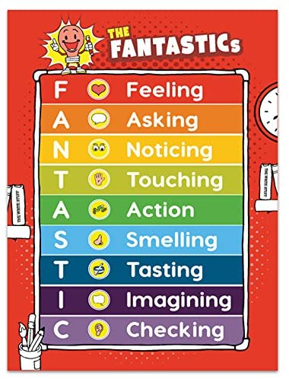

Slide 29
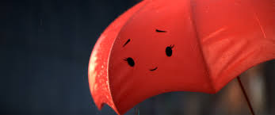
Adverbial
All of a sudden, by his side there was a red umbrella, a scarlet red umbrella.

Slide 30
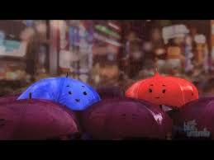
Question
Who is this beautiful umbrella? Should he introduce himself?

Slide 31
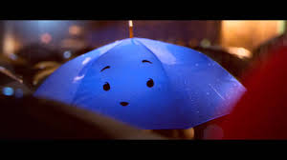
Imperative Verbs https://www.youtube.com/watch?v=lR5RamySULY
Be cool! Look handsome! Act interested! As theses thoughts flew through his mind, a sudden gust of wind blew him inside out.

Slide 32
Day 5

Slide 33
Pulled Apart
Dialogue
Precise verbs
Prepositional phrase

Slide 34
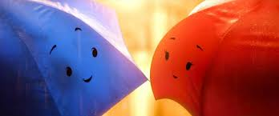
Dialogue
https://www.youtube.com/watch?v=iiinspRKGAY
Plucking up the courage to speak, he stuttered, “Do, Do, Do you want…?”

Slide 35
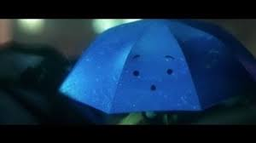
Precise verbs
Words hung unfinished in the air as a cruel twist of fate ripped her away from him.

Slide 36
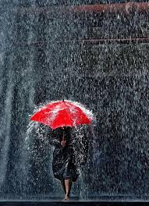
Prepositional Phrase
https://www.theschoolrun.com/what-are-prepositions
One minute she was next to the coffee shop, then she was by the subway and finally he saw her disappear into the distance.

