Slide 1


Slide 2


Slide 3
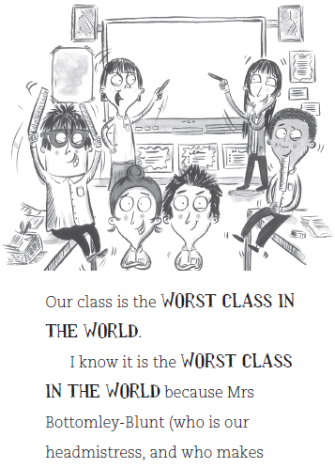

Slide 4
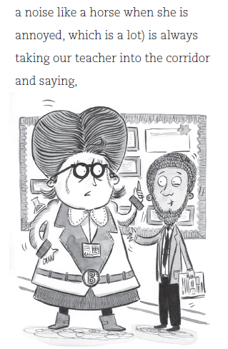

Slide 5
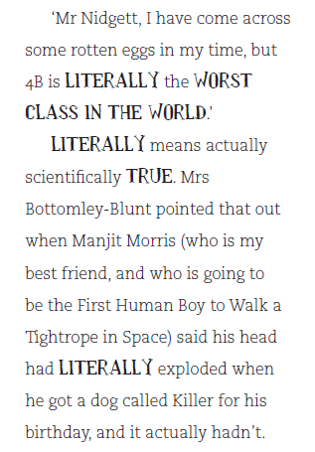

Slide 6
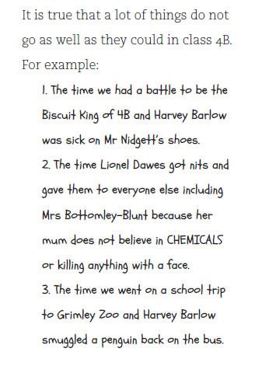

Slide 7
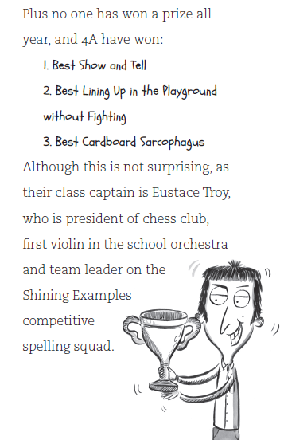

Slide 8
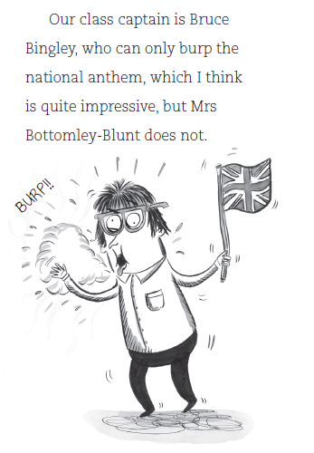

Slide 9
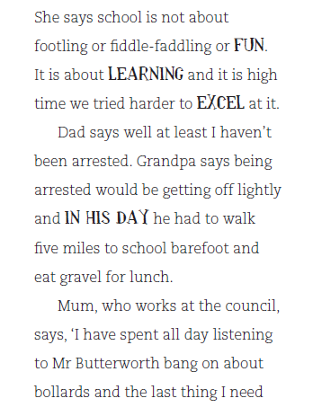

Slide 10
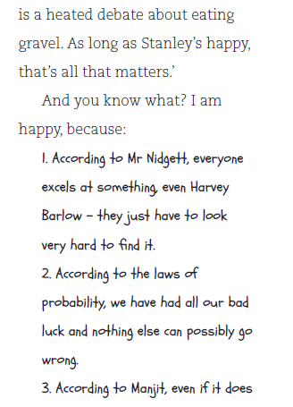

Slide 11
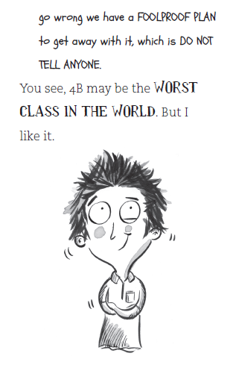

Slide 12
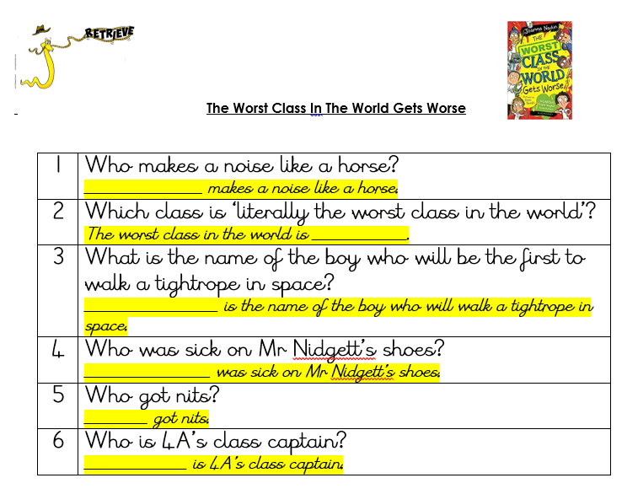

Slide 13
Answers
1 | Who makes a noise like a horse? Mrs Bottomley-Blunt
2 | Which class is ‘literally the worst class in the world’? 4B
3 | What is the name of the boy who will be the first to walk a tightrope in space? Manjit Morris
4 | Who was sick on Mr Nidgett’s shoes? Harvey Burlow
5 | Who got nits? Lionel Dawes
6 | Who is 4A’s class captain? Eustace Troy

Slide 14
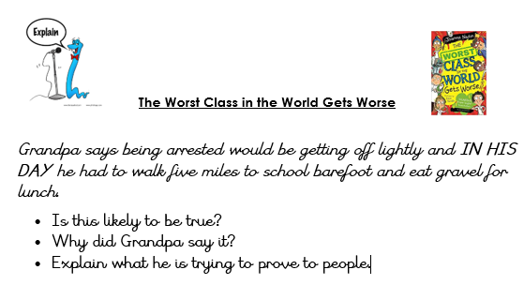

Slide 15
Example Answers
Is this likely to be true?
It is unlikely that Grandpa would have eaten gravel for lunch.
Why did Grandpa say it?
Grandpa could have said it to prove that being arrested is a lesser punishment than his normal journey to school.
Explain what he is trying to prove to people.
Grandpa might be trying to prove to the children that they do not have it as tough at school as they think, through saying in his day he went through tougher times. Shows resilience.

Slide 16
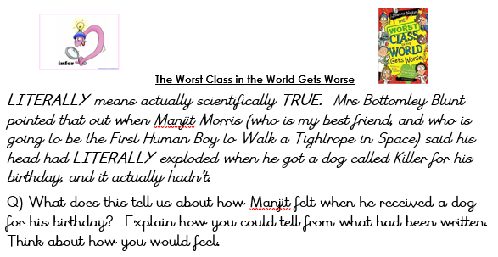

Slide 17
Example Answer
It tells us that Manjot was so excited to get a dog for his birthday. Stanley writes that his head had “literally exploded” which could mean he could not contain his feelings and excitement as they nearly burst out of his head.
I think my head would explode with excitement too.

Slide 18


Slide 19


Slide 20

After Lesson Task

