Slide 1


Slide 2
26.2.21
LO: Comparing Area

Slide 3
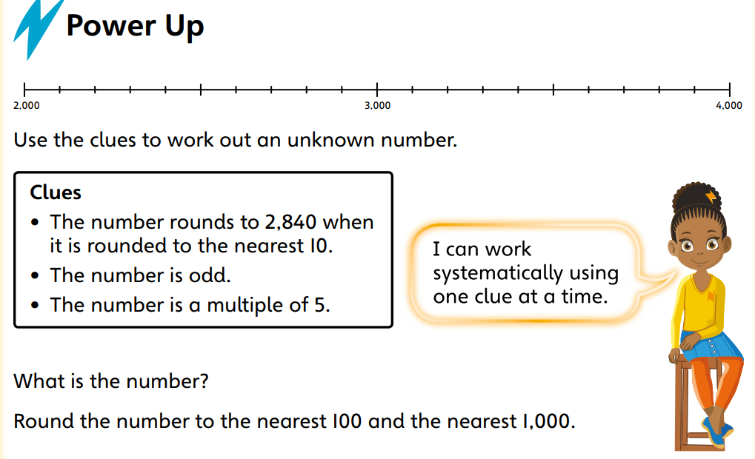

Slide 4
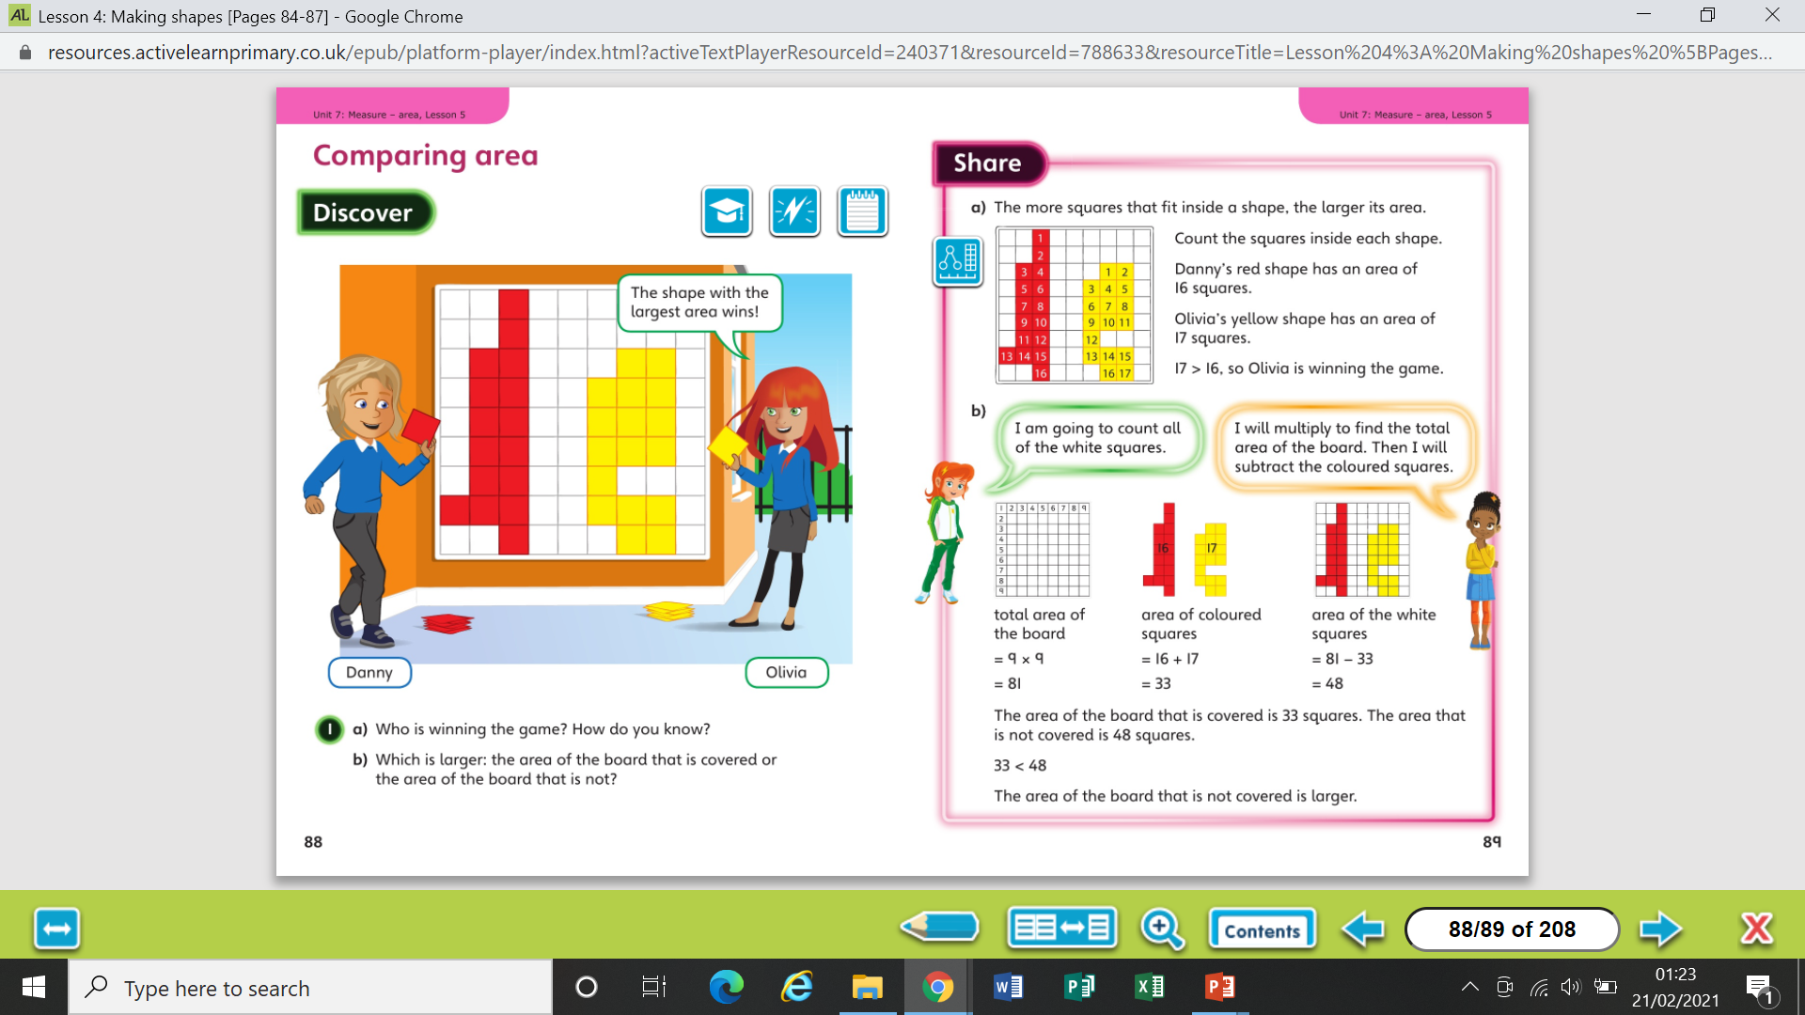

Slide 6
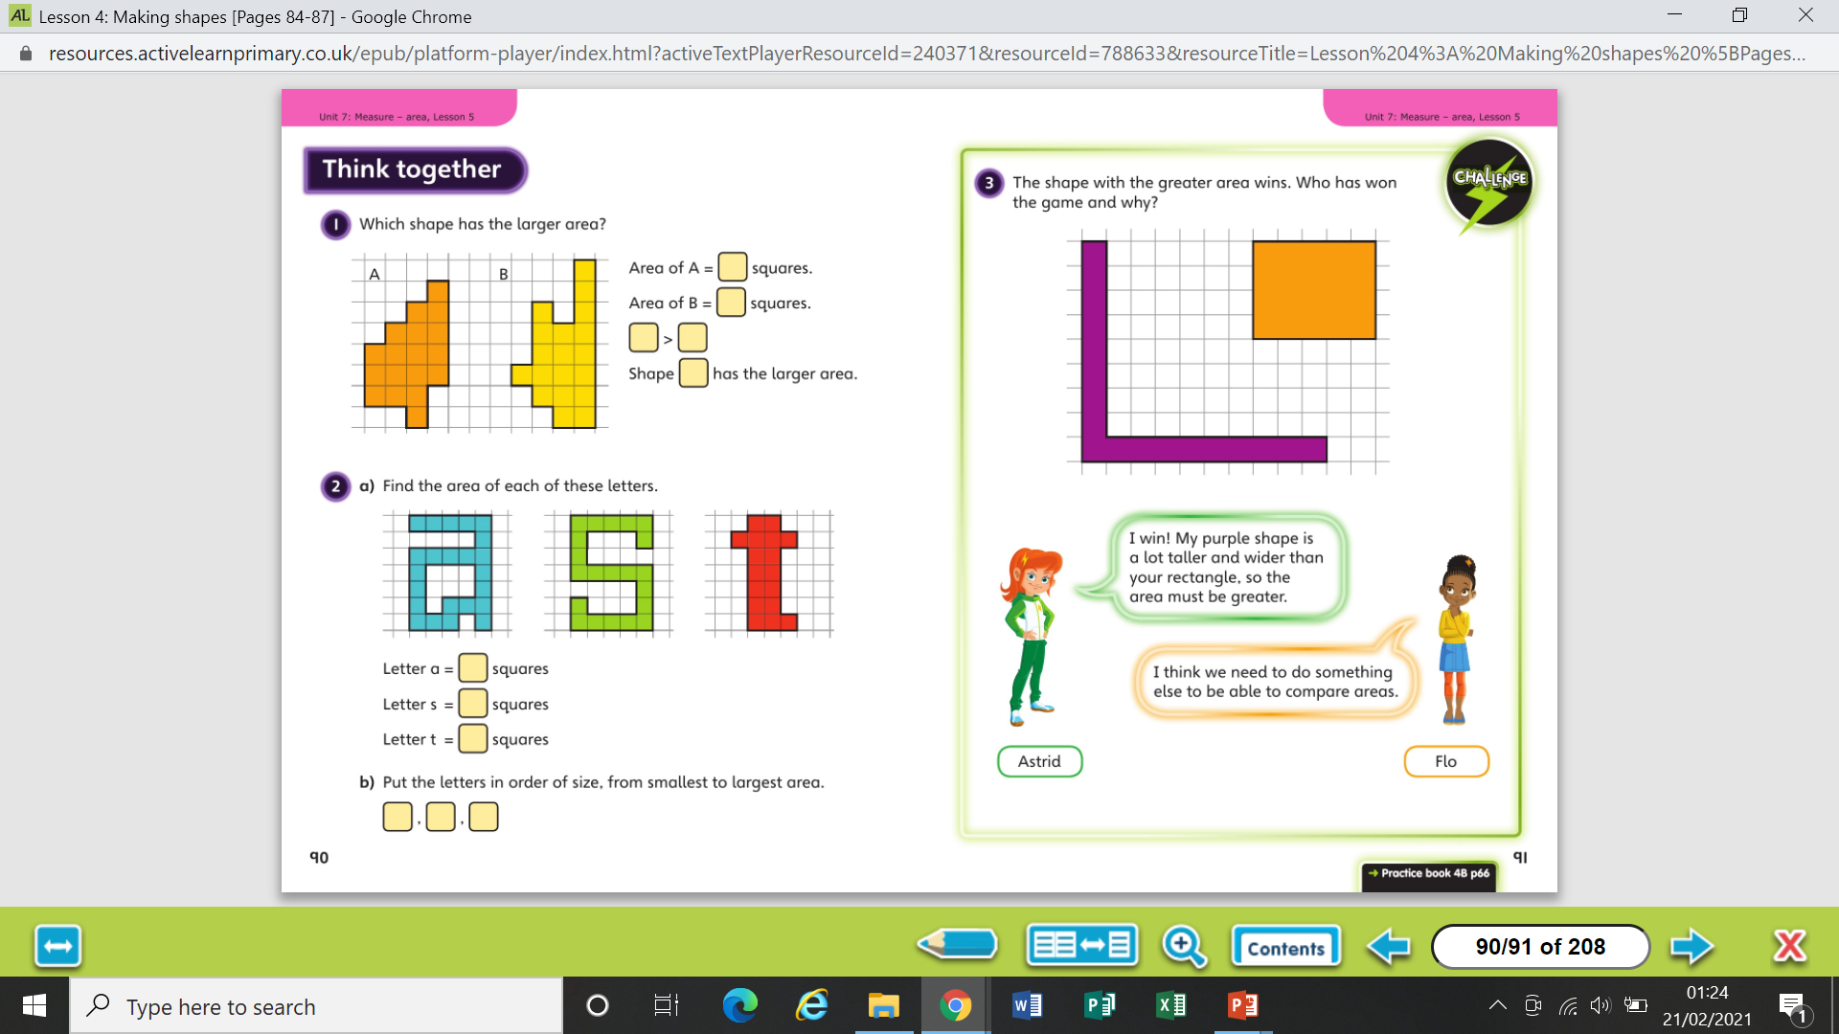

Slide 8
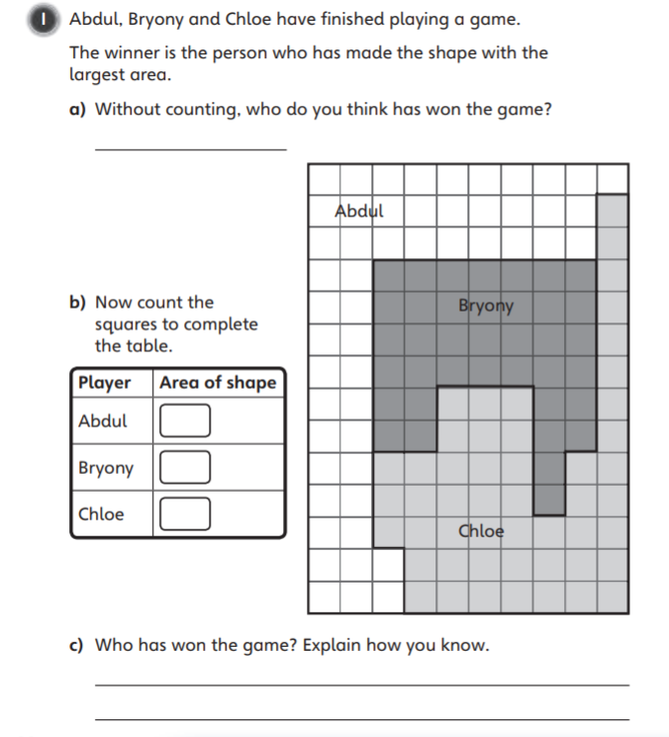
Worksheet

Slide 9
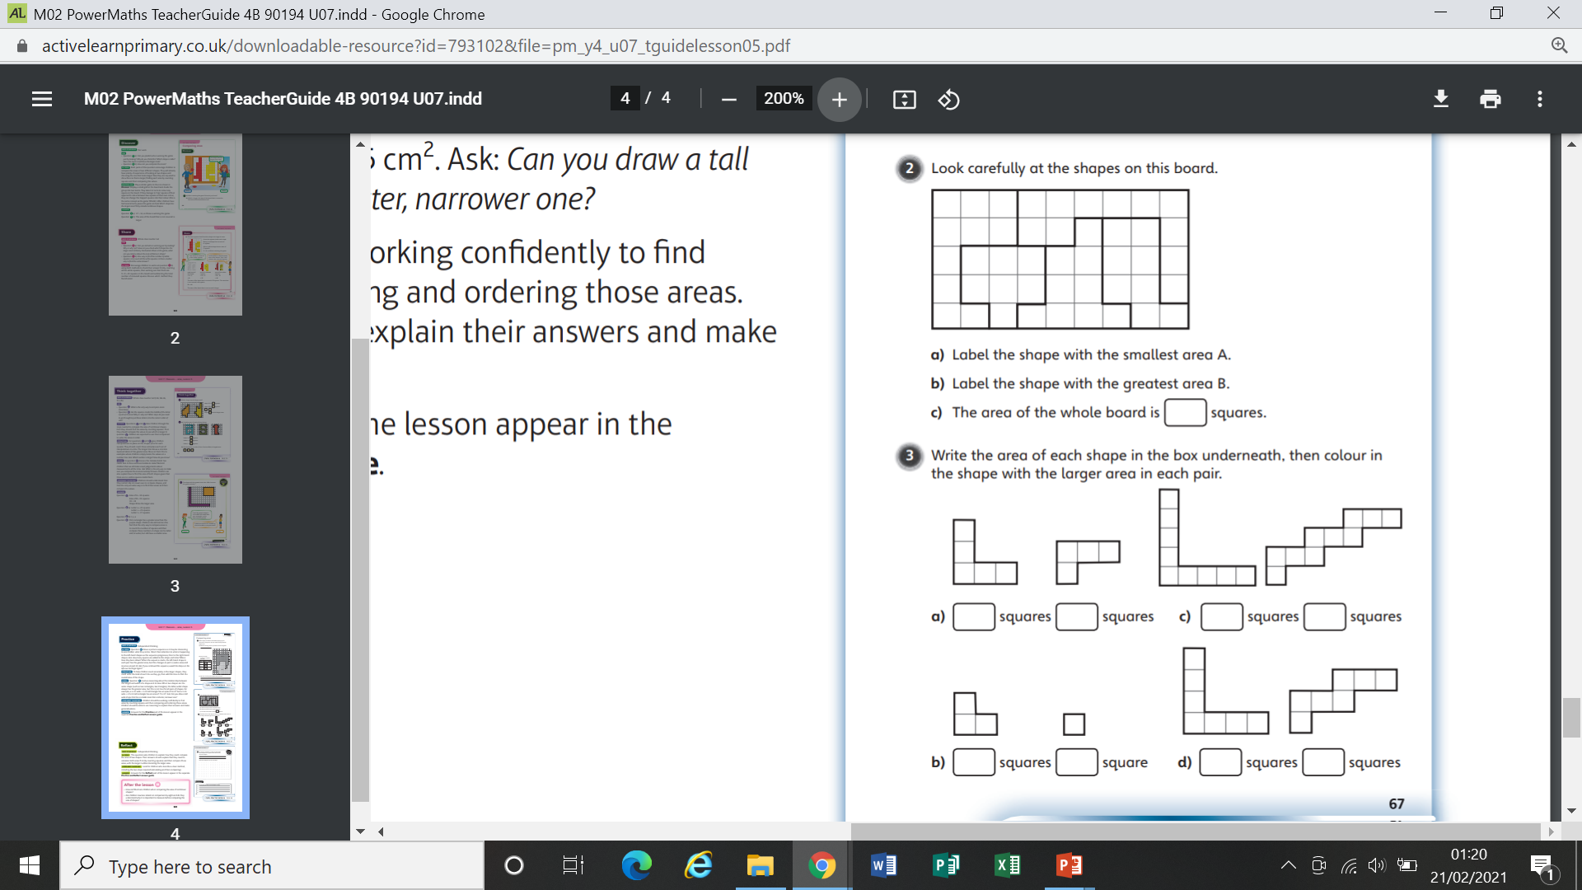
Worksheet

Slide 10
Worksheet

Slide 11
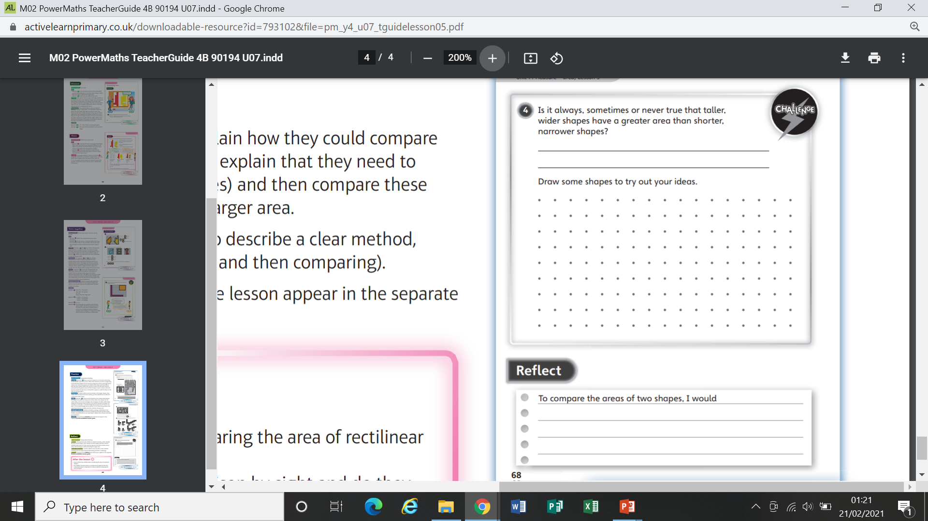
Worksheet

Slide 12
Worksheet

