Slide 1


Slide 2
23.2.21
LO: Counting Squares

Slide 3
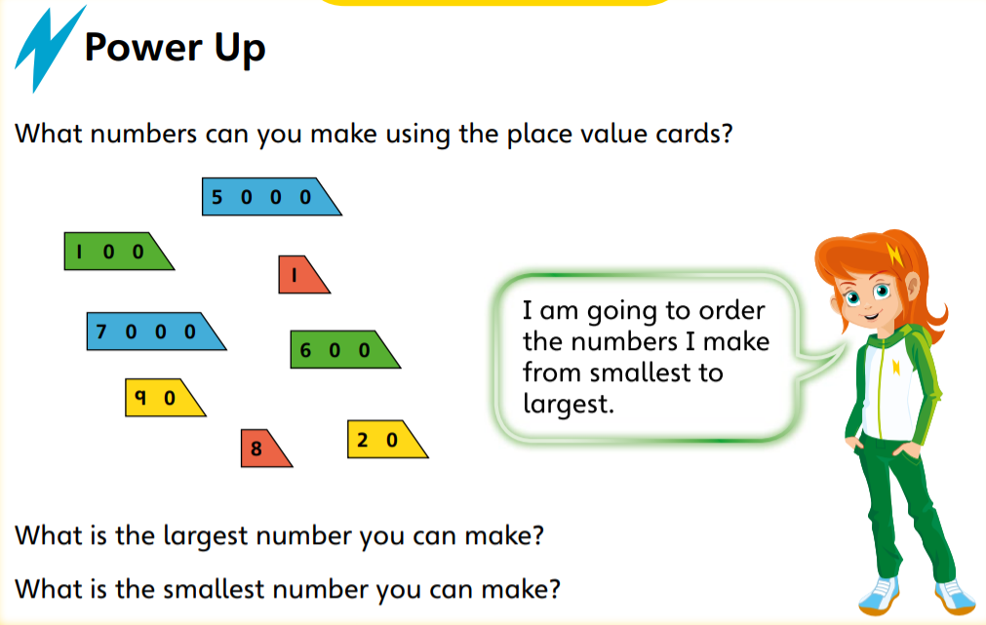

Slide 4
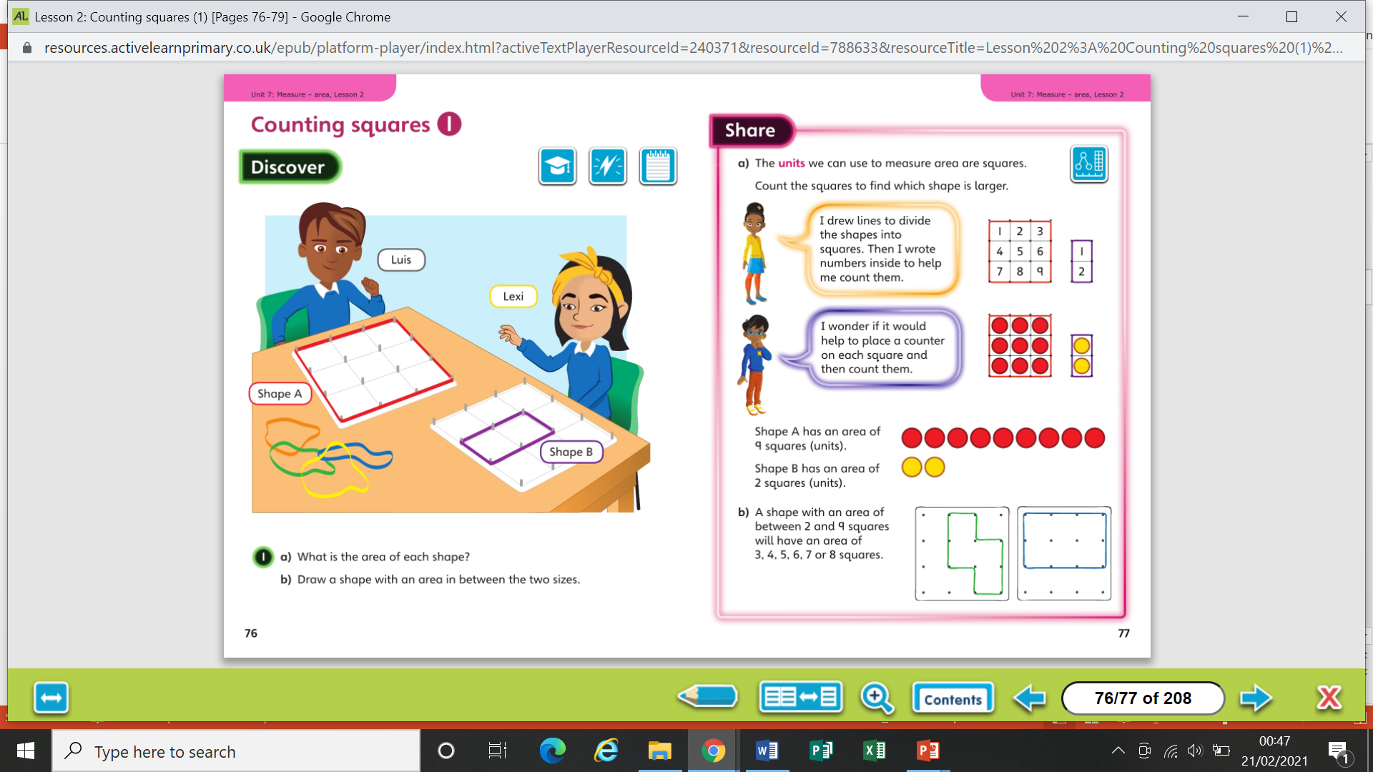

Slide 6
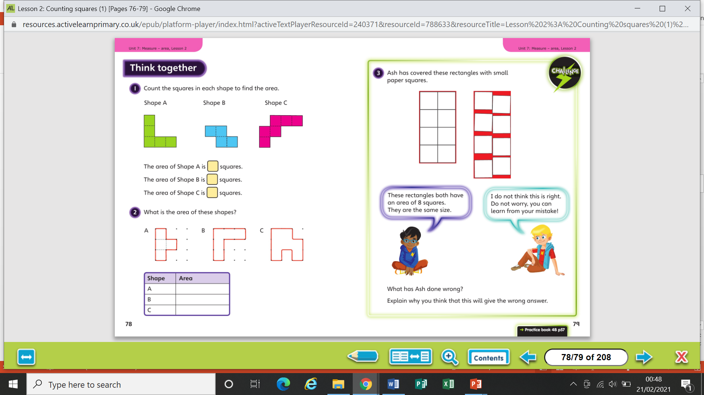

Slide 8
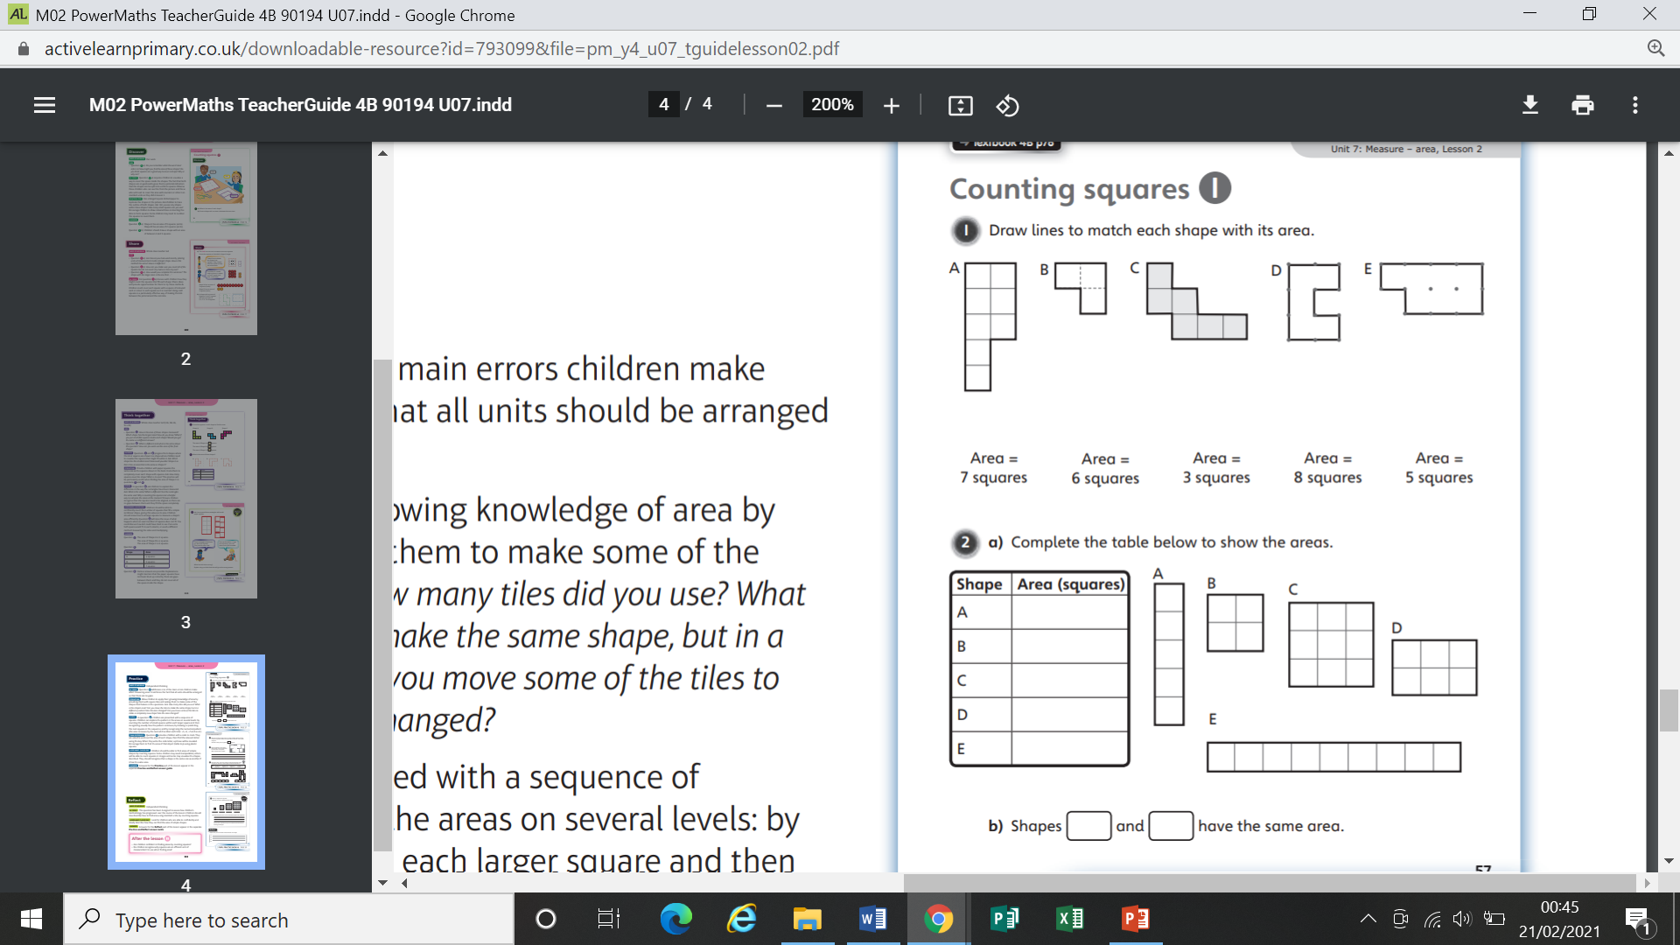
Worksheet

Slide 9
Worksheet

Slide 10
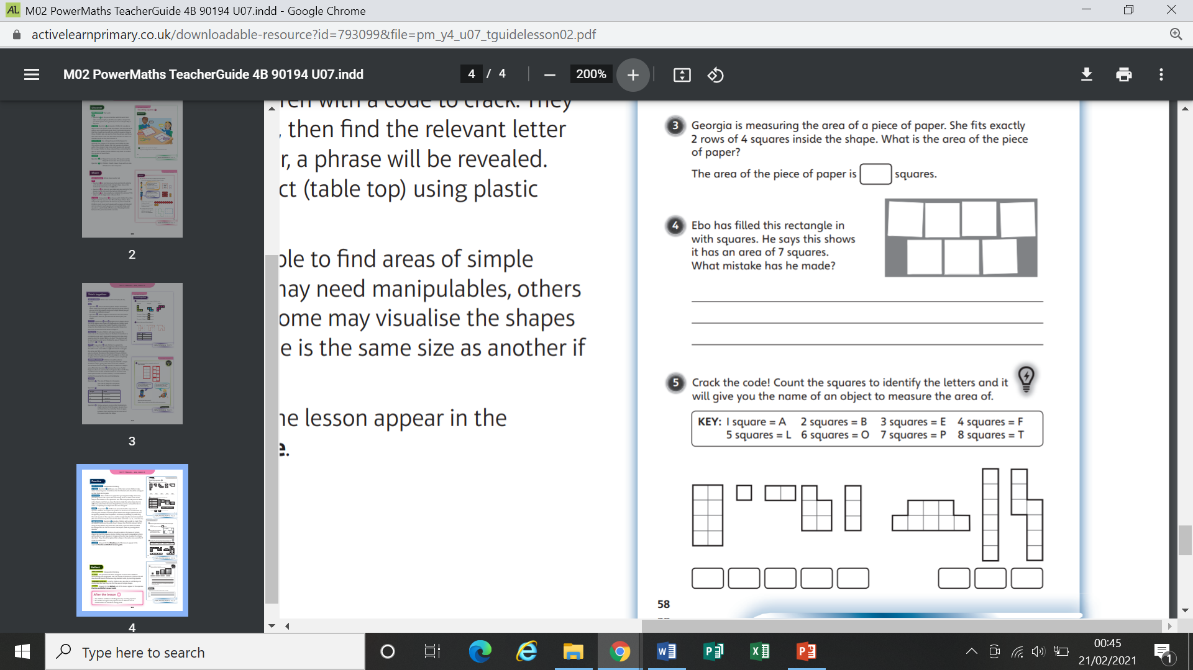
Worksheet

Slide 11
Worksheet

Slide 12
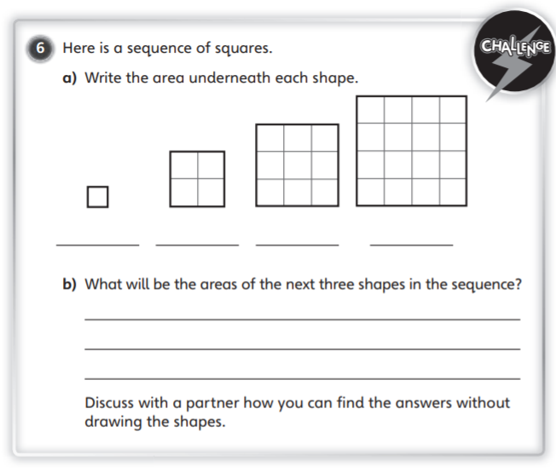
Worksheet

Slide 13
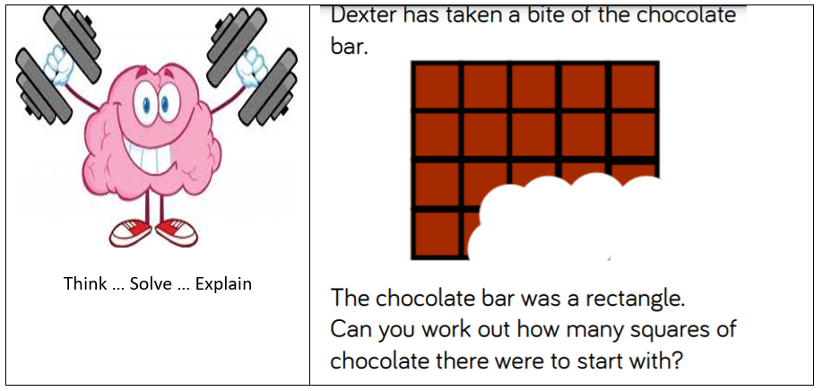

Slide 14
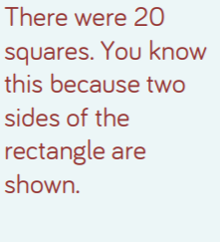
Answer

