Slide 1


Year 3 – Spring Block 4 – Length and Perimeter
Step 2: Equivalent Lengths – m and cm
© Classroom Secrets Limited 2019

Slide 2
Introduction
What are the missing markings on the metre stick?
20cm
70cm
© Classroom Secrets Limited 2019

Slide 3
Introduction
What are the missing markings on the metre stick?
0cm
20cm
40cm
60cm
80cm
100cm
10cm
30cm
50cm
70cm
90cm
© Classroom Secrets Limited 2019

Slide 4
Varied Fluency 1
Complete the part-whole model below.
631cm
6m
31cm
© Classroom Secrets Limited 2019

Slide 5
Varied Fluency 1
Complete the part-whole model below.
631cm
6m
31cm
© Classroom Secrets Limited 2019

Slide 6
Varied Fluency 2
Circle the measurement that is the odd one out.
3 m
3m and 12cm
350cm
1
2
© Classroom Secrets Limited 2019

Slide 7
Varied Fluency 2
Circle the measurement that is the odd one out.
3 m
3m and 12cm
350cm
1
2
© Classroom Secrets Limited 2019

Slide 8
Varied Fluency 3
Put these lengths in order from shortest to longest.
4m and 28cm |  | 523cm |  | 482cm
5m and 11cm |  | 4 m |  | 4m and 98cm
1
2
© Classroom Secrets Limited 2019

Slide 9
Varied Fluency 3
Put these lengths in order from shortest to longest.
(Shortest) 4m and 28cm, 4 m, 482cm, 4m and 98cm,
5m and 11cm and 523cm (longest).
4m and 28cm |  | 523cm |  | 482cm
5m and 11cm |  | 4 m |  | 4m and 98cm
1
2
1
2
1
2
© Classroom Secrets Limited 2019

Slide 10
Varied Fluency 4
Complete the conversion table:
m and cm | cm
 | 352cm
5m and 25cm
 | 185cm
8m and 89cm
 | 673cm
© Classroom Secrets Limited 2019

Slide 11
Varied Fluency 4
Complete the conversion table:
m and cm | cm
3m and 52cm | 352cm
5m and 25cm | 525cm
1m and 85cm | 185cm
8m and 89cm | 889cm
6m and 73cm | 673cm
© Classroom Secrets Limited 2019

Slide 12
Now have a go at some VF questions.
Worksheet on the school website.
Choose what questions to start on based on your confidence:
D = 1 Star difficulty.
E = 2 Star difficulty.
GD= 3 Star difficulty.

Slide 13

Reasoning 1
Lee’s bedroom is 3m and 58cm long. Is his piece of carpet long enough?
Convince me.
My piece of carpet is 388cm long.
Lee
© Classroom Secrets Limited 2019

Slide 14
Reasoning 1
Lee’s bedroom is 3m and 58cm long. Is his piece of carpet long enough?
Convince me.
Lee’s carpet is long enough because…
My piece of carpet is 388cm long.
Lee
© Classroom Secrets Limited 2019

Slide 15
Reasoning 1
Lee’s bedroom is 3m and 58cm long. Is his piece of carpet long enough?
Convince me.
Lee’s carpet is long enough because Lee’s bedroom is 3m and 58cm long which is equivalent to 358cm. His piece of carpet is 388cm long which is 30cm longer.
My piece of carpet is 388cm long.
Lee
© Classroom Secrets Limited 2019

Slide 16
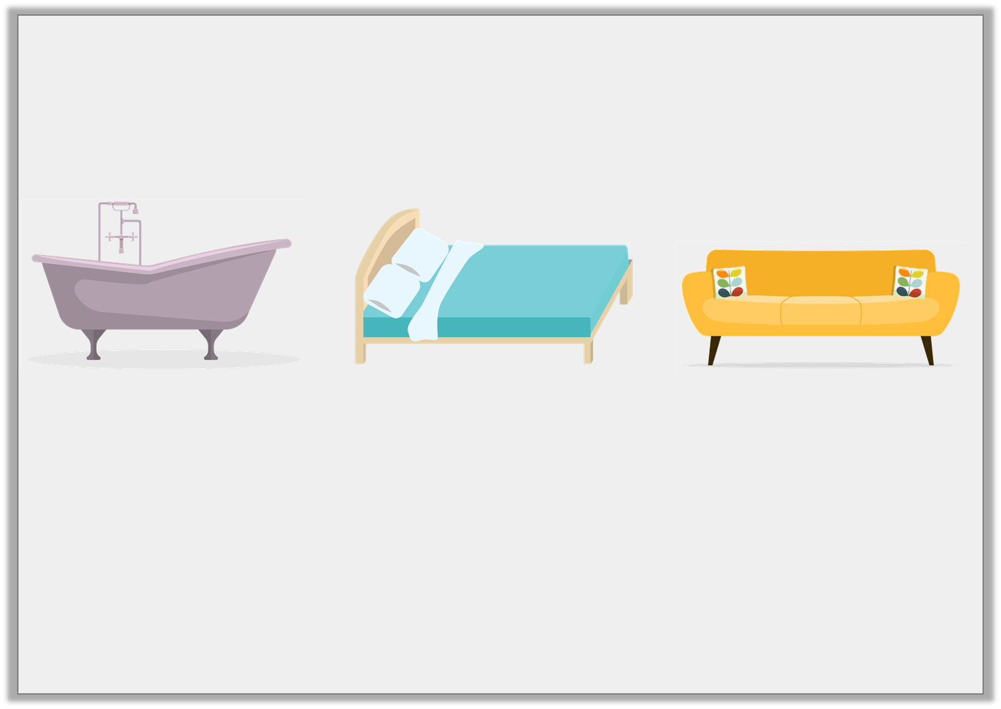
Reasoning 2
True or false? The bed is longer than both the sofa and the bathtub.
Explain your answer.
Not drawn to scale
1 m |  | 213cm |  | 2m and 31cm
1
2
© Classroom Secrets Limited 2019

Slide 17
Reasoning 2
True or false? The bed is longer than both the sofa and the bathtub.
Explain your answer.
False because…
Not drawn to scale
1 m |  | 213cm |  | 2m and 31cm
1
2
© Classroom Secrets Limited 2019

Slide 18
Reasoning 2
True or false? The bed is longer than both the sofa and the bathtub.
Explain your answer.
False because the bed’s length is 213cm and the sofa’s length is 2m and 31cm which is equivalent to 231cm so the sofa is 18cm longer than the bed.
Not drawn to scale
1 m |  | 213cm |  | 2m and 31cm
1
2
© Classroom Secrets Limited 2019

Slide 19

Problem Solving 1
Penny has used three digit cards to make three pairs of equivalent lengths.
What could the digit cards’ values be?
.
When the digits are added together, the digit sum is 17.
m cm | = | cm
m cm | = | cm
m cm | = | cm
© Classroom Secrets Limited 2019

Slide 20
Problem Solving 1
Penny has used three digit cards to make three pairs of equivalent lengths.
What could the digit cards’ values be?
Various answers, an example is shown above.
.
When the digits are added together, the digit sum is 17.
4
6
7
4
6
7
m cm | = | cm
6
4
7
6
4
7
m cm | = | cm
7
6
4
7
6
4
m cm | = | cm
© Classroom Secrets Limited 2019

Slide 21
Now have a go at some RPS questions.
Worksheet on the school website.
Choose what questions to start on based on your confidence:
D = 1 Star difficulty.
E = 2 Star difficulty.
GD= 3 Star difficulty.

