Slide 1


Year 3 – Spring Block 4 – Length and Perimeter
Step 3: Equivalent Lengths – mm and cm
© Classroom Secrets Limited 2019

Slide 2
Introduction
1cm is equal to 10mm.
Use this information to complete these conversions.
cm | 0 | 1 | 2 | 3 | 4 | 5 | 6 | 7 | 8 | 9 | 10
mm | 0 | 10 | 20 | 30 | 40 | 50 | 60 | 70 | 80 | 90 | 100
20mm |  |  | = |  | cm
 |  | mm | = | 4 | cm
300mm |  |  | = |  | cm
© Classroom Secrets Limited 2019

Slide 3
Introduction
1cm is equal to 10mm.
Use this information to complete these conversions.
cm | 0 | 1 | 2 | 3 | 4 | 5 | 6 | 7 | 8 | 9 | 10
mm | 0 | 10 | 20 | 30 | 40 | 50 | 60 | 70 | 80 | 90 | 100
20mm |  |  | = | 2 | cm
 | 40 | mm | = | 4 | cm
300mm |  |  | = | 30 | cm
© Classroom Secrets Limited 2019

Slide 4
Varied Fluency 1
Complete the measurement to match the length shown on the ruler.
cm | 0 | 1 | 2 | 3 | 4 | 5 | 6 | 7 | 8 | 9 | 10
mm | 0 | 10 | 20 | 30 | 40 | 50 | 60 | 70 | 80 | 90 | 100
 |  | cm |  |  | mm
© Classroom Secrets Limited 2019

Slide 5
Varied Fluency 1
Complete the measurement to match the length shown on the ruler.
cm | 0 | 1 | 2 | 3 | 4 | 5 | 6 | 7 | 8 | 9 | 10
mm | 0 | 10 | 20 | 30 | 40 | 50 | 60 | 70 | 80 | 90 | 100
 | 8 | cm |  | 3 | mm
© Classroom Secrets Limited 2019

Slide 6
Varied Fluency 2
Join the equivalent lengths:
48mm
93mm
721mm
4cm 8mm
9cm 3mm
72cm 1mm
© Classroom Secrets Limited 2019

Slide 7
Varied Fluency 2
Join the equivalent lengths:
48mm
93mm
721mm
4cm 8mm
9cm 3mm
72cm 1mm
© Classroom Secrets Limited 2019

Slide 8
Varied Fluency 3
Circle the longest length:
cm | 0 | 1 | 2 | 3 | 4 | 5 | 6 | 7 | 8 | 9 | 10
mm | 0 | 10 | 20 | 30 | 40 | 50 | 60 | 70 | 80 | 90 | 100
7cm 4mm
733mm
8cm 3mm
9cm 5mm
© Classroom Secrets Limited 2019

Slide 9
Varied Fluency 3
Circle the longest length:
cm | 0 | 1 | 2 | 3 | 4 | 5 | 6 | 7 | 8 | 9 | 10
mm | 0 | 10 | 20 | 30 | 40 | 50 | 60 | 70 | 80 | 90 | 100
7cm 4mm
733mm
8cm 3mm
9cm 5mm
© Classroom Secrets Limited 2019

Slide 10

Varied Fluency 4
Circle the longest length:
cm | 0 | 1 | 2 | 3 | 4 | 5 | 6 | 7 | 8 | 9 | 10
mm | 0 | 10 | 20 | 30 | 40 | 50 | 60 | 70 | 80 | 90 | 100
Not to scale
 | 540mm
 | 64mm
 | 6cm 4mm
© Classroom Secrets Limited 2019

Slide 11
Varied Fluency 4
Circle the longest length:
cm | 0 | 1 | 2 | 3 | 4 | 5 | 6 | 7 | 8 | 9 | 10
mm | 0 | 10 | 20 | 30 | 40 | 50 | 60 | 70 | 80 | 90 | 100
Not to scale
 | 540mm
 | 64mm | ✓
 | 6cm 4mm | ✓
© Classroom Secrets Limited 2019

Slide 12
Now have a go some VF questions.
Worksheet on the school website.
Choose what questions to start on based on your confidence:
D = 1 Star difficulty.
E = 2 Star difficulty.
GD= 3 Star difficulty.

Slide 13

Reasoning 1
Who is correct? Prove it.
My pet snake is the longest. It is 889mm long.
Asad
My pet snake is the longest. It is 89cm 9mm long.
Sam
© Classroom Secrets Limited 2019

Slide 14
Reasoning 1
Who is correct? Prove it.
Sam is correct because...
My pet snake is the longest. It is 889mm long.
Asad
My pet snake is the longest. It is 89cm 9mm long.
Sam
© Classroom Secrets Limited 2019

Slide 15
Reasoning 1
Who is correct? Prove it.
Sam is correct because his snake is 89cm 9mm long which is equal to 899mm. 899mm is longer than 889mm.
My pet snake is the longest. It is 889mm long.
Asad
My pet snake is the longest. It is 89cm 9mm long.
Sam
© Classroom Secrets Limited 2019

Slide 16
Reasoning 2
Spot two mistakes. Explain your answer.
cm and mm | mm
25cm and 6mm | 256mm
5cm and 8mm | 58mm
9cm and 8mm | 88mm
8cm and 2mm | 28mm
53cm and 1 mm | 531mm
© Classroom Secrets Limited 2019

Slide 17
Reasoning 2
Spot two mistakes. Explain your answer.
9cm and 8mm and 8cm and 2mm are wrong because…
cm and mm | mm
25cm and 6mm | 256mm
5cm and 8mm | 58mm
9cm and 8mm | 88mm
8cm and 2mm | 28mm
53cm and 1 mm | 531mm
© Classroom Secrets Limited 2019

Slide 18
Reasoning 2
Spot two mistakes. Explain your answer.
9cm and 8mm and 8cm and 2mm are wrong because 9cm and 8mm is equivalent to 98mm and 8cm and 2mm is equivalent to 82mm.
cm and mm | mm
25cm and 6mm | 256mm
5cm and 8mm | 58mm
9cm and 8mm | 88mm
8cm and 2mm | 28mm
53cm and 1 mm | 531mm
© Classroom Secrets Limited 2019

Slide 19
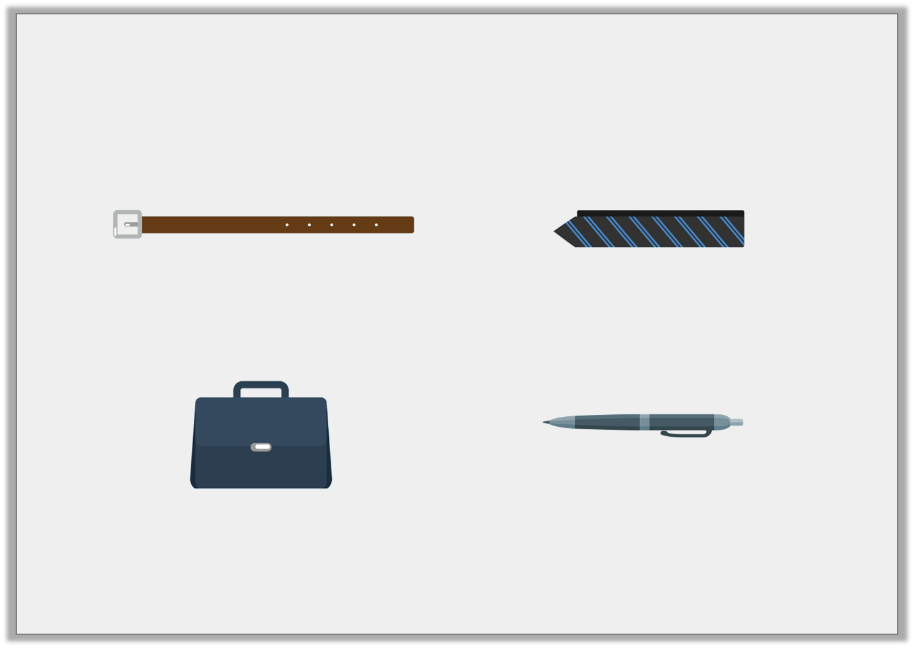
Problem Solving 1
Find the odd one out.
Write an equivalent length for the odd one out.
A. | B.
C. | D.
815mm
81cm 5mm
1
2
81 cm
8cm 5mm
Not to scale
© Classroom Secrets Limited 2019

Slide 20
Problem Solving 1
Find the odd one out.
Write an equivalent length for the odd one out.
The pen is the odd one out.
An equivalent length is 85mm.
A. | B.
C. | D.
815mm
81cm 5mm
1
2
81 cm
8cm 5mm
Not to scale
© Classroom Secrets Limited 2019

Slide 21
Now have a go some RPS questions.
Worksheet on the school website.
Choose what questions to start on based on your confidence:
D = 1 Star difficulty.
E = 2 Star difficulty.
GD= 3 Star difficulty.

