Slide 1



LIFE/work balance
We have started a #LIFEworkbalance campaign and we need your help to complete our LIFE/work balance survey.
We hope to publish the results soon, so please give 15 minutes of your time to help us get a true picture of school life.
Want to be a part of this campaign? Take the survey on our website and share it with your colleagues!
© Classroom Secrets Limited 2019

Slide 2
Year 4 – Spring Block 1 – Multiplication and Division – Divide 2 Digits by 1 Digit 1
About This Resource:
This PowerPoint has been designed to support your teaching of this small step. It includes a starter activity and an example of each question from the Varied Fluency and Reasoning and Problem Solving resources also provided in this pack. You can choose to work through all examples provided or a selection of them depending on the needs of your class.
National Curriculum Objectives:
Mathematics Year 4: (4C6a) Recall multiplication and division facts for multiplication tables up to 12 × 12 Mathematics Year 4: (4C6b) Use place value, known and derived facts to multiply and divide mentally, including: multiplying by 0 and 1; dividing by 1; multiplying together three numbers Mathematics Year 4: (4C8) Solve problems involving multiplying and adding, including using the distributive law to multiply two digit numbers by one digit, integer scaling problems and harder correspondence problems such as n objects are connected to m objects
More Year 4 Multiplication and Division resources.
Did you like this resource? Don’t forget to review it on our website.
© Classroom Secrets Limited 2018

Slide 3
Year 4 – Spring Block 1 – Multiplication and Division
Step 8: Divide 2 Digits by 1 Digit 1
© Classroom Secrets Limited 2018

Slide 4
Introduction
Partition the following 2-digit numbers.
35 |  | 84 |  | 27
© Classroom Secrets Limited 2018

Slide 5
Introduction
Partition the following 2-digit numbers.
35 |  | 84 |  | 27
30 |  | 5 |  | 80 |  | 4 |  | 20 |  | 7
© Classroom Secrets Limited 2018

Slide 6
Varied Fluency 1
True or false? The answer is 24.
75 | ÷ | 3 | =
10
10
10
1
1
10
10
1
1
10
10
1
© Classroom Secrets Limited 2018

Slide 7
Varied Fluency 1
True or false? The answer is 24.
False; 75 ÷ 3 = 25
75 | ÷ | 3 | =
10
10
10
1
1
10
10
1
1
10
10
1
© Classroom Secrets Limited 2018

Slide 8
Varied Fluency 2
Use the bar model to solve the following calculation.
 | 4 | ÷ | 4 | =
80
4
10
10
10
10
10
10
10
10
1
1
1
1
© Classroom Secrets Limited 2018

Slide 9
Varied Fluency 2
Use the bar model to solve the following calculation.
8 | 4 | ÷ | 4 | = | 21
80
4
10
10
10
10
10
10
10
10
1
1
1
1
© Classroom Secrets Limited 2018

Slide 10
Varied Fluency 3
Use the counters to solve the calculation.
72 | ÷ | 4 | =
10
10
1
1
1
1
1
1
1
10
10
10
1
1
1
1
1
1
1
10
10
1
1
10
1
1
1
1
10
1
1
1
1
1
1
10
1
1
1
1
1
1
© Classroom Secrets Limited 2018

Slide 11
Varied Fluency 3
Use the counters to solve the calculation.
72 | ÷ | 4 | = | 18
10
10
1
1
1
1
1
1
1
10
10
10
1
1
1
1
1
1
1
10
10
1
1
10
1
1
1
1
10
1
1
1
1
1
1
10
1
1
1
1
1
1
© Classroom Secrets Limited 2018

Slide 12
Varied Fluency 4
Complete the part-whole model.
78 ÷ 6 = 13
10
1
1
10
10
1
1
60 ÷ 6 = 10
18 ÷ 6 = 3
10
10
1
1
10
10
1
1
© Classroom Secrets Limited 2018

Slide 13
Varied Fluency 4
Complete the part-whole model.
78 ÷ 6 = 13
10
1
1
10
10
1
1
60 ÷ 6 = 10
18 ÷ 6 = 3
10
10
1
1
10
10
1
1
© Classroom Secrets Limited 2018

Slide 14
Reasoning 1
Three children have answered 60 ÷ 5
Who is correct? Explain your answer.
1
1
10
10
1
1
10
1
1
10
10
1
1
10
1
1
10
Bill
Jane
Tom
13
12
11
© Classroom Secrets Limited 2018

Slide 15
Reasoning 1
Three children have answered 60 ÷ 5
Who is correct? Explain your answer.
Jane is correct because…
1
1
10
10
1
1
10
1
1
10
10
1
1
10
1
1
10
Bill
Jane
Tom
13
12
11
© Classroom Secrets Limited 2018

Slide 16
Reasoning 1
Three children have answered 60 ÷ 5
Who is correct? Explain your answer.
Jane is correct because 60 ÷ 5 = 12.
1
1
10
10
1
1
10
1
1
10
10
1
1
10
1
1
10
Bill
Jane
Tom
13
12
11
© Classroom Secrets Limited 2018

Slide 17
Problem Solving 1
Which calculation is the odd one out?
65 ÷ 5 = 13
39 ÷ 3 = 13
52 ÷ 4 = 13
88 ÷ 8 = 13
91÷ 7 = 13
© Classroom Secrets Limited 2018

Slide 18
Problem Solving 1
Which calculation is the odd one out?
65 ÷ 5 = 13
39 ÷ 3 = 13
52 ÷ 4 = 13
88 ÷ 8 = 11
91÷ 7 = 13
© Classroom Secrets Limited 2018

Slide 19
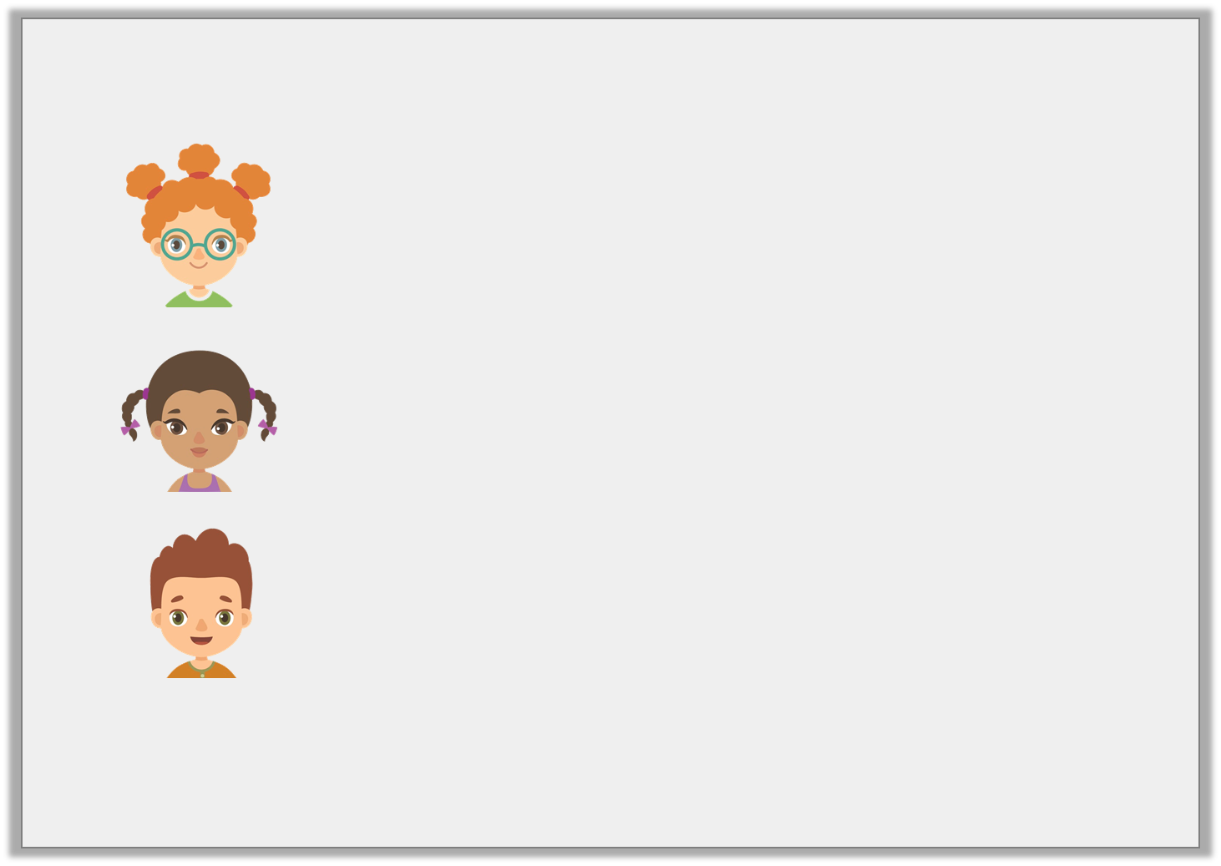
Problem Solving 2
Match the following statements with the correct card.
My calculation needs no exchange.
Annalise
My calculation is solved incorrectly.
Mary
My calculation needs to exchange.
James
96 ÷ 8 = 12
77 ÷ 7 = 11
90 ÷ 5 = 12
© Classroom Secrets Limited 2018

Slide 20
Problem Solving 2
Match the following statements with the correct card.
My calculation needs no exchange.
77 ÷ 7 = 11
Annalise
My calculation is solved incorrectly.
90 ÷ 5 = 12
Mary
My calculation needs to exchange.
96 ÷ 8 = 12
James
© Classroom Secrets Limited 2018

