Slide 1
LO: What is it like to be a Hindu in Britain today?

Slide 2
Where are Hindus in Britain?

Slide 3
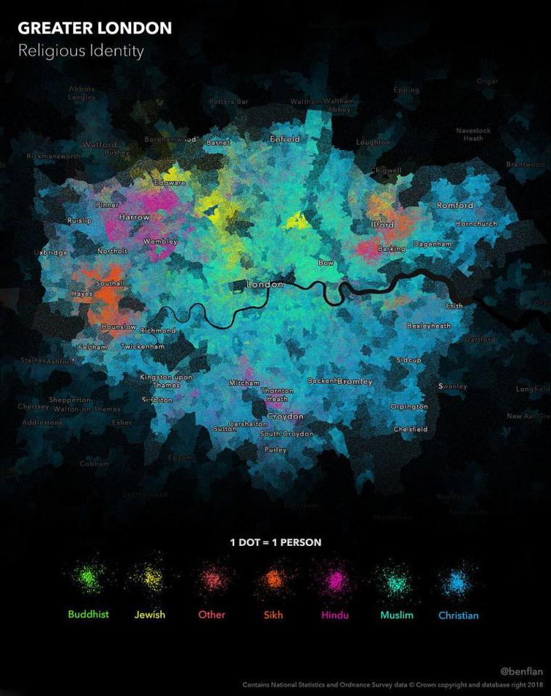
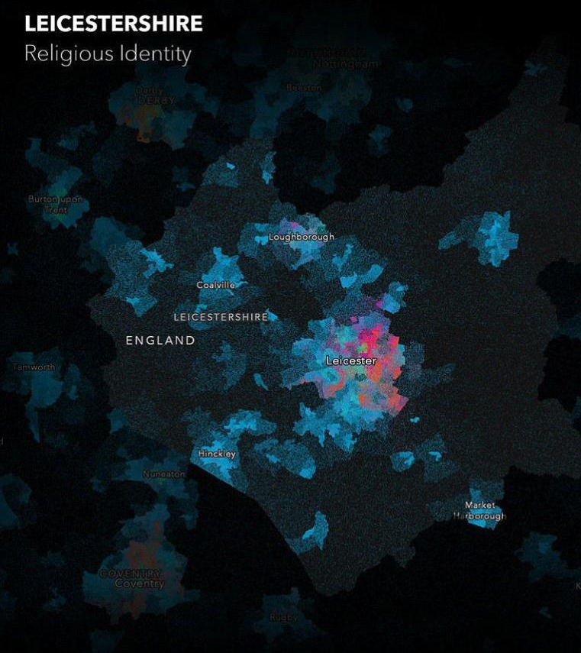
These maps shows London and Leicestershire by religion. Identify where British Hindu populations live.

Slide 4
Why did they decide to settle here?

Slide 5
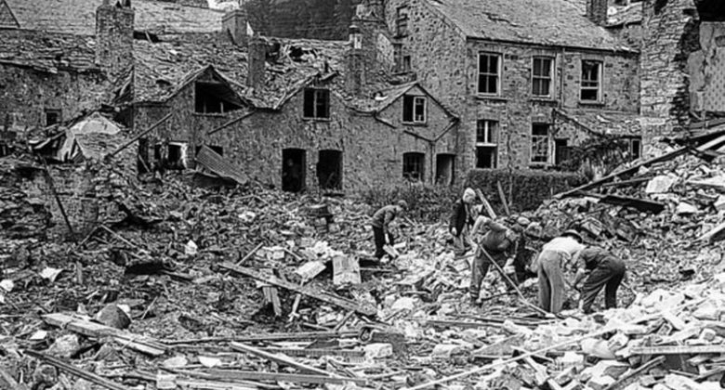
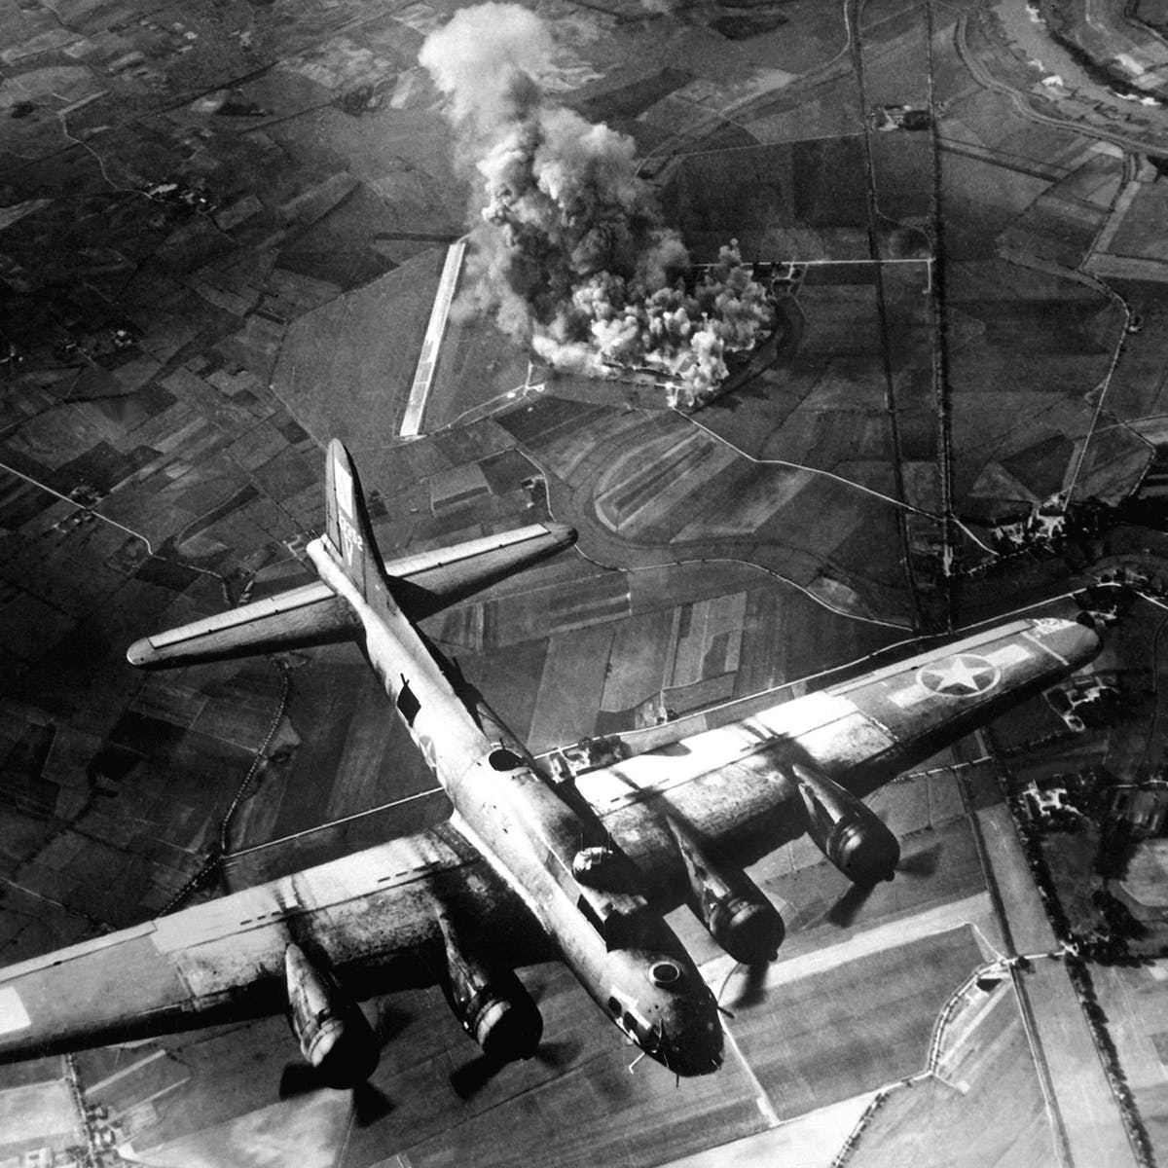
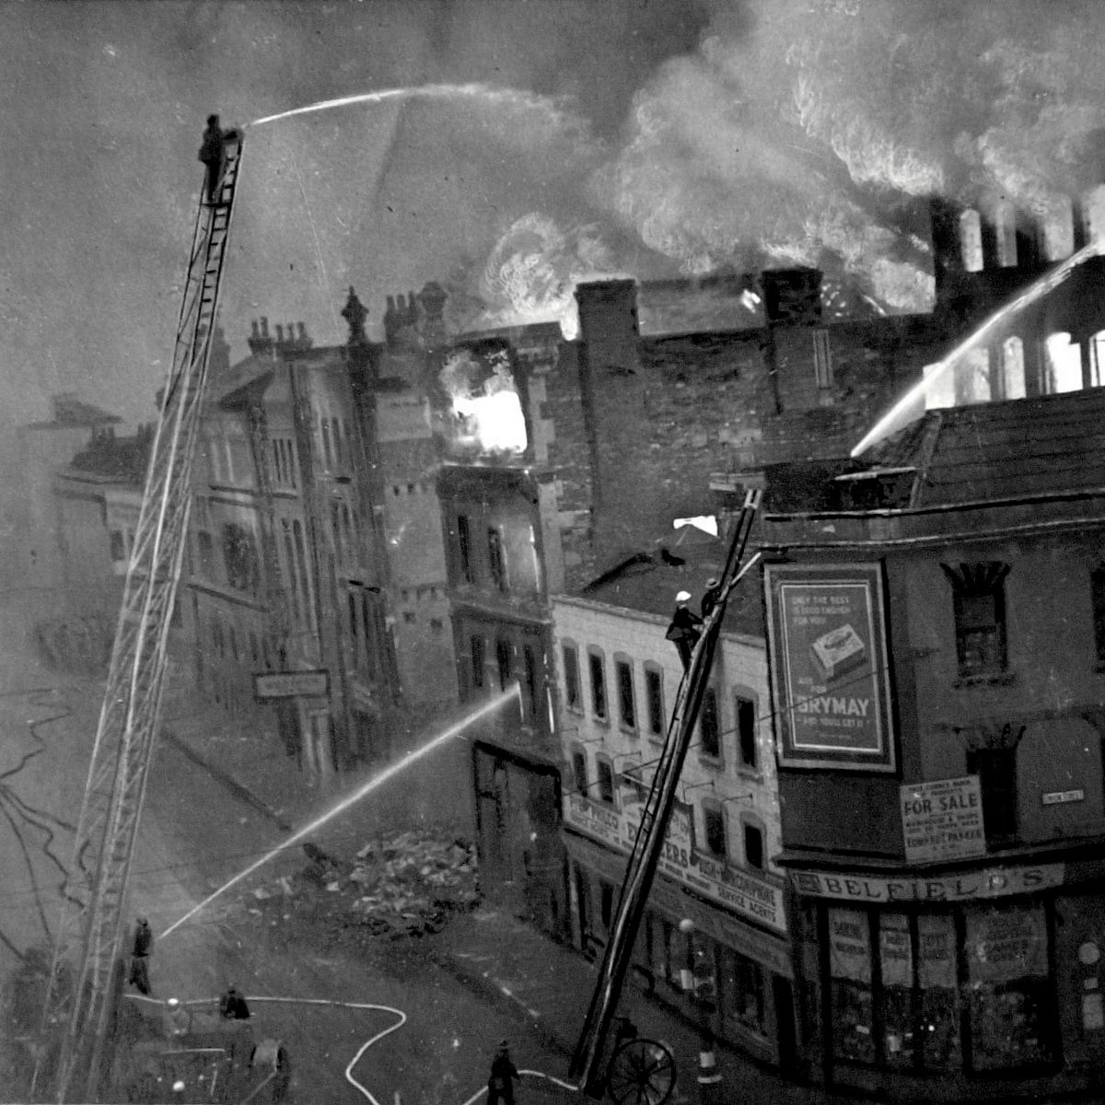
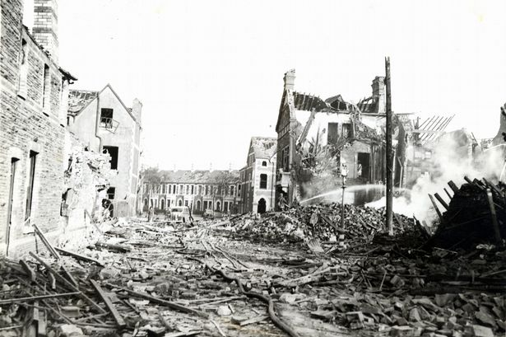
World War 2
These are some images of the impact of World War 2, in Britain. Bomb damage, destructions and ruined buildings.

Slide 6
World War 2
The British government asked workers from India and Pakistan, as well as the Caribbean, to settle in Britain and help the rebuilding to help the country.

Slide 7

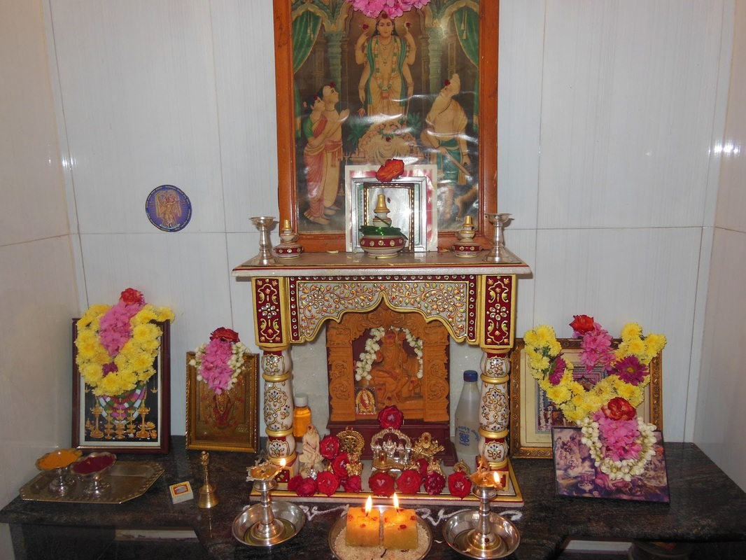
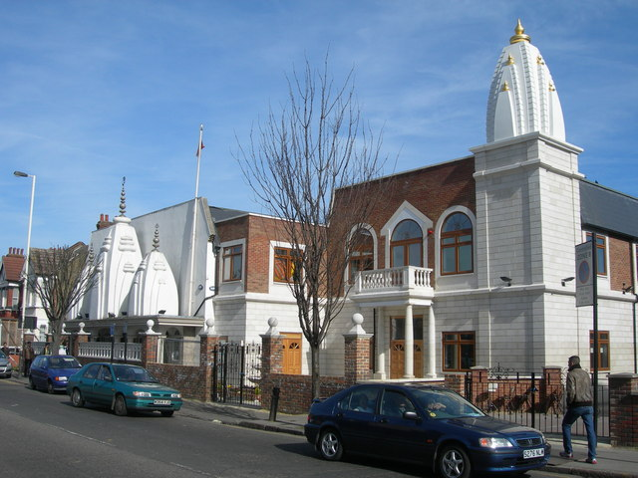
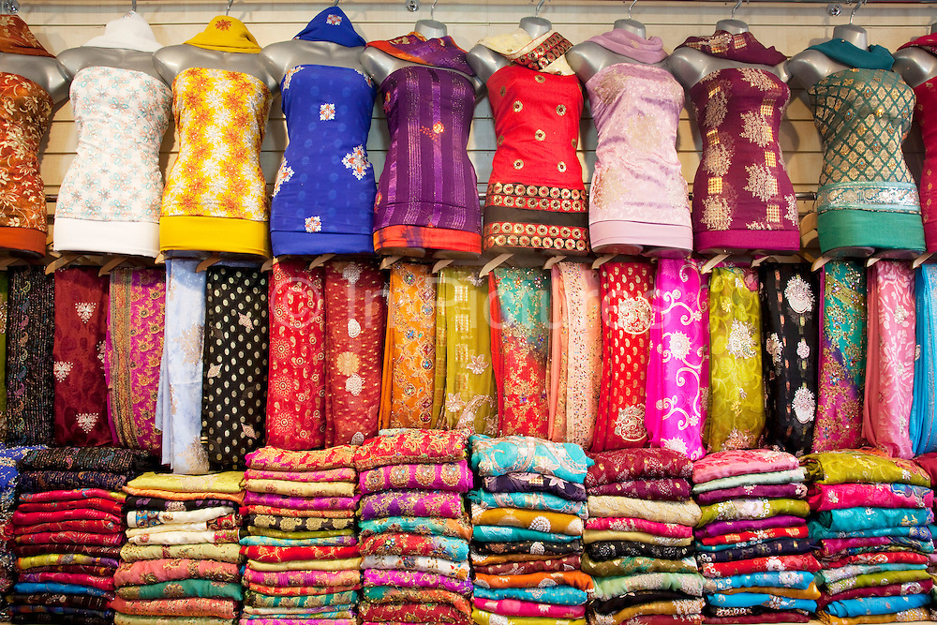
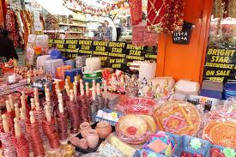
Hinduism in Britain
Discuss: What can you see?

Slide 8
https://www.bbc.co.uk/teach/class-clips-video/holi-the-spring-festival/zkkygwx
Watch the video on Holi.
Discuss: What is Holi?
Write a sentence on what the bonfire represents in Holi and throwing colour.

Slide 9
https://www.bbc.co.uk/teach/class-clips-video/diwali-the-hindu-festival-of-light/z668qp3
Watch the video on Diwali.
Discuss: How is Diwali celebrated?
Write a sentence on what the festival represents.

Slide 10
https://www.bbc.co.uk/teach/class-clips-video/a-hindu-wedding/zmqrkmn
Watch the video on a Hindu wedding.
Discuss: What is particularly Hindu about this wedding that you may have not seen at any other weddings?
Write a sentence about how a Hindu wedding is celebrated and give an example of 2 differences to one you might have attended before.

Slide 11

21st Century life in Britain
We all need to create a happy and safe country in which everyone can achieve their potential, whatever religion or background we come from.
In your books: create 10 duties, like the 10 Hindu duties, that could help achieve this.

Slide 12

Design a new Union Flag
This flag already contains the flag of three nations (England, Scotland and Ireland).
Think about the colours and images you would like to put into the new union flag- incorporating elements of 21st century Britain you see around you.

Slide 13

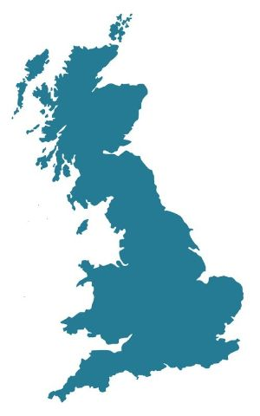
Where are Hindus in Britain and why did they decide to settle here?

