Slide 1
LO: How do Hindus show their faith? Faith in what?

Slide 2

Teacher’s share special items
Thinking point: Why do you think these items are important to your teacher?

Slide 3






Teacher’s special items
Write down what each special item tells about you, into the jigsaw pieces.

Slide 4
On the 4 piece jigsaw worksheet.
Draw and label 4 special items to you.

Slide 5

We are all unique but there are some things we all need.
Discuss: What is important to every person?
Write a sentence on some key similarities and differences between others.

Slide 6
https://www.bbc.co.uk/programmes/p02n5xj7
Watch the video

Slide 7
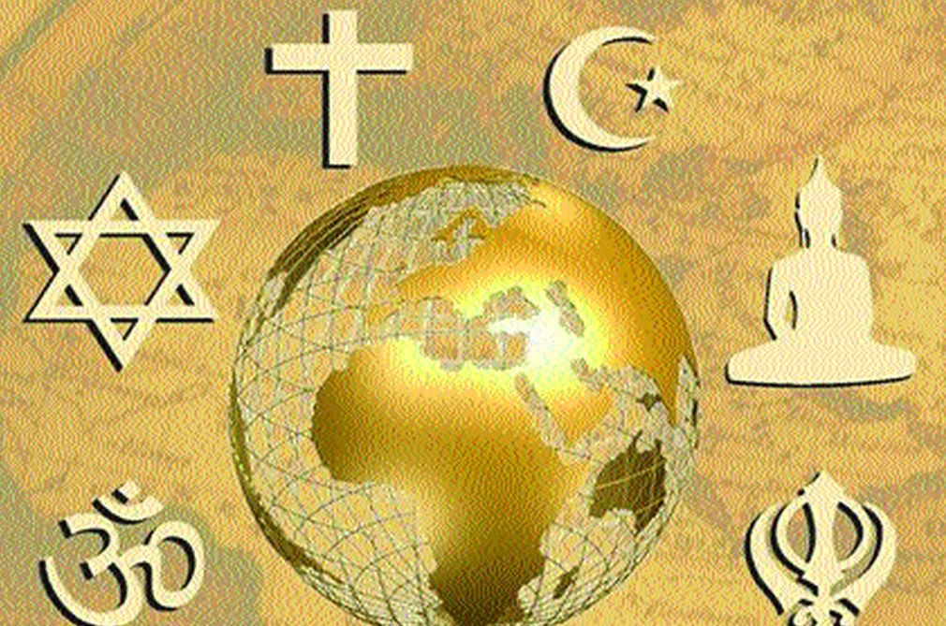
What might a person’s jigsaw show if they are religious?
Would it show their religion?
If so, what aspects might it show?
If somebody practises a religion will their jigsaw only show their religion?

Slide 8
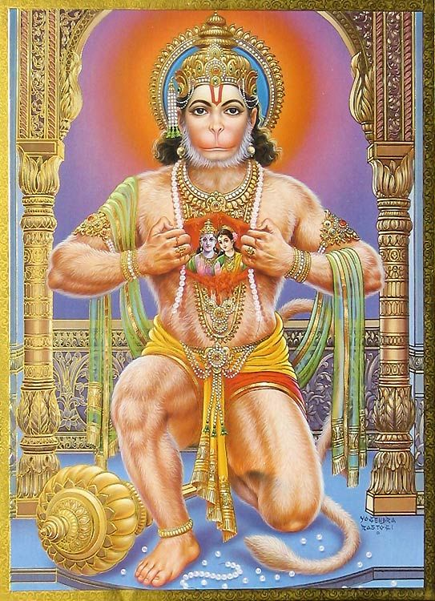
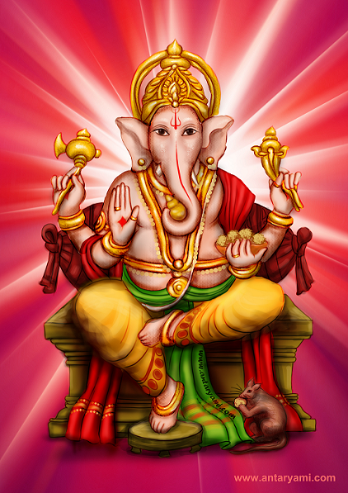
In the clip Simran holds a tray with a small flame over her brother’s head. She talks about Hindu deities and Hindu beliefs.
Hanuman
Hanuman and Ganesh are shown in the clip.
Can you remember what Simran said about the Gods?
How many did she say there are?
Ganesh

Slide 9
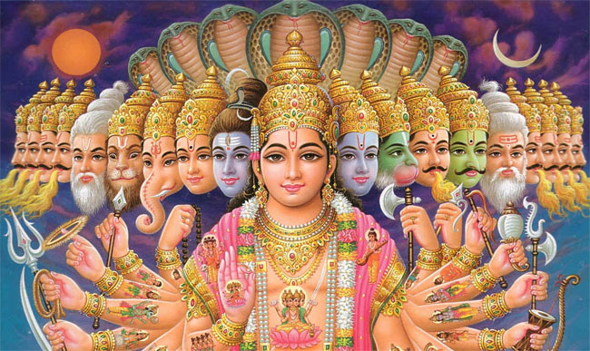
Hindu deities
Hindu deities are the gods and goddesses in Hinduism.
Deities show millions of gods, representing aspects of the one God, Brahman. They are designed to help humans focus in worship

Slide 10
Here are some of the Gods and Goddesses.

Slide 11
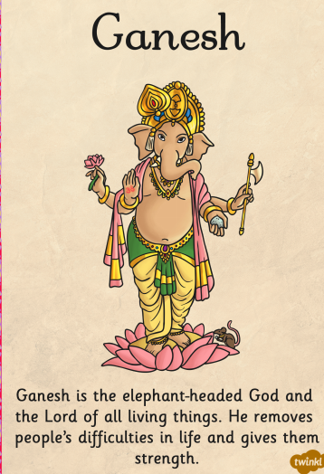
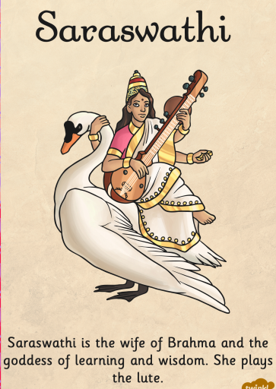

Slide 12
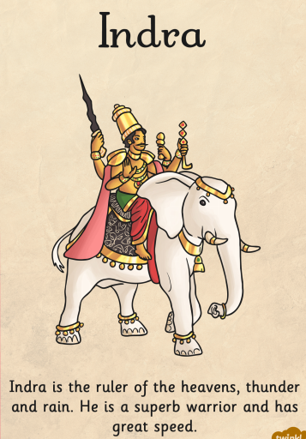
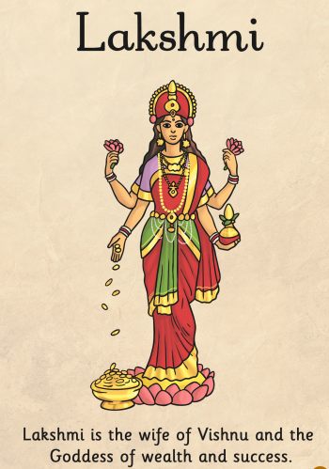

Slide 13
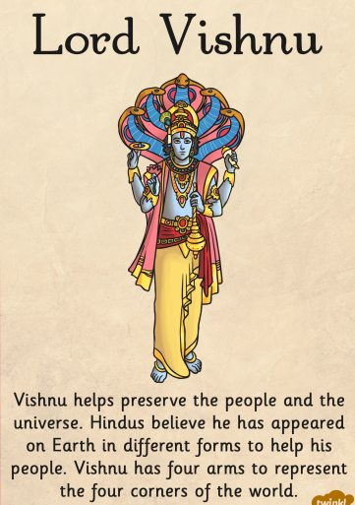
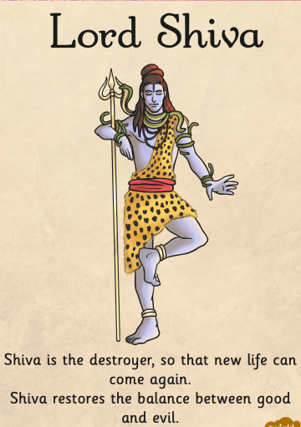

Slide 14
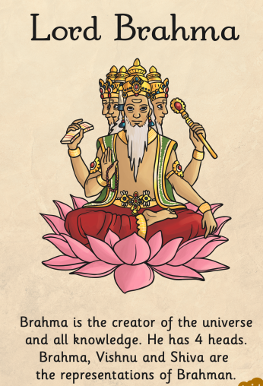
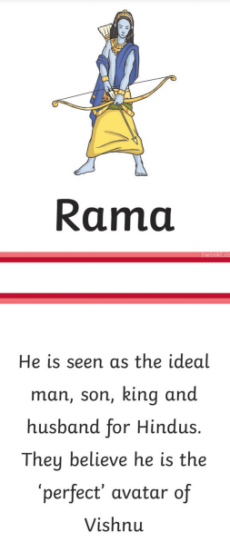
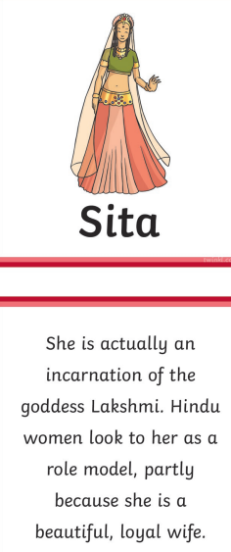

Slide 15
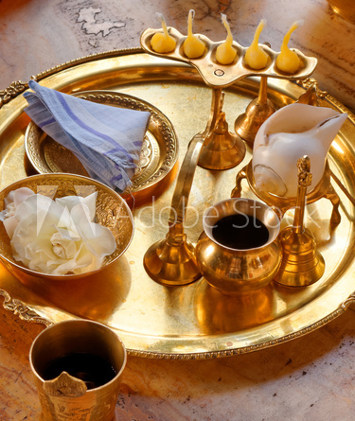
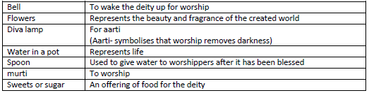
Simran and Vraj show their faith in God through puja, Hindu worship.
In a puja tray:

Slide 16
Further elements to puja.
Aarti- is a Hindu religious ritual of worship, a part of puja, in which light (usually from a flame) is offered to one or more deities.
Bhajans- Worship songs, devoted to different deities, some fast and upbeat, some peaceful and meditative. They have developed to help worship. For example, https://www.youtube.com/watch?v=Ac2580Gp8qA
Write a definition for Aart and Bhajans in your books.

Slide 17

Imagine Simran and Vraj have been asked to explain about Hinduism at their school.
How do Hindus show their faith?
What is important to Hindus?

