Slide 1


Slide 2
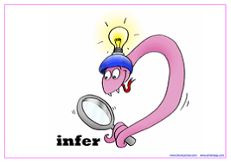
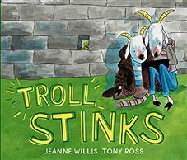
What can you see?
What do you think this story is going to be about? Explain why you think this.
Do you recognise any characters?
What does the front cover remind you of?

Slide 3
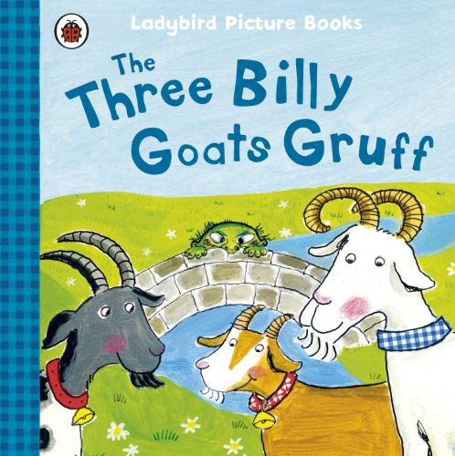
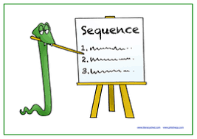
Similar story
https://www.youtube.com/watch?v=xNJBzcqjIYw
Let’s listen to The Three Billy Goats Gruff.
Bullet point a sequence of main events in this story.

Slide 4
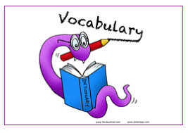
Consider the character of the troll. What does the word mean?
Let’s look up the various meanings in the Oxford English Dictionary:
https://www.lexico.com/definition/troll

Slide 5
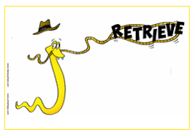
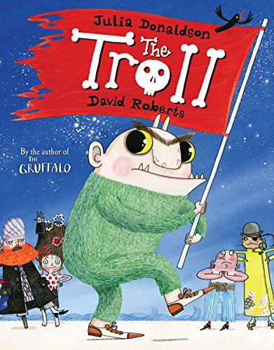
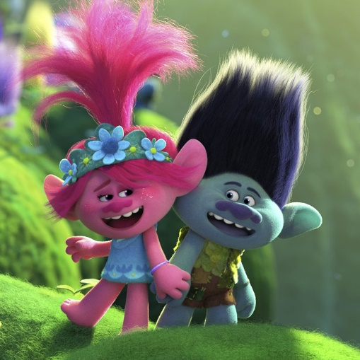
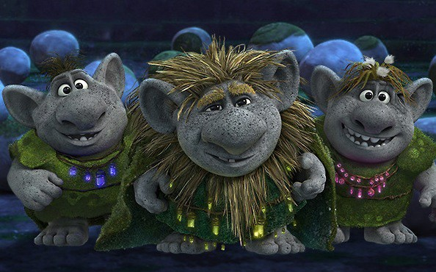
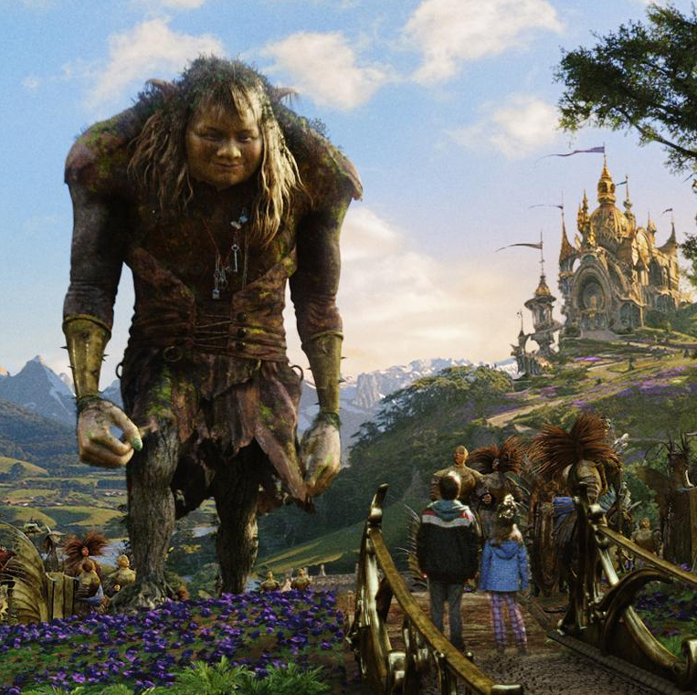
Consider how trolls are characterised in most stories.
- Have you read any books or seen any films that included trolls?
-How were they represented?
Write some words and phrases surrounding these illustrations.
Think about what the troll is doing as well as its appearance and features.

Slide 6
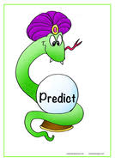
Why do you think this traditional tale might have been chosen as the bases for this new story?
What predictions can you make about what might happen?
Think about: the definitions we read, your knowledge from the original story, your consideration of the character types and from front cover observations.

Slide 8
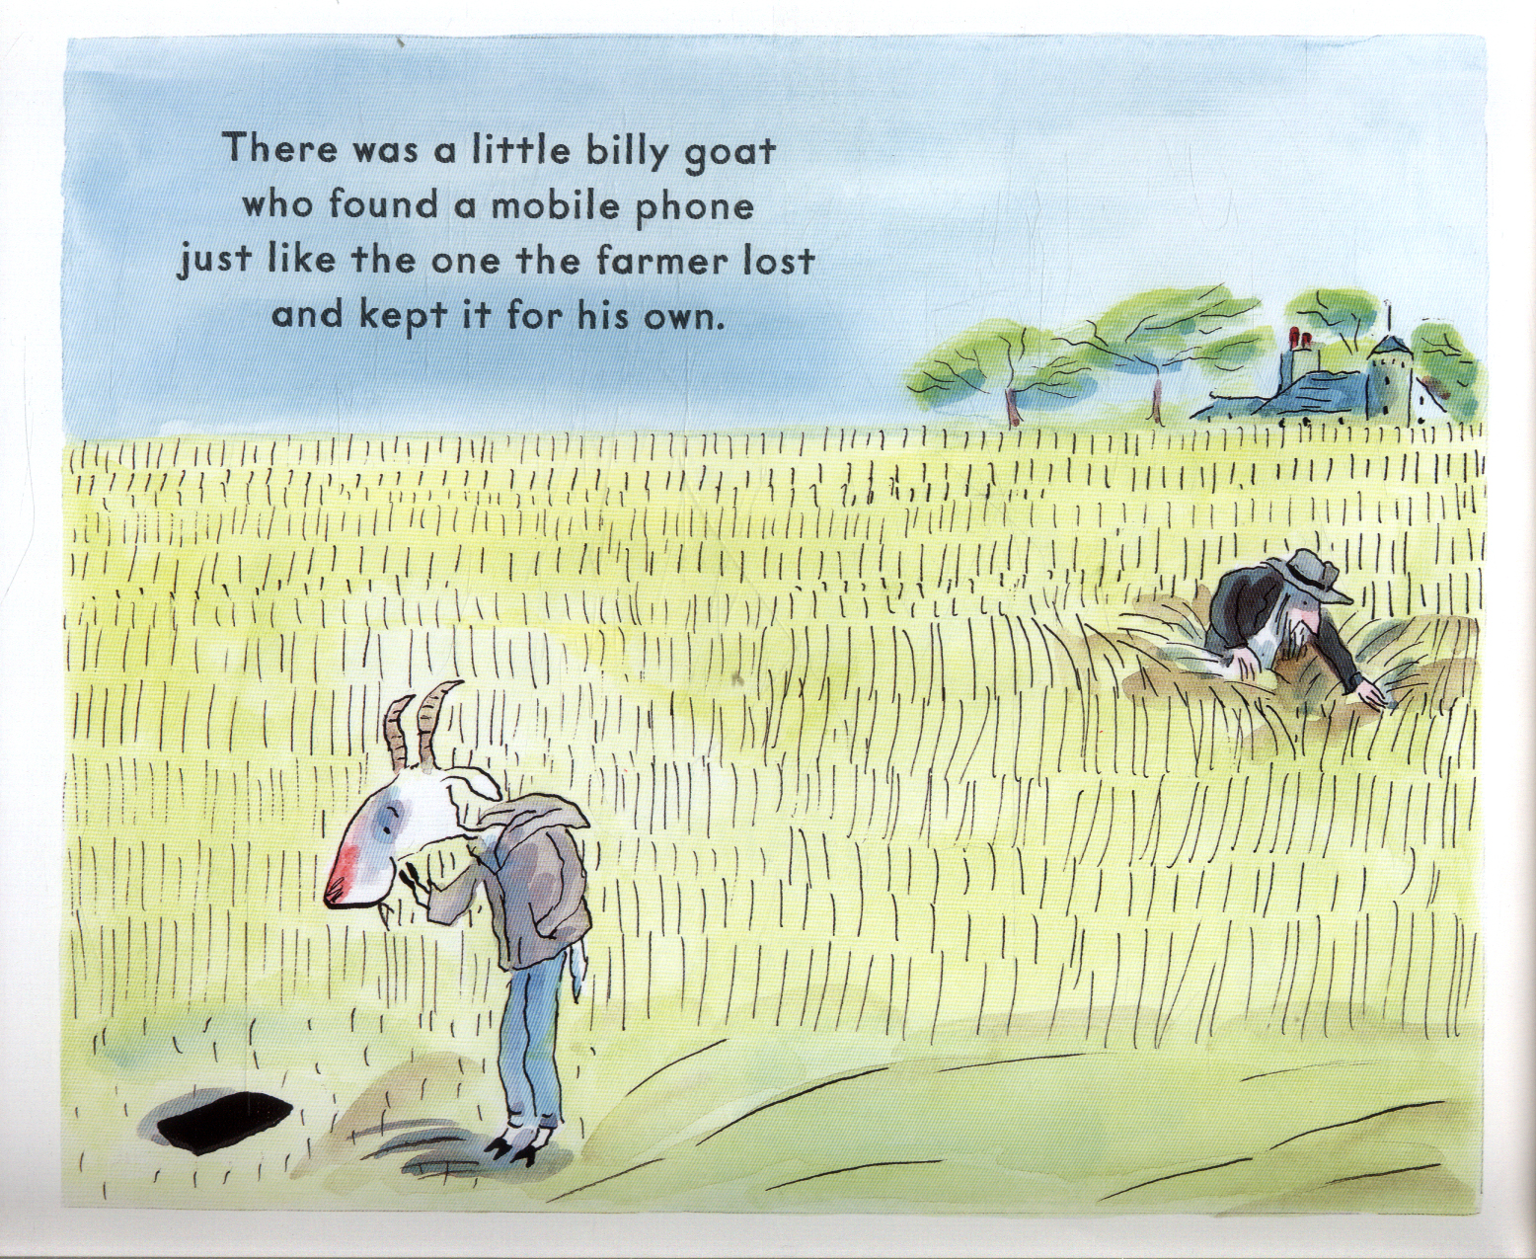
What do you think about this decision?
Was this the right thing to do? Why/why not?
Why do you think he wants it?
What could happen if you kept or used someone else’s phone?

Slide 9
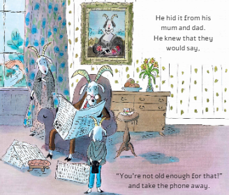
What do we know so far about Billy?
Does this match the characteristics of any of the original billy goats?
What do we know about him based on his actions so far?
Why do you think his mum and dad might “take the phone away”?
Do you agree that he’s “not old enough for that”?

Slide 10
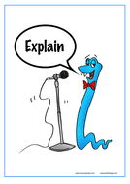
Should children under 13 be allowed their own mobile phone?
For | Against

Slide 11
Imagine if his parents noticed that he was hiding the phone.
What might they say?
Would he tell the truth about whose phone it is? Why do you think this?
Write a potential conversation between the characters.

Slide 12
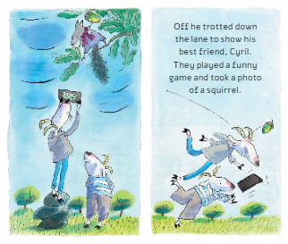
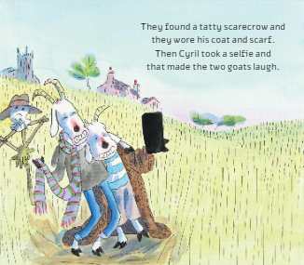

Slide 13
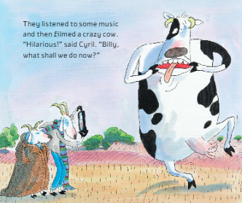
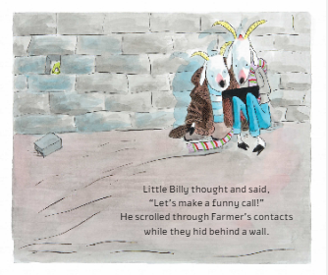

Slide 14
What do you think Billy means by “Lets make a funny phone call”?
What do you think they’re planning to do?
How would you feel if someone was looking through your private messages, contacts, etc.?

Slide 15
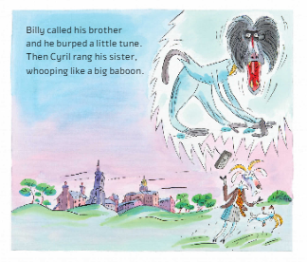
What do you think about these ‘funny calls’?
How would you feel to receive a call like these?
What does the facial expression and the body language of Cyril’s sister tell us about her response?
What about the shape and size of the bubble coming from the phone?

Slide 16
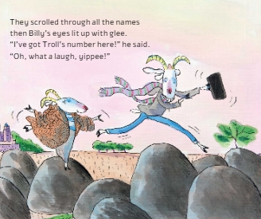

Slide 17
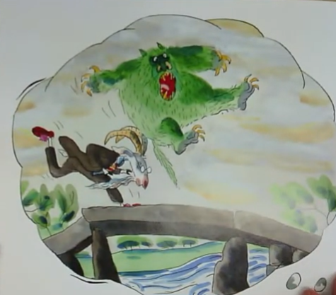
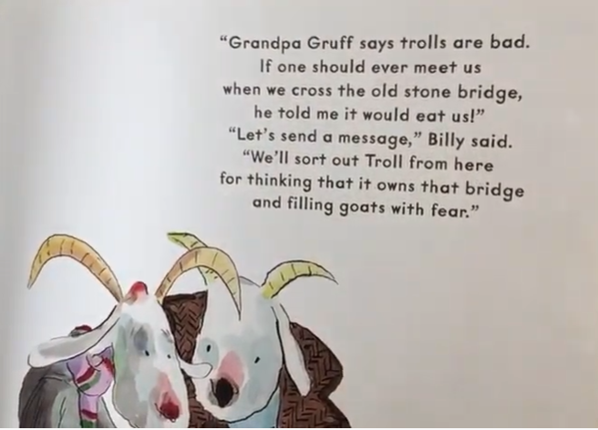

Slide 18
What do you think Cyril should do?
Why does Bill thinks it’s acceptable to ‘sort out Troll’ by sending him a text?
Should Cyril also send a text to the troll?
Does he have other options?
What should he do and why?

Slide 19
Based on Cyril’s behaviour so far, what do you think he is likely to do?
Explain why you think this.

Slide 20
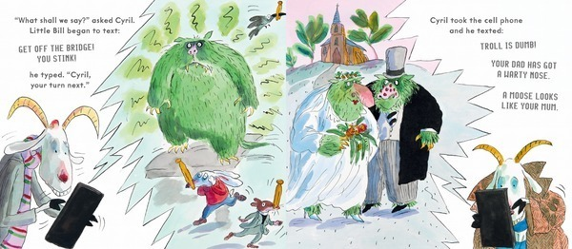

Slide 21
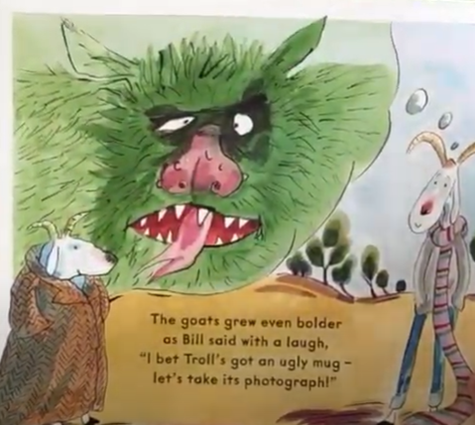
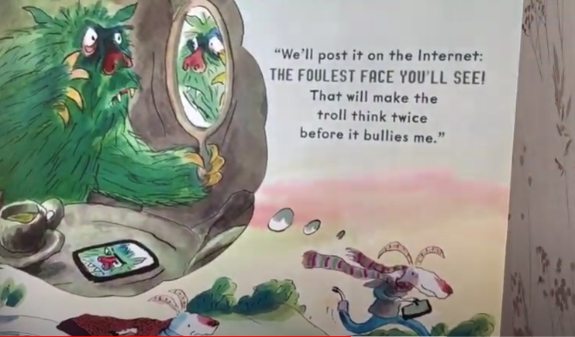

Slide 22
How do you feel about what they are saying to/about the troll?
How do you feel about what they are planning to do?
Is it worse to say something cruel directly to somebody’s face or is it worse to say it behind their back? Is there a difference?
How might it feel to read these messages as the troll?

Slide 23
What are Billy and Cyril basing their assumptions on?
What is the potential impact of acting on what other people say about someone if we don’t know them ourselves?

Slide 24
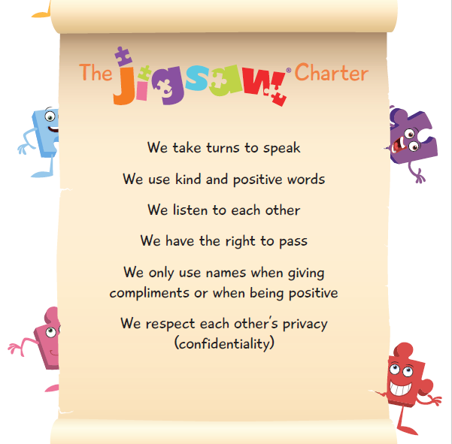
How does it feel to have nasty things said to or about you?

Slide 25
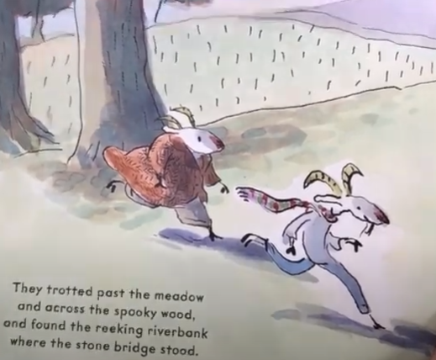
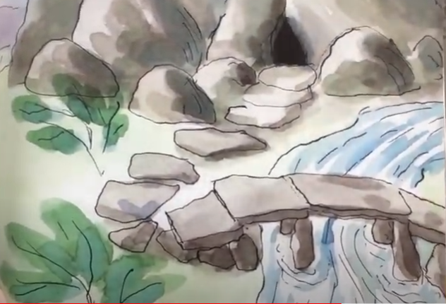

Slide 26
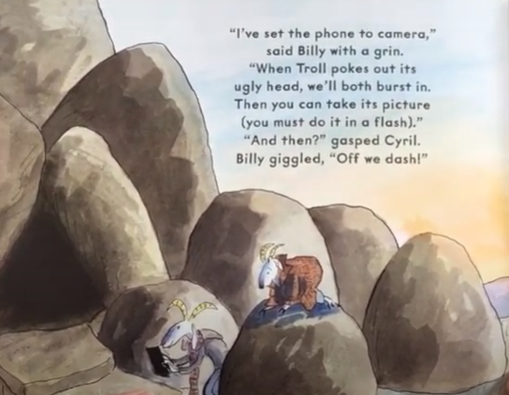
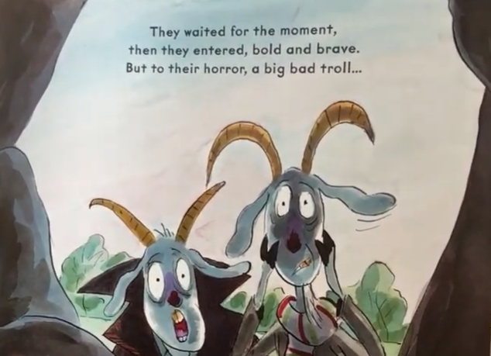

Slide 27
How have the Billy and Cyril reacted to what they can see?
What might the two Billy goats have witnessed?
What might provoke the reaction that you can see in the illustration?

Slide 28
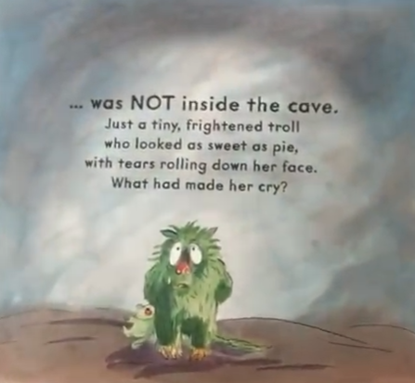
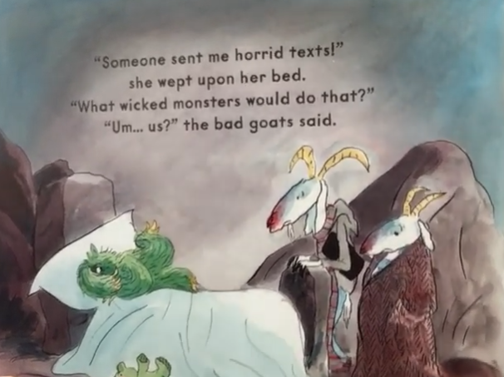

Slide 29
How do you think they are feeling now?
What has got them to this point?
How and why have things escalated for Billy and Cyril?

Slide 30
Timeline- Decisions made by Billy and Cyril in the story.

Slide 31
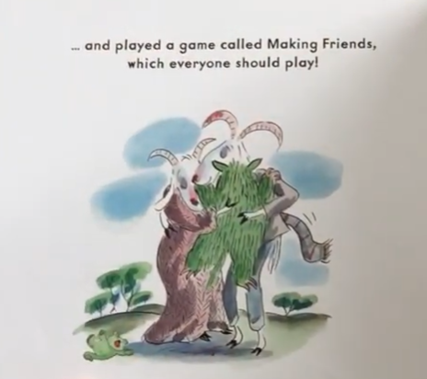

Slide 32
Let’s now read the whole book.

Slide 34
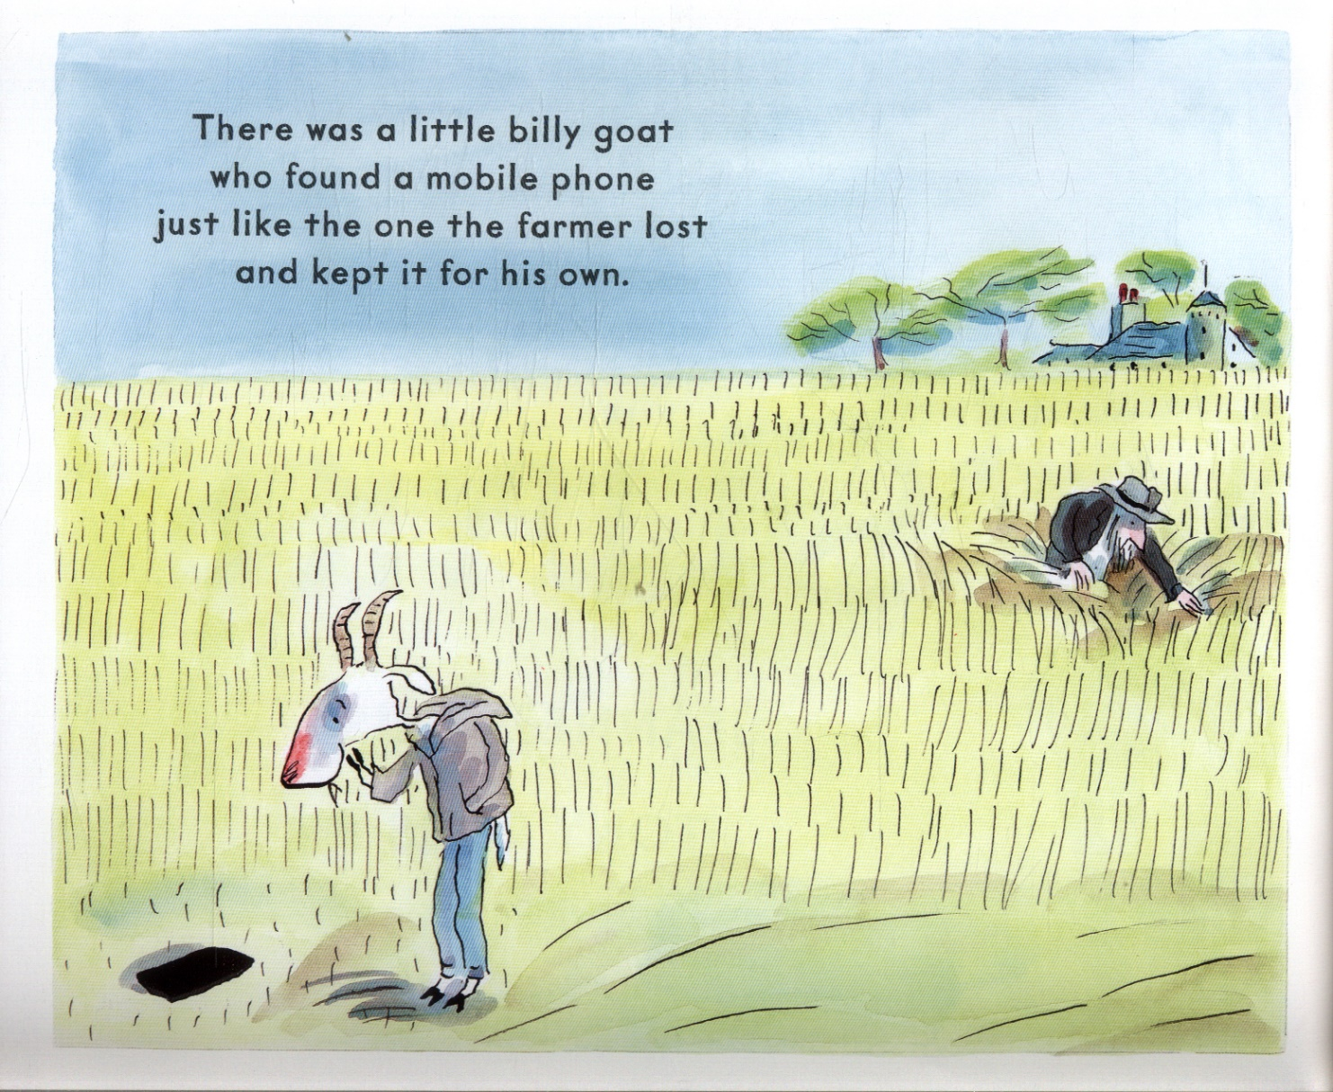

Slide 44
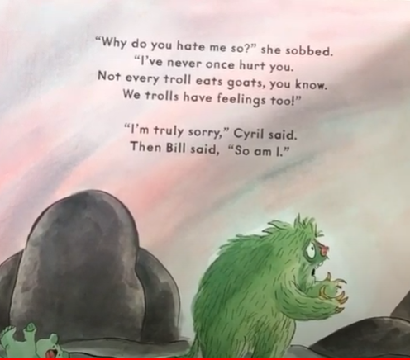
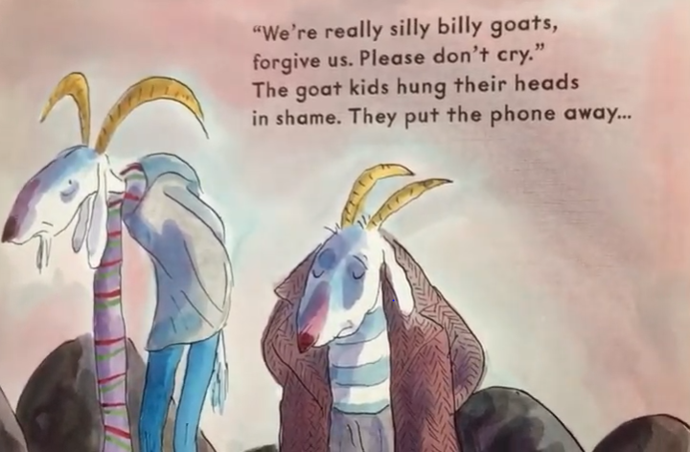

Slide 46
Do you think the original story has a particular message?
What do you feel the key messages are in this new story that Jeanne Willis and Tony Ross have created?
Why do you think Jeanne Willis might have chosen this story to make this point?
Who is/are the real troll(s) in this story?

