Slide 1


Slide 2
8.2.21
LO: Adding Lengths

Slide 3
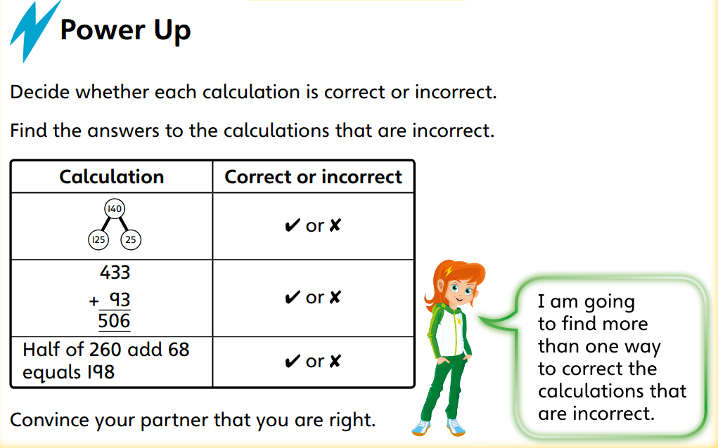

Slide 4

Exploring conversions

Slide 5
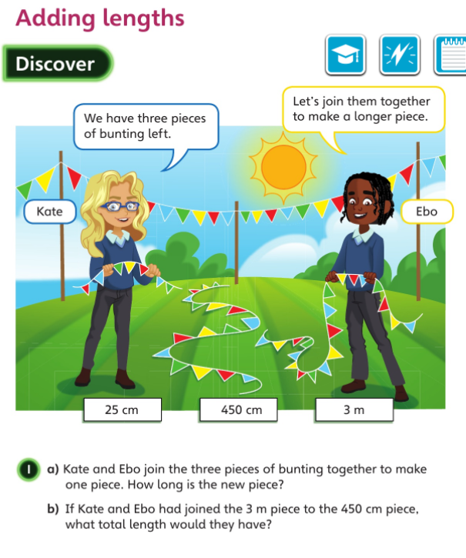

Slide 6


Slide 7
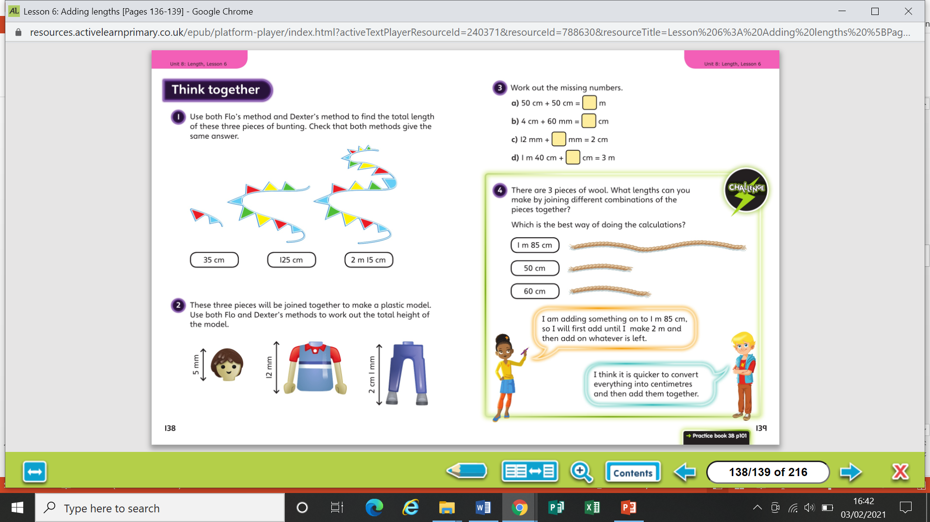

Slide 9
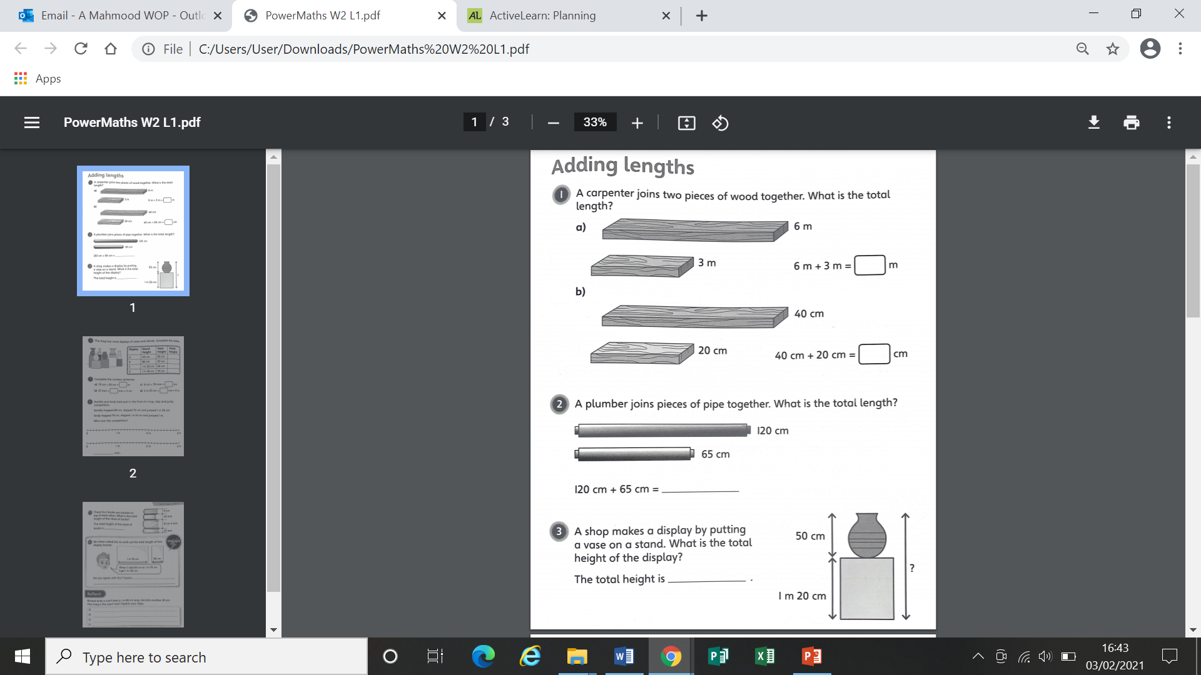
Worksheet

Slide 10
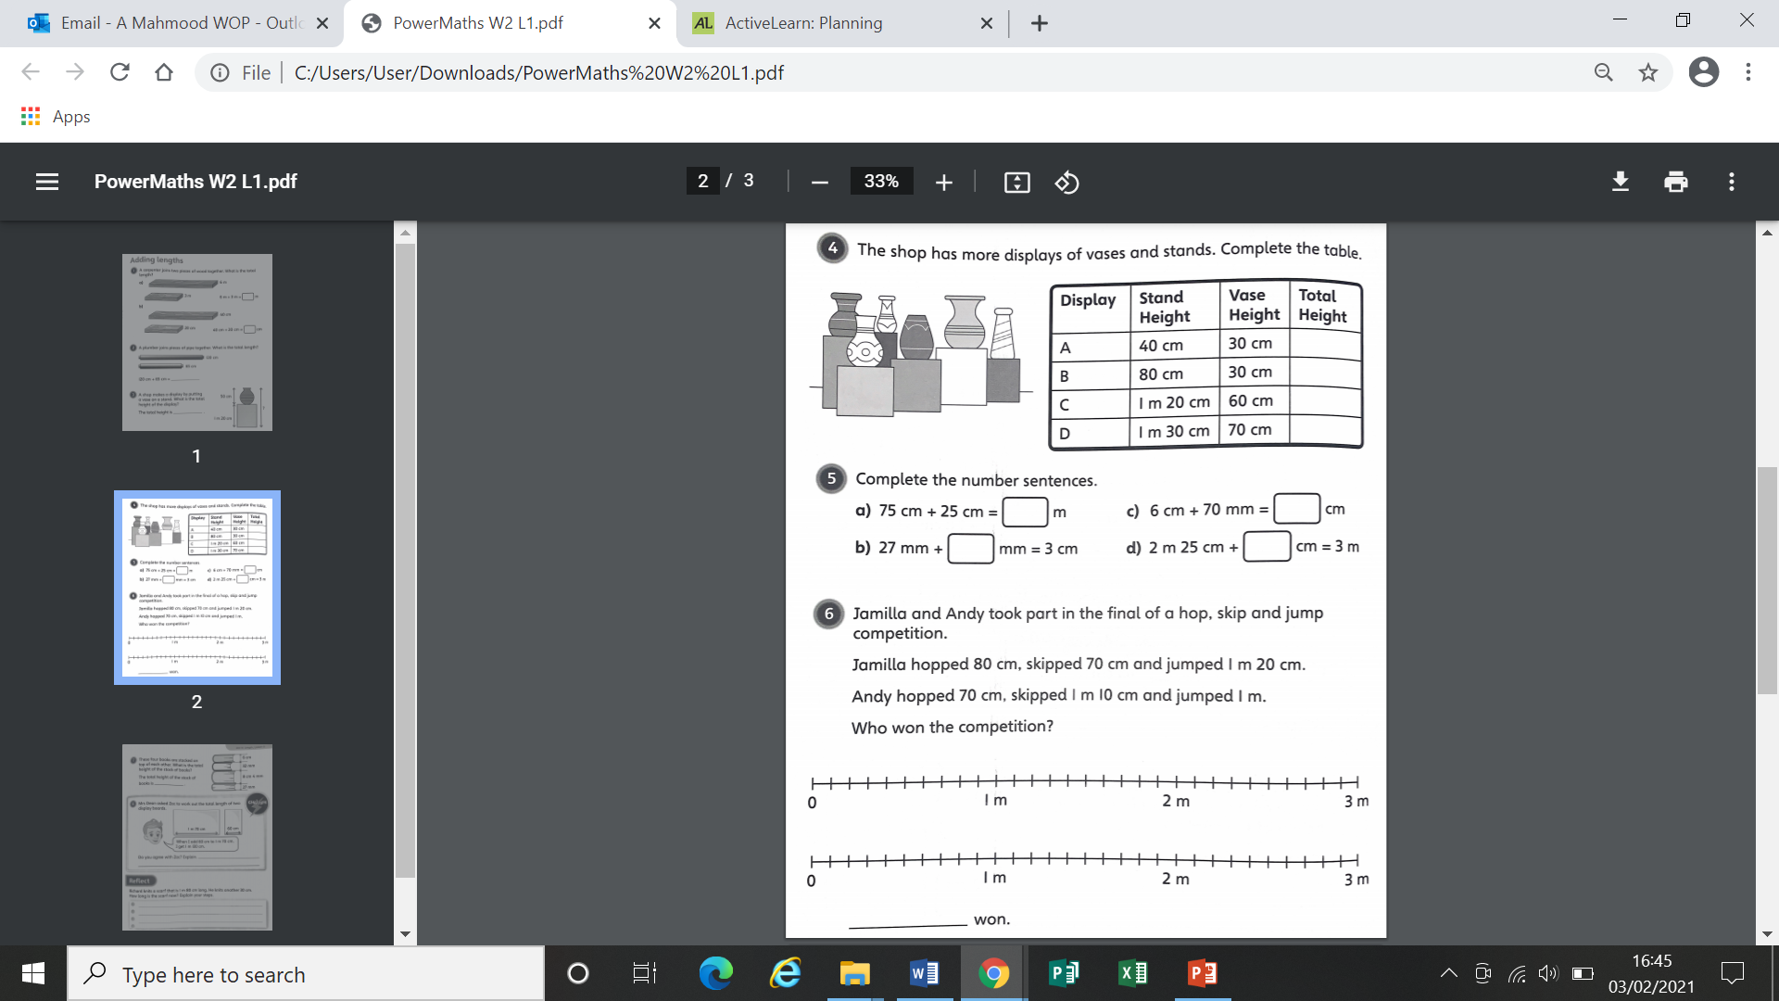
Worksheet

Slide 11
Worksheet

Slide 12
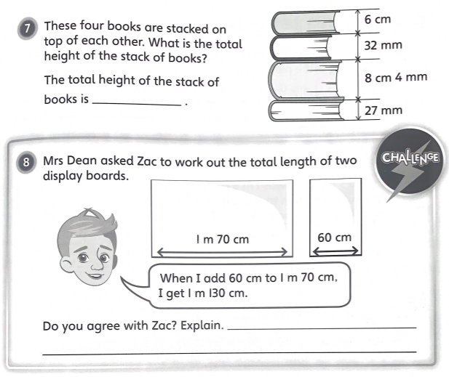
Worksheet

Slide 13
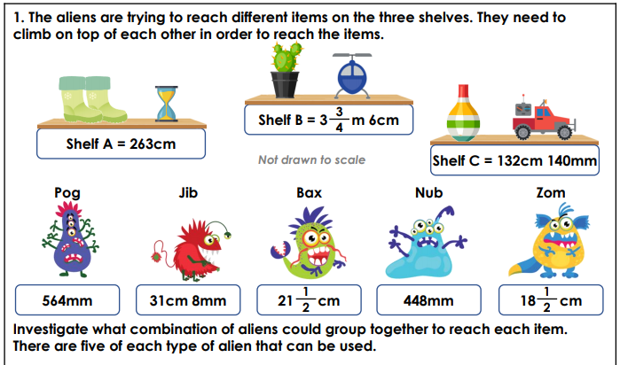
Discussion Question

Slide 14
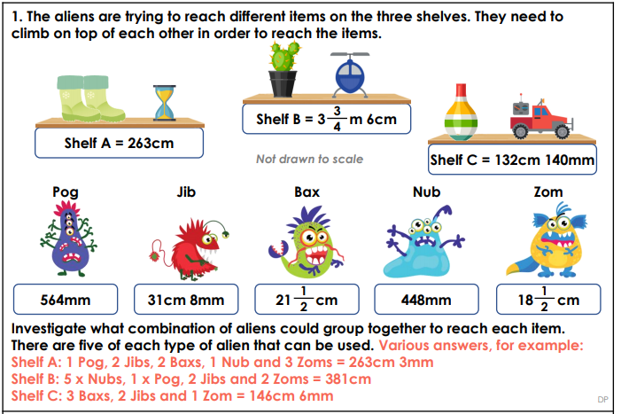

Slide 15
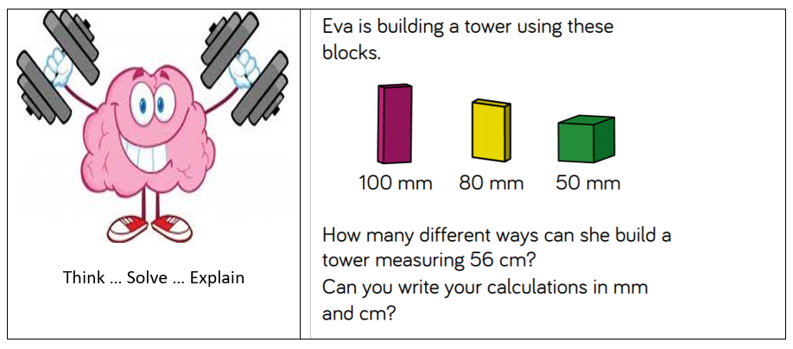

Slide 16
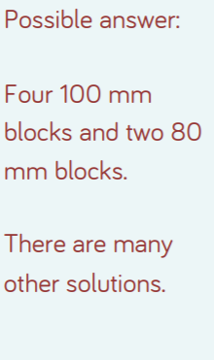
Answer

