Slide 1


Slide 2
10.2.21
LO: Subtracting Lengths

Slide 3
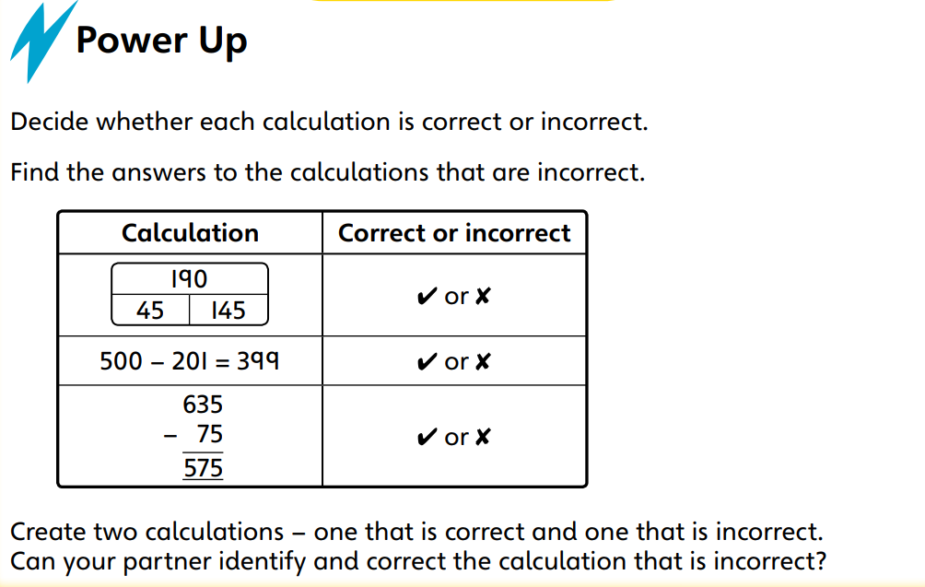

Slide 4

Exploring conversions

Slide 5
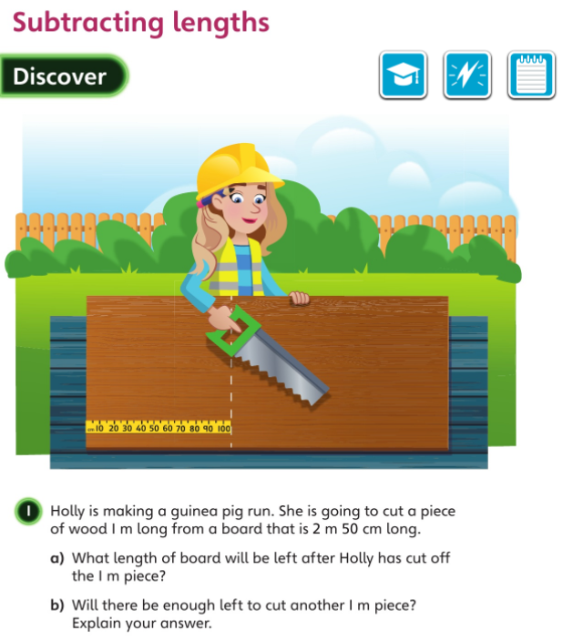

Slide 6


Slide 7
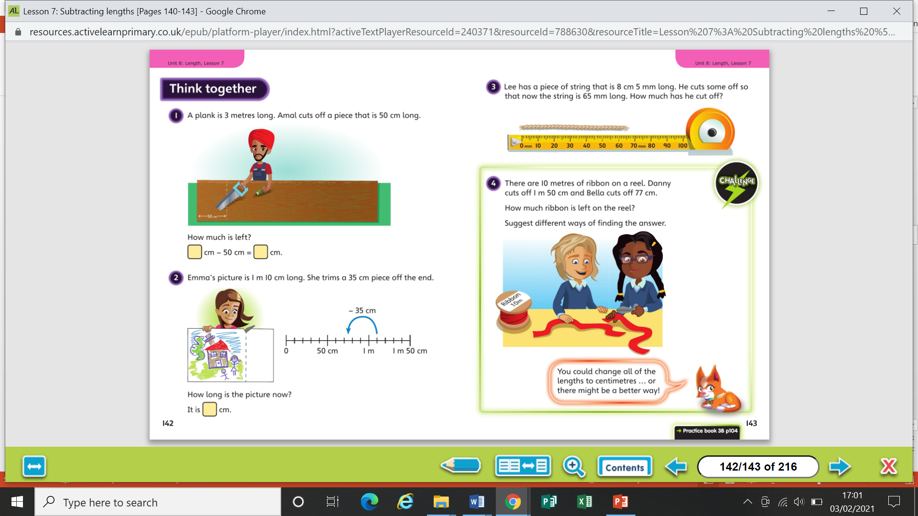

Slide 8


Slide 9
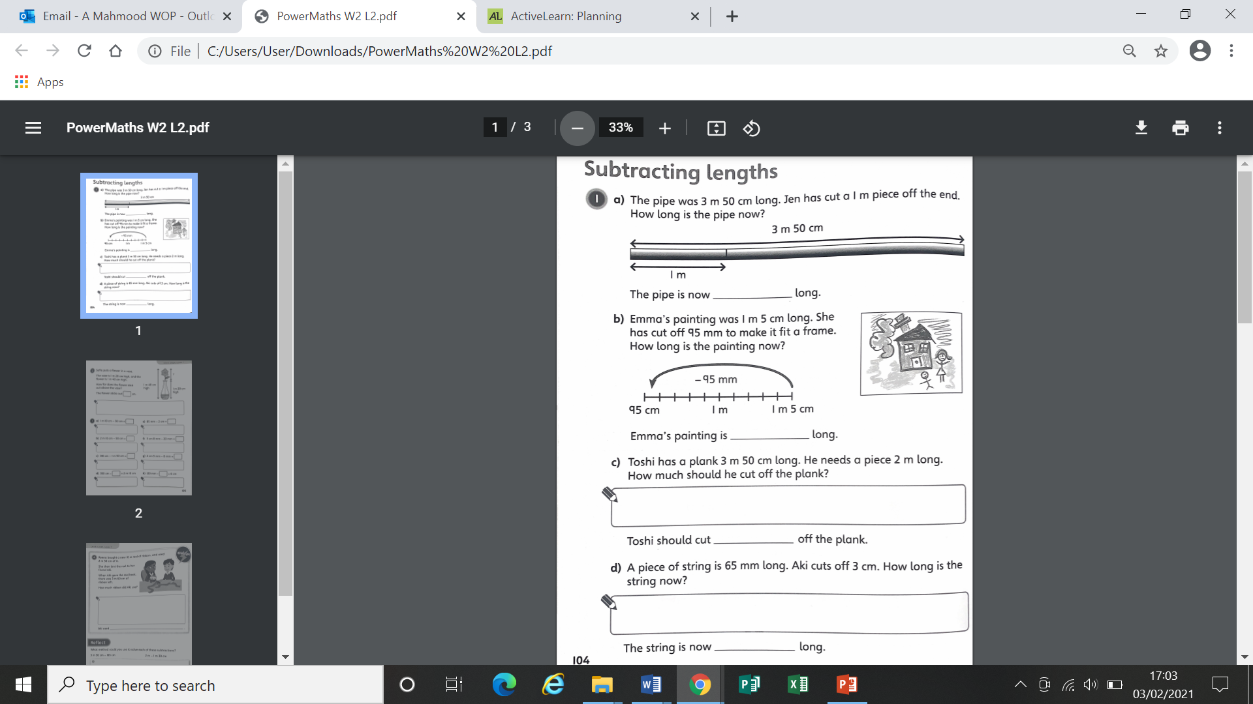
Worksheet

Slide 10
Worksheet

Slide 11
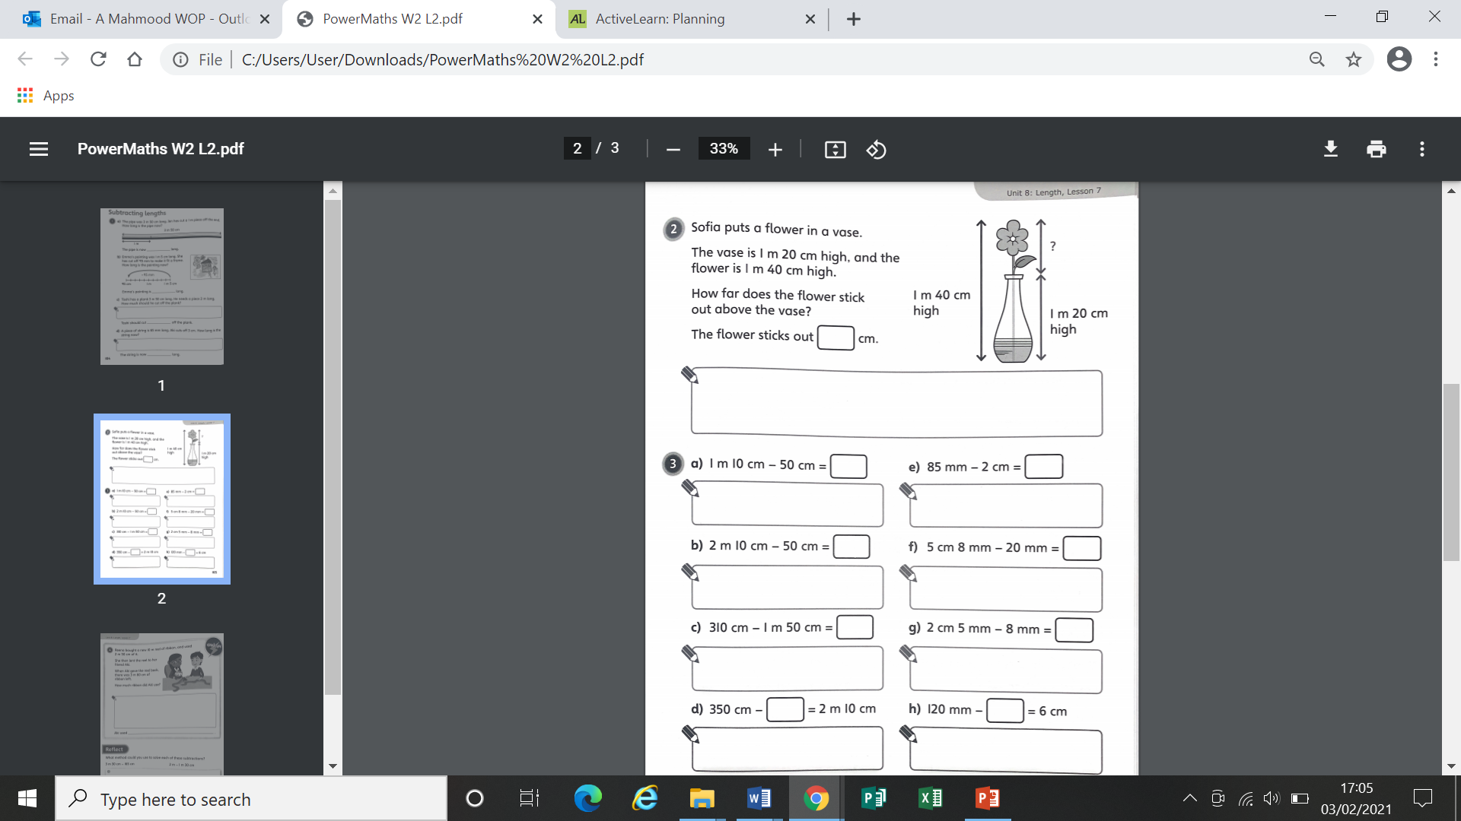
Worksheet

Slide 12
Worksheet

Slide 13
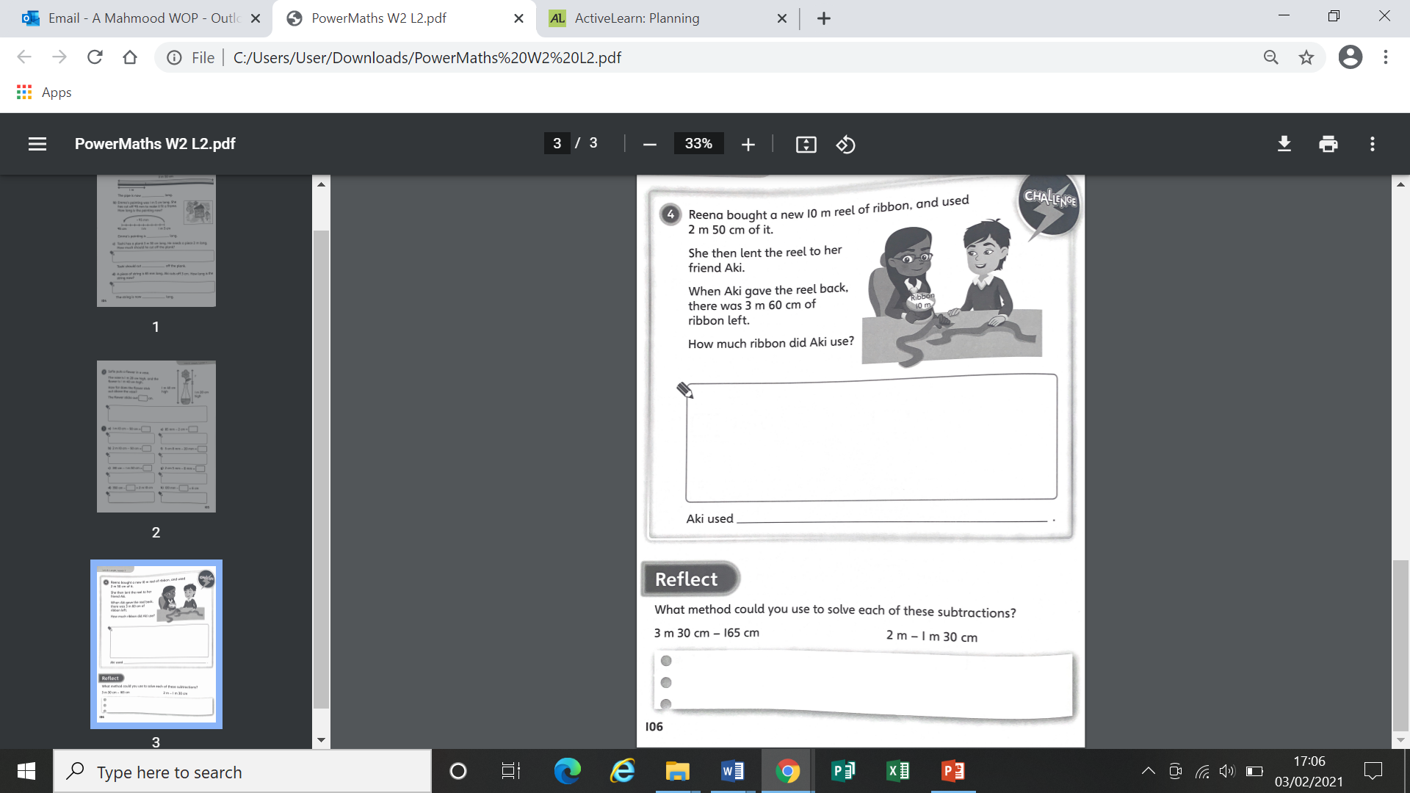
Worksheet

Slide 14
Worksheet

Slide 15
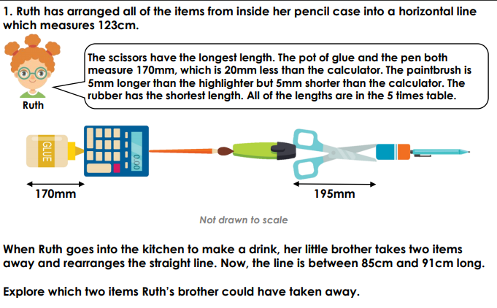
Discussion Question

Slide 16
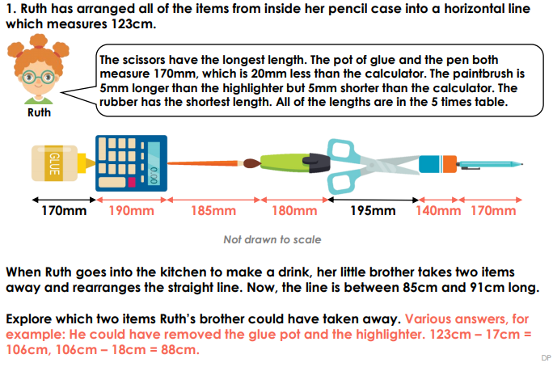

Slide 17
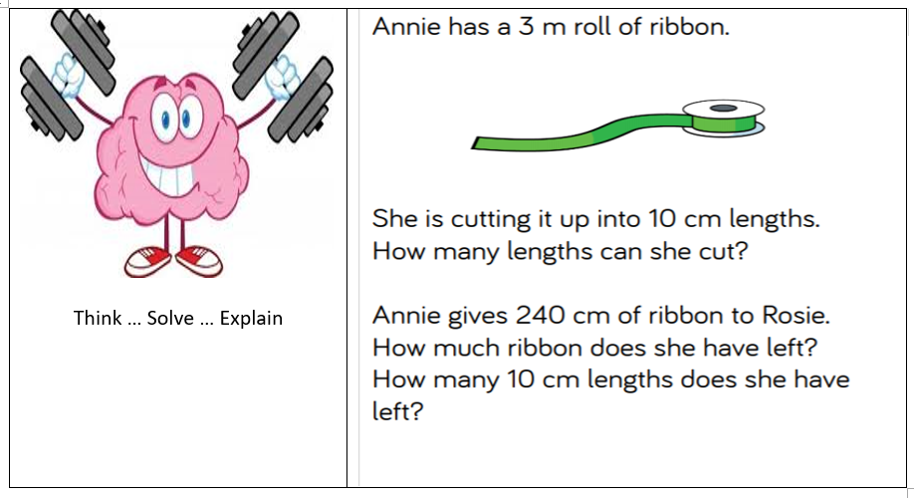

Slide 18
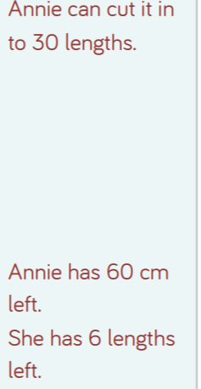
Answer

