Slide 1
Thursday 25th March 2021 – Maths Live Lesson

Slide 2

Fact Families to 10
Addition and Subtraction
LO: I can understand and make fact families using addition and subtraction.

Slide 3
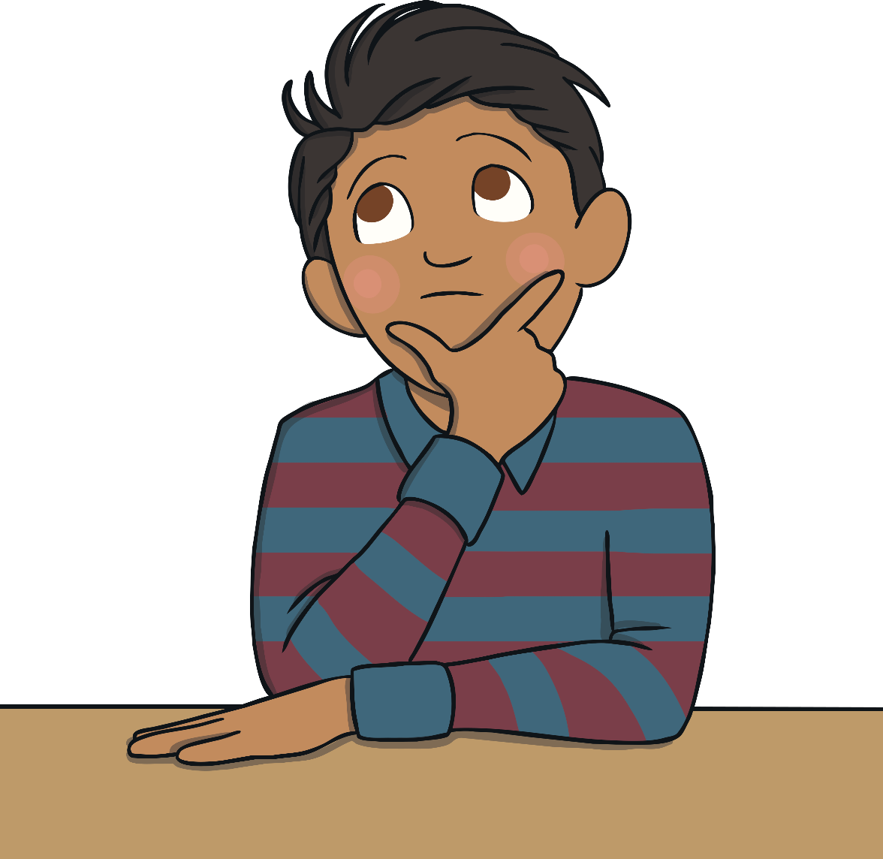
Fact Family Triangles
I have 10 lollies.
10
7 are green and 3 are blue.
7
3

Slide 4



Fact Family Triangles
I have 10 lollies.
10
7 are green and 3 are blue.
7
3
7 + 3 = 10
3 + 7 = 10
+
+

Slide 5

Fact Family Triangles
I have 10 lollies.
10
I eat the blue ones.
7
3
10 - 3 = 7

Slide 6
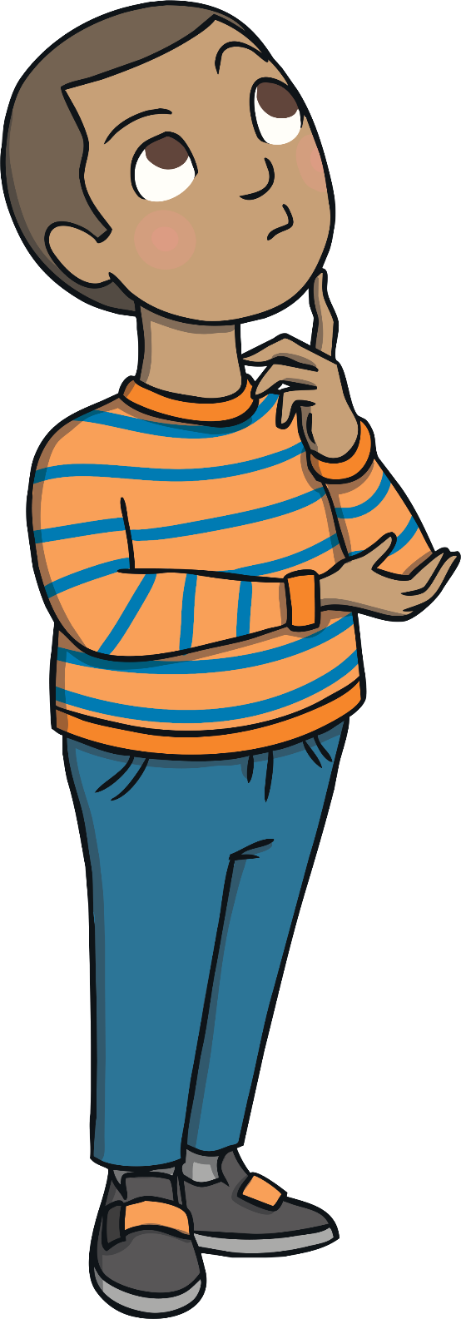
Fact Family Triangles
I have 10 lollies.
10
I save the green ones for later.
7
3
10 - 7 = 3

Slide 7

Fact Family Triangles
10
7 + 3 = 10
3 + 7 = 10
10 – 3 = 7
10 – 7 = 3
7
3

Slide 8

Fact Family Triangles
I have 10 apples.
10
6 are red and 4 are green.
6
4

Slide 9
Fact Family Triangles
Can you write down the addition facts/number sentences for these numbers?
I have 10 apples.
10
6 are red and 4 are green.
6
4

Slide 10


Fact Family Triangles
I have 10 apples.
10
6 are red and 4 are green.
6
4
6 + 4 = 10
4 + 6 = 10
+
+

Slide 11
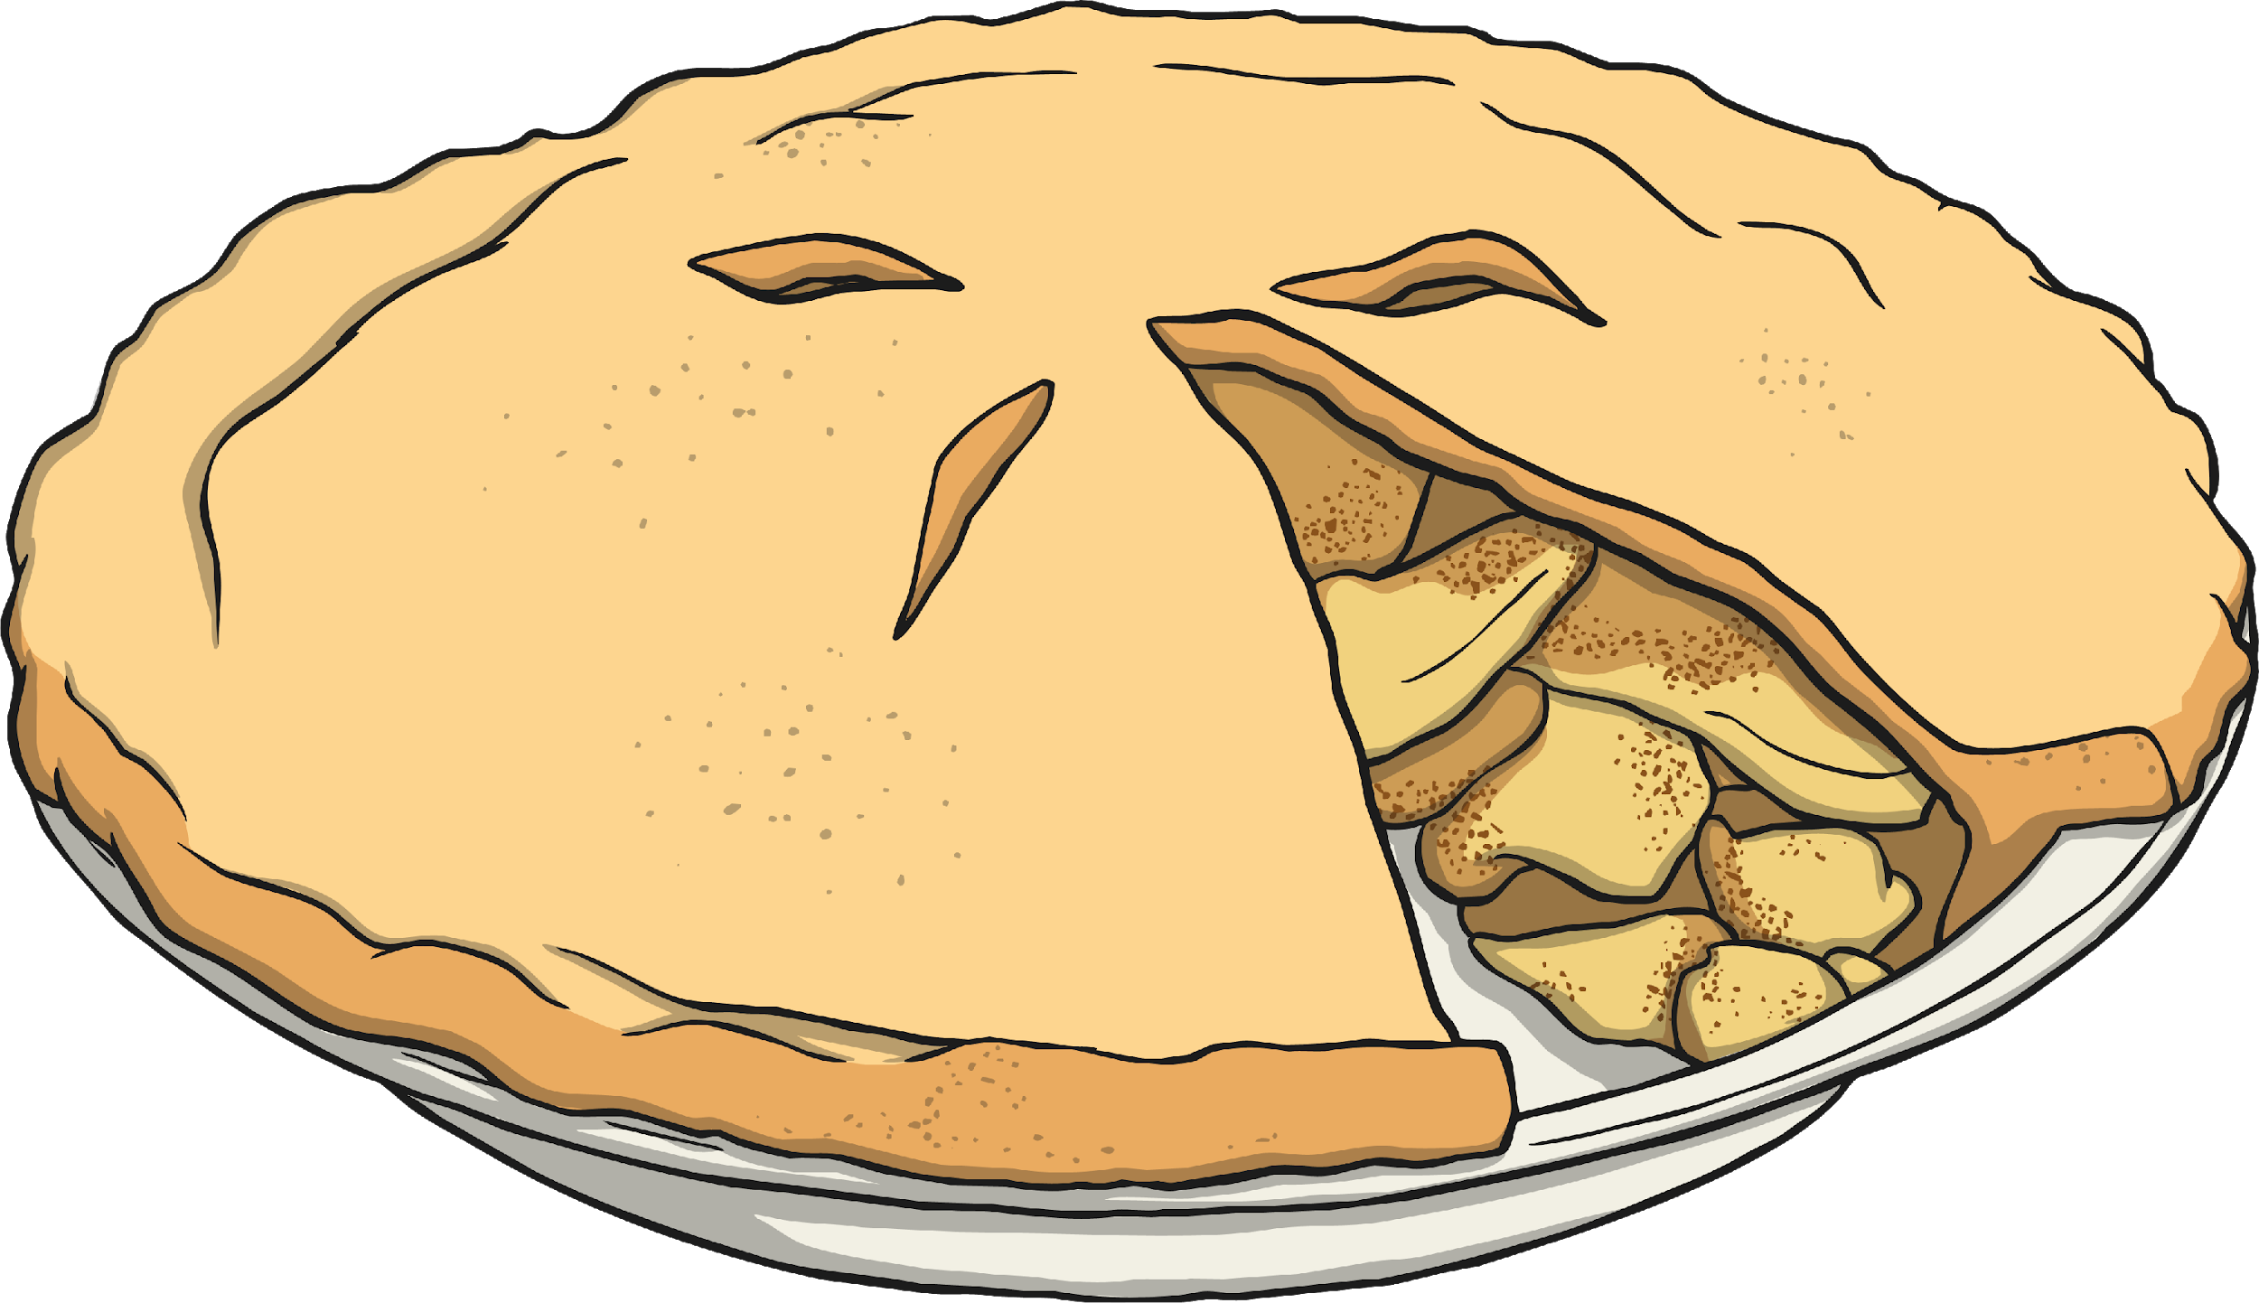

Fact Family Triangles
I have 10 apples.
10
I cook the 4 green apples in a pie.
6
4
10 – 4 = 6

Slide 12
Fact Family Triangles
I have 10 apples.
10
I give the 6 red apples to friends in my class.
6
4
What other subtraction number sentence could we write?

Slide 13
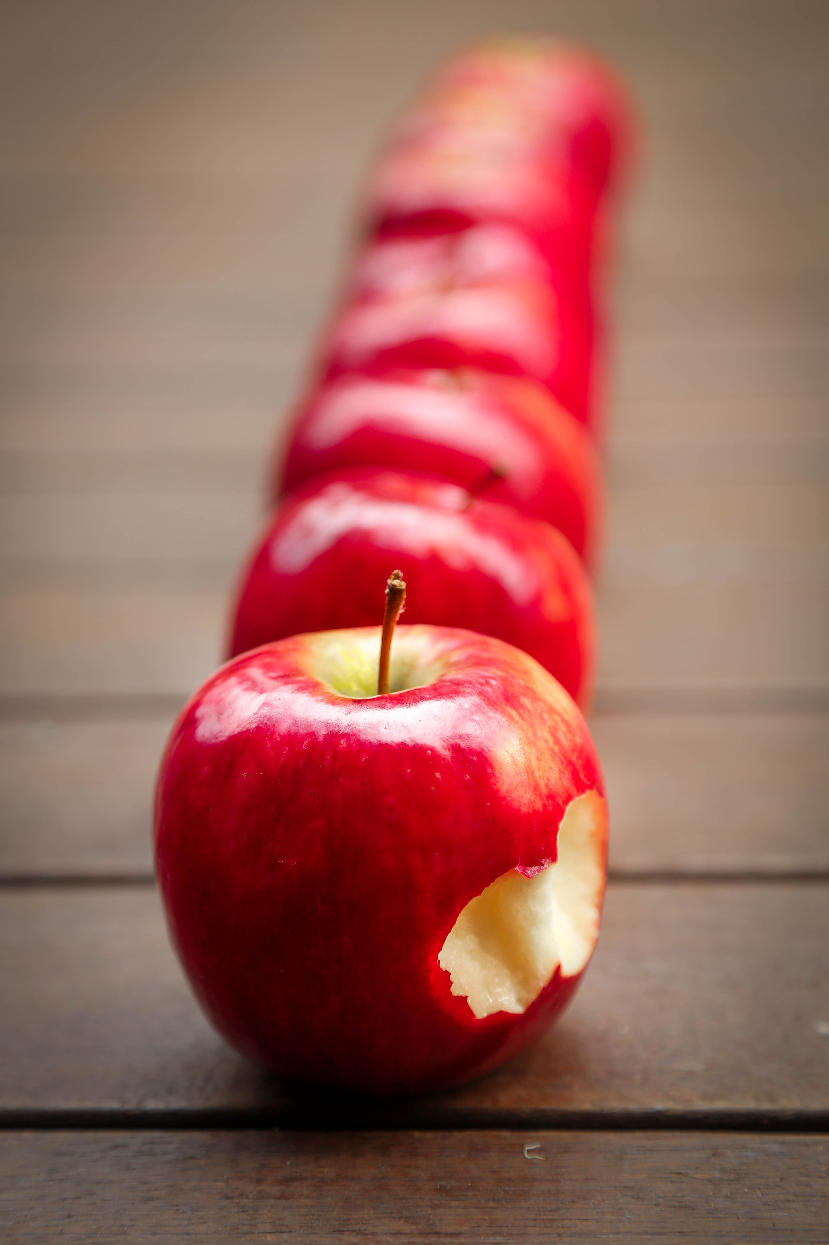

Fact Family Triangles
I have 10 apples.
10
I give the 6 red apples to friends in my class.
6
4
10 – 6 = 4

Slide 14

Fact Family Triangles
10
6 + 4 = 10
4 + 6 = 20
10 – 4 = 6
10 – 6 = 4
6
4

Slide 15

Fact Family Triangles
I have 10 flowers.
10
2 are pink and 8 are orange.
What are the 2 addition sentences I can make with these numbers?
2
8

Slide 16


Fact Family Triangles
I have 10 flowers.
10
2 are pink and 8 are orange.
2
8
2 + 8 = 10
8 + 2 = 10
+
+

Slide 17

Fact Family Triangles
I have 10 flowers.
10
I send the 2 pink flowers to my Aunty.
2
8
10 – 2 = 8

Slide 18

Fact Family Triangles
I have 10 flowers.
10
I put 8 orange flowers in a vase.
2
8
What is my subtraction number sentence?

Slide 19
Fact Family Triangles
I have 10 flowers.
10
I put 8 orange flowers in a vase.
2
8
10 – 8 = 2

Slide 20

Fact Family Triangles
10
2 + 8 = 10
8 + 2 = 10
10 – 2 = 8
10 – 8 = 2
2
8

Slide 21
Fact Family Triangles
Can you match the triangle with the correct fact family?
10
10
10
1
9
5
5
6
4
6 + 4 = 10
4 + 6 = 20
10 – 4 = 6
10 – 6 = 4
9 + 1 = 10
1 + 9 = 10
10 – 9 = 1
10 – 1 = 9
5 + 5 = 10
5 + 5 = 10
10 – 5 = 5
10 – 5 = 5

Slide 22

Now let’s play a game to test your understanding.
https://www.bbc.co.uk/games/embed/karate-cats-2?exitGameUrl=https%3A%2F%2Fbbc.co.uk%2Fbitesize%2Farticles%2Fzf4sscw

Slide 23
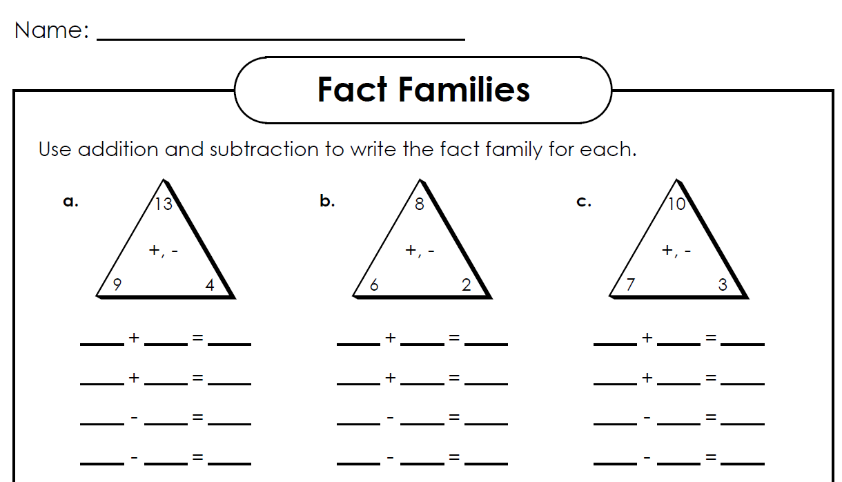
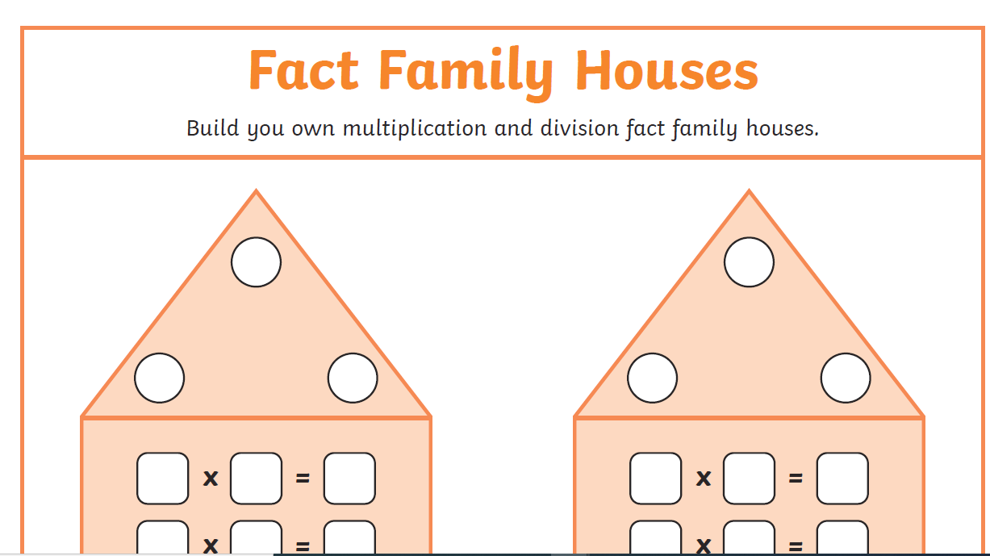
Follow up activity
:
Challenge:
Thanks for taking part!!
I look forward to seeing you again later for our Phonics Session.

